Slide 1
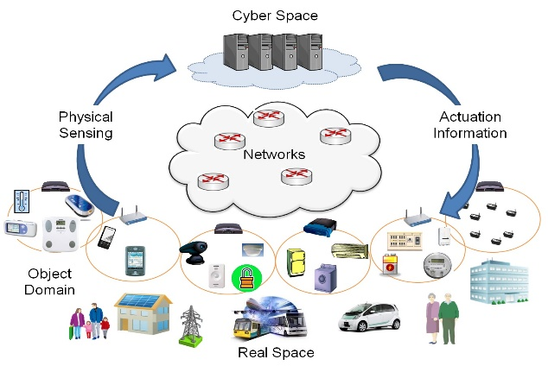



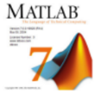

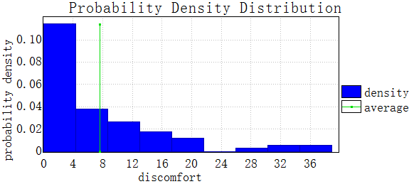
Cyber Part
Physical Part
Constraint
Abstract
Modeling
Modeling
Models:
CTMC DTMC
MDP TA UML etc.
Tools:
Models:
Modelica
Simulink etc.
Tools:
Property:
BLTL ALTL GSCL etc.
Coordination
encode
encode
FMUs
FMUs
coordination behavior verifier
Properties
Verified Model
Co-verification
Simulator
Traces
Checker
Simulation & Co-simulation
Controller
Observations
Algorithm
Distributed Statistical Model Checking

Slide 2
1
Cyber Part
Physical Part
Constraint
Abstract
Modeling
2
4
SysML BDDs
SysML IBD
Property:
BLTL ALTL GSCL etc.
3
Coordination
coordination behavior verifier
FMUs
Master Algorithm (MA)
Connector configuration
Properties
5
Verified Model
Co-verification
Simulator
Traces
Checker
Simulation & Co-simulation
Controller
Observations
Algorithm
Distributed Statistical Model Checking

Slide 3

Modeling
Architecture design
Verification
SysML IBD
Connector configuration
model
Channels
Network of TA
FMU
encode
TA for FMU
SysML BDD
…
…
…
UPPAAL
FMU
encode
TA for FMU
SysML BDD
model
Verified
Property
Master Algorithm (MA)
TA for MA
Verified model
Co-simulation
Simulation traces
generate
Co-simulation Engine

Slide 4
Data->(高斯拟合，多项式拟合，线性拟合等)->择优（方差等）->输入x预测下一个步长 （拟合过程动态，即根据数据拟合函数动态改变）
Save State
Save State
getMaxStepSize()-> 0.12
fmu1
0.12
getMaxStepSize()->0.15
fmu2
Learningandpredict()->y1=f1(x)-> 0.13
0.13
0.08
fmu3
Learningandpredict()->y2=f2(x)-> 0.08
fmu4
0.08
0.08
fmu5
Reject andreturn step
Rollback and dostep

Slide 5

Statistical model checker
Simulator
traces
Model checker
observations
SMC algorithm
Traces generation
Statistical testing
+
+
Distributed technology
Abstraction & Learning technique
Distributed SMC (distributed BIE, distributed BHT, etc.)
SMC based on Abstraction & Learning (AL-SMC)
Reduce the time for generating a single trace
Reduce the number of traces
Distributed SMC with Abstraction & Learning

Slide 6
统计模型检测器
仿真器
迹
模型检测器
检测结果
SMC 算法
迹的生成
统计分析
+
+
分布式技术
抽象 & 学习 技术
分布式 SMC (分布式 BIE, 分布式 BHT, 等等)
基于抽象和学习的SMC
减少单条迹产生需要的时间
减少产生迹的数量
基于抽象和学习的分布式统计模型检测算法

Slide 7

Trace
Property
AL-SMC
Property-based
Projection
PCA-based
Dimension Reduction
Probability Evaluation via Multi-BIEs
BIE analyzer 1
PFT
Building and Optimization
of PFT
Key States Extraction
…
BIE analyzer m
Abstraction process

Slide 8
迹
验证属性
基于抽象和学习的SMC
基于属性的投影
基于主成分分析算法的降维
基于多个BIE的评估分析
BIE分析器 1
前缀频率树
简化迹
…
前缀频率树的构建和约减
关键状态提取
BIE分析器 m
抽象过程

