Slide 1
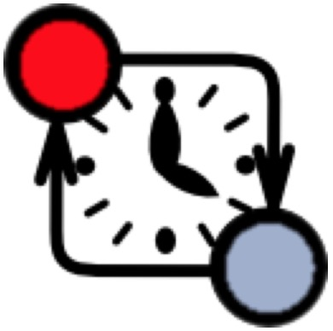
Modeling phase
Architecture design phase
Verification phase
SysML connector
Connector configuration
model
Channels
Network of Timed Automata
encode
Timed Automaton for FMU
FMU
SysML BDD
…
…
UPPAAL
…
encode
Timed Automaton for FMU
FMU
SysML BDD
Properties
Master Algorithm (MA)
model
Timed Automaton for MA
Verified model
Co-simulation phase
generate
Simulation traces
Co-simulation Engine

Slide 2
Modeling
Architecture design
Verification
SysML connector
Connector configuration
model
Channels
Network of Timed Automata
encode
FMU
TA for FMU
SysML BDD
…
…
…
UPPAAL
FMU
encode
TA for FMU
SysML BDD
Verified
Property
Master Algorithm (MA)
model
TA for MA
Verified model
Co-simulation
Simulation traces
generate
Co-simulation Engine

