Slide 1
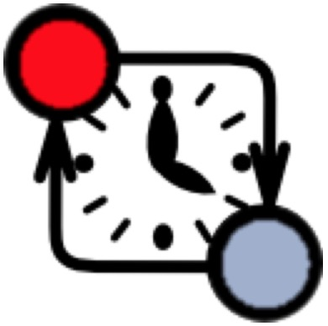
Design models /phase
Simulation models
Verification models
Model Checking
SysML connector
Connector configuration
translate
Channel
Network of Timed Automata
SysML BDD
encode
Timed Automata for FMU
FMU
…
…
…
UPPAAL
SysML BDD
FMU
encode
Timed Automata for FMU
True
Properties
Director
Master Algorithm (MA)
model
Timed Automata for FMU
import
Simulation trace
Co-simulation Engine

Slide 2
Modelling phase
Coordination phase
Verification phase
SysML connector
Connector configuration
translate
Channel
Network of Timed Automata
encode
Timed Automaton for FMU
FMU
SysML BDD
…
…
UPPAAL
…
encode
Timed Automaton for FMU
FMU
Sy ML BDD
Properties
Master Algorithm (MA)
model
Timed Automaton for MA
Verified model
Co-simulation phase
Simulation trace
Co-simulation Engine

