Slide 1
Optimising RETE for Stream Reasoning
Using the Storm framework

Slide 2

Motivation
We want to process (enrich and query) “big data”
Data looks like “User256-likes-post2045” and is continuously generated
DBMS can’t deal with the update rates
We need a new type of system to apply persistent entailment rules and continuous queries on the data
We want the system to run on a computer cluster and scale horizontally

Slide 3
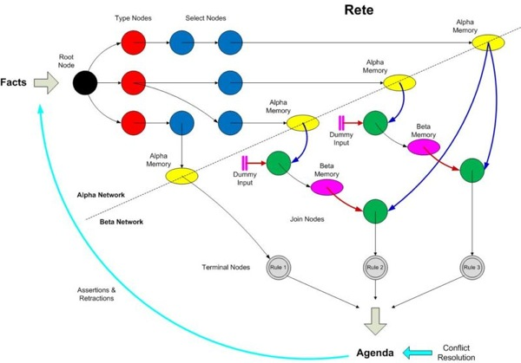
The RETE algorithm
A pattern-matching algorithm for implementing production rule systems
Essentially a way of forming long-lived graphs of Filters and Joins
These graphs are called RETE-networks
Tuples pass through the network once and partial matches are stored after each node (i.e. sacrificing memory for speed)
A single network can implement many concurrent queries and therefore nodes can be shared

Slide 4
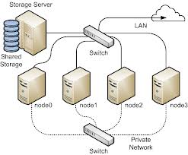
RETE on a computer cluster
In search of a framework to hide the complexity of the cluster
Storm is a relatively new, open-source framework from Twitter
Built specifically for scalable continuous computation
Storm applications are called Topologies and are similar to MapReduce jobs
However they run indefinitely (waiting for tuples to process) until manually terminated

Slide 5
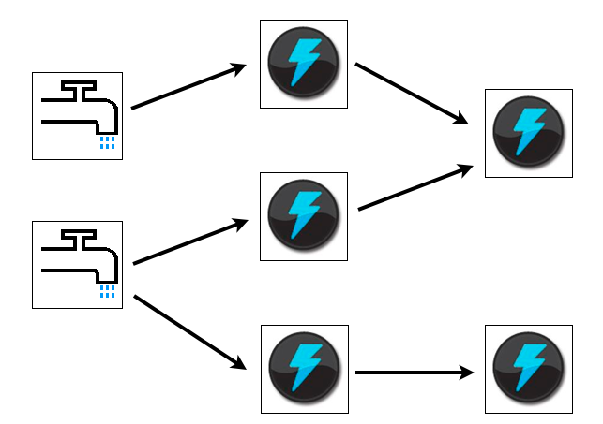
Storm Topologies
Storm’s three basic abstractions: Streams, Spouts and Bolts
A Stream is an unbounded sequence of tuples with a predefined schema
Spouts read tuples from some source and generate one or more Streams
Bolts subscribe to any number of streams and process tuples as they are received, possibly emitting new Streams

Slide 6
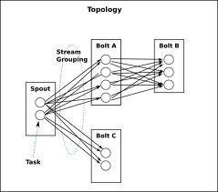
Stream groupings
The workload is spread across multiple JVM instances running in parallel on the cluster
Spouts and Bolts can be seen as having multiple instances running in parallel
Stream groupings define which instance processes each tuple
Shuffle grouping for Filters, Fields grouping for Joins, All grouping for cross-products

Slide 7

RETE on Storm
TrendMiner (Sina et al, 2012)
Single Spout, one Bolt per Rete operator
Heavy message replication from Spout to Filter-Bolts
Inter-query node sharing when queries have common filters
Also Join-Bolt reordering to make cross-products smaller

Slide 8

Is node-sharing beneficial on Storm?
In-process cluster simulator - Storm’s “local mode”
Set debug mode “on” to see tuples being emitted
Kestrel server for I/O queues
Maven to build the project
Used Python, Perl and Bash scripting to run Topologies and measure throughput

Slide 9
First experiment
Confirm that simulation is realistic
Do messages cost more than simple string comparisons?
Yes.

Slide 10
Second experiment
Tuning the parallelism of the Topology
Topology: a Kestrel-Spout, a Filter-Bolt and a Terminal-Bolt
In local mode, optimal parallelism was: two instances for the Spout and one for each Bolt

Slide 11
Third experiment
Sharing two equivalent filters
Filters that block the same tuples
Slope of the line is the throughput

Slide 12
Why not put all Filters in the same Bolt then?
En-bloc filtering: One bolt doing all filtering – one shuffle grouping to the spout
Instead of 10 bolts emitting one stream each, one bolt emitting all 10 streams
Join-Bolt subscribed to <Filter-Bolt-7, stream “default”> now subscribes to <Universal-Filter-Bolt, stream “7”>
The Universal-Filter-Bolt internally iterates over the whole filter list
Filter sharing can still happen internally
The bolt’s can still run in parallel across the cluster

Slide 13
Can we do the same with Joins?
To some extend, yes.
Fields grouping is what limits us
Or rather, the need to parallelise Join-Bolts without missing joins
Join clustering: “If two joins in a cluster have a variable in common, all joins in the cluster should have that variable in common”

Slide 14
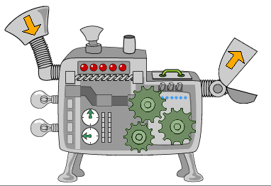
The delivered Topology Builder
Takes a list of filters as input and creates Storm Topologies
The “shape” of the Topology depends on whether various optimisations are turned on or off
Optimisations: Equivalent-filter-sharing, En-bloc-filtering, Join-clustering
Shows that En-bloc filtering is superior to external equivalent filter sharing
Show that Join-clustering is beneficial and that it doesn’t break when parallelism is more than 1
Not meant to be a fully working DSMS system (just a program for experimentation)
I’ve also submitted the various scripts that can be used to run the Topologies and measure their throughput in local mode

