Slide 1
Optimising RETE for Stream Reasoning
Using the Storm framework

Slide 2

Motivation
We want to process (enrich and query) “big data”
Data looks like “User256-likes-post2045” and is continuously generated
DBMS can’t deal with the update rates
We need a new type of system to apply persistent entailment rules and continuous queries on the data
We want the system to run on a computer cluster and scale horizontally

Slide 3
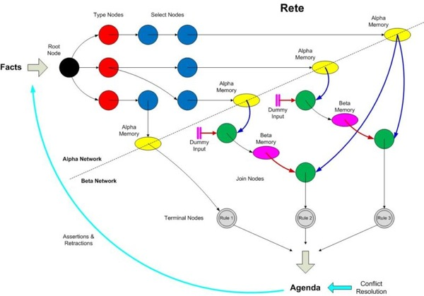
The RETE algorithm
A pattern-matching algorithm for implementing production rule systems
Essentially a way of forming long-lived graphs of Filters and Joins
These graphs are called RETE-networks
Tuples pass through the network once and partial matches are stored after each node (i.e. sacrificing memory for speed)
A single network can implement many concurrent queries and therefore nodes can be shared

Slide 4
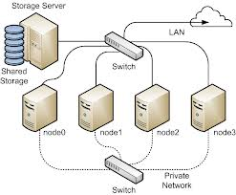
RETE on a computer cluster
In search of a framework to hide the complexity of the cluster
Storm is a relatively new, open-source framework from Twitter
Built specifically for scalable continuous computation
Storm applications are called Topologies and are similar to MapReduce jobs
However they run indefinitely (waiting for tuples to process) until manually terminated

Slide 5
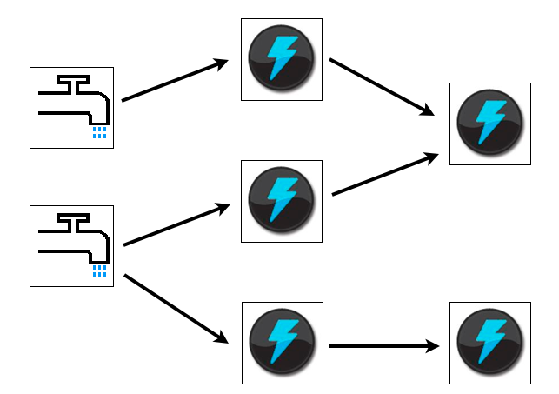
Storm Topologies
Storm’s three basic abstractions: Streams, Spouts and Bolts
A Stream is an unbounded sequence of tuples with a predefined schema
Spouts read tuples from some source and generate one or more Streams
Bolts subscribe to any number of streams and process tuples as they are received, possibly emitting new Streams

Slide 6
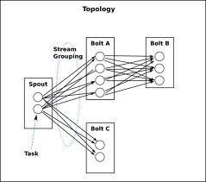
Stream groupings
The workload is spread across multiple JVM instances running in parallel on the cluster
Spouts and Bolts can be seen as having multiple instances running in parallel

