Slide 1
服务器集群基础知识培训

Slide 2
集群达成的目标
Keepalived保持在线
负载均衡
可变动

Slide 3
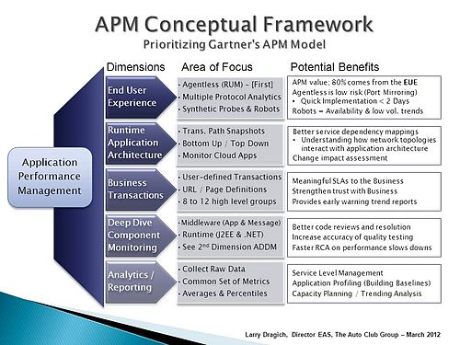
可扩展运维的背景
概念：在IT系统领域，可扩展运维（Application Performance Management aka APM）需要那些手段应对呢？
保持在线
Notes:
[1] 定义来自Gartner Research

Slide 4
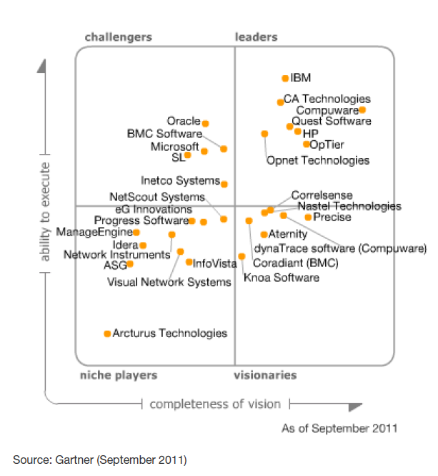
保持在线的策略
备胎模式拒绝server unavailable
双域名双dns com主 net辅助
双机房 机房坏了 怎么办
双主机 nginx 代理 keepalive保持在线
双网卡 保证物理网卡损坏不影响服务
双…
By Gartner Research

Slide 5
Keepalived主
vrrp_instance VI_1 {
state MASTER
interface eth0 #网卡端口
virtual_router_id 51 #路由顺序要比备胎靠前
priority 100 #重要性要比备胎靠前
advert_int 1
authentication {
auth_type PASS
auth_pass 1111 #主从密码要匹配
}
virtual_ipaddress {
192.168.200.16#虚拟ip
}
}

Slide 6
Keepalived辅助
vrrp_instance VI_1 {
state MASTER
interface eth0 #网卡端口
virtual_router_id 52 #路由顺序要比正房靠后
priority 101 #重要性要比正房靠后
advert_int 1
authentication {
auth_type PASS
auth_pass 1111 #主从密码要匹配
}
virtual_ipaddress {
192.168.200.16#虚拟ip
}
}

Slide 7
Nginx反向代理
upstream lx_proxy {
ip_hash;
server 192.168.250.5:80;
}
location / {
proxy_pass http://lx_proxy;
}

Slide 8
Mysql主
1、修改/etc/my.cnf 在[mysqld]区段内加入参数 server-id=1
log-bin sql-bin-update-same
2、为Slave服务器创建连接账户，用于同步
mysql>GRANT FILE ON *.* TO backup@192.168.1.2 IDENTIFIED BY ‘1234’;

Slide 9
Mysql备胎
1、修改/etc/my.cnf 在[mysqld]区段加入 master-host=192.168.0.1 master-user=backup master-password=1234 master-port=3306 server-id=2 master-connect-retry=60 预设重试间隔60秒 replicate-do-db=vbb 告诉slave只做vbb数据库的更新 replicate-ignore-db=mysql #不同步的数据库 replicate-ignore-table=vbb.users #不同步vbb数据库的users表 log-slave-updates=1

Slide 10
查看是否同步
mysql>slave start;
5、查看Slave服务器同步信息
mysql>show slave status/G;
最简单可以用phpmyadmin同步。有同步向导模式指引你。同步前必须保证主库副库数据一致。

Slide 11
Redis主
aemonize no 改为yes

Slide 12
Redis辅
aemonize no 改为yes
slaveof 192.168.10.1 6379

Slide 13
虚拟机
DOCKER 真实主机性能 文件层分隔。
KVM 需要主机支持虚拟化。系统层资源
VMWARE 最老最稳定
Virtualbox 性能最差
docker run -p 6379:6379 -d 192.168.1.132:5000/redis:latest
telnet 192.168.11.100 6380
Info exit

Slide 14
应用性能管理的趋势
终端用户体验监控将会越来越重要
APM面对的应用场景将会越来越复杂
APM需要全面/更早介入产品的生命周期
分析的重要性将仅次于用户体验监控
IT高层会越来越重视APM

Slide 15
环境搭建1 编译
#!/bin/bash###系统环境安装yum -y install zlib-devel openssl-devel libxml2-devel libtool-ltdl-devel libxml2-devel libxml2 libpng-devel autoconf \libevent libevent-devel autoconf automake libtool pcre-devel lrzsz wget gcc-c++ makeservice iptables stopchkconfig iptables offsed -i 's:SELINUX=enforcing:SELINUX=disabled:g' /etc/sysconfig/selinux ####解压软件包 function ex(){ if [[ "$1" =~ .tar.bz2$ ]] then tar xjf $@ elif [[ "$1" =~ .tar.gz$ ]] then tar xzf $@ elif [[ "$1" =~ .zip$ ]] then unzip $@ elif [[ "$1" =~ .tgz$ ]] then tar xzf $@ elif [[ "$1" =~ .tar$ ]] then tar xf $@ fi}#####进入相应脚本，软件包所在的目录baseDir=`dirname $0`cd $baseDirbaseDir=`pwd`cd $baseDirecho "go install........"###解压配置文件压缩包prog="config_file"ex $prog*####安装mysql 5.5.32yum -y install cmake ncurses-devel bisonuseradd mysqlprog="mysql"ex $prog-*prog_dir=`find * -maxdepth 1 -type d -name "$prog-*"`cd $prog_dirmv CMakeCache.txt CMakeCache.txt.bakcmake -DCMAKE_INSTALL_PREFIX=/usr/local/mysql\-DMYSQL_UNIX_ADDR=/tmp/mysqld.sock \-DDEFAULT_CHARSET=utf8 \-DDEFAULT_COLLATION=utf8_general_ci \-DWITH_EXTRA_CHARSETS=all \-DWITH_MYISAM_STORAGE_ENGINE=1 \-DWITH_INNOBASE_STORAGE_ENGINE=1 \-DWITH_MEMORY_STORAGE_ENGINE=1 \-DWITH_READLINE=1 \-DENABLED_LOCAL_INFILE=1 \-DMYSQL_DATADIR=/usr/local/mysql/data \-DMYSQL_USER=mysqlmake && make installln -s /usr/local/mysql/lib/libmysqlclient.so.18 /usr/lib64/libmysqlclient.so.18ln -s /usr/local/mysql/lib/libmysqlclient.so.18 /usr/lib64/libmysqlclient.so.18mkdir -p /usr/local/mysql/datamkdir -p /usr/local/mysql/log/cd support-filescp my-huge.cnf /etc/my.cnfcp mysql.server /etc/rc.d/init.d/mysqldchmod +x /etc/init.d/mysqld/usr/local/mysql/scripts/mysql_install_db --user=mysql --datadir=/usr/local/mysql/data/ --basedir=/usr/local/mysql/usr/local/mysql/bin/mysqld_safe --defaults-file=/etc/my.cnf --datadir=/usr/local/mysql/data --user=mysql &sleep 10 && echo -e "\n"echo "/usr/local/mysql/bin/mysqld_safe --defaults-file=/etc/my.cnf --datadir=/usr/local/mysql/data --user=mysql &">> /etc/rc.localcd $baseDir######安装phpprog="jpeg"ex $prog*prog_dir=`find * -maxdepth 1 -type d -name "$prog*"`cd $prog_dir./configure --prefix=/usr/local/jpegmake mkdir /usr/local/jpeg mkdir /usr/local/jpeg/include mkdir /usr/local/jpeg/lib mkdir /usr/local/jpeg/binmkdir /usr/local/jpeg/manmkdir /usr/local/jpeg/man/man1make installcd $baseDirprog=libpngex $prog-*prog_dir=`find * -maxdepth 1 -type d -name "$prog-*"`cd $prog_dir./configure --prefix=/usr/local/libpngmakemake installcd $baseDirprog="freetype"ex $prog-*prog_dir=`find * -maxdepth 1 -type d -name "$prog-*"`cd $prog_dir./configure --prefix=/usr/local/freetype makemake installcd $baseDirprog="gd"ex $prog-*prog_dir=`find * -maxdepth 1 -type d -name "$prog-*"`cd pierrejoye-gd-libgd-5551f61978e3/src./configure \--prefix=/usr/local/gd \--with-zlib=/usr/local/zlib\--with-png=/usr/local/libpng\--with-jpeg=/usr/local/jpeg\--with-freetype=/usr/local/freetypesed -i 's/png.h/\/usr\/local\/libpng\/include\/png.h/g' gd_png.cmake && make installcd $baseDirprog="curl"ex $prog-*prog_dir=`find * -maxdepth 1 -type d -name "$prog-*"`cd $prog_dir./configure --prefix=/usr/local/curlmakemake installcd $baseDirprog="libmcrypt"ex $prog-*prog_dir=`find * -maxdepth 1 -type d -name "$prog-*"`cd $prog_dir./configure prefix=/usr/local/libmcrytp/ \--enable-ltdl-installmakemake install cd $baseDirprog="php"ex $prog-*prog_dir=`find * -maxdepth 1 -type d -name "$prog-*"`cd $prog_dir./configure --prefix=/usr/local/php \--with-libxml-dir \--enable-xml \--with-config-file-path=/usr/local/php/etc \--with-mysql=/usr/local/mysql \--with-mysqli=/usr/local/mysql/bin/mysql_config \--with-gd=/usr/local/gd \--with-iconv-dir=/usr/local \--with-freetype-dir=/usr/local/freetype \--with-jpeg-dir=/usr/local/jpeg \--with-png-dir=/usr/local/libpng \--with-zlib-dir=/usr/local/zlib \--with-curl=/usr/local/curl \--disable-rpath \--enable-safe-mode \--enable-bcmath \--enable-shmop \--enable-sysvsem \--enable-inline-optimization \--with-curlwrappers \--enable-mbregex \--enable-fpm \--enable-mbstring \--enable-gd-native-ttf \--with-openssl \--with-mhash \--enable-pcntl \--enable-sockets \--with-ldap-sasl \--with-xmlrpc \--enable-zip \--enable-soap \--with-mcrypt=/usr/local/libmcrytp \--with-php-config=/usr/local/php/bin/php-config \--enable-pdo \--with-php-config=/usr/local/php/bin/php-config \--with-pdo-mysql=/usr/local/mysqlmake make installcp php.ini-development /usr/local/php/etc/php.inicd /usr/local/php/etc/cp -a /usr/local/src/ycyshell/autolx/config_file/php-fpm.conf .cd $baseDircd $prog_dircp sapi/fpm/init.d.php-fpm /etc/init.d/php-fpmchmod +x /etc/init.d/php-fpmchkconfig --add php-fpm/etc/init.d/php-fpm startecho "/etc/init.d/php-fpm start" >> /etc/rc.localcd $baseDir#####安装libjpeg-6b.tar.gzprog="libjpeg"ex $prog-*prog_dir=`find * -maxdepth 1 -type d -name "$prog-*"`cd $prog_dir./configuremake make installcd $baseDir##安装GraphicsMagickprog="GraphicsMagick"ex $prog-*prog_dir=`find * -maxdepth 1 -type d -name "$prog-*"`cd $prog_dir./configure --prefix=/usr/local/Gmagick --enable-shared --disable-openmpmake make installcd $baseDirprog="gmagick"ex $prog-*prog_dir=`find * -maxdepth 1 -type d -name "$prog-*"`cd $prog_dir/usr/local/php/bin/phpize./configure --with-php-config=/usr/local/php/bin/php-config --with-gmagick=/usr/local/Gmagick/make && make installsed -i '821a extension_dir = "/usr/local/php/lib/php/extensions/no-debug-non-zts-20090626/"' /usr/local/php/etc/php.inised -i '$a extension=gmagick.so' /usr/local/php/etc/php.ini/etc/init.d/php-fpm restartcd $baseDir####安装memcacheprog="memcached"ex $prog-*prog_dir=`find * -maxdepth 1 -type d -name "$prog-*"`cd $prog_dir./configure --with-libevent=/usrmakemake installcd $baseDir/usr/local/bin/memcached -d -m 512 -u rootecho "/usr/local/bin/memcached -d -m 512 -u root" >> /etc/rc.localprog="memcache"ex $prog-*prog_dir=`find * -maxdepth 1 -type d -name "$prog-*"`cd $prog_dir/usr/local/php/bin/phpize./configure --with-php-config=/usr/local/php/bin/php-configmake && make installsed -i '$a extension=memcache.so' /usr/local/php/etc/php.ini/etc/init.d/php-fpm restartcd $baseDir##安装fastdfsprog="FastDFS"ex $prog\_*prog_dir=`find * -maxdepth 1 -type d -name "$prog*"`cd $prog_dir./make.sh./make.sh installcp init.d/* /etc/init.d/cd $baseDir#######tracker配置mkdir -p /var/www/fastdfssed -i 's/base_path=.*/base_path=\/var\/www\/fastdfs/g' /etc/fdfs/tracker.conf/usr/local/bin/fdfs_trackerd /etc/fdfs/tracker.confecho "/usr/local/bin/fdfs_trackerd /etc/fdfs/tracker.conf" >> /etc/rc.local####strorage配置mkdir -p /var/www/fastdfs/fdfs_storagesed -i 's:base_path=.*:base_path=/var/www/fastdfs/fdfs_storage:g' /etc/fdfs/storage.confsed -i 's:store_path0=.*:store_path0=/var/www/fastdfs/fdfs_storage:g' /etc/fdfs/storage.confsed -i 's/tracker_server=.*/tracker_server=192.168.1.17:22122/g' /etc/fdfs/storage.conf/usr/local/bin/fdfs_storaged /etc/fdfs/storage.confecho "/usr/local/bin/fdfs_storaged /etc/fdfs/storage.conf" >> /etc/rc.local####client 配置sed -i 's/base_path=.*/base_path=\/var\/www\/fastdfs\/fdfs_storage/g' /etc/fdfs/client.confsed -i 's/tracker_server=.*/tracker_server=192.168.1.17:22122/g' /etc/fdfs/client.conf####fastdfs php扩展配置cd $baseDir/$prog_dir/php_client/usr/local/php/bin/phpize./configure --with-php-config=/usr/local/php/bin/php-config --with-fastdfs_clientmake && make installsed -i '$a extension=fastdfs_client.so' /usr/local/php/etc/php.iniecho -e "fastdfs_client.base_path = /var/www/fastdfs\nfastdfs_client.connect_timeout = 2\nfastdfs_client.network_timeout = 60\nfastdfs_client.log_level = info\nfastdfs_client.log_filename =\nfastdfs_client.http.anti_steal_secret_key =\nfastdfs_client.tracker_group_count = 1\nfastdfs_client.tracker_group0 = /etc/fdfs/client.conf" >> /usr/local/php/etc/php.ini/etc/init.d/php-fpm restartcd $baseDir######安装fastdfs nginx扩展prog="fastdfs"ex $prog-*fdfs_dir=`find * -maxdepth 1 -type d -name "$prog-*"`####安装nginxprog=zlibex $prog-*prog_dir=`find * -maxdepth 1 -type d -name "$prog-*"`cd $prog_dir./configure --prefix=/usr/local/zlibmake && make installcd $baseDirprog=pcreex $prog-*echo $prog-*prog_dir=`find * -maxdepth 1 -type d -name "$prog-*"`cd $prog_dir./configure && make && make installcd $baseDirprog="nginx"ex $prog-*prog_dir=`find * -maxdepth 1 -type d -name "$prog-*"`cd $prog_dir./configure --prefix=/usr/local/nginx --with-http_realip_module --with-http_stub_status_module --with-pcre --with-http_gzip_static_module \--with-http_ssl_module --add-module=$baseDir/$fdfs_dir/src/make && make installmv /usr/local/nginx/conf/nginx.conf /usr/local/nginx/conf/nginx.conf.bakcp $baseDir/config_file/nginx.conf /usr/local/nginx/conf/cp $baseDir/$fdfs_dir/src/mod_fastdfs.conf /etc/fdfs/touch /var/www/fastdfs/logs/mod_fastdfs.loguseradd wwwchown www:www /var/www/fastdfs/logs/mod_fastdfs.logchmod 777 /var/www/fastdfs/logs/mod_fastdfs.logsed -i 's/base_path=.*/base_path=\/var\/www\/fastdfs/g' /etc/fdfs/mod_fastdfs.confsed -i 's/tracker_server=.*/tracker_server=192.168.1.17:22122/g' /etc/fdfs/mod_fastdfs.confsed -i 's:store_path0=.*:store_path0=/var/www/fastdfs/fdfs_storage:g' /etc/fdfs/mod_fastdfs.confsed -i 's:log_filename=.*:log_filename=/var/www/fastdfs/logs/mod_fastdfs.log:g' /etc/fdfs/mod_fastdfs.confsed -i 's:url_have_group_name = false:url_have_group_name = true:g' /etc/fdfs/mod_fastdfs.confcd $baseDir/usr/local/nginx/sbin/nginx/etc/init.d/php-fpm restartecho "/usr/local/nginx/sbin/nginx" >> /etc/rc.local

Slide 16
环境搭建2 yum
Yum install nginx
yum install mongodb-server
yum install mysql mysql-server
yum install php
yum install php-mysql php-gd libjpeg* php-imap php-ldap php-odbc php-pear php-xml php-xmlrpc php-mbstring php-mcrypt php-bcmath php-mhash libmcrypt libmcrypt-devel php-fpm

Slide 17
环境搭建3 dock
docker run -d -p 80:80 -v /var/www/:/var/www/ stenote/docker-lemp:latest
192.168.1.148

Slide 18
日常用到的命令
Grep
Vi
Sed
Awk
Shell脚本
正则

Slide 19
Ju53运维架构
Api可控
监控告警
Nginx反向代理
44
Php服务器
Redis服务器群
依赖监控
36
Mysql服务器群
dnspod.cn
45
keepalived
37
38
39
10
11
12
13
10
11
12
13

Slide 20
ju53的APM现状
哈勃
应用数据
CSP
应用数据
依赖监控
Hotspot
应用数据
性能剖析
monitor
鱼眼
北斗
天机
鹰眼
监控告警
依赖监控
页面监控
系统指标
用户体验
拓扑结构
线上压测
容量规划
监控告警
设备监控
页面监控
页面剖析
系统指标
数据库指标
系统指标
数据库指标
Dragoon
应用监控
分层监控
监控告警
bench
业务数据
能够解决某一方面，某一领域的问题
APM功能维度都有涉及，缺少拳头产品
系统繁多，数据分散，功能重合
数据很多，指标不一，分析偏少

Slide 21
理想的APM未来
从用户体验出发，全流程覆盖
研发 · 测试 · 生产 · 业务
ENTERPRISE
Performance Analytics
SAAS
Performance Test & EUE
产品环境
业务监测
应用监测
系统指标
依赖拓扑
性能剖析
测试
瓶颈分析、问题定位
性能基线和回归
研发流程
持续优化
产品环境
终端用户体验监测
同质业务横向检测
测试
线上压测
线下性能测试
分布式跟踪

Slide 22
平台解决的问题
统一的性能测试流程支持流程持续改进
统一的性能数据库支持性能基线和回归
可以复用的性能测试/分析方法和资产
软件服务化降低工具持有成本
测试资源虚拟化/动态化降低设备成本
自动化重复/低附加值工作提高效率
形成平台技术社区沉淀知识和经验

Slide 23

遇到的问题
Standard
Enterprise
Hybrid Cloud
环境
数据
安全
性能

Slide 24
一体化性能测试平台
环境搭建
性能测试
性能监控
结果分析
页面性能
机器申请
权限管理
环境搭建
脚本
场景
任务
趋势监控
结果分析
测试执行
PAP
结果
TPS、RT
响应时间分布
基线
TPS
RT
失败率
服务器指标
JVM指标
性能指标
服务器指标
JVM指标
实时展示

Slide 25
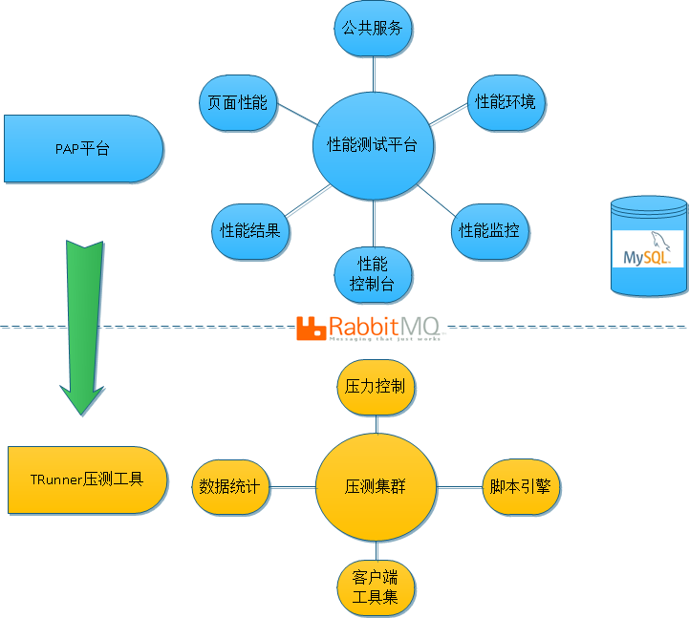
平台设计概要

Slide 26
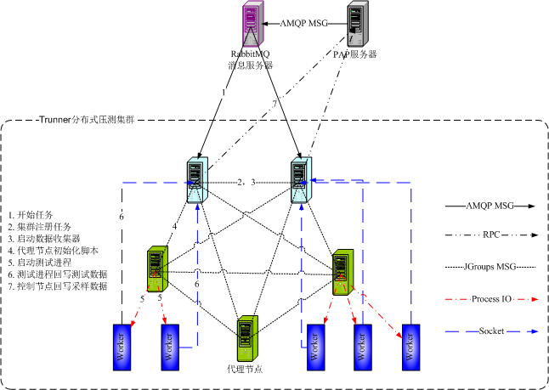
测试平台拓扑结构

Slide 27
平台运行数据

Slide 28
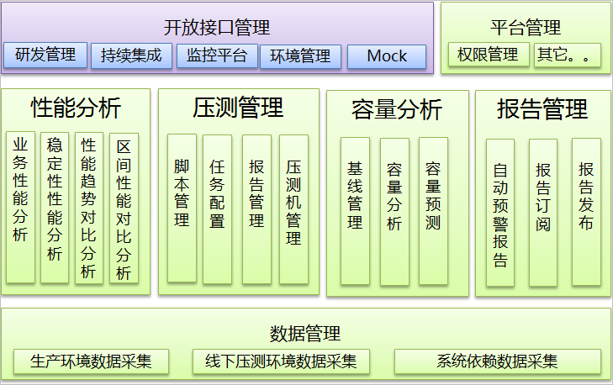
后续发展

Slide 29
Discussion

