Slide 1
神经网络语言模型的性能优化研究
On Optimization Perspective of Neural Language Model
北京航空航天大学 计算机学院 研究生开题答辩
答辩人：姜楠 SY1506330
导师：荣文戈副教授
2016 年12 月20 日

Slide 2
论文选题的背景与意义
神经网络在语言模型中应用广泛；
循环神经网络语言模型精确度最好，但是计算费时需要优化。
本课题调研各种优化方案，并结合各方面的已有成果，在保证模型精度不降低的情况下，使其速度尽可能的达到最快。
同时我们还考虑了使用当前流行的CUDA计算方案。

Slide 3
语言模型历史发展
1. N-gram:
Kneser-Ney n-gram
2. Neural Network Language Model:
neural probabilistic language model 2007
3. Recurrent Neural Network Language Model
rnnlm 2010
4. LSTM/GRU language Model
lstmlm 2012
5. Character Level Language Model
lstm-char-cnn 2016

Slide 4
部分参考文献
Chen S F, Goodman J. An empirical study of smoothing techniques for language modeling[J]. Computer Speech & Language, 1999, 13(4): 359-394.
Bengio Y, Ducharme R, Vincent P, et al. A neural probabilistic language model[J]. journal of machine learning research, 2003, 3(Feb): 1137-1155.
Mikolov T, Karafiát M, Burget L, et al. Recurrent neural network based language model[C]//Interspeech. 2010, 2: 3.
Sundermeyer M, Schlüter R, Ney H. LSTM Neural Networks for Language Modeling[C]//Interspeech. 2012: 194-197.
Kim Y, Jernite Y, Sontag D, et al. Character-aware neural language models[J]. arXiv preprint arXiv:1508.06615, 2015.

Slide 5
国内外研究现状及发展动态
运行方案
CPU or GPU
Larger vocabulary optimizations
1. spherical family (曲面函数族)
2. sampling estimation.
Noise constrastive estimation
blackout
3. structured output layer
Class-based hierarchical softmax
Tree-based hierarchical softmax
Adaptive softmax

Slide 6
GPU和CPU性能对比
Operations | Results
matrix multiplication; Convolution; large element-wise operations; | Good
Indexing; dimension-shuffling; Reshaping; | Moderate
Summation over rows/columns | Bad
Copying large data | Terrible

Slide 7
国内外研究现状及发展动态
Computational expensive.
1. spherical family
2. sampling estimation.
Noise constrastive estimation
blackout
3. structured output layer
Class-based hierarchical softmax
Tree-based hierarchical softmax
Adaptive softmax

Slide 8
1. spherical family(球面函数族)

Slide 9
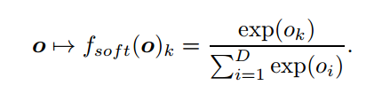
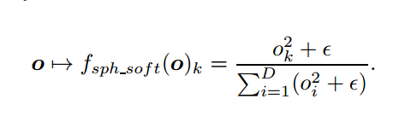
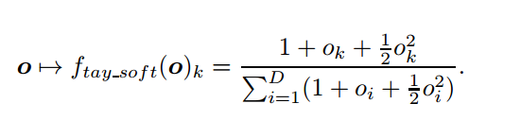
Taylor Expansion
SOFTMAX.
SPHERICAL SOFTMAX.
TAYLOR SOFTMAX.
AN EXPLORATION OF SOFTMAX ALTERNATIVES BELONGING TO THE SPHERICAL LOSS FAMILY. ICLR 2016 [university de montreal]

Slide 10
Cheap to compute in training while it fails in testing time.
2. 采样方案
Noise contrastive estimation [2010-2012]
Importance sampling. [2008]
Blackout sampling.[2016]

Slide 11

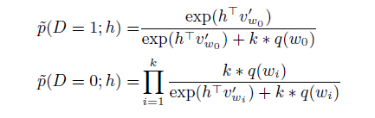

2.1 Noise contrastive estimation
True data distribution Vs Noises data distribution.
Usually use unigram distribution to model the noise distribution.
Simple, Fast Noise-Contrastive Estimation for Large RNN Vocabularies. NAACL, 2016.
Notes:
Simple, Fast Noise-Contrastive Estimation for Large RNN Vocabularies

Slide 12
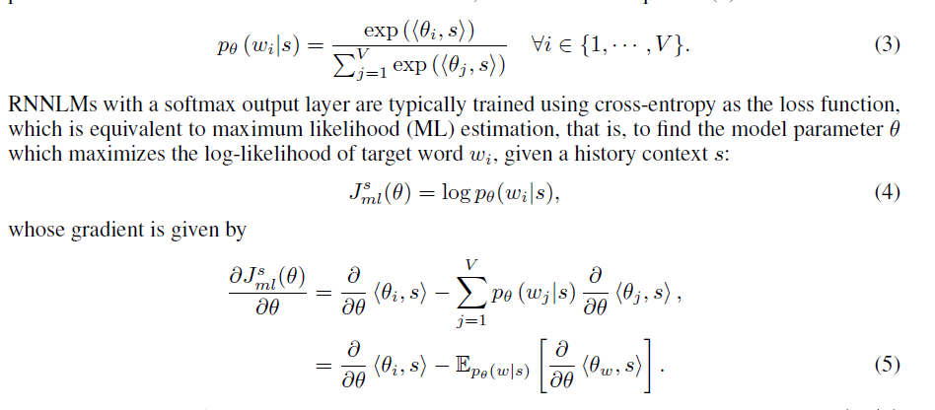
2.2 Blackout sampling
softmax
Cost function
gradient
BlackOut: Speeding up Recurrent Neural Network Language Models With Very Large Vocabularies. 2015

Slide 13
部分参考文献
Mnih A, Kavukcuoglu K. Learning word embeddings efficiently with noise-contrastive estimation[C]//Advances in Neural Information Processing Systems. 2013: 2265-2273.
Gutmann M, Hyvärinen A. Noise-contrastive estimation: A new estimation principle for unnormalized statistical models[C]//AISTATS. 2010, 1(2): 6.
Mikolov T, Sutskever I, Chen K, et al. Distributed representations of words and phrases and their compositionality[C]//Advances in neural information processing systems. 2013: 3111-3119.
Mnih A, Teh Y W. A fast and simple algorithm for training neural probabilistic language models[J]. arXiv preprint arXiv:1206.6426, 2012.

Slide 14
课题研究内容与关键技术 3. Structured output layer

Slide 15
课题研究内容与关键技术
1. class-based hierarchical softmax.
2. tree-based hierarchical softmax.
3. word clustering.

Slide 16

3.1 Class-based hierarchical softmax

Slide 17
3.2 Tree-based Hierarchical softmax
加速比：v/log(V)

Slide 18

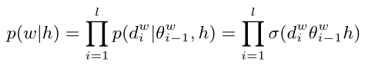
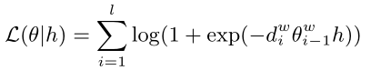
模型数学化

Slide 19
构建树的策略
均匀划分单词类别：
Frequency binning.
Word-net binning.
word-embedding clustering.
非均匀划分单词类别：
Brown clustering

Slide 20
评价指标
混杂度(Perplexity).
计算复杂度
训练参数

Slide 21
一些现有的代码库
Theano
https://github.com/jiangnanHugo/language_modeling
https://github.com/pascal20100/factored_output_layer
C++
https://github.com/IntelLabs/rnnlm
CUDA
https://github.com/isi-nlp/Zoph_RNN
Tensorflow
https://github.com/tensorflow/models/tree/master/lm_1b

Slide 22
开发环境设置
Linux： 操作系统
R： 主要用于数据统计和图表处理
Python2.7： 使用的开发语言和开发环境
Theano： 主要的建模语言
其他：bash script 和 cuda

Slide 23
时间安排
2016 年12 月 2017 年1 月: 整理资料，学习研究语言模型的领域知识;
2017 年2 月 2017 年4 月: 研究学习深度学习模型的知识, 特别是循环神经网络的建模过程;
2017 年5 月2017 年7 月: 调研并实现解决大词表问题的主要手段, 并实现基本代码框架;
2017 年8 月2017 年10 月: 实验验证与完善;
2017 年11 月2018 年3 月:资料整理和论文撰写.

Slide 24
Thanks !

