Slide 1
神经网络语言模型的性能优化研究
On Optimization Perspective of Neural Language Model
北京航空航天大学 计算机学院 研究生开题答辩
答辩人：姜楠 SY1506330
导师：荣文戈副教授
2016 年12 月20 日

Slide 2
论文选题的背景与意义
神经网络在语言模型中应用广泛；
循环神经网络语言模型精确度最好，但是计算费时需要优化。
本课题调研各种优化方案，并结合各方面的已有成果，在保证模型精度不降低的情况下，使其速度尽可能的达到最快。
同时我们还考虑了使用当前流行的CUDA计算方案。

Slide 3
语言模型历史发展
1. N-gram:
Kneser-Ney n-gram
2. Neural Network Language Model:
neural probabilistic language model 2007
3. Recurrent Neural Network Language Model
rnnlm 2010
4. LSTM/GRU language Model
lstmlm 2012
5. Character Level Language Model
lstm-char-cnn 2016

Slide 4
reference
Chen S F, Goodman J. An empirical study of smoothing techniques for language modeling[J]. Computer Speech & Language, 1999, 13(4): 359-394.
Bengio Y, Ducharme R, Vincent P, et al. A neural probabilistic language model[J]. journal of machine learning research, 2003, 3(Feb): 1137-1155.
Mikolov T, Karafiát M, Burget L, et al. Recurrent neural network based language model[C]//Interspeech. 2010, 2: 3.
Sundermeyer M, Schlüter R, Ney H. LSTM Neural Networks for Language Modeling[C]//Interspeech. 2012: 194-197.
Kim Y, Jernite Y, Sontag D, et al. Character-aware neural language models[J]. arXiv preprint arXiv:1508.06615, 2015.

Slide 5
Optimizations
Devices
CPU or GPU
Larger vocabulary optimizations
1. spherical family
2. sampling estimation.
Noise constrastive estimation
blackout
3. structured output layer
Class-based hierarchical softmax
Tree-based hierarchical softmax
Adaptive softmax

Slide 6
What can be accelerate on GPU?
Operations | Results
matrix multiplication; Convolution; large element-wise operations; | Good
Indexing; dimension-shuffling; Reshaping; | Moderate
Summation over rows/columns | Bad
Copying large data | Terrible

Slide 7
Nvidia or AMD
Architecture | Review
Nvidia CUDA | Good
AMD OpenCL | promising
是由苹果（Apple）公司发起，业界众多著名厂商共同制作的面向异构系统通用目的并行编程的开放式、免费标准，也是一个统一的编程环境。
Tensorflow starts support openCL.

Slide 8
Evaluation metrics
Perplexity.
Computational complexity.
Parameter to train.

Slide 9
Large vocabulary problem
Computational expensive.
1. spherical family
2. sampling estimation.
Noise constrastive estimation
blackout
3. structured output layer
Class-based hierarchical softmax
Tree-based hierarchical softmax
Adaptive softmax

Slide 10
1. spherical family

Slide 11
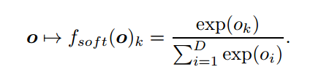
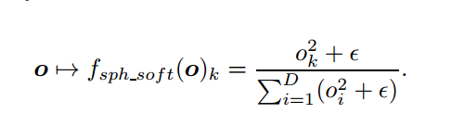
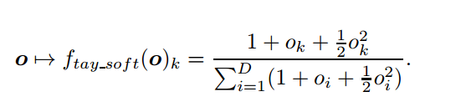
Taylor Expansion
SOFTMAX.
SPHERICAL SOFTMAX.
TAYLOR SOFTMAX.
AN EXPLORATION OF SOFTMAX ALTERNATIVES BELONGING TO THE SPHERICAL LOSS FAMILY. ICLR 2016 [university de montreal]

Slide 12
Cheap to compute in training while it fails in testing time.
2. sampling
Noise contrastive estimation [2010-2012]
Importance sampling. [2008]
Blackout sampling.[2016]

Slide 13

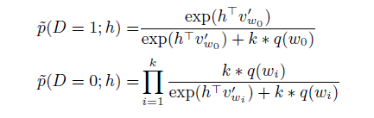

2.1 Noise contrastive estimation
True data distribution Vs Noises data distribution.
Usually use unigram distribution to model the noise distribution.
Simple, Fast Noise-Contrastive Estimation for Large RNN Vocabularies. NAACL, 2016.
Notes:
Simple, Fast Noise-Contrastive Estimation for Large RNN Vocabularies

Slide 14
reference
Mnih A, Kavukcuoglu K. Learning word embeddings efficiently with noise-contrastive estimation[C]//Advances in Neural Information Processing Systems. 2013: 2265-2273.
Gutmann M, Hyvärinen A. Noise-contrastive estimation: A new estimation principle for unnormalized statistical models[C]//AISTATS. 2010, 1(2): 6.
Mikolov T, Sutskever I, Chen K, et al. Distributed representations of words and phrases and their compositionality[C]//Advances in neural information processing systems. 2013: 3111-3119.
Mnih A, Teh Y W. A fast and simple algorithm for training neural probabilistic language models[J]. arXiv preprint arXiv:1206.6426, 2012.

Slide 15
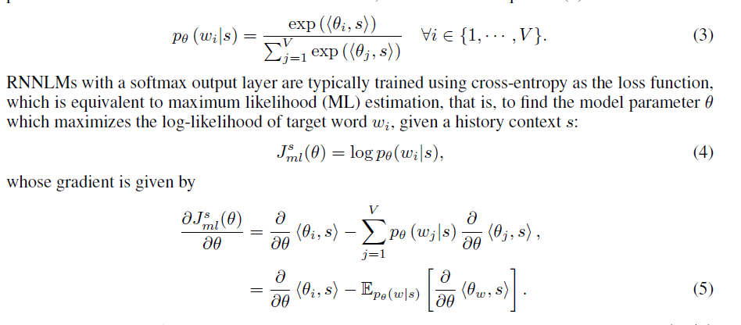
2.2 Blackout sampling
softmax
Cost function
gradient
BlackOut: Speeding up Recurrent Neural Network Language Models With Very Large Vocabularies. 2015

Slide 16
3. Structured output layer

Slide 17
Hierarchical softmax
1. class-based hierarchical softmax.
2. tree-based hierarchical softmax.
3. Adaptive softmax.

Slide 18

3.1 Class-based hierarchical softmax

Slide 19
3.2 Tree-based Hierarchical softmax
Speedup ratio v/log(V)

Slide 20

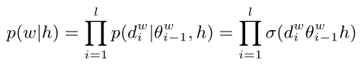
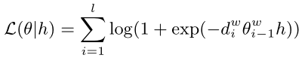
Example

Slide 21
3.3 Adaptive softmax
Split vocabulary into 2 part: V_{h} & V_{t}

Slide 22
Tree construction rules.
Frequency binning.
Word-net binning.
kmean+word-embedding clustering.

Slide 23
Some resource
Theano
https://github.com/jiangnanHugo/language_modeling
https://github.com/pascal20100/factored_output_layer
C++
https://github.com/IntelLabs/rnnlm
CUDA
https://github.com/isi-nlp/Zoph_RNN
Tensorflow
https://github.com/tensorflow/models/tree/master/lm_1b

Slide 24
开发环境设置
Linux： 操作系统
R： 主要用于数据统计和图表处理
Python2.7： 使用的开发语言和开发环境
Theano： 主要的建模语言
其他：bash script 和cuda

Slide 25
时间安排
2016 年12 月 2017 年1 月: 整理资料，学习研究语言模型的领域知识;
2017 年2 月 2017 年4 月: 研究学习深度学习模型的知识, 特别是循环神经网络的建模过程;
2017 年5 月2017 年7 月: 调研并实现解决大词表问题的主要手段, 并实现基本代码框架;
2015 年8 月2015 年10 月: 实验验证与完善;
2015 年11 月2015 年12 月:资料整理和论文撰写.

Slide 26
Thanks !

