Slide 1
Machine Learning for Market Microstructure and High Frequency Trading
Reporter: Nan Jiang
Supervisor: Wenge Rong

Slide 2
Terminology
Trade execution: 交易流程
Generation of alpha: 投资的正反馈因子
Quantitative finance: 量化金融
CAPM: Capital Asset Pricing Model,资本资产定价模型
Fama and French factors: CAPM中的3因子模型
Liquidity: 流动资产
Buying and selling shares: 买入或抛售股票份额
bid-ask spread: 买卖差价
Dark pool: 黑池
Kearns M, Nevmyvaka Y. Machine learning for market microstructure and high frequency trading[J]. 2013: 91-124.

Slide 3
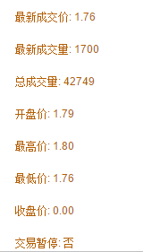
Terminology
Order book: 交易委托账本.
The list of orders that stock exchange use to record the interest of buyers and sellers.券商送到交易所的限价委托单，如果当时无法成交，就会自动纪录到交易所的交易委托账本里，等待成交机会
Cross the Spread:
a trader (or algorithm) is forced to buy at the offer price or sell at the bid, instead of letting, for instance, the buy limit order rest at the bid and letting the market cross.
Kearns M, Nevmyvaka Y. Machine learning for market microstructure and high frequency trading[J]. 2013: 91-124.

Slide 4
Introduction
Optimized Trade Execution via Reinforcement Learning
Predicting Price Movement from Order Book State
Optimized Execution in Dark Pools via Censored Exploration.
Kearns M, Nevmyvaka Y. Machine learning for market microstructure and high frequency trading[J]. 2013: 91-124.

Slide 5
Trade Execution
Background:
a client request us to buy these shares in a period of time on their behalf, and we would like to obtain the best possible prices within these constraints. And subsequent risk in holding the resulting position of V shares is borne by the client.
Kearns M, Nevmyvaka Y. Machine learning for market microstructure and high frequency trading[J]. 2013: 91-124.

Slide 6
Trade Execution
Problem：
buy/sell a volume of shares in a specified amount of time. & minimize the expenditure.
Model: reinforcement learning
State & Actions
Originate from control theory.
Kearns M, Nevmyvaka Y. Machine learning for market microstructure and high frequency trading[J]. 2013: 91-124.

Slide 7
Trade Execution
Step:
Identify finite states.
Identify a set of available actions.
Identify actions impact on models
Calculate the cost function
Algorithm for learning an optimal policy
Validation on test data.
Kearns M, Nevmyvaka Y. Machine learning for market microstructure and high frequency trading[J]. 2013: 91-124.

Slide 8
Trade Execution
Feature:
Bid-Ask Spread: 买卖差价
Bid-Ask Volume Imbalance:
The number of shares at the bid – the number of shares at the ask [at current order book]
Signed Transaction Volume:
The number of shares brought in last 15 seconds -
The number of shares sold in the last 15 seconds.
Immediate Market Order Cost
The cost of purchase the remaining shares immediately
Kearns M, Nevmyvaka Y. Machine learning for market microstructure and high frequency trading[J]. 2013: 91-124.

Slide 9
Price Movement Prediction
Background:
we would like to learn models that themselves profitably decide:
when (Under what conditions in a givens state space) to trade;
how (In which direction and with with order) to trade
Kearns M, Nevmyvaka Y. Machine learning for market microstructure and high frequency trading[J]. 2013: 91-124.

Slide 10
Price Movement Prediction
Problems:
Develop feature that permit the prediction of directional price movement from certain states.
(profitable ones > unprofitable ones)
Develop algorithm for execution at sufficient low trading costs.
Assumption:
the profitable predictive signals are not erased by our trading cost.
Kearns M, Nevmyvaka Y. Machine learning for market microstructure and high frequency trading[J]. 2013: 91-124.

Slide 11
Price Movement Prediction
Feature:
Bid-Ask Spread: 买卖差价
Price: 当前价格的涨跌方向
Smart Price: the weighted average of bid price & ask price.
Trade Sign: 股票交易频率标志
Bids-Ask Volume Imbalance
Signed Transaction Volume
Kearns M, Nevmyvaka Y. Machine learning for market microstructure and high frequency trading[J]. 2013: 91-124.

Slide 12
Price Movement Prediction
Actions:
Buying 1 share at the bid-ask midpoint and holding the position for t seconds.
We sell at the midpoint of t=10 seconds
Strategy:
Buying and selling after t seconds if the midpoint increase.
The reverse action if it decreased.
Kearns M, Nevmyvaka Y. Machine learning for market microstructure and high frequency trading[J]. 2013: 91-124.

Slide 13
Price Movement Prediction
Methodology:
Reconstruct Order Book on historical data for each stock
At each trading time, compute the current state & the result of both action (buy then sell, sell then buy)
Learn model on year 2008 data; test the learned policy on year 2009 data
Kearns M, Nevmyvaka Y. Machine learning for market microstructure and high frequency trading[J]. 2013: 91-124.

Slide 14
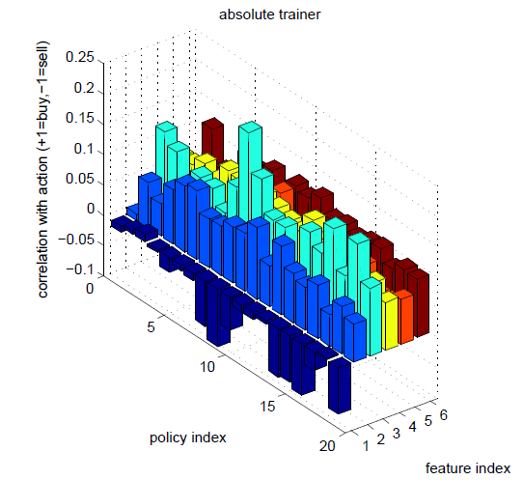
Price Movement Prediction
Result & Conclusion:
Project the learned policy onto each individual feature;
Conclude the relationship between the feature and the actions
Kearns M, Nevmyvaka Y. Machine learning for market microstructure and high frequency trading[J]. 2013: 91-124.

Slide 15
谢谢！
Kearns M, Nevmyvaka Y. Machine learning for market microstructure and high frequency trading[J]. 2013: 91-124.

