Slide 1
Final Exam
Date: 9 Jan 2020 (10:30-12:30)
Location: 曹西-101（CaoXi-101）
有限开卷，允许带3张有内容的A4纸（可双面）入场 Limited open book exam, 3 A4-sheets, double-sided
40道单选题+5道填空+4道问答题
40 single choices+5 fill blanks+4 question answering
补充说明：此提纲列出的是重点部分，并非所有考试内容范围。

Slide 2
OS Concepts
Dinosaurs book

Slide 3
Chapter 1
OS definition, kernel,
Interrupt
Synchronous vs. Asynchronous I/O
Hardware generated
Caused by error
Software generated
System call

Slide 4
Device status table
Storage hierarchy
Cache and coherency
OS structure: multi-programming for CPU utilization; and multi-tasking (time sharing) for interactivity
OS operation: user-mode and kernel (monitor) mode

Slide 5
Process mgmt: Multi-threaded process has one program counter per thread
Memory mgmt: determines what is in memory
Storage mgmt: file system
I/O subsystem: hide peculiarities

Slide 6
Chapter 2
Read the main textbook
OS services
  Resource allocation

Slide 7
Chapter 3
Process states: the state transition diagram (fig 3.2). The waiting state is sometimes called blocked state.
PCB contents
Process scheduling queues
Context switch
Consumer/producer
IPC communication models

Slide 8
Chapter 4
Thread concept
User/kernel threads
Multi-threading models: many-to-one, one-to-one, many-to-many
Thread specific data structure

Slide 9
Chapter 5
CPU scheduling criteria: utilization, throughput, turnaround-time, waiting time, response time
Scheduling algorithms
SJF: not really practical

Slide 10
Chapter 6
Three requirements to solve critical section problem
Preemptive/non-preemptive kernels
Synchronization hardware
Semaphore
  Counting semaphore
Producer-consumer (bounded-buffer) problem
Readers-writers problem

Slide 11
Chapter 7
Four conditions to form a deadlock
Deadlock prevention
Avoidance
Banker’s algorithm

Slide 12
Chapter 8
Binding time
Logical/physical addresses
Swapping
Dynamic storage allocation: first/best/worst fit
External/internal fragmentation
Paging: Page table, TLB, hierarchical page table, inverted page table
Effective access time
Segmentation: segment table

Slide 13
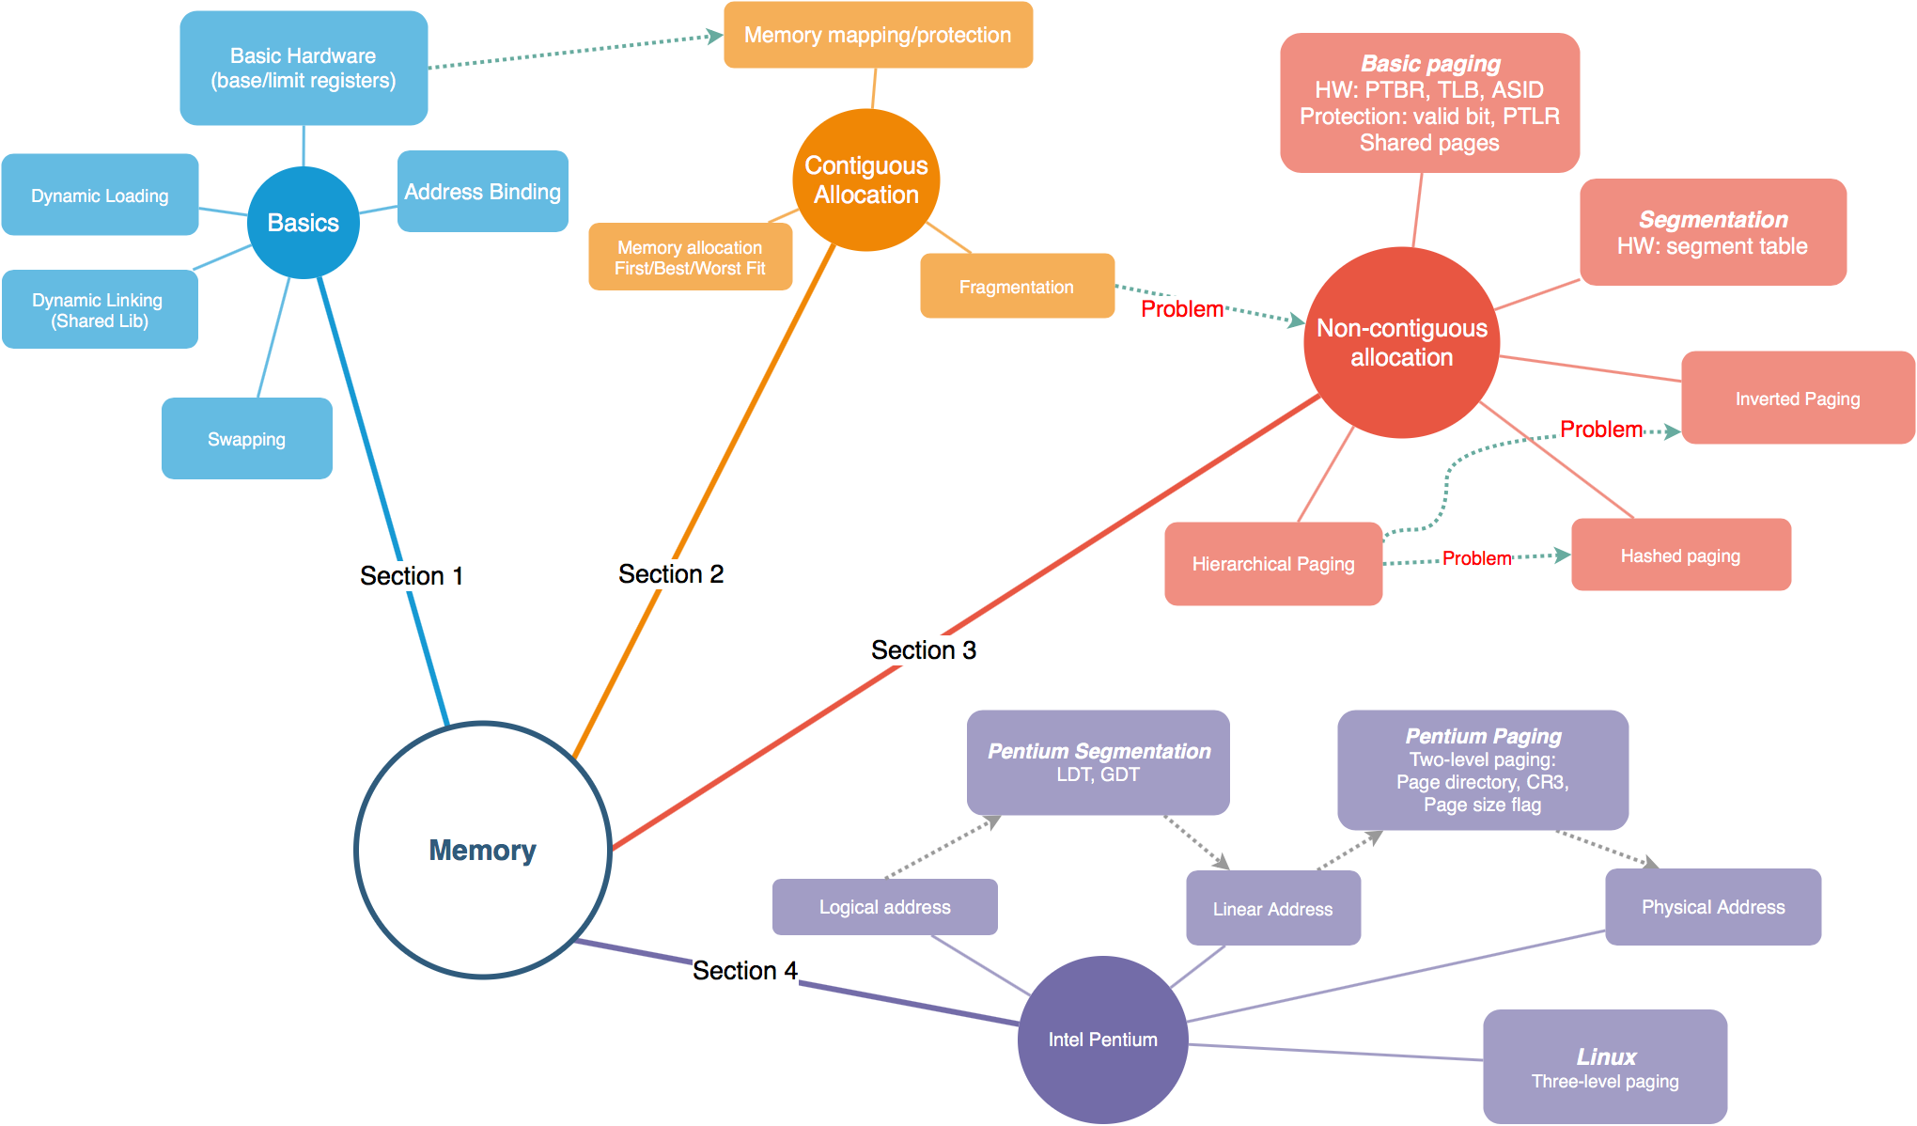
Memory

Slide 14
Chapter 9
Concept of virtual memory
Demand paging
Page fault, Effective Access Time (EAT)
Page replacement algorithms – algorithms LRU, OPT, NRU, CLOCK, MFU etc.
Thrashing
Working set
Memory mapped file

Slide 15
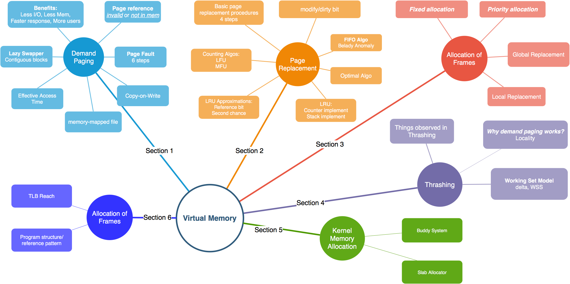
Virtual Memory

Slide 16
Chapter 10
File system
File operations
Open file tables
Access methods: sequential, direct
Directory structure: tree-structured directory
Absolute path/relative path
File protection

Slide 17
Chapter 11
FCB
Virtual file systems
File allocation methods: contiguous/linked/FAT/indexed allocation, extents, Unix file allocation
Free space mgmt
Log structured file systems

Slide 18
Chapter 12
Time to access a disk block
Disk scheduling algorithms
RAID concept

Slide 19
Chap 13
Devices accessed by special i/o instruction, or memory mapped i/o
Polling, interrupts, DMA
Blocking/non-blocking i/o
Device status table
Caching, buffering, spooling
Life cycle of an i/o request

Slide 20
OS Lab
边干边学、 Linux Kernel Dev 3.0

Slide 21
LKD01 Overview of Linux
Basic commands in Linux (mostly introduced in chap1~chap8 of LEARNING LINUX KERNEL BY PRACTICE 边干边学)
Basic commands like ls, cp, mv, echo, gcc, find, grep,…
Basic BASH/shell scripting
Lab project guides
How to write a kernel module?

Slide 22
LKD02 Building Linux Kernel
Building a kernel
Linux kernel boot process

Slide 23
LKD03 Process Management in Linux
Linux PCB (task_struct fields)
Process states
Creating (child) processes

Slide 24
LKD04 Process scheduling
Fair scheduling
The runqueue structure
Lab project 2 guide

Slide 25
LKD05 System calls in Linux
System call processing
Invoking system_call()
Return from system call

Slide 26
LKD06 Kernel data structures
List structure implementation in Linux

Slide 27
LKD07 Interrupts
Implementation of interrupt handlers

Slide 28
LKD12,15 Kernel Memory Mgmt. & Process Address Space
Addressing in the Intel architecture
Address spaces in linux
Memory management data structures in linux: e.g. MM, VMA
Hierarchical paging in linux
Page fault in linux
Physical memory management in linux: buddy algorithm, slab allocation

Slide 29
LKD13 The Linux File System
Linux FCB information, inode structure
Special files
The /proc filesystem
VFS objects
open()、read() implementation
Lab project 3 guide

