Slide 1
Generating a Data-Driven Surrogate Model for Machine Damage Accumulation
Problem 1
GEEKER_JSM
Molla Hafizur Rahman, Joseph A Hardy, Shuo Jiang

Slide 2
PROBLEM DESCRIPTION
Introduction
Background
A large amount of useful data can be produced through sensor.
These sensor data can be used to for future prediction such as damage accumulation over time

Slide 3
PROBLEM DESCRIPTION
Data
Total Machines = 5
Each machine has 5 independent variables = Band, Peak velocity, Peak acceleration, RMS velocity, Temperatures, Battery voltage.
Challenges
Measure the damage accumulation given the sensor data
Sensor data
Predictive model
Damage accumulation

Slide 4
Approach
Approach overview and background information
Data preprocessing:
There is some missing timesteps in the dataset.
Data is realigned with the corresponding timesteps.
Data analytical tool being used
Python
Scikit-learn
TensorFlow

Slide 5
Approach
Algorithm
We tried different algorithms
Regression
Multilayer-perceptron
Long-short term memory unit (LSTM)

Slide 6
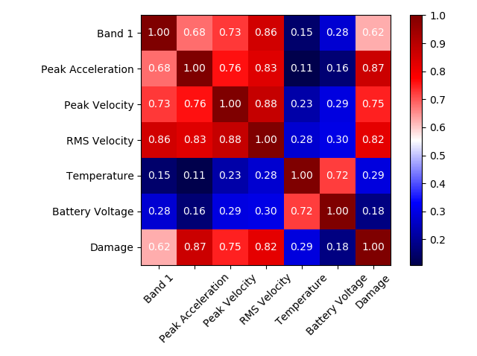
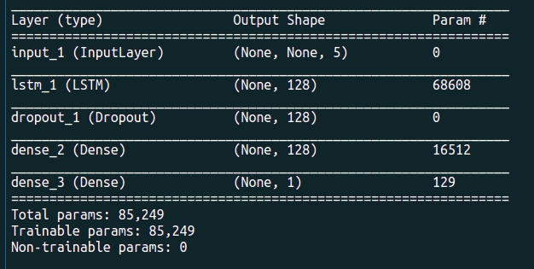
Results
Figure
Video
Model
Figure : Correlation analysis of the variables
Figure : Model

Slide 7
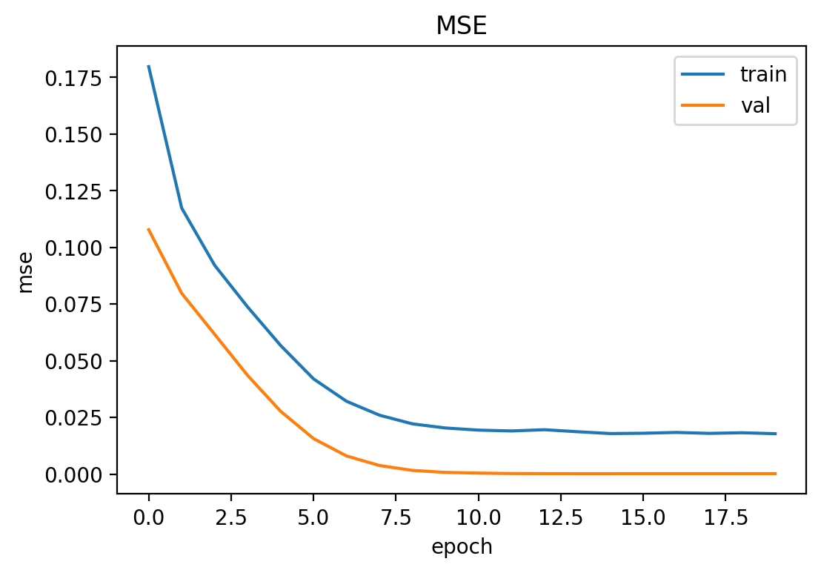
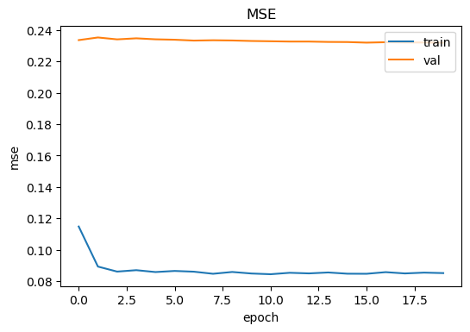
Results
Y for drill data:
R^2_train: -0.0005414460957939848
R^2_val: -0.004994708997576369
R^2_test: -0.004591628785126645
X for Drill Data:
R^2_train: 0.6428144449889928
R^2_val: 0.993586532458652
R^2_test: 0.9973778377669812
Performance
Figure : Training and validation error on drill dataset

Slide 8
Findings and Discussion
How your approach/model/simulation helps address the challenges and solve the problem?
Our model only ended up working for one of the machines and only one of its axes.

Slide 9
Closure & Insights

