Slide 1
EE353: Network Optimization
Chapter 2: Mathematical Tools
Lecturer: Dr.Yiyin Wang (王易因)
Dept. of Automation
Shanghai Jiao Tong University

Slide 2
Staff
Lecturers:
Xiaofan Wang （汪小帆）
Yiyin Wang （王易因）
  Office: Room 2-528, SEIEE Building
  Email: yiyinwang@sjtu.edu.cn
  Web: http://iwin.sjtu.edu.cn/yiyinwang/index.html
Lin Wang（王琳）
Cailian Chen （陈彩莲）
Teaching Assistant
Ziwen Yang (杨紫雯), 1106385445@qq.com
Yiyin Wang / EE353
1

Slide 3
Objective
The primary objective of this chapter is
  to introduce fundamentals about convex optimization
  to recognize/formulate problems as convex optimization problems
  to provide fundamental tools and methodologies to solve convex optimization problems
Yiyin Wang / EE353
2
Notes:
…you will be able to
1. Recognize/formulate problems as convex optimization problems
2. Develop numerical codes for problems of moderate size
3. Characterize optimal solution, give limits of performance,

Slide 4
Syllabus
Fundamentals of convex optimization
  Convex sets, convex functions, convex problems (2.1)
  Duality (2.2)
Applications
  Linear programming (LP) (2.3)
  Semidefinite programming (SDP) (2.3)
Algorithms
  Descent algorithm (2.4)
  Interior-point algorithm (2.5)
Yiyin Wang / EE353
3
Notes:
前面的课程讲述了什么是网络化控制系统,如何进行网络化控制系统的建模与稳定性分析,如何设计网络化控制系统等等。这节课主要讲述如何借助仿真工具Truetime进行网络化控制系统的仿真。什么是网络化控制系统？
课程的目标是什么？
什么是网络控制系统的仿真？仿真的目的是什么？可以用在什么地方？如何用到控制当中？
有哪些仿真工具？
什么是TrueTimeToolbox?
TrueTime的结构和功能？
TrueTime可以用来仿真什么样的系统？他能评估哪些系统性能指标？
TrueTime的基本模块？
如何用TrueTime来做仿真
仿真实例、仿真作业

Slide 5
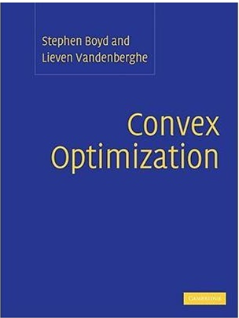
Textbook
Convex optimization by
  Stephen Boyd
  Lieven Vandenberghe
Yiyin Wang / EE353
4

Slide 6
Homework & Midterm
Two homework assignments
  Release at Oct. 17, due date Oct. 31
  Release at Oct. 31, due date Nov.11
  Midterm exam (Nov. 14)
  Open book exam (bring slides with you)
Yiyin Wang / EE353
5

Slide 7
Acknowledgements
Slides borrow heavily from lectures by Stephen Boyd (Stanford), Lieven Vandenberghe (UCLA), and Mung Chiang (Princeton)
More resources
  ``Convex optimization’’, Stanford
  http://stanford.edu/~boyd/teaching.html
  ``Optimization of Communications Systems’’, Princeton
  http://www.princeton.edu/~chiangm/class.html
Yiyin Wang / EE353
6

Slide 8

http://icassp2015.org/

Slide 9
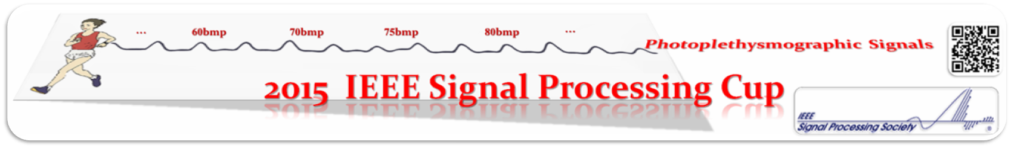
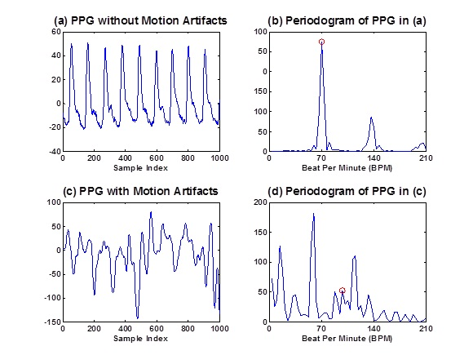
http://www.zhilinzhang.com/spcup2015/

Slide 10
Aug.11, 2014 Training data are available (more will be available later).
Jan. 16, 2015 Deadline for team registration to join the competition.
Jan. 26, 2015 Competition data are available and results can be submitted.
Feb. 6, 2015 Deadline for submission of competition data.
Feb. 27, 2015 Announcement of the best three teams.
Apr. 20, 2015 Final competition at ICASSP 2015.

