Slide 1






Expense Tracker
An Open Source Software Project
23013145
JIANG WENLONG

Slide 2

What is Open Source Software?
Open Source Software (OSS) is software whose source code is publicly available. Anyone can use, study, modify, and share the code according to the license terms.
Why is Open Source Important?
Examples of Open Source Software
Encourages collaboration among developers Helps people learn from existing code Improves software quality through community contributions Reduces development costs
Linux Python Git Visual Studio Code

Slide 3
Project Overview
The project I selected is called Expense Tracker.
It is a simple Python application that helps users record and manage their daily expenses. The program also provides charts to visualize spending patterns.
Main Features
Project Files
Add expense records
View expense history
Calculate total expenses
Generate pie charts
Generate bar charts
Expense Tracker.py
README.md
LICENSE
requirements.txt
expense_pie_chart.png
expense_bar_chart.png

Slide 4


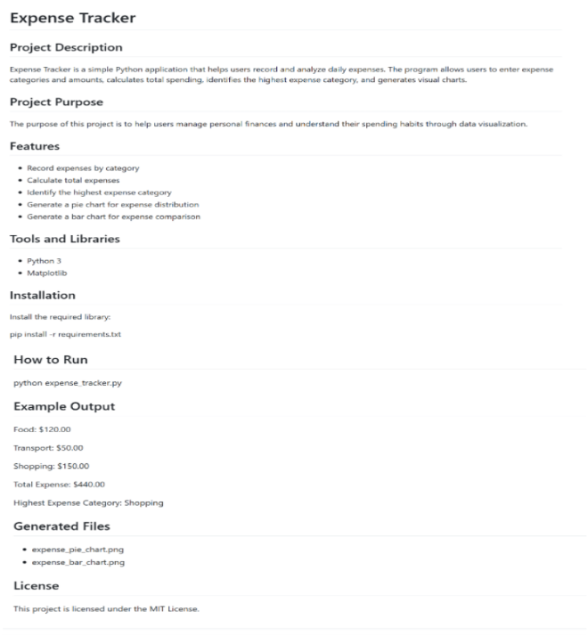
README.md Documentation
README.md is the first document that users see when they visit a GitHub repository. It explains: What the project does How to install the project How to run the program What technologies are used How the project is organized

Slide 5

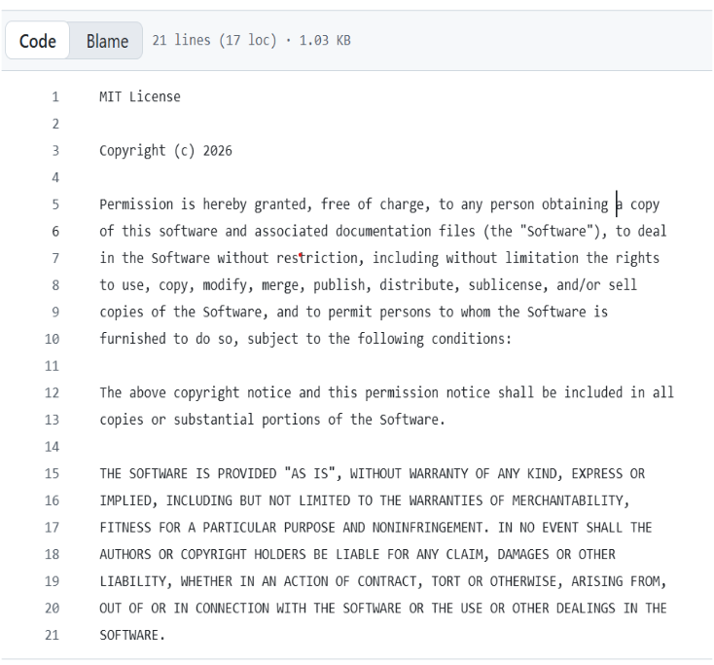
LICENSE File
Understanding the LICENSE File A LICENSE file explains how other people can use and share the software. This project uses the MIT License.
MIT License Allows
Using the software freely
Modifying the source code
Sharing the software
Using it for commercial purposes
Why It Matters Without a license, users may not know what they are legally allowed to do with the project. The license makes software sharing safer and clearer.

Slide 6



Technologies Used
Programming Language：Python
Library Used：Matplotlib
Purpose of Matplotlib：
Create pie charts
Create bar charts
Visualize expense data
Data Structure：
The program uses a Python dictionary to store expense categories and amounts.
Dependency Management： The project includes a requirements.txt file.

Slide 7

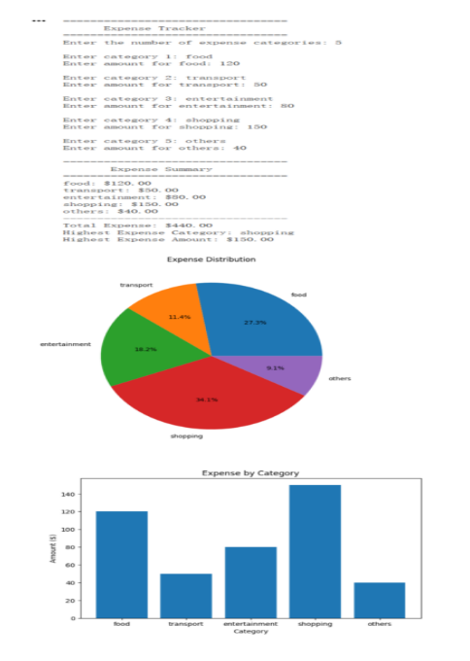
Project Implementation and Results
Project Implementation：
Output Files：
Results： The application successfully records expenses and generates visual reports. Users can clearly understand their spending habits through charts and statistical summaries.
User Input ↓ Store Data in Dictionary ↓ Calculate Statistics ↓ Find Highest Expense ↓ Generate Charts ↓ Display Results

Slide 8








Open Source Evaluation and Conclusion
Strengths of the Project
This project successfully demonstrates the essential practices of open-source software development. In addition to implementing an expense management application, it follows open-source standards through proper documentation, licensing, dependency management, and code sharing.
Clear project structure
Complete READMEdocumentation
MIT License included
Dependency management with requirements.txt
Source code hosted on GitHub
Conclusion:
Evaluation and Conclusion
Through this project, I learned:
Open-source software concepts
Git and GitHub usage
Documentation writing with README.md
Software licensing
Dependency management
Python programming and data visualization

Slide 9


Thank You

