Slide 1
POS 产品– 国内外现状调研分析报告
26/11/ 2003
罗时飞
luoshifei@fenet.com.cn

Slide 2
待讲述内容
POS相关词汇
国际规范： http://www.nrf-arts.org
JavaPOS 1.7.0
参考资料
总结

Slide 3
POS相关词汇
POS: Point of Service, Point of Sells, Point of Sale.
POS V4: POS Version 4
UnifiedPOS: Unified Point of Service
OPOS: OLE for Retail POS
JavaPOS: Java for Retail POS

Slide 4
国际规范
UnifiedPOS: an architectural specification for application interfaces to point-of-service devices that are used in the retail environment. 即，用于定义零售行业中、通过应用编程接口操作POS设备的架构规范。
本标准主要内容包括：

Slide 5
UnifiedPOS标准主要内容
The UnifiedPOS Retail Peripheral Architecture overview.
Text descriptions of the interface to the functions of the device.
UML terminology and diagrams for each device category, to describe: Relationships between classes/interfaces and objects in the system. 即，UML术语和流程图。
Basis for creating C++, Java, IDL, or other OO technology to implement the UML design. 即，实现上述UML设计。
Operational characteristics and details for implementations which are compliant to the UnifiedPOS architecture.

Slide 6
UnifiedPOS实现
OPOS：借助于ActiveX技术。
JavaPOS：以OPOS为出发点。
本文将重点介绍JavaPOS。

Slide 7
零售行业国外巨头
IBM
NCR
Wincore
360Commerce
Microsoft
Sun
Retail Pro
EPSON
……

Slide 8
JavaPOS 1.7.0
定义：Java for Retail POS (JavaPOS) provides for open POS device solutions for applications based on Java development technology. It is an implementation of
the UnifiedPOS architecture that defines:
(1)An architecture for Java-based POS (Point-Of-Service or Point-Of-Sale) device access.
(2)A set of POS device interfaces (APIs) sufficient to support a range of POS solutions.

Slide 9
JavaPOS 1.7.0
部署JavaPOS驱动（应用）前提：
(1)提供操作串口、并口、USB等的API Library. Java Communications Port API (COM/API) or optionally some other Java communications API that supports hardware device connectivity.
(2) jpos.config/loader (JCL).

Slide 10
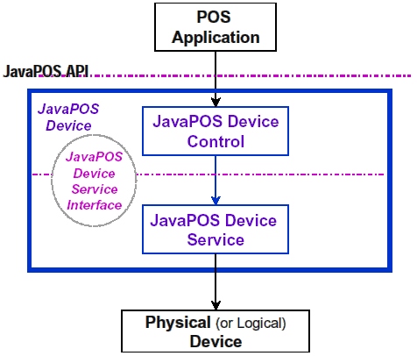
JavaPOS 1.7.0
架构概述
Application或者Applet
借助于JavaPOS Device Control API实现应用与Device的交互！
System Developer的职责！

Slide 11
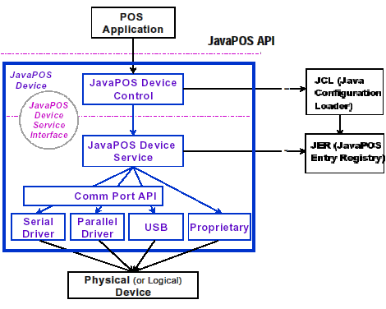
JavaPOS 1.7.0
架构进一步细化

Slide 12
JavaPOS 1.7.0-设备行为模型
Properties、Methods、Events: 遵循Java中的JavaBean DP。
“Java POS APIs”
设备初始化和消除：

Slide 13
JavaPOS 1.7.0-设备行为模型-操作设备流程
Obtain a Device Control reference.
Register for events (add listeners).
Call the open method to instantiate a Device Service and link it to the Device Control.
Call the claim method to gain exclusive access to the Physical Device. Required for exclusive-use Devices; optional for some sharable Devices. (See “Device Sharing Model” on page B-9 for more information).
Set the DeviceEnabled property to true to make the Physical Device operational. (For sharable Devices, the Device may be enabled without first claiming it.)
Use the device.
Set the DeviceEnabled property to false to disable the Physical Device.
Call the release method to release exclusive access to the Physical Device.
Call the close method to unlink the Device Service from the Device Control.
Unregister from events (remove listeners).

Slide 14
JavaPOS 1.7.0-设备行为模型
设备共享模型：
JavaPOS Devices fall into two sharing categories:
(1)Devices that are to be used exclusively by one JavaPOS Device Control instance.即，独占。
(2)Devices that may be partially or fully shared by multiple Device Control instances.即，共享。
存在两种设备：单独使用(比如，打印机)、共享使用（比如，keylock）。

Slide 15
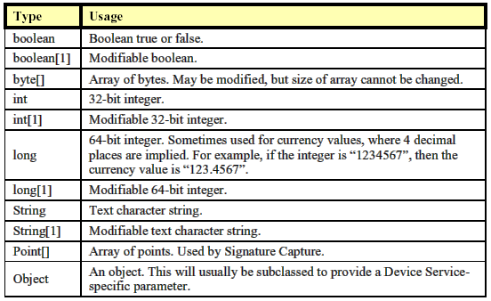
JavaPOS 1.7.0-设备行为模型
数据类型

Slide 16
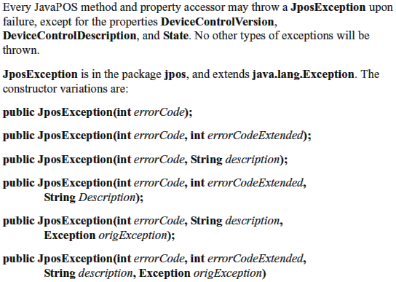
JavaPOS 1.7.0-设备行为模型
异常

Slide 17
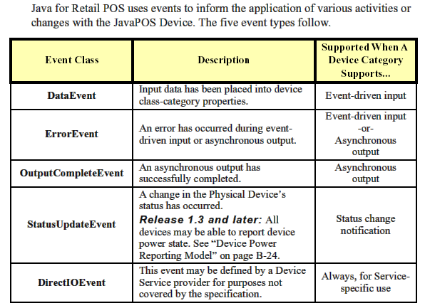
JavaPOS 1.7.0-设备行为模型
事件（Events）

Slide 18
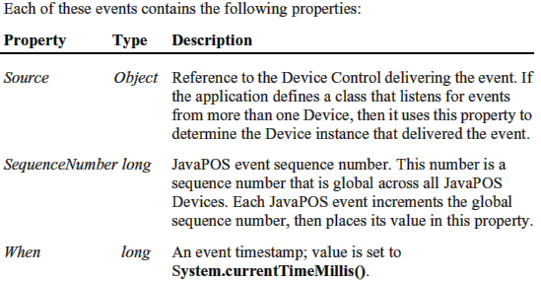
JavaPOS 1.7.0-设备行为模型
事件包含的Properties

Slide 19
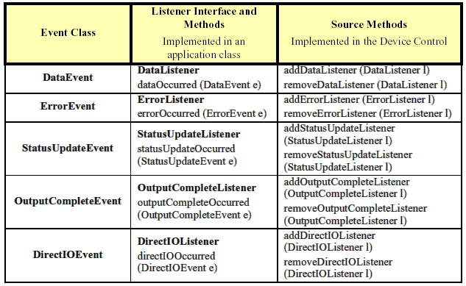
JavaPOS 1.7.0-设备行为模型
注册Events

Slide 20
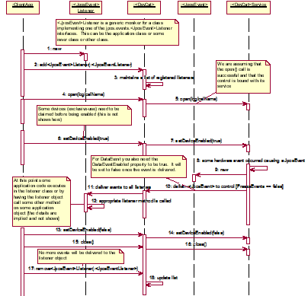
JavaPOS 1.7.0-设备行为模型
Events注册序列图

Slide 21
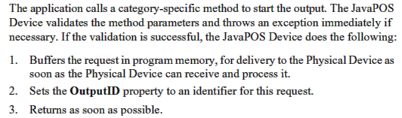
JavaPOS 1.7.0-设备行为模型
设备输入模型: 事件驱动
设备输出模型: 同步输出、异步输出
异步输出

Slide 22
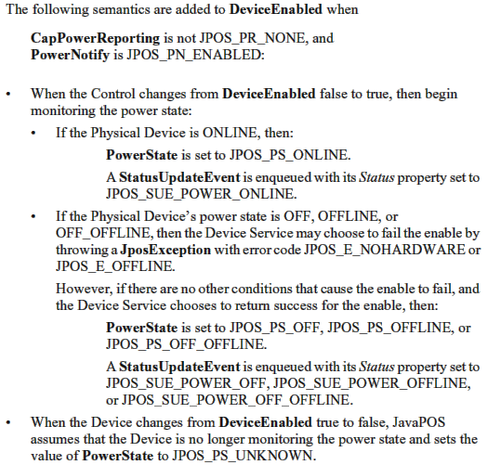
JavaPOS 1.7.0-设备行为模型
Device Power Reporting Model
(1)模型：ONLINE\OFF\OFFLINE\OFF_OFFLINE
(2)Properties: CapPowerReporting\PowerState\PowerNotify
(3)Power Reporting Requirements for DeviceEnabled:

Slide 23
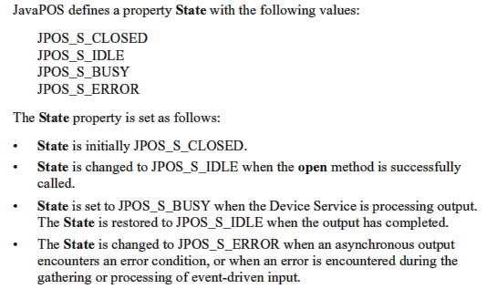
JavaPOS 1.7.0-设备行为模型
设备状态

Slide 24
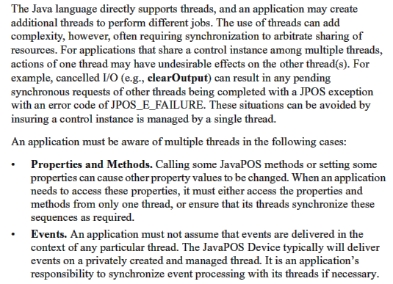
JavaPOS 1.7.0-设备行为模型
线程

Slide 25
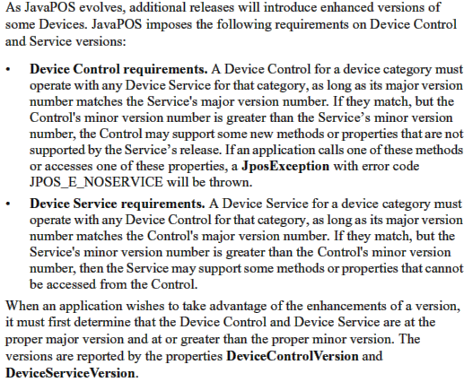
JavaPOS 1.7.0-设备行为模型
Version Handing

Slide 26
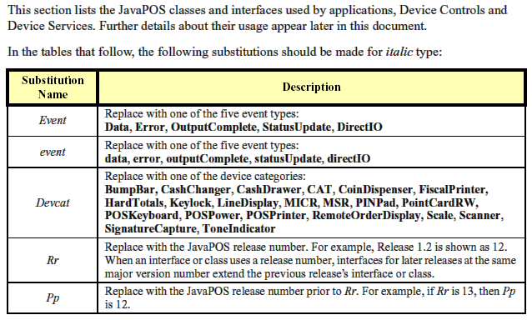
JavaPOS 1.7.0-类和接口
若干约定

Slide 27
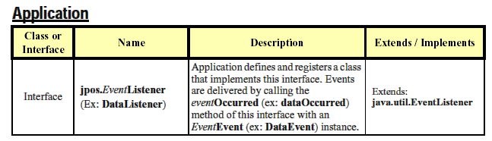
JavaPOS 1.7.0-类和接口

Slide 28
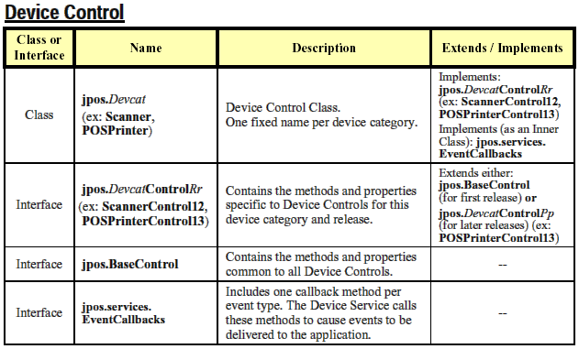
JavaPOS 1.7.0-类和接口

Slide 29
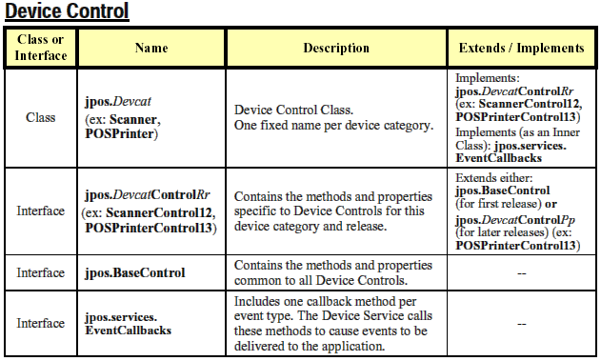
JavaPOS 1.7.0-类和接口

Slide 30
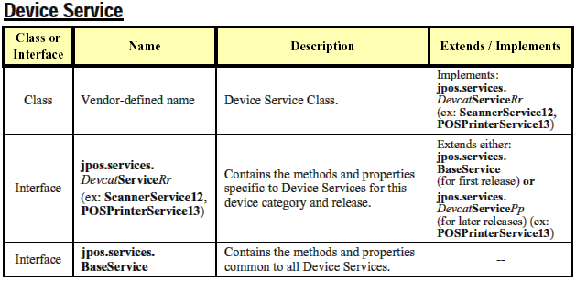
JavaPOS 1.7.0-类和接口

Slide 31
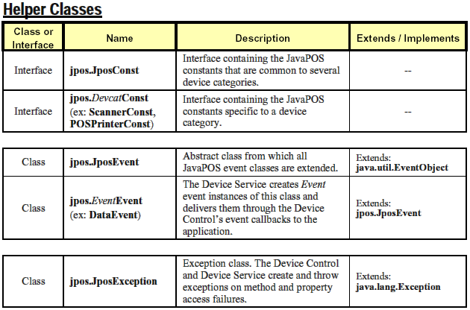
JavaPOS 1.7.0-类和接口

Slide 32
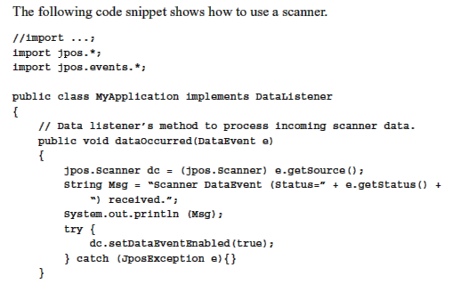
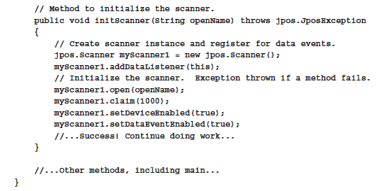
JavaPOS 1.7.0-类和接口
代码示例

Slide 33
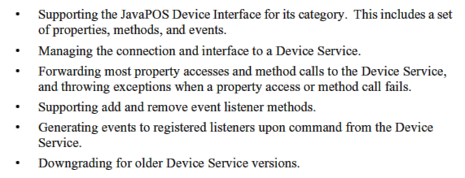
JavaPOS 1.7.0-设备控制
设备控制职责：

Slide 34
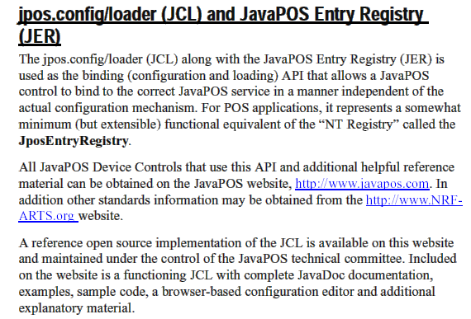
JavaPOS 1.7.0-设备控制
设备服务管理（Device Service Management）

Slide 35
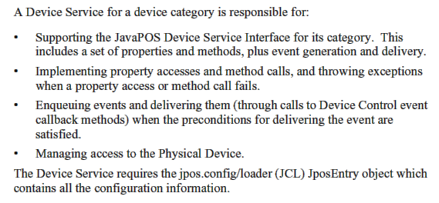
JavaPOS 1.7.0-设备服务
设备服务职责

Slide 36
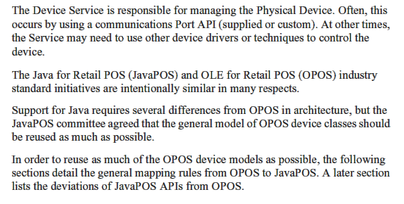
JavaPOS 1.7.0-设备服务
物理设备访问

Slide 37
参考资料
  http://www.nrf-arts.org/
  Wincor Nixdorf Web Site: http://www.wincor-nixdorf.com/internet/index.html
  JavaPOS Web Site: http://www.javapos.com/
  IBM RSS Web Site: http://www2.clearlake.ibm.com/store/support/html/drivers.html
  UnifiedPOS Version 1.70
  广州融通系统集成有限公司POS 3.x产品
  上海海鼎信息工程股份有限公司: http://www.hd123.com/
  360Commerce：http://www.360commerce.com/
  Retail Pro: http://www.retailpro.com/index.asp
  IBM中国：http://www-900.ibm.com/cn/products/pos/index.shtml
  http://cn.sun.com/press/jan2002/250200294232925.html
  IBM JavaPOS 1.7.0 Drivers

Slide 38
总结
就目前国外主流POS产品而言，其架构方式多种多样。
本文从POS系统本身的硬件设备出发，给出JavaPOS介绍。
希望能给我们的POS Version 4开发起到借鉴作用。

Slide 39

http://www.royalstone.cn/

