Slide 1
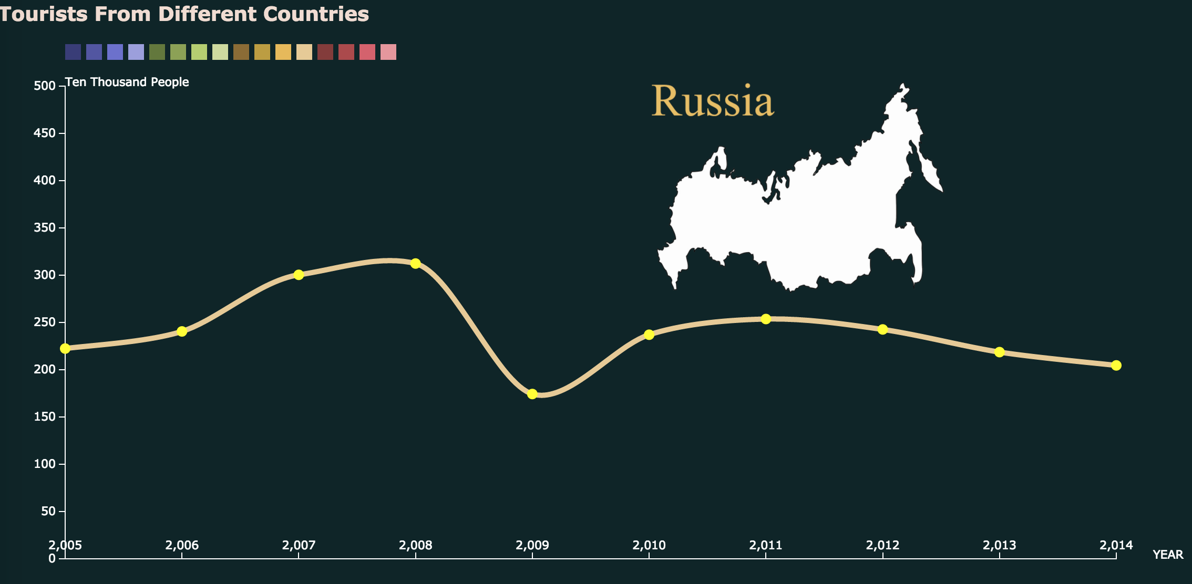
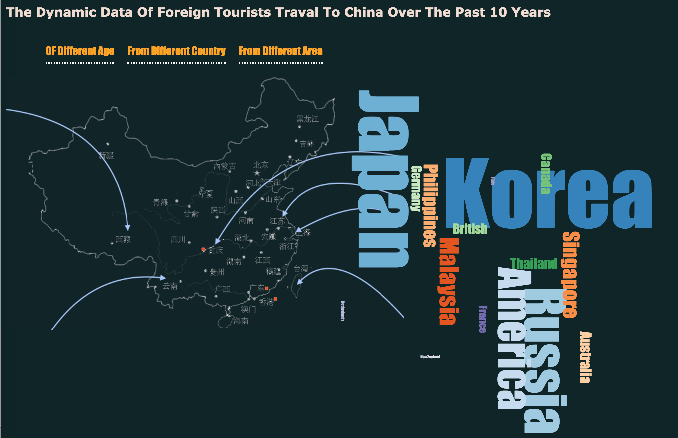
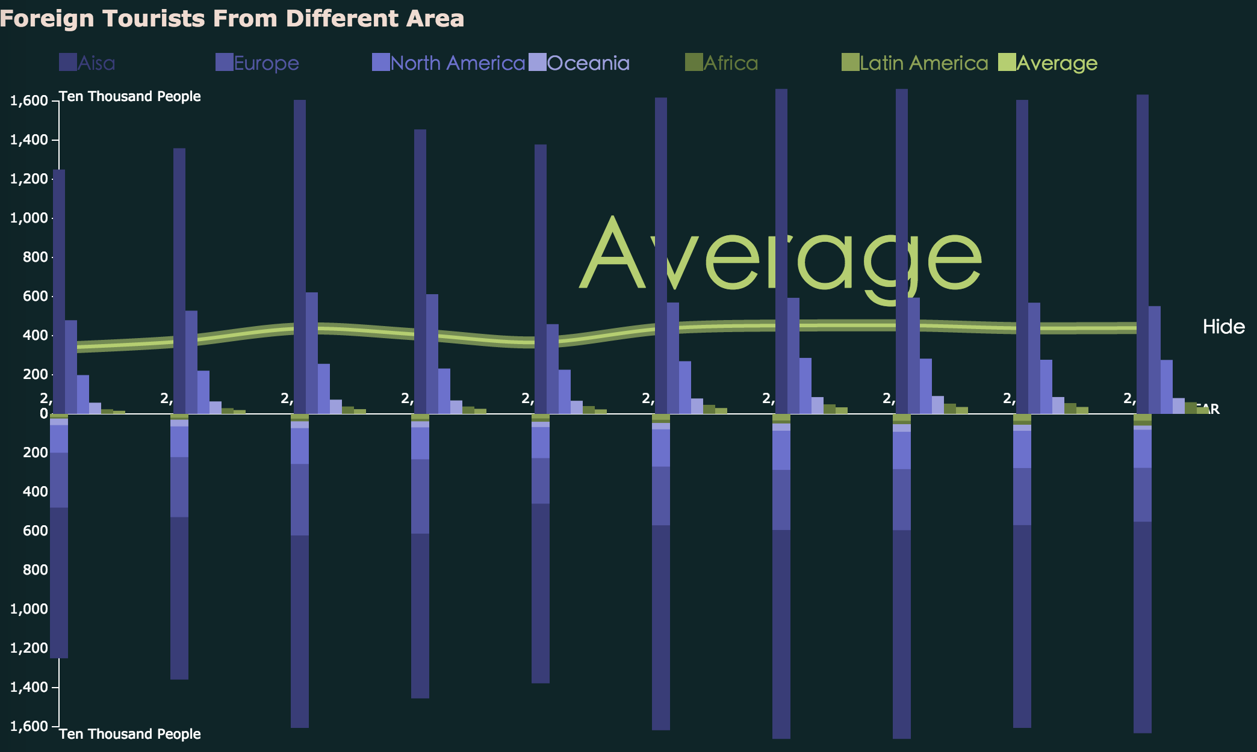
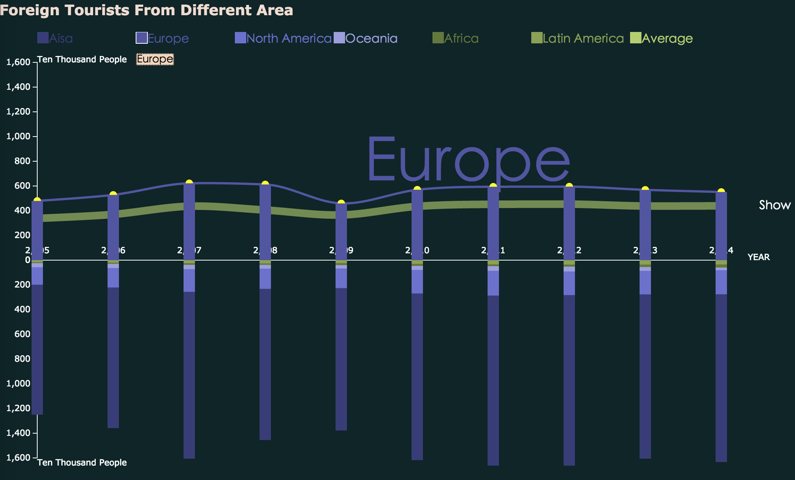
Tourism data over the past decade
From different countries
From different continents
Of different age group
D3.js JQuery
Notes:
Hello, every one, from my part, I did the visualization for the tourism data of china over the past ten years, and I specially designed and developed these diagrams with d3.js and jquery for that.
Besides, my works mainly focus on how many foreign tourists have travelled to china since 2004, and the selected data cover three topics: their age groups, countries and areas.

Slide 2
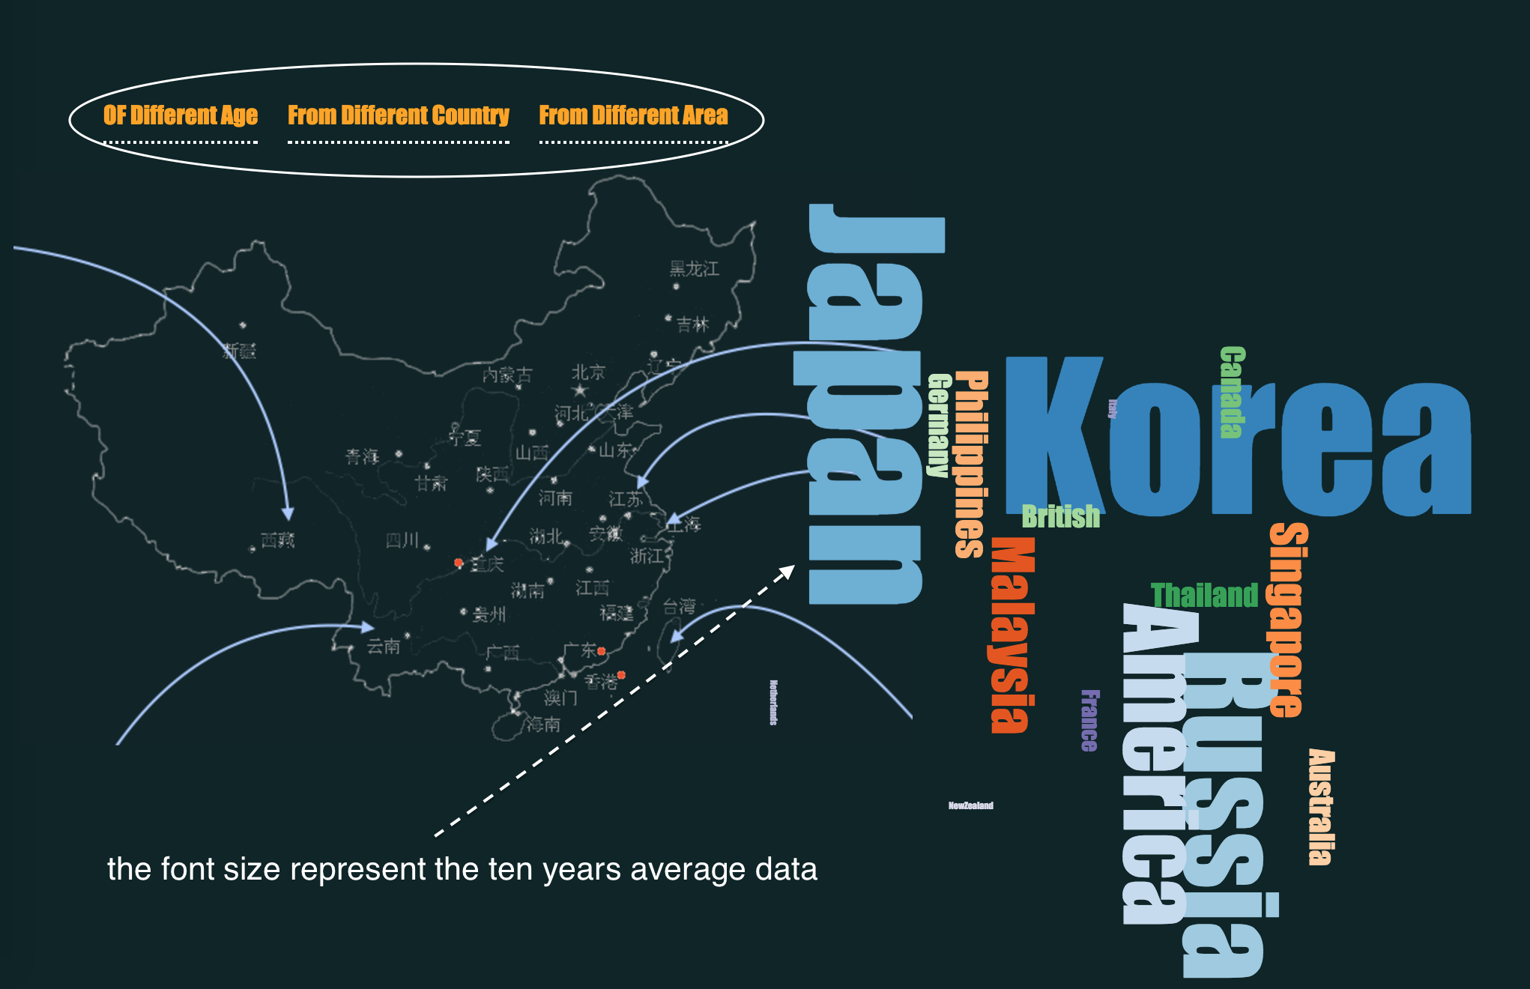
Preview the ten years average data by generating ‘Tag Clouds’
Notes:
1.Now in this index page, for preview, I roughly show the ten years average data of each topic by generating some tag clouds. the font sizes are corresponding to the average data size.from the tag clouds, we can easily know those tourists are mainly adults and middle-ages, range from 25 years old to 64 years old and they are mainly from japan、korea and russia these asia countries.

Slide 3
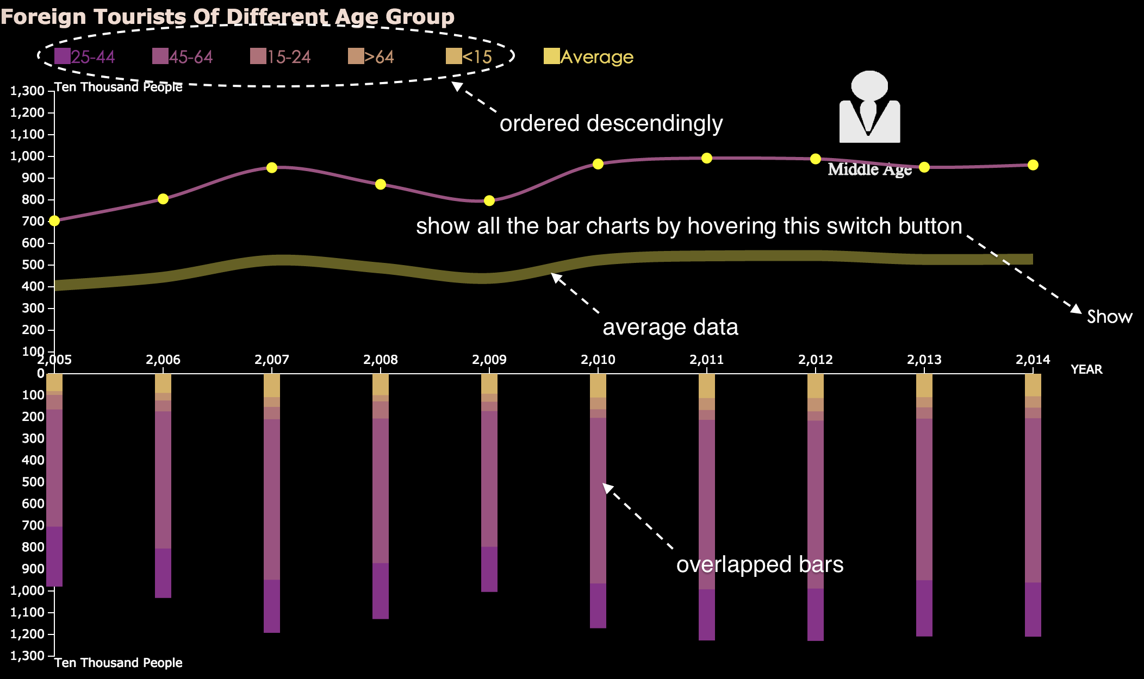

Slide 4
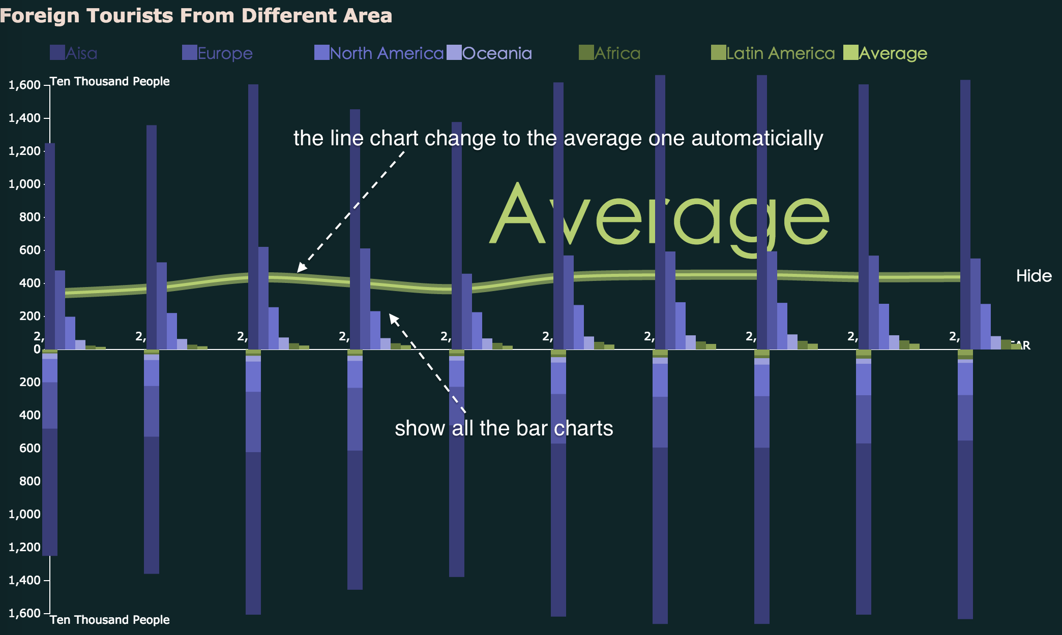

Slide 5


