Slide 1
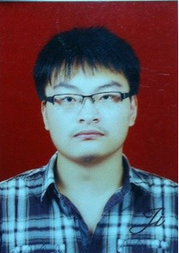
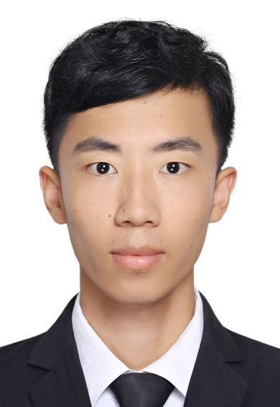
Social Trends of China
( group13 )
YuQingtian
JiangXinhou
WangKaili
YangYonggui

