Slide 2
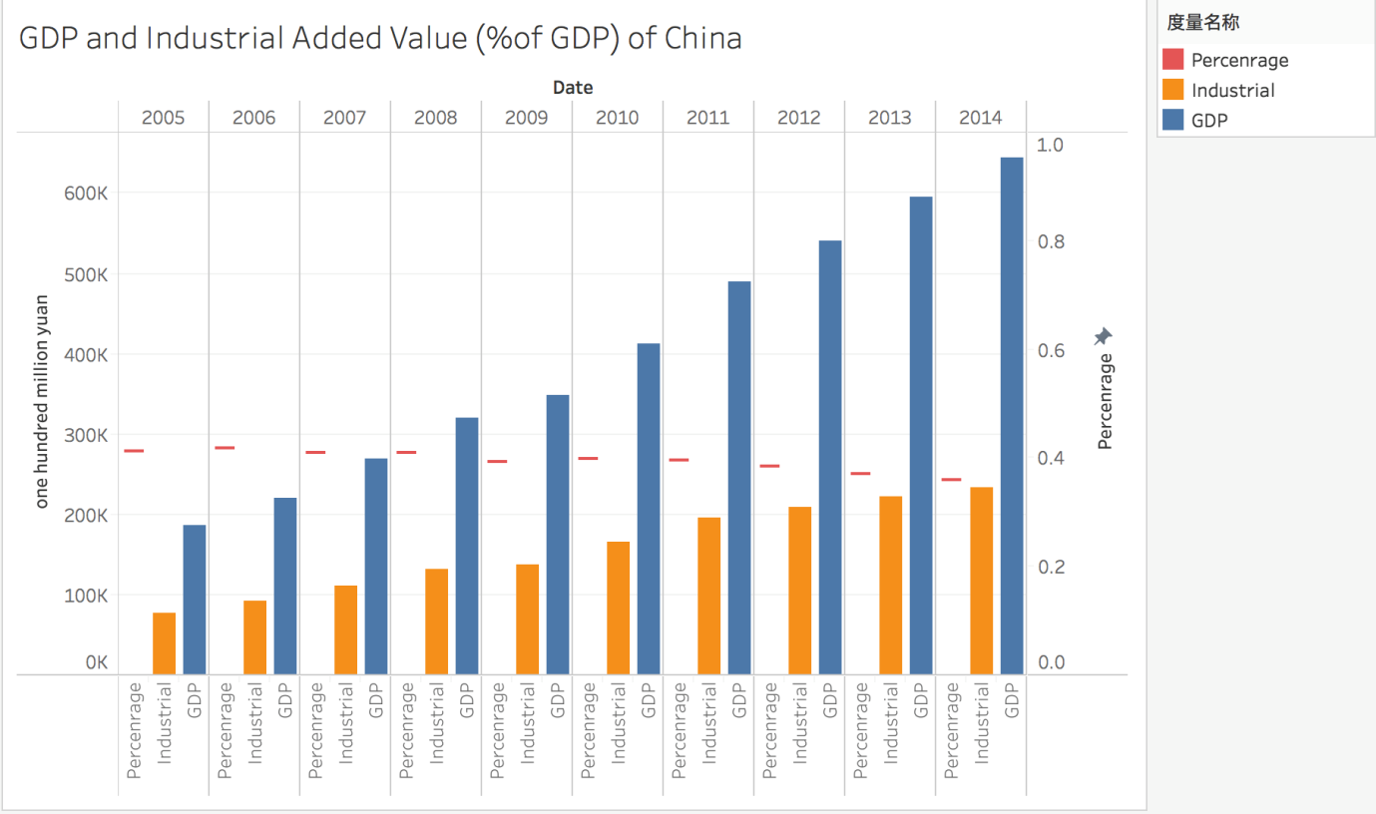
Development of Industry
1.GDP and industrial added valve in China

Slide 3
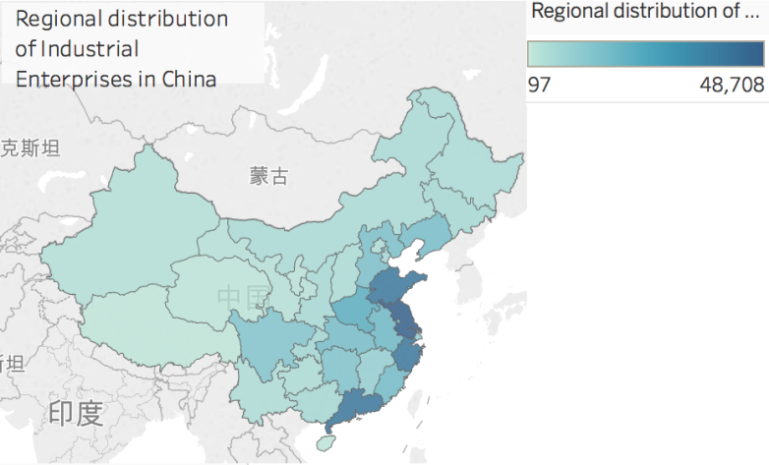
Development of Industry
2.Regional Distribution of Industrial Enterprises

Slide 4
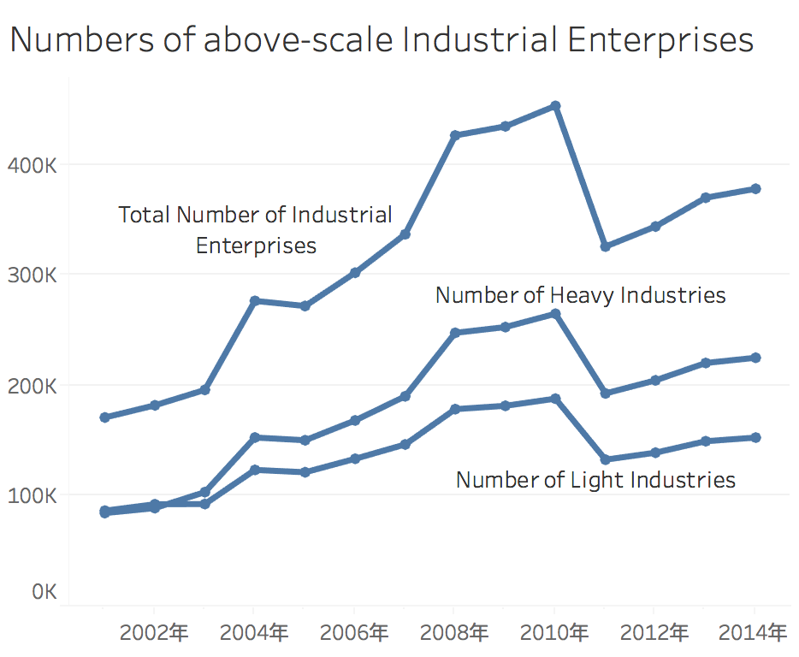
Development of Industry
3.Numbers of Above-scale Industrial Enterprises
Revenue from main operations
2001-2011:
Above 5 million Yuan
2011-2014:
Above 20 million Yuan

Slide 5
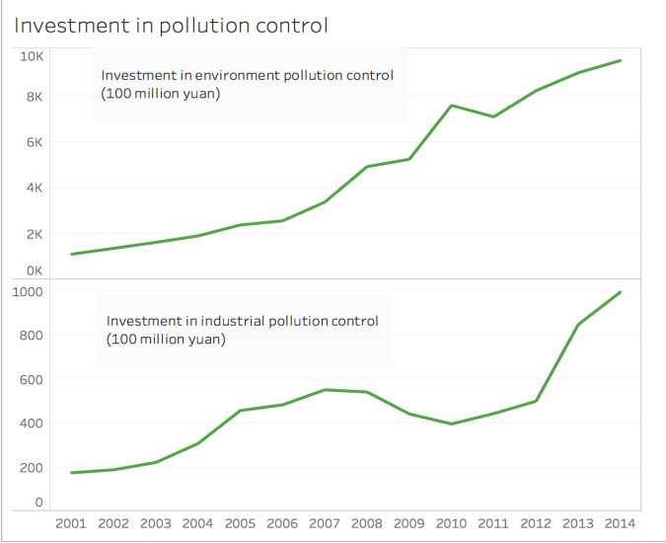
Development of Industry
4. Investment in Environment Pollution Control

Slide 6
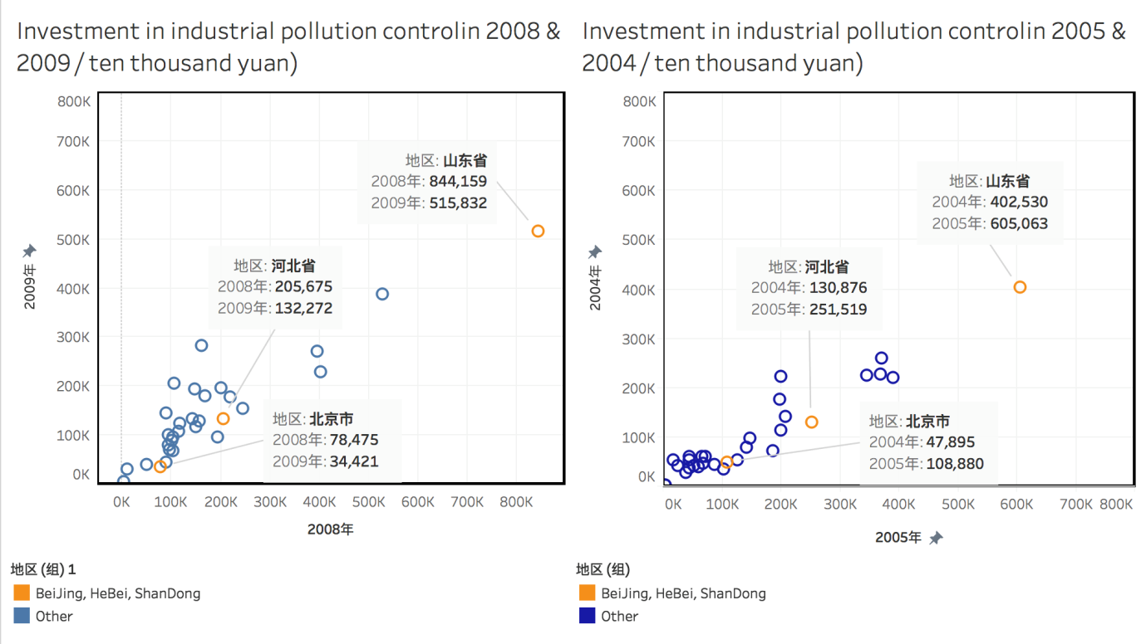
Development of Industry
5.comparison between investment in industrial pollution control in
2005 & 2004 2008 & 2009

