Slide 1


KDD 2022
Proceedings of the 28th ACM SIGKDD Conference on Knowledge Discovery and Data Mining
Mining Spatio-Temporal Relations via Self-Paced Graph Contrastive Learning
Rongfan Li*, Ting Zhong*, Xinke Jiang*, Goce Trajcevski, Jin Wu, Fan Zhou†
University of Electronic Science and Technology of China (UESTC)
Iowa State University, Ames
*Equal contribution.
†Corresponding author: Fan Zhou (fan.zhou@uestc.edu.cn)
2022-07-09
Notes:
Thanks for the session chair’s gracious introduction.
Good afternoon, everyone, I’m Chengtai Cao, It’s a great pleasure for me to be here.
The topic of our work is “Meta-GNN: On Few-shot Node Classification in Graph Meta-learning”
Now, I would like to introduce some of our work to you.

Slide 2
KDD 2022
Outline
Introduction
Our Framework: SPGCL
Evaluation
Future Work
2022-07-09
Mining Spatio-Temporal Relations via Self-Paced Graph Contrastive Learning
Notes:
I am going to give this presentation in three parts: introduction, our framework: Meta-GNN and evaluation.

Slide 3
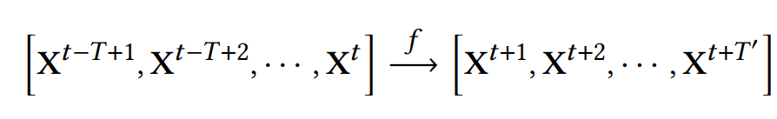
Introduction
What is Spatio-Temporal Data Prediction?
There are some geographical nodes positions, each with a sequence of time series data, such as Landslide Data, Traffic Data(i.e., PERMS03/PERMS04)
We aim to predict the future series data on each nodes by analyzing spatial and temporal dependencies.

Slide 4
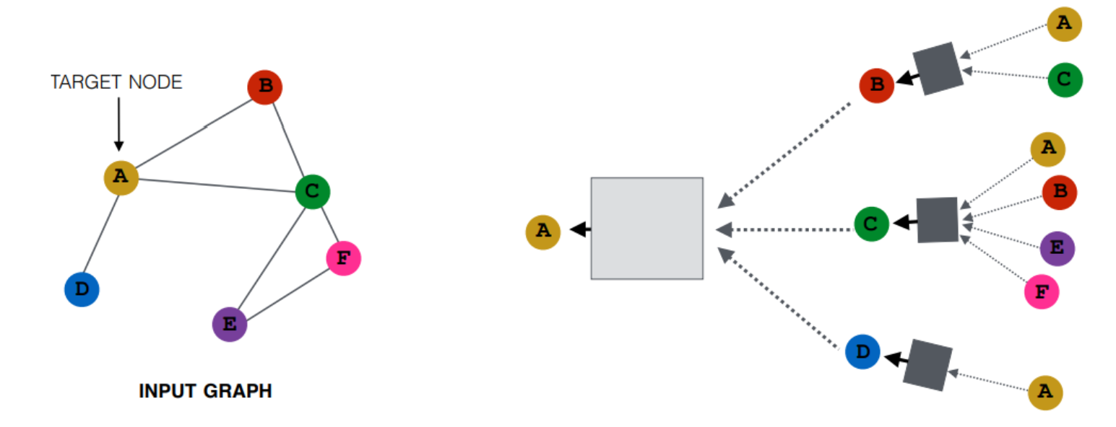
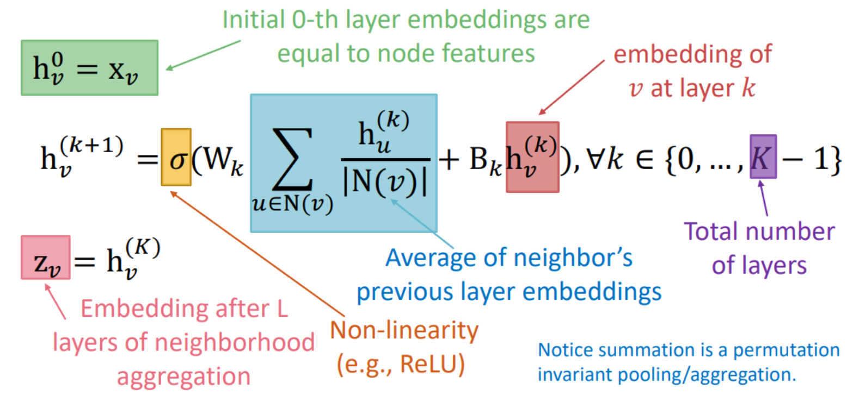

Introduction
How GNN works?
Weakness:
Need a pre-defined graph structures (i.e., adjacency matrix A)
If graph structure does not exist, KNN-based&Threshold-based methods are introduced to build adjacency and Laplacian matrices.
[1] Pictures are from CS224W: Machine Learning with Graphs. http://web.stanford.edu/class/cs224w/

Slide 5
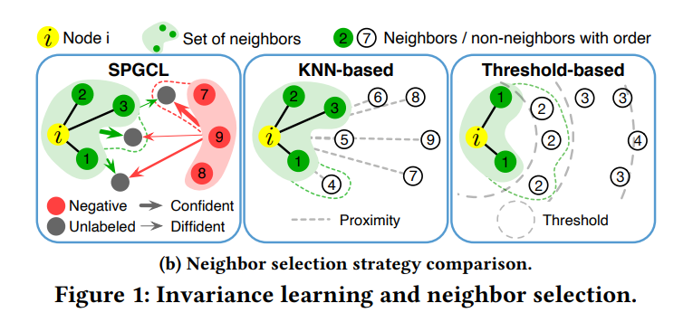
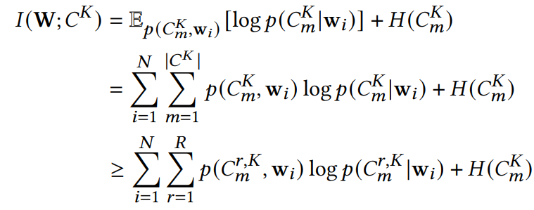
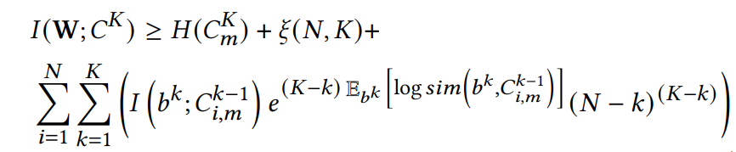
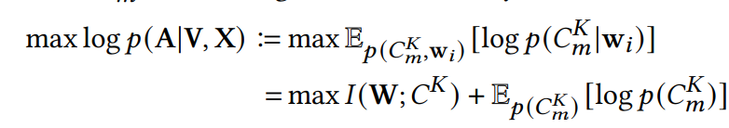
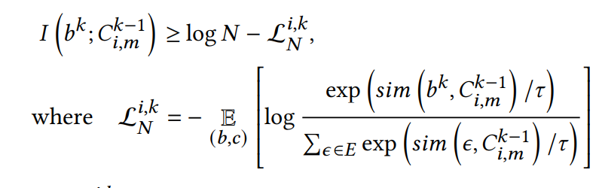
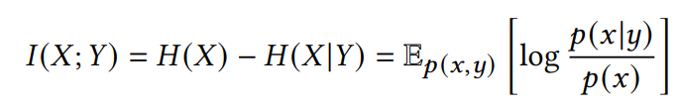
Our Framework: SPGCL
2. How global MI connected with local MI?
1. Without adjacency, how SPGCL beats traditional methods?
Route Entropy Inequality:
Further derivation:
Learn to build adjacency:
W: Node; C: Node's Neighborhoods at K step

Slide 6
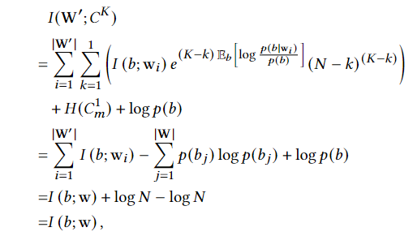
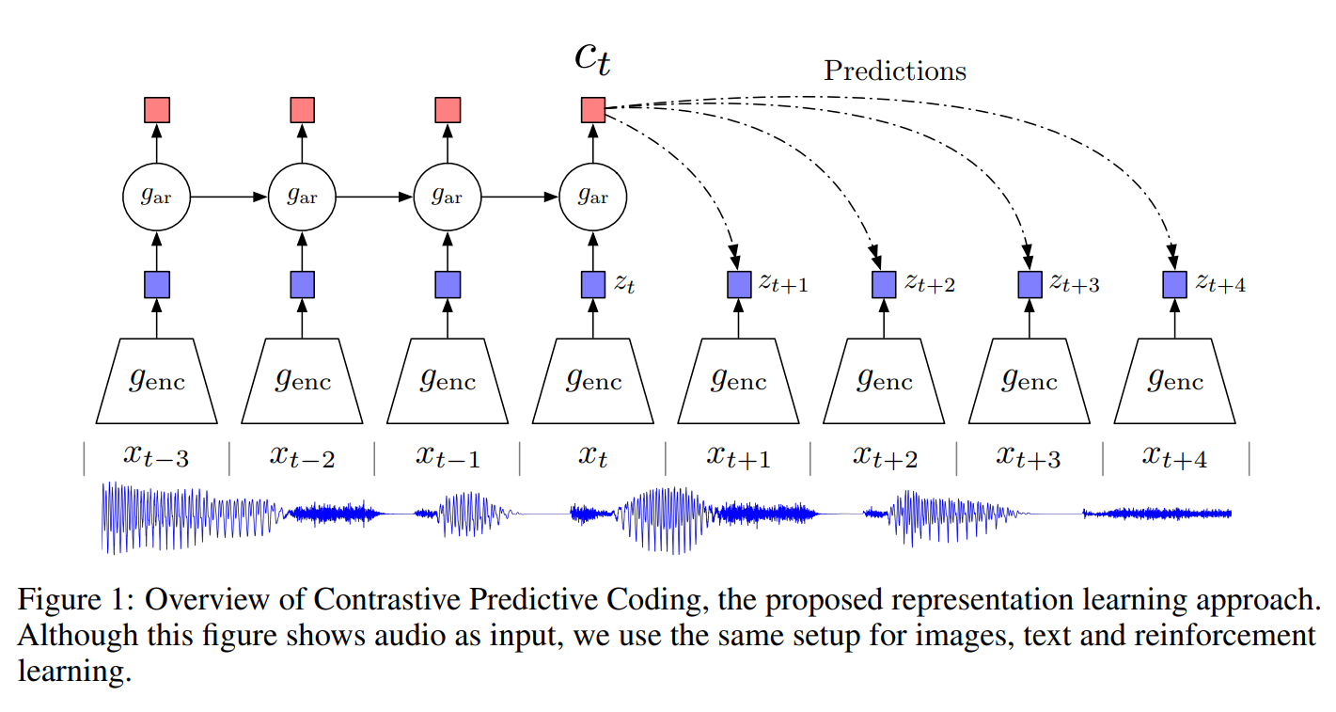
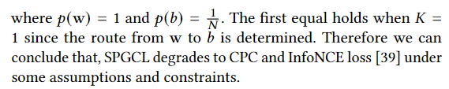
Our Framework: SPGCL
3. A more general framework -- how SPGCL degrades to InfoNCE proposed by CPC¹?
CPC is an approach maximizing mutual information between anchor node and neighborhoods for the NEXT ONE STEP
Under special condition, SPGCL degrades to InfoNCE
InfoNCE is an one-step prediction for anchor-node and its next neighbor.
SPGCL is a multi-steps prediction for anchor-node-based neighborhoods.
Common point: The larger of N, the tighter bound of InfoNCE and SPGCL
[1] Aaron van den Oord, Yazhe Li, and Oriol Vinyals. 2019. Representation Learning with Contrastive Predictive Coding. arXiv:18

Slide 7
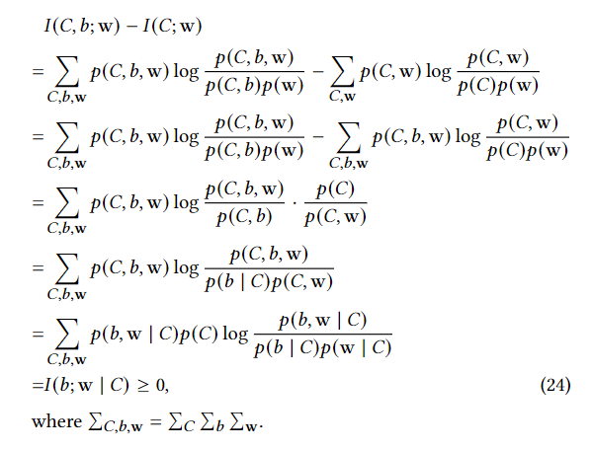
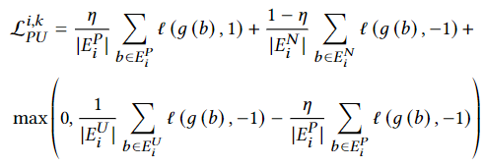

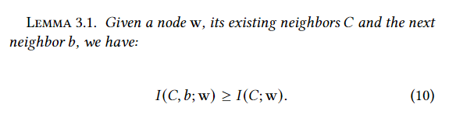
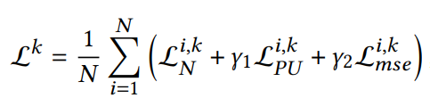
Our Framework: SPGCL
4. A fatal flaw and solutions:
Solutions:
Add penalty ? X
A unified size of neighbors? X
A fixed step K ? X
PU-Learning Loss attracts our attention, and is modified to PUN-Learning Loss
Total Loss:
The model is too greedy to converge, i.e., the processing of maximizing of MI is endless and we can not get an optimized number of neighbors !
Pick & Contrast dynamically, till the unlabeled data runs out, or no more neighbors can achieve the MI threshold.

Slide 8
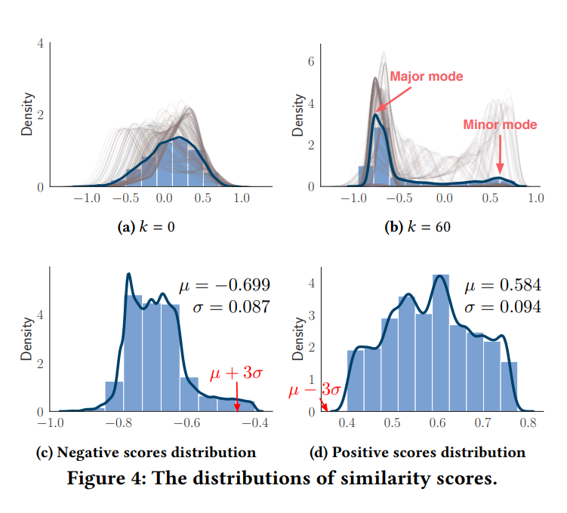
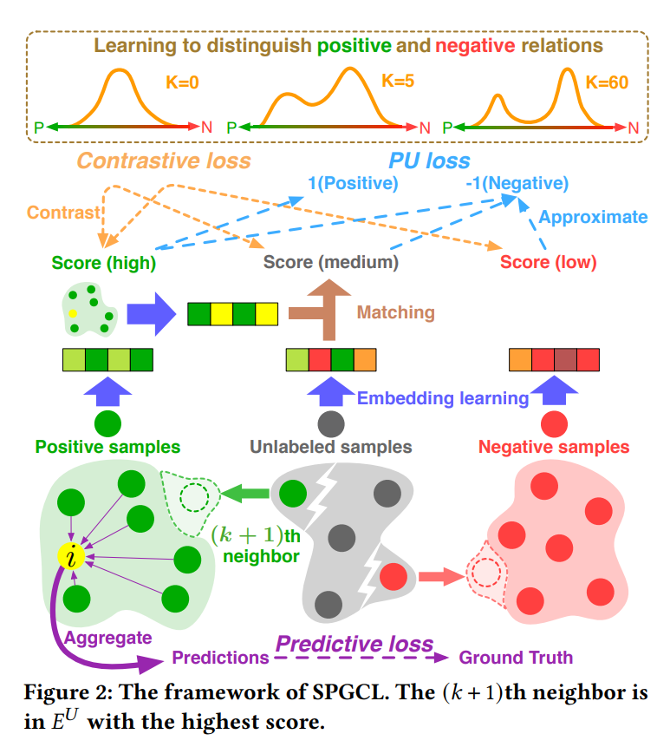
Our Framework: SPGCL
5. How SPGCL works?
Contributions of SPGCL:
A more general framework of InfoNCE, which first proved that multi-step contrastive learning is equal to global optimal.
First to combine CL & PUL, propose a new PUN-L.
A brand-new method for learning adjacency dynamically from graph embedding with stronger theoretical proofs than ever before.
A more flexible framework, incorporating multiple metrics and adaptive threshold.

Slide 9
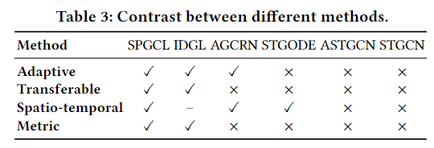
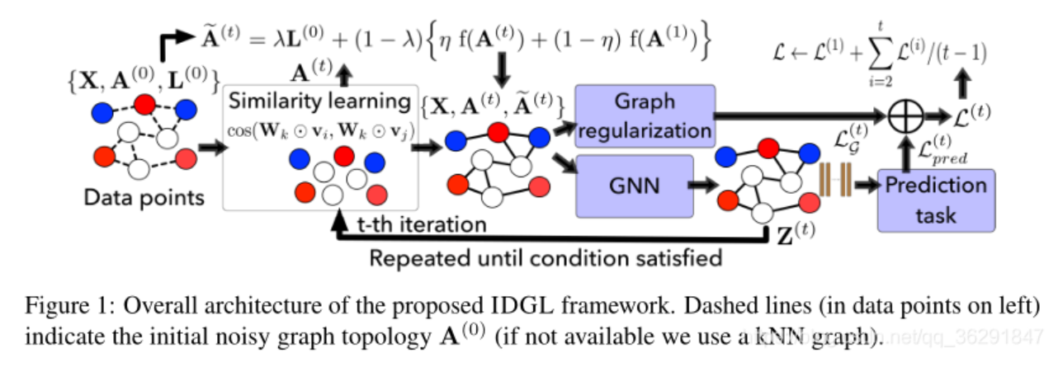
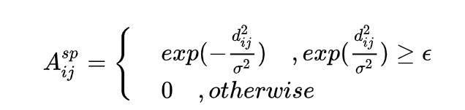
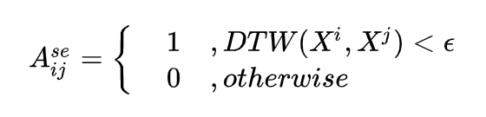
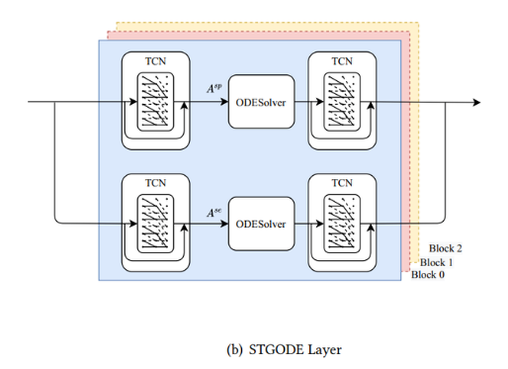
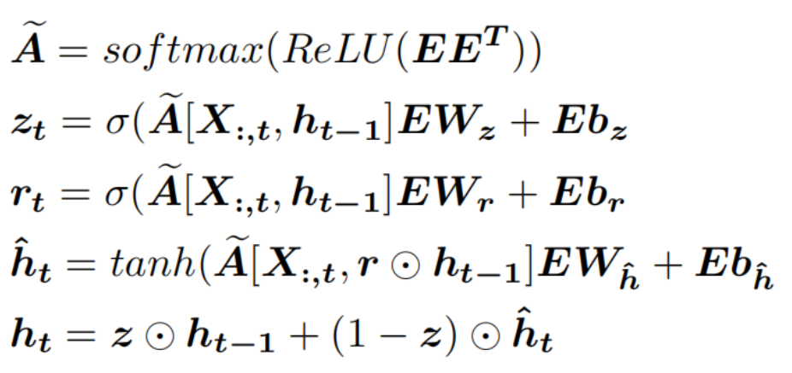
Our Framework: SPGCL
5. Other baseline methods:
STGODE¹:
1. adjacency based on static threshold:
IDGL²:
2. Separate Spatio-Temporal dependency:
AGCRN³:
Not Transferable & Transductive
[1] Zheng Fang, Qingqing Long, Guojie Song, and Kunqing Xie. 2021. Spatial temporal graph ode networks for traffic flow forecasting. In SIGKDD. 364–373.
[2] Yu Chen, Lingfei Wu, and Mohammed Zaki. 2020. Iterative Deep Graph Learning for Graph Neural Networks: Better and Robust Node Embeddings. In NeurIPS. 19314–19326.
[3] Lei Bai, Lina Yao, Can Li, Xianzhi Wang, and Can Wang. 2020. Adaptive graph convolutional recurrent network for traffic forecasting. In NeurIPS. 17804–17815.

Slide 10
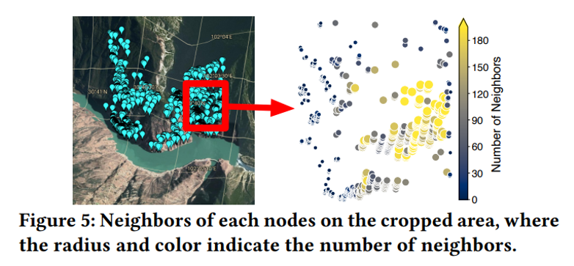
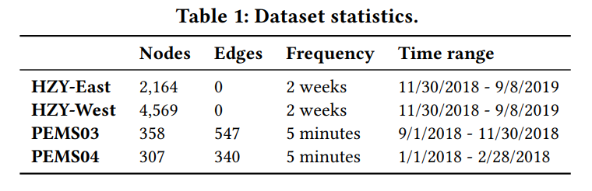
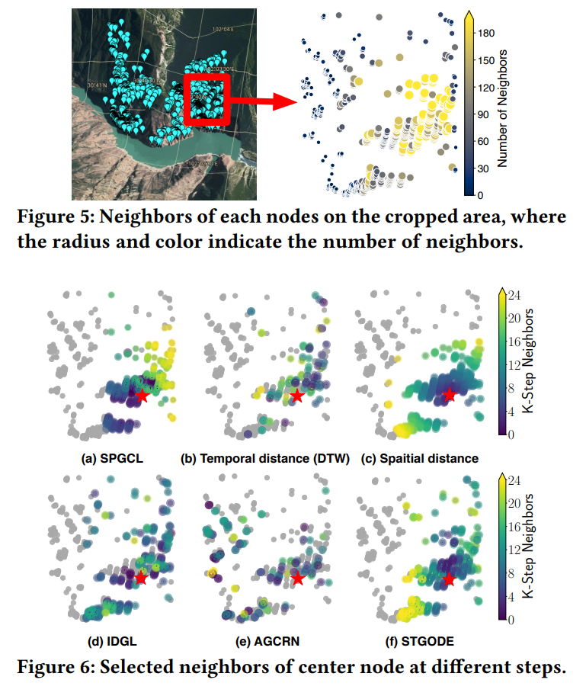
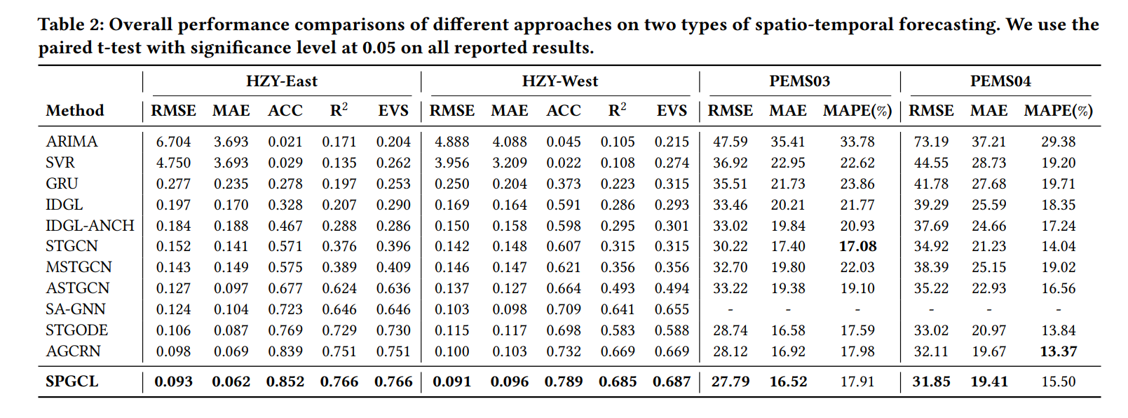
Evaluation
HZY dataset: no predefined edges and massive nodes
PEMS dataset: sparse adjacency and few nodes

Slide 11


Future Work
SPGCL: max
$$I(w; C)$$
node and its neighbors MI
Second proximity: max
$$I(C_{i}; C_{j})$$
node i’s neighbors and node j’s neighbors MI
More higher proximity: max ?

Slide 12
Mining Spatio-Temporal Relations via Self-Paced Graph Contrastive Learning
Thank you!
2022-07-09

