Slide 1
Handwriting Recognition
Team 17
蒋一航 周德程 曹琨 常润泽 郑虞

Slide 2
Introduction
Use Convolutional Neural Networks(CNN) to recognize handwritten English letters.
Goal: Accuracy rate ≥ 90%.

Slide 3
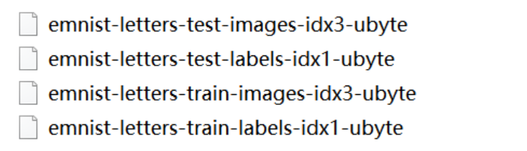
Dataset(MNIST)
The MNIST dataset is from the National Institute of Standards and Technology (NIST). The training set consists of handwritten digits from 250 different people, 50% of which are high school students and 50% from the population. The Census Bureau's worker test set also has the same proportion of handwritten digits.
We only need handwriting letters.

Slide 4
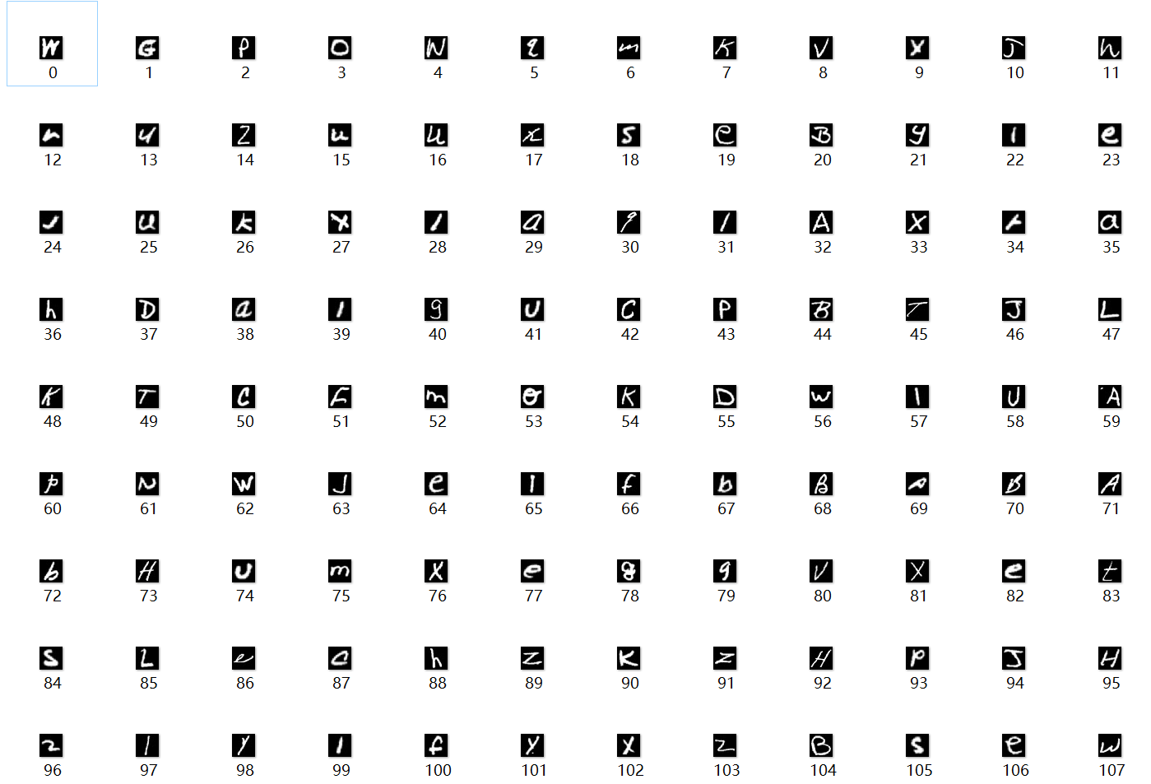
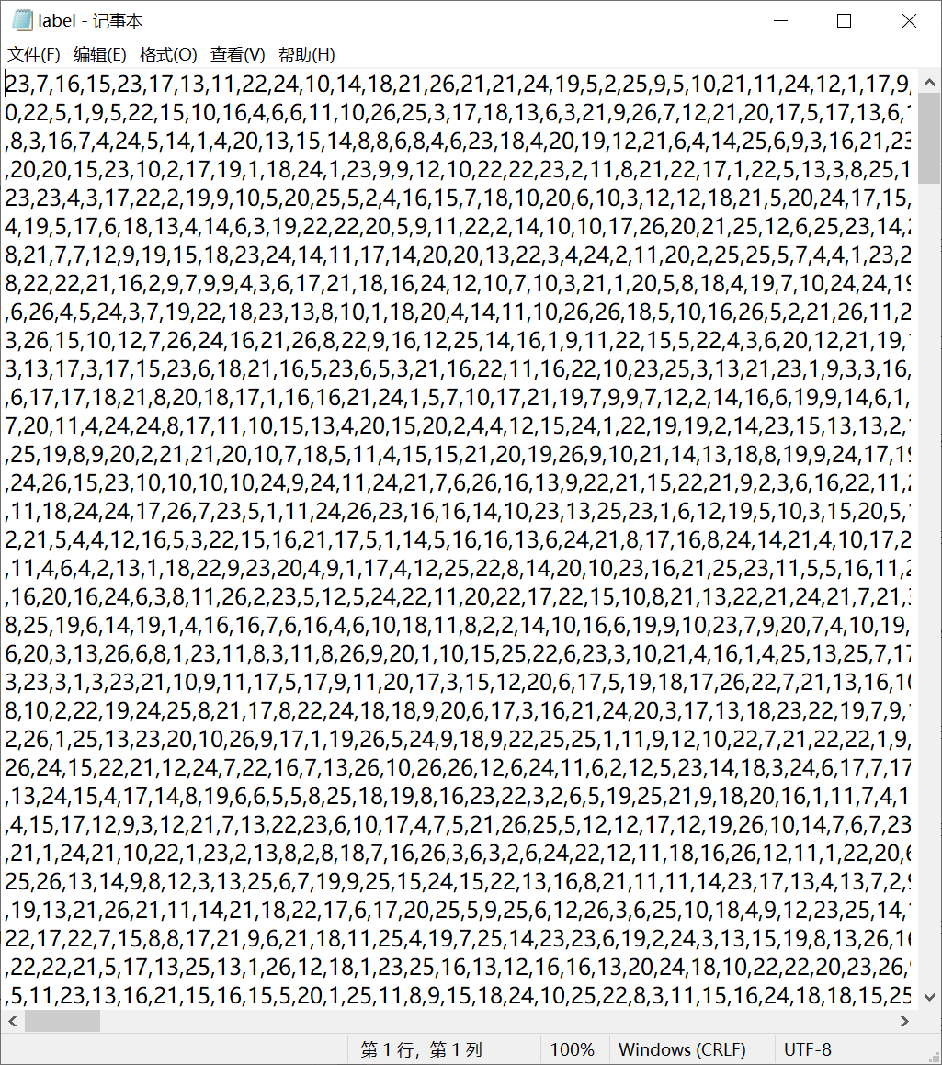
Dataset(MNIST)
After unzip, we get 124,800 handwritten letters with corresponding labels for the train set, and 20,800 handwritten letters with corresponding labels for the test set.
Part of train set
Part of train set label

Slide 5

Dataset(MNIST)
To make the data more convenient to deal with, we further classified the dataset.
ImageFolder(root, transform=None, target_transform=None, loader=default_loader)

Slide 6
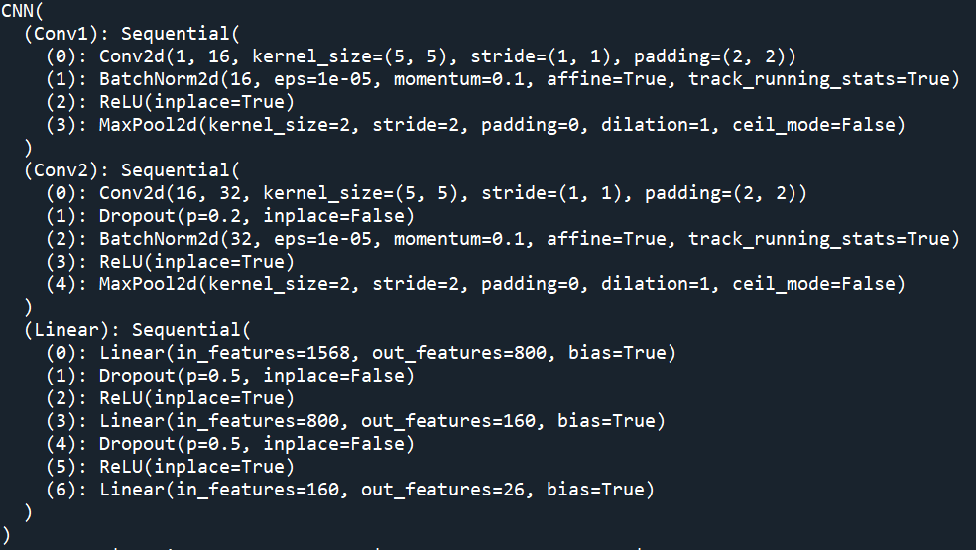
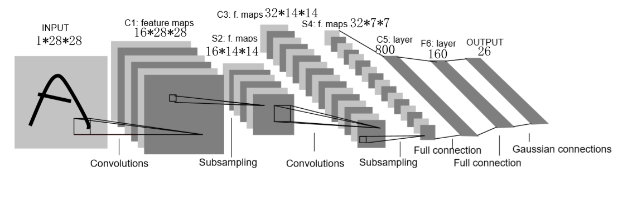
CNN Building
The network used in this training letter recognition is similar to the structure of LeNet-5: a two-layer convolutional network(convolution + pooling) + a three-layer fully connected layer.

Slide 7
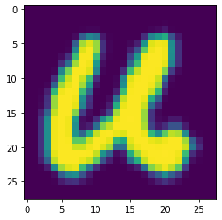
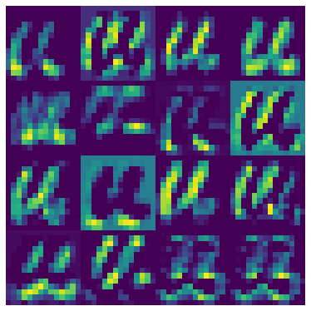
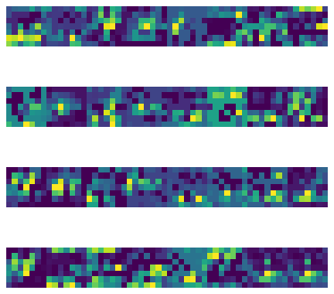
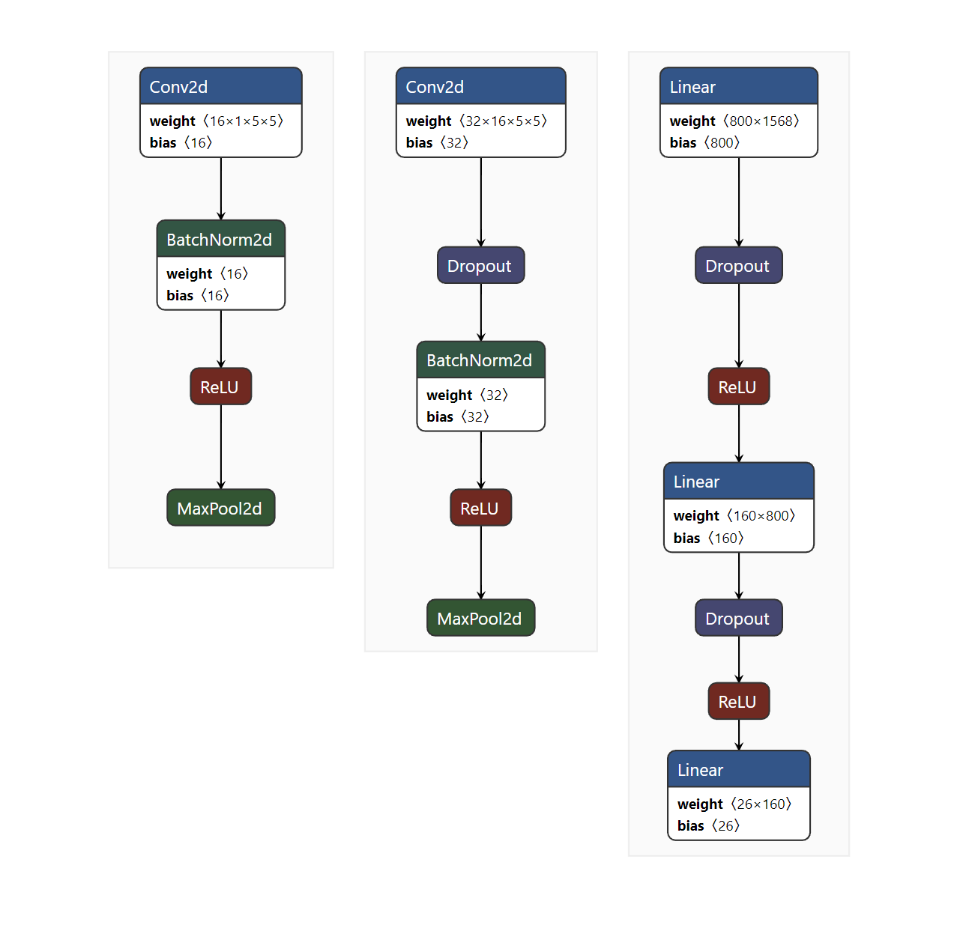

CNN Building
Origin image
After cov1
After cov2
U or u
Fully connected layer
Model of our CNN

Slide 8
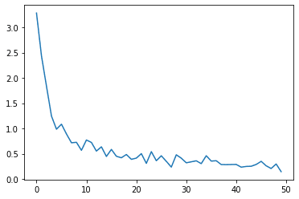
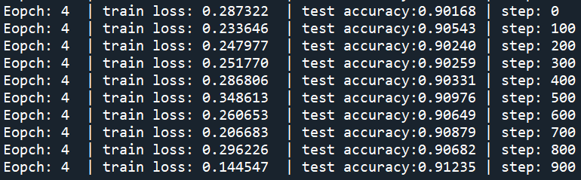
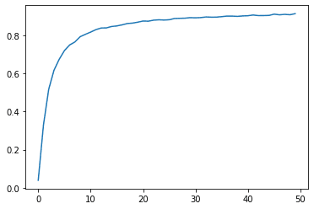
CNN Result
Train loss
Accuracy ≈ 0.91
Test accuracy

Slide 9
External resources
Netron: Model visualization.
Torch: Main Lib to build CNN Model.
PIL.Image and cv2: Dataset image processing.

Slide 10
THANKS

