Slide 1
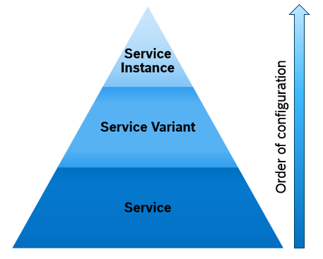
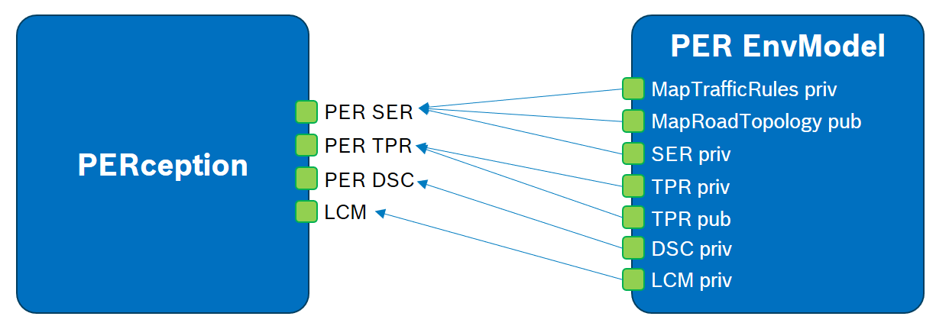
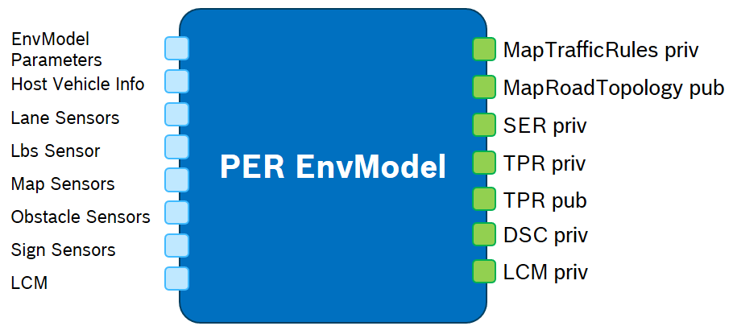
What is a subsystem? What is a service?
Subsystem and Service
Problem space
PERception is a subsystem
Subsystems are used to structure the problem space.
Subsystem cluster system requirements of a certain scope.
A subsystem provides features which are (hard) linked to the system requirements of the scope.
The EnvModel is a service of the subsystem PER
A system service is the smallest sub-unit of a subsystem’s solution that provides a systemic service (“Leistung”) acc. to system requirements.
A service realizes one or more system feature (defined in the SRSD) of one subsystem.
The service may depend on system features from other subsystems. They are also provided as outputs from their services.
A service has to fulfill the DC service requirements. (Known gaps, work in progress!)
Subsystem
Service
Solution space
Service
Exactly the same as Flux ports

Slide 2
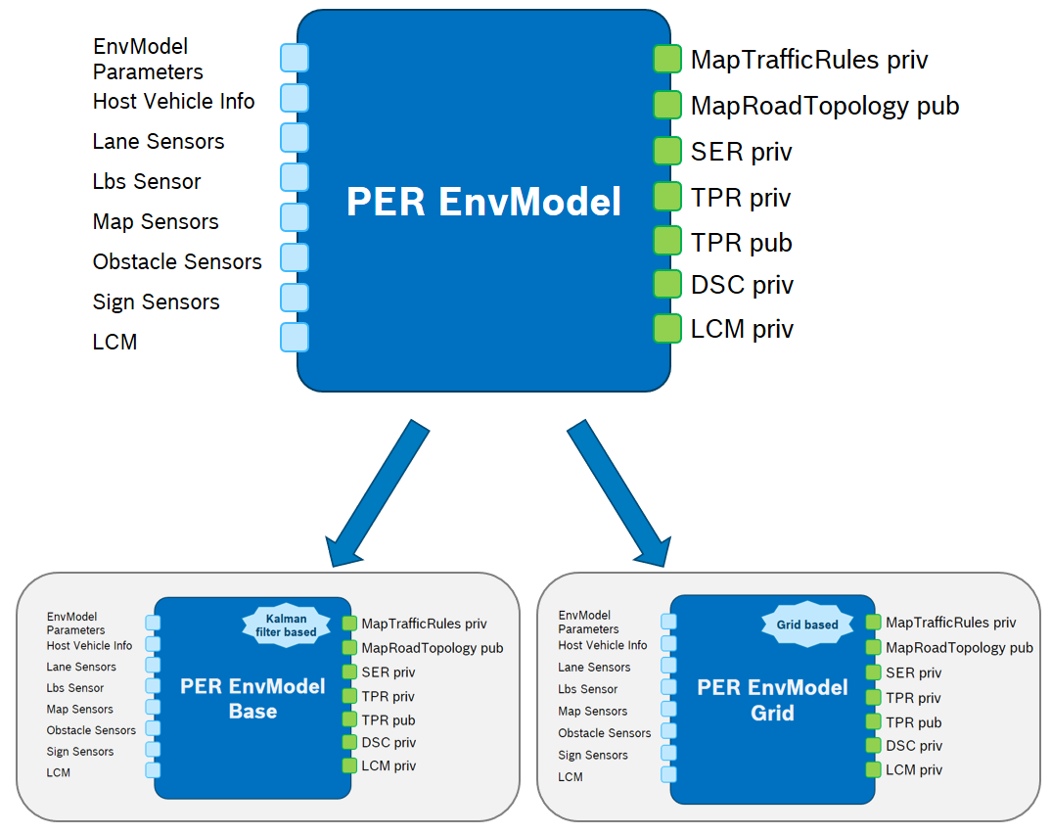
Definition of a service variant
Service Variant
Why do we need service variants? To fulfill different constraints (like resource usage & safety aspects) and/or TPIs.
Definition:
Service variants realize the same set of system feature(s) and depend on the same system features as the service, but differ in their implementation.
Due to differences in implementation, service variants of the same service have different requirements to computing and communication resources (constraints) and can achieve different TPI.
Different service variants of a service have the exact same interfaces (inputs and outputs) both on semantical and on syntactical level.
What does service variant mean on a software level?
Unfortunately ODC did not yet implement software packages. This means that variation on software level is not straight forward and easy to handle especially if you want to re-use large parts of the code of another service variant. → Link to PF
Same inputs and outputs as the service both on semantical and on syntactical level!

Slide 3
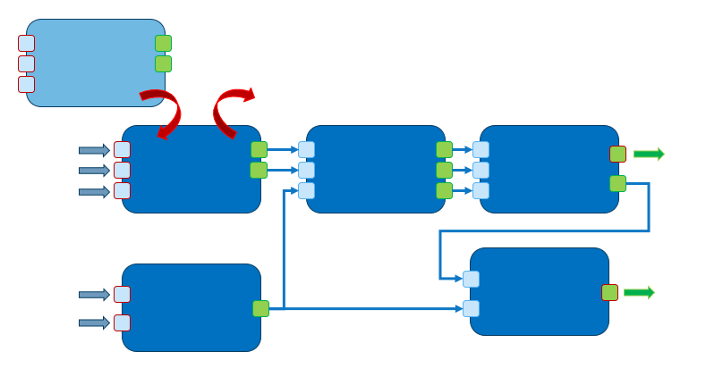
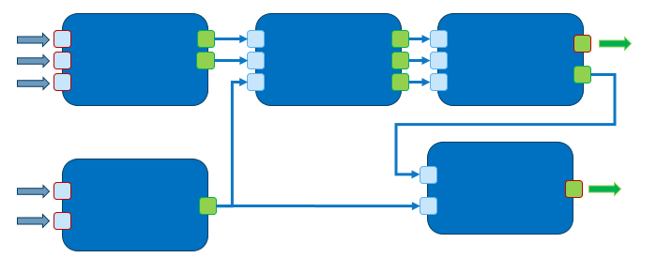
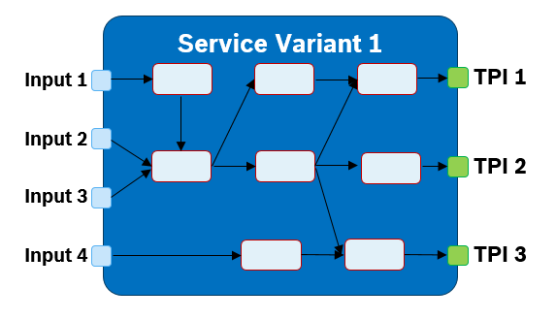
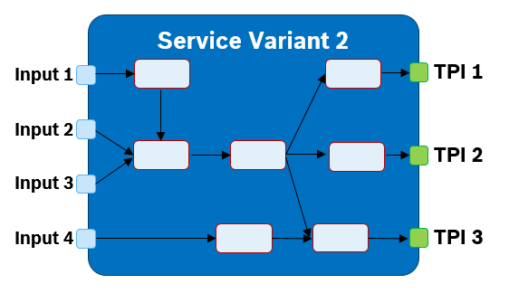
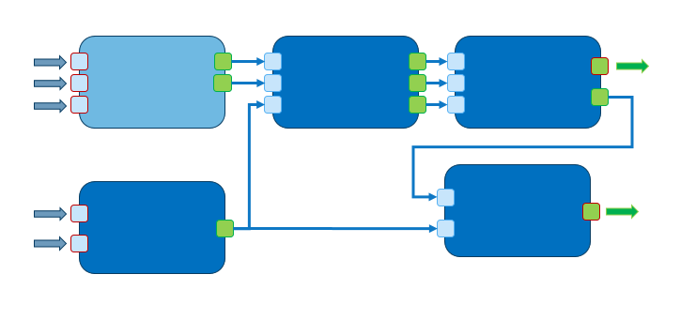
Benefits of a service variant
Service Variant
Service variants have the same interfaces as the service to ease test, benchmarking and plug & play.
If none of these aspects is important, one may as well create a separate new service serving e.g. a reduced feature scope.
Test
By having the same input and output ports on semantical and syntactical level, we can re-use many of our system and service tests.
Benchmarking
By having the same input and output ports on semantical and syntactical level, we can easily benchmark different service variants against each other.
Plug & Play
By having the same input and output ports on semantical and syntactical level, we can easily assess different system configurations

Slide 4
Service Variants
Service Variants
EnvModel base
MapTrafficRules priv
DEP
REP
EimTPR
MapRoadTopology pub
SER priv
In the PER subsystem we currently have six service variants for the EnvModel Service:
EnvModel_Base
EnvModel_ReCr
EnvModel_Reduced
EnvModel_RsbLoc
EnvModel_Grid
EnvModel_NNSensorModels
In the SIT subsystem we currently have two service variants for the SIT-BC Service:
SIT-BC_Develop
SIT-BC_Stable
TPR priv
SPD
RiP
EimRER
TPR pub
DSC priv
SEP
EimSER
LCM priv
EnvModel ReCr
MapTrafficRules priv
DEP
REP
EimTPR
MapRoadTopology pub
SER priv
SPD
RiP
EimRER
TPR priv
TPR pub
DSC priv
SEP
EimSER
LCM priv

Slide 5
Service Variants
Service Variants
EnvModel base
MapTrafficRules priv
DEP
REP
EimTPR
MapRoadTopology pub
SER priv
In the PER subsystem we currently have six service variants for the EnvModel Service:
EnvModel_Base
EnvModel_ReCr
EnvModel_Reduced
EnvModel_RsbLoc
EnvModel_Grid
EnvModel_NNSensorModels
In the SIT subsystem we currently have two service variants for the SIT-BC Service:
SIT-BC_Develop
SIT-BC_Stable
TPR priv
SPD
RiP
EimRER
TPR pub
DSC priv
SEP
EimSER
LCM priv
EnvModel Grid
MapTrafficRules priv
MapRoadTopology pub
Grid based implementation
SER priv
TPR priv
TPR pub
DSC priv
LCM priv

Slide 6
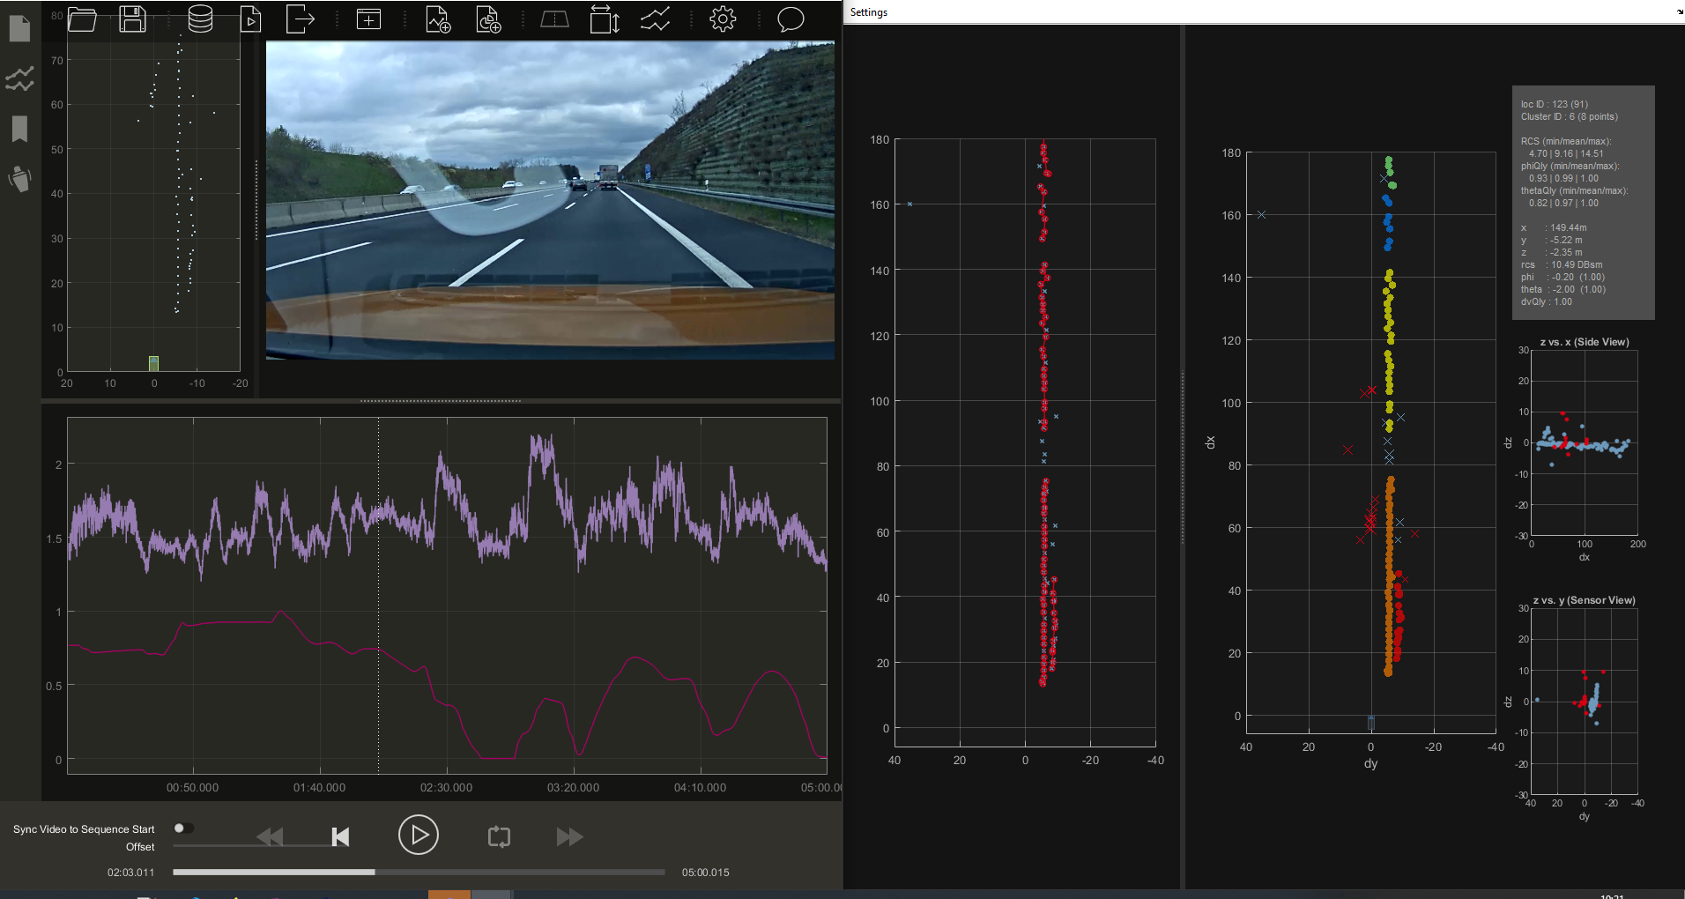
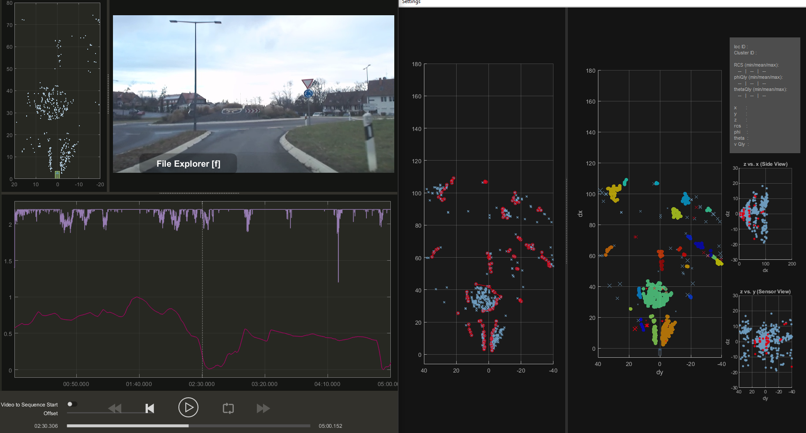
EnvModel RsbLoc
Service Variants
Location based roadside boundary and course estimation
Increase range of both features
Currently, stationary objects are used to generate the roadside boundary. As the number of objects are limited, the range is limited as well.
Handling of more complex situations
Detection of round abouts possible
Detection of smaller roadside structures possible

Slide 7
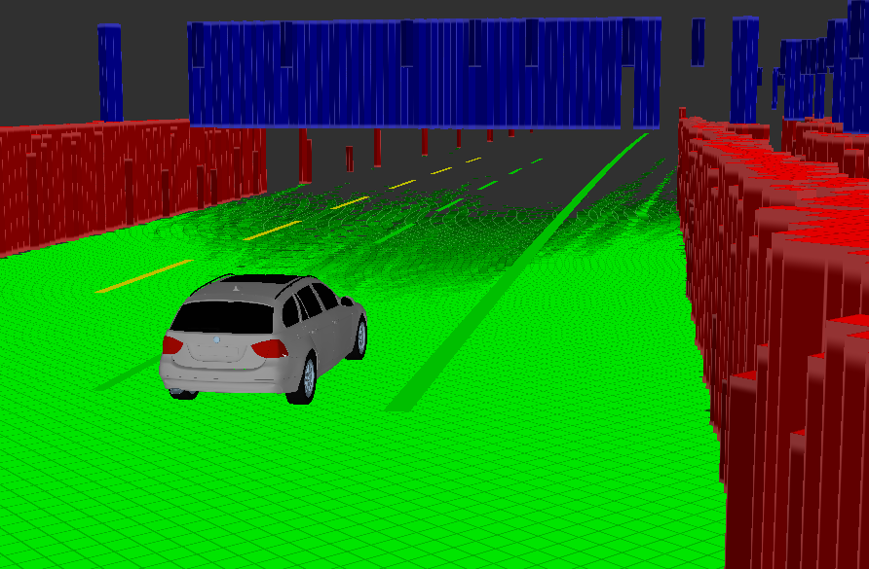
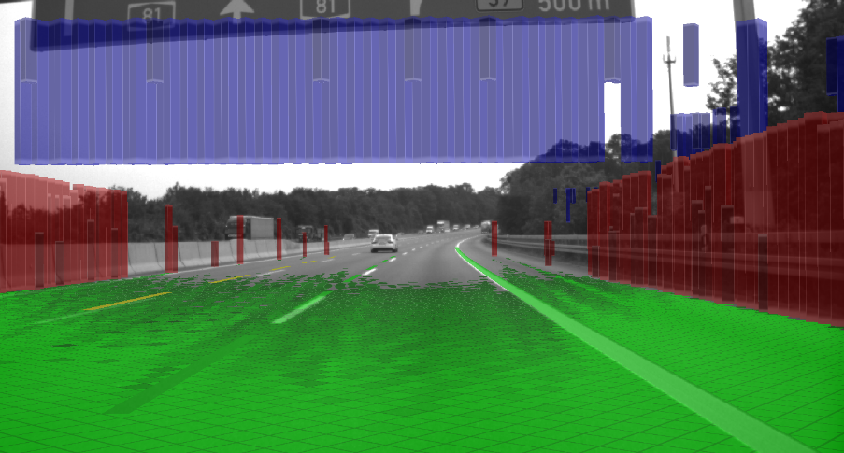
Service Variants
EnvModel Grid
Different grid layers enable distinguishing between freespace, obstacles and underdrivable objects.
Underdrivable objects like traffic signs, bridges only on “upper level”
Nearby obstacles have high probability due to many measurement “hits”
High belief that free cells nearby are in fact free, not so sure in distance
Green = free area
Red = obstacle
Blue = obstacle in upper level grid

Slide 8
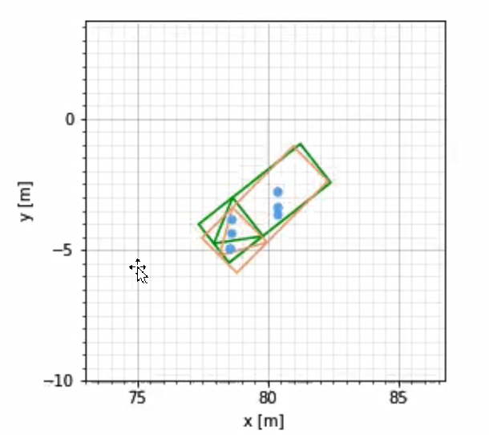
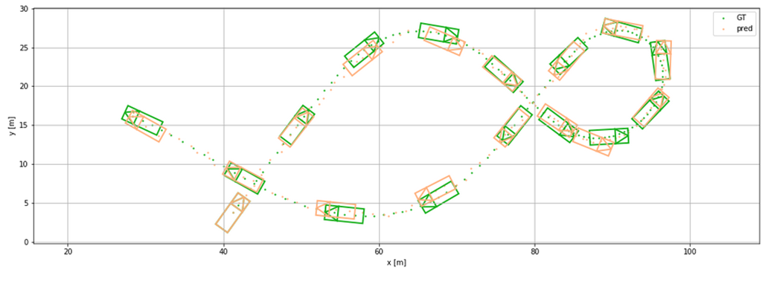
Service Variants
PERCEPTION
EnvModel NNSensorModels
Prediction
Measurements
Association
Tracked Objects
Data-driven measurement models: Implicitly learn object and situation dependency
Tracking Filter
…
Update
DNN
GT
NN
Local Grid representation of radar locations centered around predicted vehicle position
The DNN infers a corrected vehicle position and orientation.
The inferred vehicle position and orientation is used as a measurement for the tracking.

Slide 9
FlexPER
Service Architecture
Service variants ←→ FlexPER
With the FlexPER we would offer an easy mechanism to create service variants via a plug-in.
EnvModel base hull + plug-in
MapTrafficRules priv
DEP
REP
EimTPR
MapRoadTopology pub
SER priv
RiP
EimRER
TPR priv
SPD
TPR pub
DSC priv
SEP
EimSER
LCM priv

Slide 10
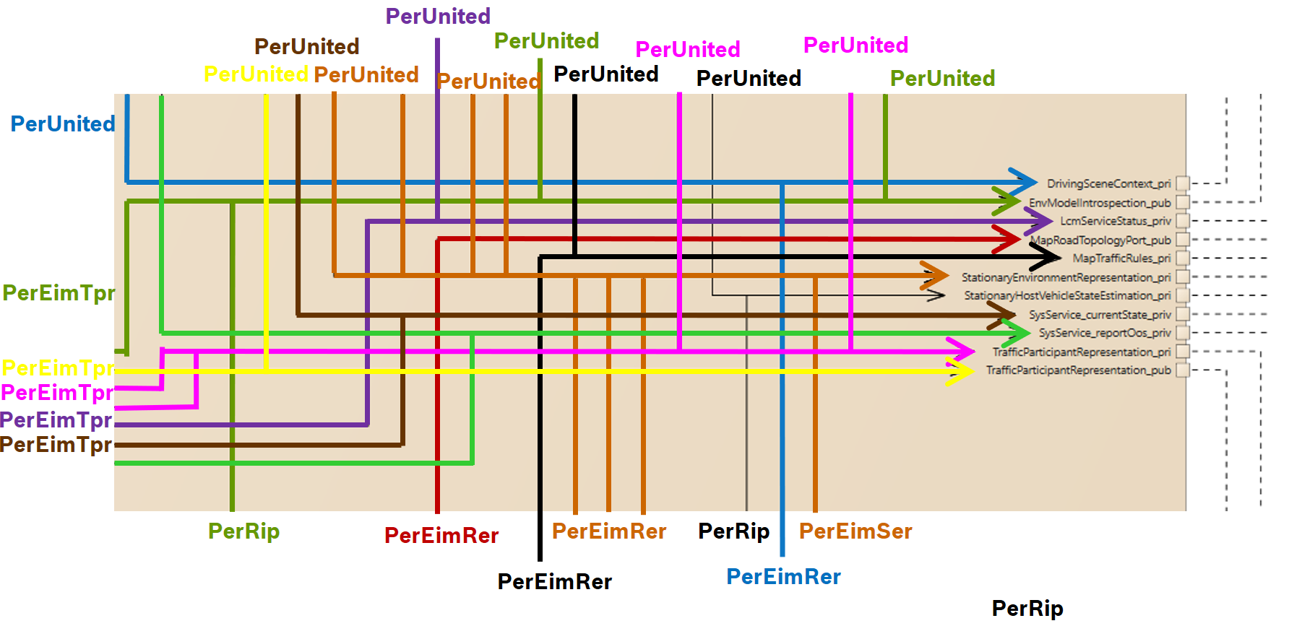
EnvModel Service
Service Architecture
In Flux we have the same output ports as in the functional architecture:
MapTrafficRules_priv → mapTrafficRulesPort_out
MapRoadTopology_pub → mapRoadTopologyPort
TrafficParticipantRepresentation_priv → fusTrajPort_out, hvmTrajectoryPort_out
TrafficParticipantRepresentation_pub → fusObjPort_out
StationaryEnvironmentRepresentation_priv → RoadSignsPort_out, RoadTopology_out, StatFusObjPort_out
→ RoadSideBoundarySegmentPort_out
StationaryHostVehicleStateEstimation_priv → hvmSepPort_out
EnvModelIntrospection_pub → RipIntrospectionPort_out
DrivingSceneContext_priv → TrafficContextsPort_out
LcmServiceStatus_priv: Service state management, OOS, etc
We are working/will soon be working on the blue marked ones

Slide 11
Perception
Look into the service variant EnvModel_Base
SPD
Schedule the order of processing of measurements provided at the input of PER including the corresponding time stamps.
Provide information about the state of the host vehicle at the time of the measurements.
DEP
Create dynamic objects, track dynamic objects - i.e. marked with a unique identifier - and estimate their attributes
Fuse the most important information provided by one or more sensors.
SEP
Create static objects and those of unclear moving state, track those objects and estimate their attributes
REP
Incorporate information from regulatory sensors (e.g. video lanes, maps, car2X)
Estimate the roadside boundaries based on the stationary objects,
Provide road course, lane model and road edges and estimate their attributes. Roadsigns shall be considered.
RIP
Resolve multi-hypothesis approaches as well as inconsistencies between the representations of the stationary (processed in Per::PerSepRunnable), dynamic (processed in Per::PerDepRunnable) and regulatory (processed in Per::PerRepRunnable) environment.

Slide 12
Perception
Look into the service variant EnvModel_Base
SPD
Schedule the order of processing of measurements provided at the input of PER including the corresponding time stamps.
Provide information about the state of the host vehicle at the time of the measurements.
DEP
Create dynamic objects, track dynamic objects - i.e. marked with a unique identifier - and estimate their attributes
Fuse the most important information provided by one or more sensors.
SEP
Create static objects and those of unclear moving state, track those objects and estimate their attributes
REP
Incorporate information from regulatory sensors (e.g. video lanes, maps, car2X)
Estimate the roadside boundaries based on the stationary objects,
Provide road course, lane model and road edges and estimate their attributes. Roadsigns shall be considered.
RIP
Resolve multi-hypothesis approaches as well as inconsistencies between the representations of the stationary (processed in Per::PerSepRunnable), dynamic (processed in Per::PerDepRunnable) and regulatory (processed in Per::PerRepRunnable) environment.
Here are the so called sensor drivers.
If we are talking about required flexibility we are talking about these elements and not about the blue ones. Still also the blue ones belong to the service variant!

Slide 13
Dynamic environment
Sensor dependent
Perception
Create new objects
Predict position of existing objects to timestamp of new data
Classification of object types
Update objects
Update ASIL levels
Radar sensor input
Associate new data to existing objects
Synchronize input data
Merge objects or split objects if beneficial
Locations, Objects
Validate all objects
Remove invalid objects
Video sensor input
Fuse type classification
Output
Objects
Cross plausibilization between stationary and dynamic world
Provide traffic participant representation

