Slide 1
ODC functional chain views

Slide 2
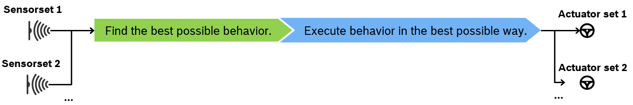
Mission
One Driving Core
Our joint mission:
Using different sensor sets we shall find the best possible “ADAS control behavior”. Then using different actuator sets will shall execute the “ADAS control behavior” in the best possible way.
ADAS Control Behavior is not exactly the same as todays SIT-BS behavior.
Notes:
-

Slide 3
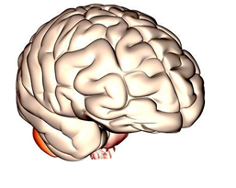

ADAS Control Framework for Driving Vision
ADAS Control Framework is the Bosch Operating System for all future Driver Assistance Systems including HAD. It runs customer specific Apps on various Sensor- and Computing Platforms, abstracting from E/E architecture and includes mainstream reference implementations.
Compatible with
One BBM
System Architecture
Common
Domain Model
One System
Architecture*
One ADAS
Framework
Behaviour
Behaviour
Parking Pilot
Adapt. Cruise Control
Lane Keeping
Support
Highway
Pilot
...
Interpretation
Situation Reaction
Analysis Pattern
Perception
Motion Planning and Control
Acting
Steering System
ADAS Control System ADAS Control Framework*
Perception
Reaction
Target values/ Feedback
Powertrain System
Ego Motion Planning
Motion Control & Actuator Mmgt.
Brake System
Environment Sensing
Computing and
Communication
Resources
Sensor
Radar
Sensor
Video
Sensor
Ultra-sonic
Domain Computer
DASy
Sensor
VMS-x
Sensing
Actuating
Vehicle Environment
Actuators / External Sensors / HMI / C2X IF
* Based on common work and test model and artefacts to product lines, test runs for complete ADAS control framework to avoid braking changes by isolated SW changes
8
© Robert Bosch GmbH 2016. Alle Rechte vorbehalten, auch bzgl. jeder Verfügung, Verwertung, Reproduktion, Bearbeitung, Weitergabe sowie für den Fall von Schutzrechtsanmeldungen.

Slide 4












Functional chain
One Driving Core
Problem break-down along functional chain:
Prepare behavior and Target Path and Trajectory for execution
Provide actor target values to reach target motion based on vehicle kinetic response
Check plausibility of information also by adding a priori knowledge
Evaluate all planned behaviors and provide metrics. Evaluate system uncertainty.
BC-Env.-Mod.
FCT
Sensorset 1
Actuatorset 1
Driver Mod.
Perception
Behaviour and Trajectory
Planning
Behaviour and system
evaluation
Decision on behaviour
Ego Motion Generation
Motion Control & Actuator Mmgt.
Sensorset 2
Ego vehicle Mod.
Actuatorset 2
Aggregate/Collect all measured information about the environment, the driver and the ego vehicle
Plan different behaviors and trajectories – possibly with different level of detail
Decide on a behavior based on the provided metrics
Provides kinematic target state for vehicle
2
© Robert Bosch GmbH 2018. All rights reserved, also regarding any disposal, exploitation, reproduction, editing, distribution, as well as in the event of applications for industrial property rights.
Notes:
Vielleicht cut an der Stelle wo mehr Informationen von VMC in den nächsten Schritt einfließen als von DACore?

Slide 5

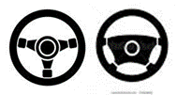








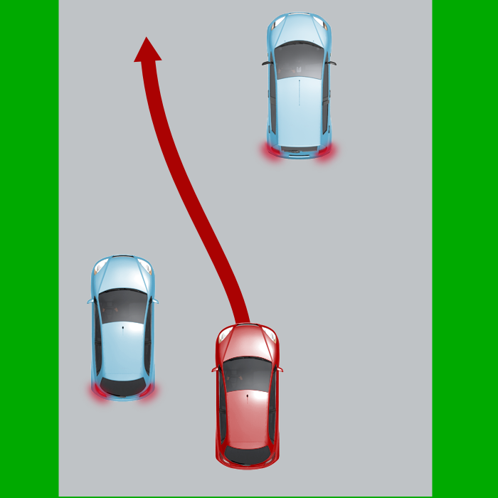

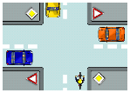
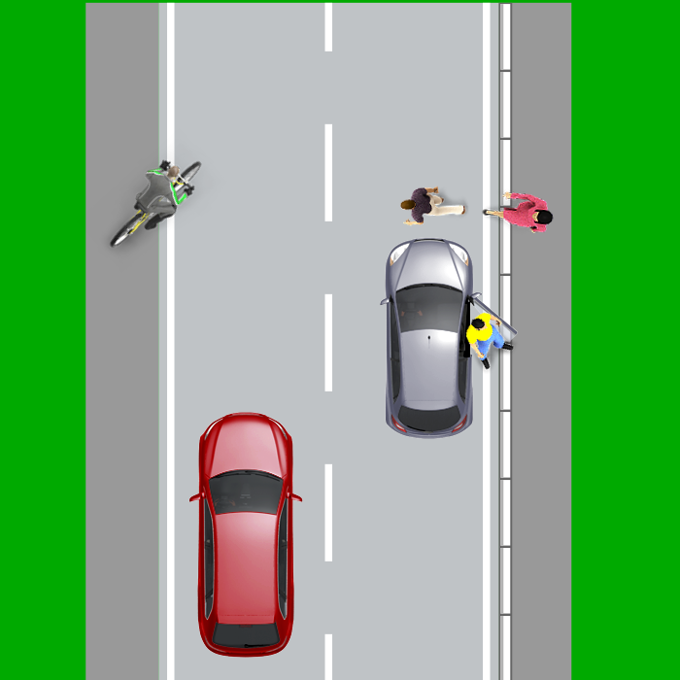



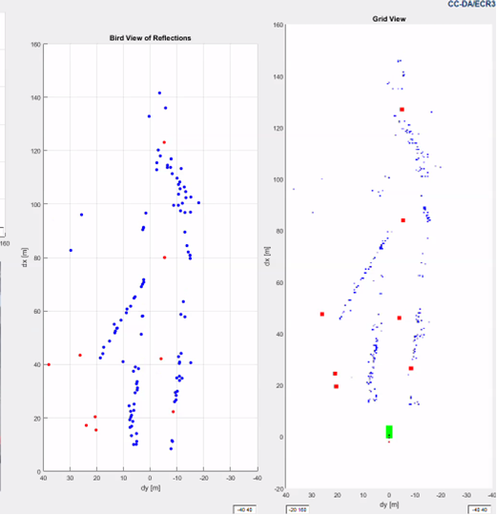








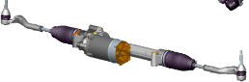
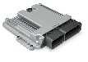
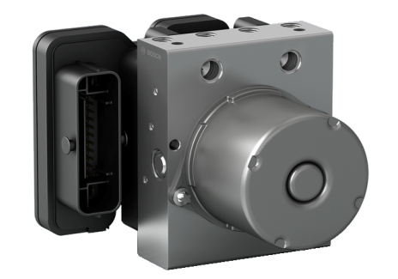
FCT (APP)
ACC
AEB
AEB-VRU
TJA
HWA
TJP
HWP
DiaTester
SVB (APP)
Behavior Evaluation
Safe and Feasible Situation Filters
Math
Behavior Execution
Service Level Coordination
Persistent Data
CCR-NRCS
Host Vehicle
Behavior Simulation
RPM
CCR-US
DSM
System Time
Behaviors
ODC One Driving Core
Diagnostic Information
Mgmt.
CCR-DASy
Dispatching
SIT
Behavior
Strategy
Agents
CCR-Video
Plausibilized
Environment Model
Ego Motion and State Estimation
Communication
Motion Control & Actuator Mgmt.
Ego Motion Planner
CCR-Radar
PER
EGM
MCAM
DDM
CCD
CCR-Radar
Common
Environment Model
CCR-Radar
EMS
Computing
Sensor-specific Object Hypothesizes
ENS-R
ENS-V
ENS-N
ENS-L
ENS-M
STR
PT
Brake
Intern | Chassis Systems Control | Dr. Markus Voss (CC-DA/EYD5) | 18.04.2016

Slide 6
Functional chain
One Driving Core
Sensor characteristics
Radar: Locations (dx, dy, dv, dΦ)
Video: Lines, Textures, …
Ego Motion and State Estimation
Static: Weight, dimensions, …
Dynamic: Velocity, yaw rate, steering angle, track, …
Estimated behaviour strategy wrt intention
- Comfortable driving
Fast moving forward
Accident free driving
Accident severity minimization
confrom to regulations
Economic driving
Driver intention
Plausible estimated status of environment model
Actuator Control
Set point values
Target powertrain / brake force
Target Steering angle
Driver model
Presence, attention, viewing direction, tiredness level, …
Actuator Feedback
Pedal position
Actual powertrain / brake force
Estimated status of environment model
Moving objects: dx, dy, dv, quality
Road border construction: dx, dy, geometry, quality
Driving lane: number of lanes, topology, curve radius, quality
Trajectory Corridor
Reaktion pattern selection & parametrization
Motion Target Values:
- Lat Target yaw rate, curvature
- Long Target ax, jerk limits
EGM (Ego Motion Generation)
MCAM (Motion Control and Actuator Management)
subsystem
subsystem

Slide 7
E&E cuts / interfaces to actuators within ODC scope
One Driving Core
ADAS ECUs
ADAS Control System ODC: One Driving Core
Steering System
Sensor
Ultra-sonic
Str angle
Str angle Str trq
Lbs Sensors
Str trq
Str trq
Sensor
Video
Lane Sensors
Powertrain System
Fx
Fx
Sign Sensors
ax
ax Fx
Sensor
Radar
Obstacle Sensors
Brake System
Trajectory
Trajectory +/-ax +/-Fx
Map Sensors
FCT
+/-ax
+/-ax +/- Fx
Domain Computer
DASy
-ax
-ax - Fx
- Fx
- Fx

