Slide 1
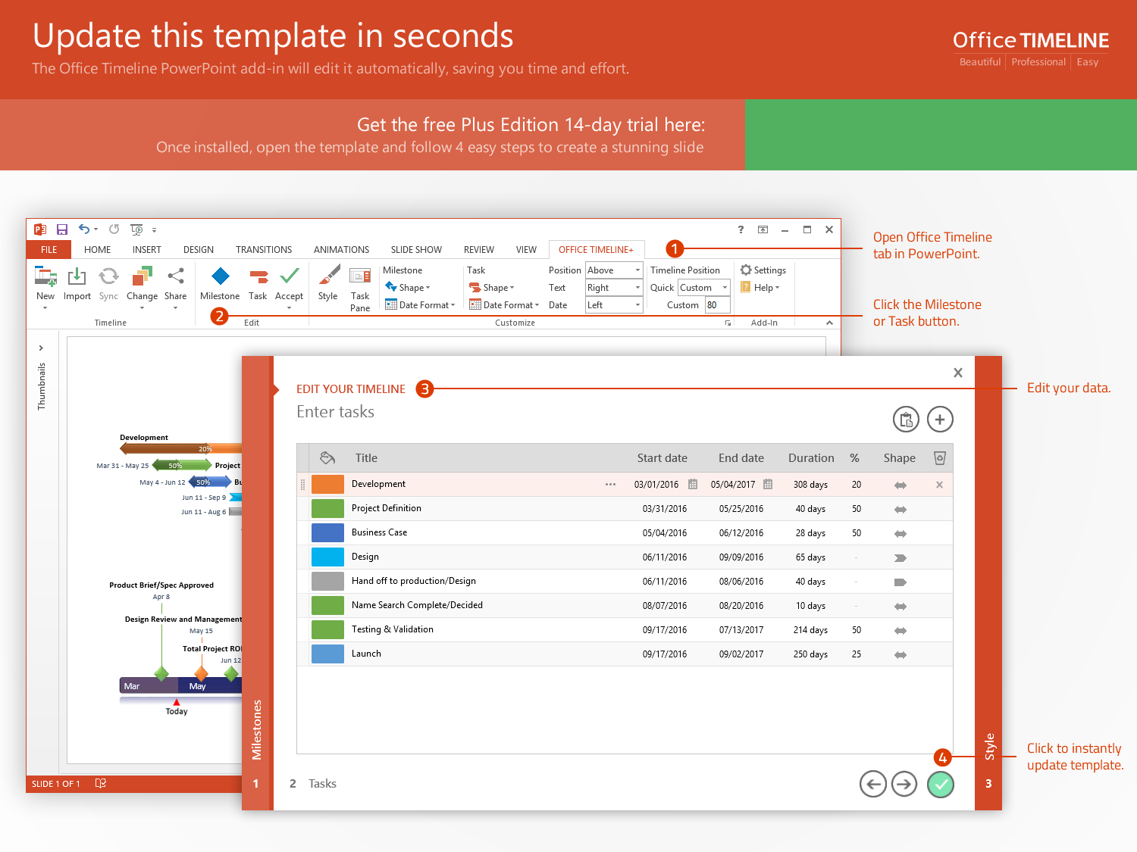
https://www.officetimeline.com/14-days-trial

Slide 2
Milestone 2
Mar 7
Milestone 1
Milestone 3
Milestone 4
Milestone 5
Milestone 6
Mar 14
Jan 10
Jun 29
Oct 20
Nov 30
2018
Jan
Feb
Mar
Apr
May
Jun
Jul
Aug
Sep
Oct
Nov
Dec
2018
40 days
Today
Task 1
Jan 5 - Mar 1
100%
29 days
Task 2
Feb 2 - Mar 14
50%
36 days
Task 3
Mar 14 - May 2
38%
150 days
Task 4
Mar 25 - Oct 20
40%
18 days
Task 4
Oct 21 - Nov 15
25 days
Task 6
Nov 16 - Dec 20

