Slide 1



Enabling ECN over Generic Packet Scheduling
Wei Bai, Kai Chen, Li Chen, Changhoon Kim, Haitao Wu
Notes:
Hello everyone, I am Wei Bai from Hong Kong University of Science and Technology. Today, I am going to talk about our work “Enabling ECN over Generic Packet Scheduling in data center networks”. This is a joint work with Prof. Kai Chen and Li Chen from Hong Kong University of Science and Technology, Dr. Changhoon Kim from Barefoot networks and Dr. Haitao Wu from Microsoft.

Slide 2
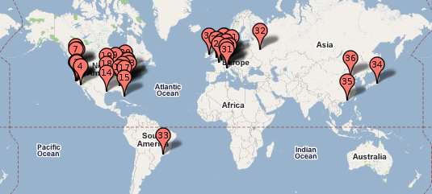
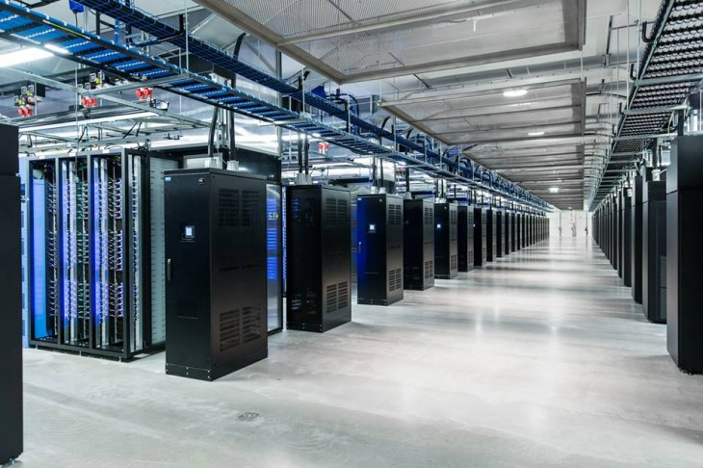
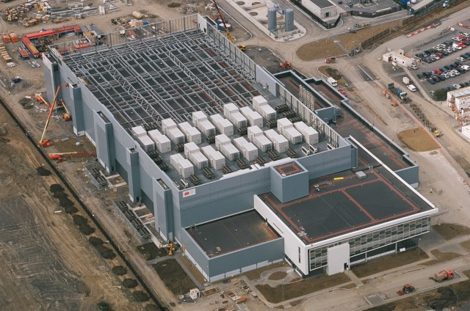
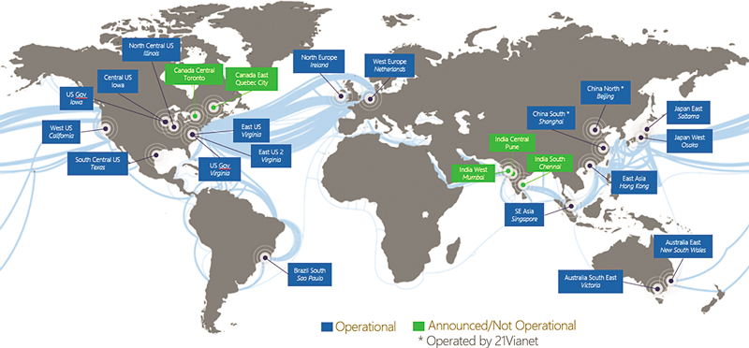
Data Centers Around the World
Google’s worldwide DC map
Facebook DC interior
Microsoft’s DC in Dublin, Ireland
Global Microsoft Azure DC Footprint
Notes:
The context of this work is data center. As we know, to provide services to global users, many data centers have been built around the world.

Slide 3




Inside the Data Center (DC)
Network requirements of applications
Desire low latency for short messages
Desire high throughput for large flows
Notes:
There are many applications running inside the data center. These applications impose diverse requirements to the network. [click] Some applications, such as web search and cache, desire low latency for short messages. [click] Some applications, such as Hadoop and Spark, desire high throughput for large flow transfers. There are also some other applications that may desire both high throughput and low latency.

Slide 4
Inside the Data Center (DC)
Network requirements of applications
Desire low latency for short messages
Desire high throughput for large flows
Network performance improvement
Packet scheduling
ECN-based transport protocols
Combine
ECN = Explicit Congestion Notification
Notes:
To meet such diverse network requirements, network operators typically use following two technologies. [click] The first one is packet scheduling. [click] The second one is ECN-based transport protocols, such as DCTCP. [click] In many production data centers, both technologies are used in combination. [click] Operators classify traffic into several FIFO queues and enforce various packet scheduling algorithms among these queues. But Inside the same queue, operators still need ECN to achieve both high throughput and low latency. As I will show later, such combination using current operation practice may achieve poor network performance. This is the motivation of our work.

Slide 5
Packet Scheduling in Data Centers
Weight
Real-time Services
4
Best-effort Services
2
Round Robin
Background Services
1
Inter-Service Traffic Isolation
Bai et al. (NSDI’16)
Notes:
In current production data centers, many operators use round-robin schedulers to isolate traffic from services.

Slide 6

Packet Scheduling in Data Centers
Strict Priority
Priority
(0, 100KB] Flows
High
(100KB, 10MB) Flows
Medium
Round Robin
(10MB, $∞$) Flows
Low
Flow Scheduling
Bai et al. (NSDI’15)
Notes:
There are also some research efforts, such PIAS and PASE, that uses strict priority to minimize flow completion times.

Slide 7

Packet Scheduling in Data Centers
Strict Priority
Round Robin
Existing fixed-function
switching chips
Notes:
Even though most current fixed-function commodity switching chips, such as Broadom Trident, can only support strict priority and round robin schedulers.

Slide 8

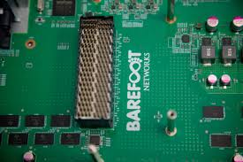
Packet Scheduling in Data Centers
Strict Priority
Round Robin
Future programmable
switching chips
Notes:
But in the near future, we are likely to have more flexible programmable switching chips. These chips may support more powerful packet schedulers.

Slide 9
Packet Scheduling in Data Centers
Programmable
Schedulers
Strict Priority
Round Robin
Push-In-First-Out (PIFO) Queue
A Sivaraman et al. (SIGCOMM’16)
Notes:
Such as PIFO. PIFO can let us program a wide variety of scheduling algorithms. Given this trend, we envision that we will be faced with more sophisticated scheduling algorithms in future data centers. So we wonder

Slide 10
Can we enable ECN for arbitrary packet schedulers in data centers?
Notes:
Can we enable ECN for arbitrary packet schedulers.

Slide 11


ECN/RED without Packet Scheduling
Packets get marked when queue length $Q>K$
$$K$$
mark
don’t mark
Notes:
To answer this question, we start from the simplest case: ECN without packet scheduling. Without packet scheduling, there is only one single FIFO queue at the switch egress port. Note that today’s commodity switches typically adopt RED, random early detection, to perform ECN marking. With RED, packets get ECN marked if the queue length is larger than K, a configurable static marking threshold.

Slide 12

ECN/RED without Packet Scheduling
Packets get marked when queue length $Q>K$
To achieve 100% throughput
Buffer Occupancy
K
Time
Notes:
Obviously, we need to choose a moderate K value to achieve 100% throughput.

Slide 13

ECN/RED without Packet Scheduling
Packets get marked when queue length $Q>K$
To achieve 100% throughput
$$K≥C×RTT×λ$$
Small number of concurrent large flows in DC
M Alizadeh et al. (SIGCOMM’10)
Notes:
In data centers, there is typically a small number of concurrent large flows on the same link. Therefore, we can assume that TCP flows are highly synchronized and the buffer requirement is C times RTT times lambda.

Slide 14

ECN/RED without Packet Scheduling
Packets get marked when queue length $Q>K$
To achieve 100% throughput
$$K≥C×RTT×λ$$
Fixed link capacity
Notes:
In this formula, C is the fixed link capacity.

Slide 15
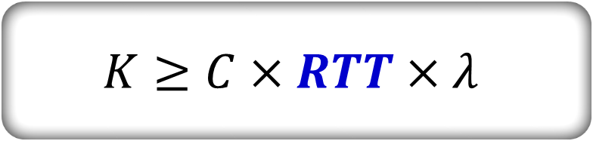
ECN/RED without Packet Scheduling
Packets get marked when queue length $Q>K$
To achieve 100% throughput
$$K≥C×RTT×λ$$
Base round-trip time, relatively stable in DC
Wu et al. (CoNEXT’12)
Notes:
RTT is base round-trip time. It is relatively stable in homogenous data center environment and can be well measured.

Slide 16

ECN/RED without Packet Scheduling
Packets get marked when queue length $Q>K$
To achieve 100% throughput
$$K≥C×RTT×λ$$
Determined by congestion control algorithms
Notes:
Lambda is a fixed parameter determined by the congestion control algorithm at the end host. For example, for regular ECN-enabled TCP, lambda equals to 1.

Slide 17

ECN/RED without Packet Scheduling
Packets get marked when queue length $Q>K$
To achieve 100% throughput
$$K≥C×RTT×λ$$
Standard queue length threshold
A static value in data center environment
Notes:
We call C times RTT times lambda as the standard queue length threshold. Because C is given, RTT is stable and can be well estimated, lambda is also known, we can compute a static value as the standard queue length threshold and

Slide 18

ECN/RED without Packet Scheduling
Packets get marked when queue length $Q>K$
To achieve 100% throughput
static threshold: $K$
Easy to configure at the switch
Notes:
configure this static threshold at the switch to mark packets. As we can see, ECN/RED configuration without packet scheduling is very easy. Now, let’s move to ECN/RED in the packet scheduling context.

Slide 19


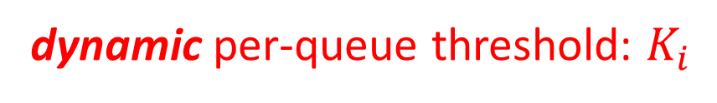
ECN/RED with Packet Scheduling
Each queue is a link with the varying capacity
Ideal ECN/RED solution
Packets should get marked if the length of queue i $Q_{i}>K_{i}=C_{i}×RTT×λ$
dynamic per-queue threshold: $K_{i}$
varying capacity: $C_{i}$
Notes:
When we configure packet scheduling at the switch, each switch port will consist of multiple FIFO queues. Each queue can be regarded as a virtual link with the varying capacity. [click] So we can easily derive the ideal ECN/RED solution with packet scheduling: packets of queue i should get ECN marked if the length of queue i is larger than Ci times RTT times lambda. Note that Ci is the varying capacity of queue i which is affected by both the scheduling policy and traffic demands. [click] Given this, each queue will have a dynamic per-queue threshold Ki.

Slide 20
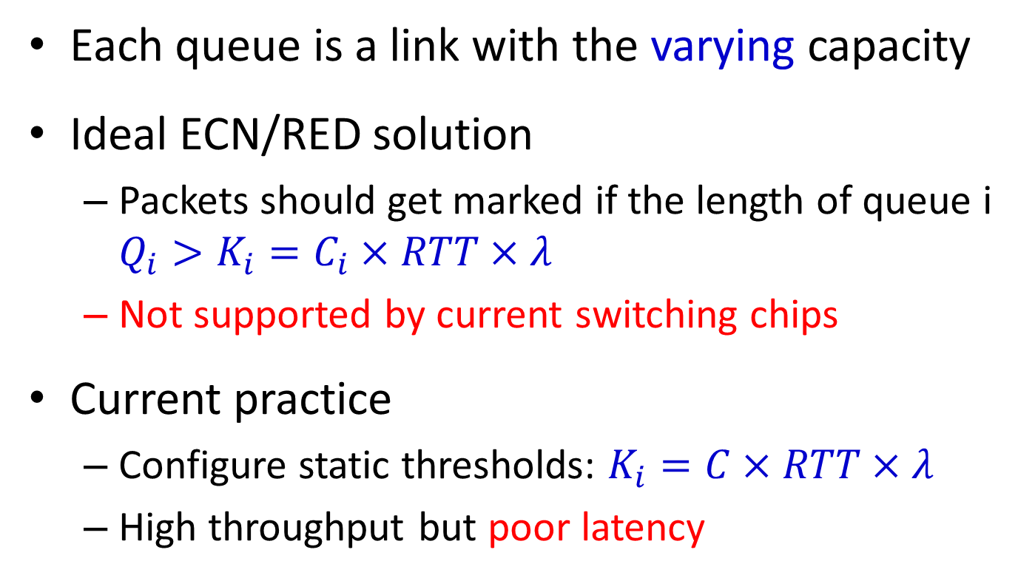
ECN/RED with Packet Scheduling
Each queue is a link with the varying capacity
Ideal ECN/RED solution
Packets should get marked if the length of queue i $Q_{i}>K_{i}=C_{i}×RTT×λ$
Not supported by current switching chips
Current practice
Configure static thresholds: $K_{i}=C×RTT×λ$
High throughput but poor latency
Notes:
However, the ideal ECN/RED solution is not supported by current switching chips because current switching chips can only support static per-queue threshold configuration. [click] Given the varying queue capacity Ci should be no larger than the fixed link capacity C, current operation practice is to configure the standard queue length threshold C times RTT times lambda to all the queues. Such configuration can achieve high throughput but seriously degrade packet latency when many queues are active simultaneously. Given current operation practice is far from enough, we would like to change our switch hardware to implement the ideal ECN/RED solution.

Slide 21
To Implement Ideal ECN/RED Solution
A general way to estimate the queue capacity
Queue capacity = Queue departure rate when the queue keeps non-empty
Leverage the solution from PIE (HPSR’13)
Start measurement when # of bytes in the switch buffer > dq_thresh
Get the rate to drain dq_thresh bytes
Notes:
To implement ideal ECN/RED solution, the key is to find a general approach to estimate the varying queue capacity for arbitrary packet schedulers. [click] Note that the queue capacity equals to the queue departure rate when the queue keeps non-empty. [click] Realizing this, we borrow the solution from PIE to solve this problem. We start a measurement cycle when there are more than dq_thresh bytes in the switch buffer. We get the rate to drain dq_thresh bytes as a sample. In this way, we can ensure that the switch buffer keeps non-empty during a measurement cycle. In this approach, dq_thresh is a key parameter that determines how frequently we start a measurement cycle. We call dq_thresh as the measurement window and we find that there is a tradeoff in the choice of dq_thresh.

Slide 22
Trade-off of Measurement Window
Transmitted packets from queue 1
Transmitted packets from queue 2
Queue 1 and 2 keep non-empty during the transmission
Sequence of packets
Link capacity: C
Notes:
Here I use a simple example to show the this tradeoff. In this example, there are two queues. Packets from queue 1 and queue 2 are marked with blue color and gray color respectively. Both queues keep non-empty during the transmission. Here is the sequence of transmitted packets. Every time queue 1 transmits 4 MTU-sized packets and 2 transmits 4 MTU-size packets and so on.

Slide 23
Trade-off of Measurement Window
Transmitted packets from queue 1
Transmitted packets from queue 2
Queue capacity 1 = Queue capacity 2 = 0.5C
Sequence of packets
Link capacity: C
Notes:
Obviously, both queues should have the same queue capacity, 0.5C. C is the link capacity.

Slide 24
Trade-off of Measurement Window
A too small measurement window
e.g., dq_thresh = 3MTU
Sample rate of queue 1
C
3/7 C
3/7 C
C
Sequence of packets
Link capacity: C
Notes:
If we choose a too small measurement window, say 3MTU, let’s see what happens to the rate measurement of queue 1, the blue one. [click] In the first measurement window …….. [click] In the second measurement window ……… [click] In the third measurement window ………… [click] In the fourth measurement window ……. As we can see, sample rates oscillate a lot around the actual departure rate 0.5C. Even if we use moving average to smooth these sample rates, we still get a over-estimated smooth rate.

Slide 25
Trade-off of Measurement Window
A too small measurement window
Degrade measurement accuracy
Sample rate of queue 1
C
3/7 C
3/7 C
C
Sequence of packets
Link capacity: C
Notes:
So our observation is that a too small measurement window degrades the measurement accuracy.

Slide 26
Trade-off of Measurement Window
A too small measurement window
Degrade measurement accuracy
A too large measurement window
e.g, dq_thresh = 20MTU
Sequence of packets
Link capacity: C
Notes:
If we use a too large measurement window, say 20MTU, we can mitigate the inaccuracy of the rate measurement.

Slide 27
Trade-off of Measurement Window
A too small measurement window
Degrade measurement accuracy
A too large measurement window
Cannot efficiently capture the dynamic changes
Sequence of packets
Link capacity: C
Notes:
But a too large measurement window is too slow to capture the change of the queue capacity. Moreover, a too large dq_thresh also increases the switch queueing delay.

Slide 28
Trade-off of Measurement Window
A too small measurement window
Degrade measurement accuracy
A too large measurement window
Cannot efficiently capture the dynamic changes
Rate measurement is non-trivial
Notes:
Therefore, we need to choose a moderate measure window to balance above trade-offs. The ideal measure window is determined by many factors, such as the packet size, scheduling policy, and even the traffic pattern. It’s very hard to find an universal value that can work for all scenarios. This increases the burden of network operators. So do we have to measure the rate?

Slide 29

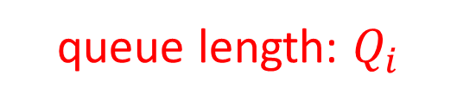

Another View
Ideal ECN/RED solution
Packets should get marked if $Q_{i}>C_{i}×RTT×λ$
queue length: $Q_{i}$
varying capacity: $C_{i}$
Notes:
Maybe we can think the problem from another perspective. [click] Based on the ideal ECN/RED solution, an enqueued packet gets marked if Qi is larger than Ci times RTT times lambda.

Slide 30

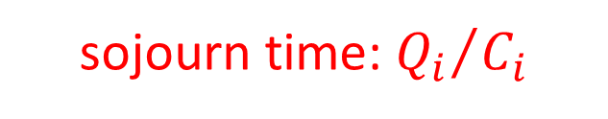
Another View
Ideal ECN/RED solution
Packets should get marked if ${Q_{i}}/{C_{i}}>RTT×λ$
sojourn time:${{ Q}_{i}}/{C_{i}}$
varying capacity: $C_{i}$
Notes:
If we move Ci to the left of the formula, the packet should get marked if Qi over Ci is larger than RTT times lambda. Qi over Ci is essentially the queue delay or sojourn time that the packet will experience at the switch.

Slide 31
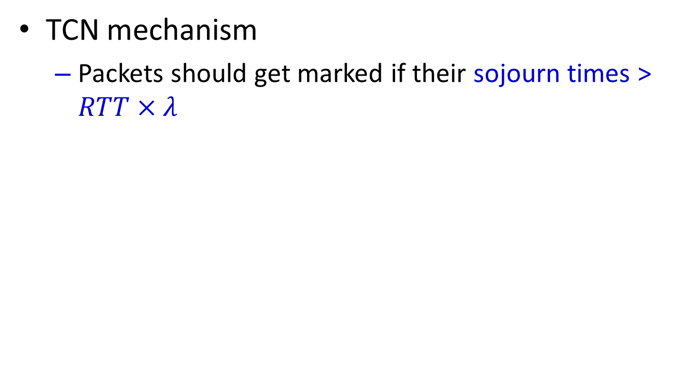
TCN
TCN mechanism
Packets should get marked if their sojourn times > $RTT×λ$
Time-based Congestion Notification
Notes:
So we have packets should get marked if their sojourn times are larger than RTT times lamba. This is the key idea of TCN, time-based congestion notification.

Slide 32
TCN in Detail
Sojourn time measurement
Enqueue: attach a metadata to each packet to store the enqueue time
Teq
Notes:
We now introduce TCN in detail. TCN has two components. The first one is sojourn time measurement. [click] When a packet is enqueued, we attach a metadata to each packet to store the current system time.

Slide 33
TCN in Detail
Sojourn time measurement
Enqueue: attach a metadata to each packet to store the enqueue time
Dequeue: calculate sojourn time
sojourn time = now - Teq
Teq
Notes:
At the dequeue side, we calculate the sojourn time for each packet using current system time minus enqueue timestamp.

Slide 34
TCN in Detail
Sojourn time measurement
Enqueue: attach a metadata to each packet to store the enqueue time
Dequeue: calculate sojourn time
2B-long metadata is enough for DC
Notes:
Given data center networks have very low latency, our analysis demonstrates that 2B-long metadata is enough for data center.

Slide 35
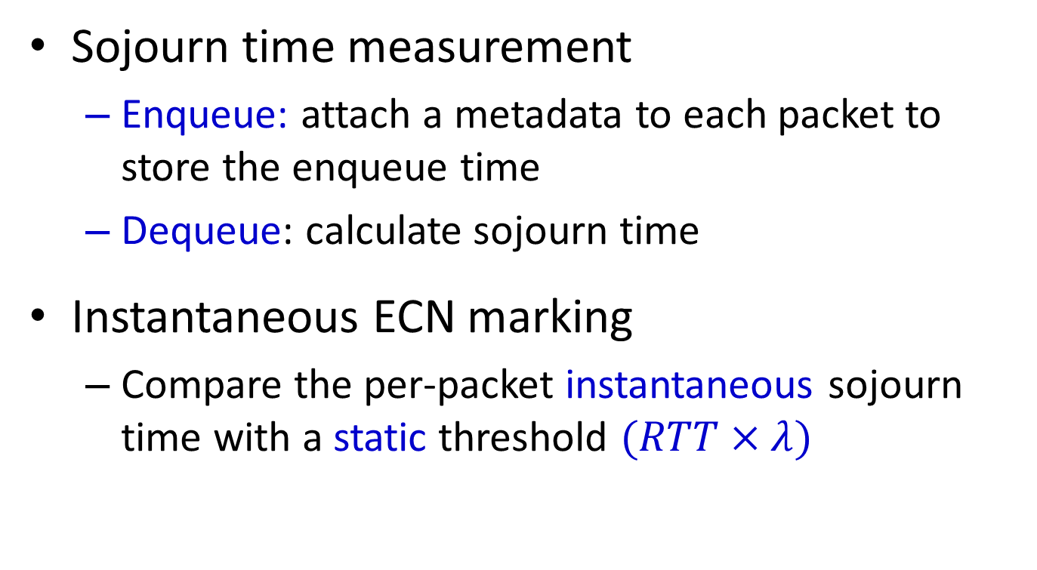
TCN in Detail
Sojourn time measurement
Enqueue: attach a metadata to each packet to store the enqueue time
Dequeue: calculate sojourn time
Instantaneous ECN marking
Compare the per-packet instantaneous sojourn time with a static threshold $(RTT×λ)$
Stateless Data Plane Algorithm
Notes:
After getting the sojourn time, TCN compares the per-packet instantaneous sojourn time with a static threshold to mark packets. TCN does not create or modify any state in the data plane. [click] Therefore, it is essentially a stateless data plane algorithm which is cheap to implement in hardware.

Slide 36
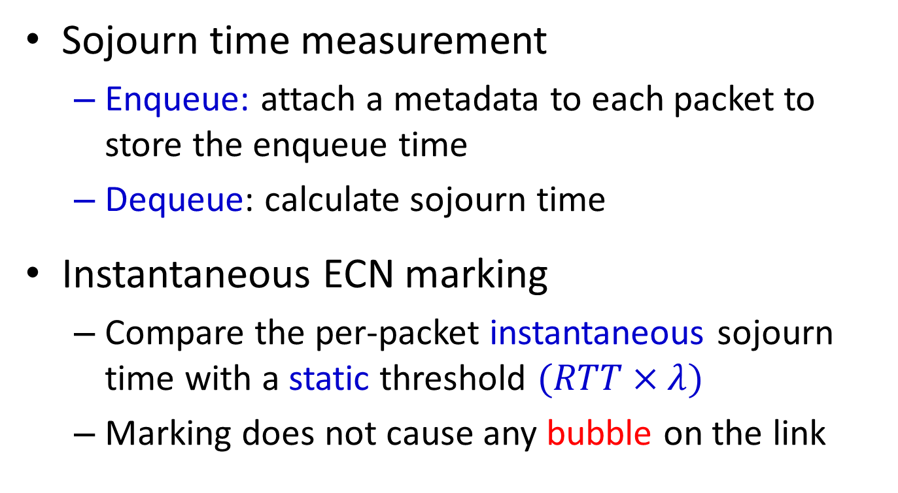
TCN in Detail
Sojourn time measurement
Enqueue: attach a metadata to each packet to store the enqueue time
Dequeue: calculate sojourn time
Instantaneous ECN marking
Compare the per-packet instantaneous sojourn time with a static threshold $(RTT×λ)$
Marking does not cause any bubble on the link
Notes:
Moreover, TCN only modifies several bits at the IP header to mark packets rather than drop packets. Therefore, it does not cause any bubble on the link which may degrade the link utilization.

Slide 37
TCN vs CoDel
Advantages of TCN
Stateless: cheaper to implement in hardware
Instantaneous: faster reaction to busty traffic
Notes:
You may wonder the differences between TCN and CoDel, a sojourn-time AQM for Internet. The key idea of CoDel is tracking the minimum sojourn time over a varying time window to mark packets. Compared to CoDel, we think TCN has two advantages. First, TCN is cheaper to implement in hardware due to its stateless fashion. Second, TCN can deliver faster reaction to bursty traffic in data centers, such as incast pattern.

Slide 38
TCN vs CoDel
Advantages of TCN
Stateless: cheaper to implement in hardware
Instantaneous: faster reaction to busty traffic
Simplicity of TCN
Unique Characteristics of Data Centers
Notes:
TCN is a specialized AQM for data center environment rather than a general approach. So its simplicity is mainly from unique characteristics of data center environments.

Slide 39
TCN vs CoDel
Advantages of TCN
Stateless: cheaper to implement in hardware
Instantaneous: faster reaction to busty traffic
Simplicity of TCN
Small number of concurrent large flows
Relatively stable RTTs
Prior knowledge of transport at the end host
Notes:
In data centers, we have a small number of concurrent large flows which are usually synchronized. Base RTT is relatively stable and can be well measured. Operators have the prior knowledge of transport protocol at the end host. Therefore, we can compute a static sojourn time threshold to mark packets instantaneously.

Slide 40
Testbed Evaluation
TCN software prototype
Linux qdisc kernel module on a multi-NIC server
Testbed setup
9 servers are connected to a software switch
End-hosts use DCTCP as the transport protocol
ECN schemes compared
Per-queue RED with the standard threshold
CoDel
Notes:
We have implemented TCN as a qdisc kernel module running on a multi-NIC server to emulate the switch hardware. We connect 9 servers to this software switch and use DCTCP as the transport protocol. We mainly consider two schemes: per-queue ECN/RED with the standard threshold, current operation practice, and CoDel, a sojourn-time based AQM for Internet.

Slide 41

Static Flow Experiment
1 flow (500Mbps)
SP/WFQ
1 flow
Q1
high prio
Q2
w=1 (low)
Q3
w=1 (low)
4 flows
Notes:
We start from a simple static flow experiment. In this experiment, there are 3 senders sending traffic to the same receiver. First, sender 1 starts a long-lived flow with the demand of 500Mbps. Then sender 2 starts a long-lived flow. Finally, sender 3 starts 4 long-lived flows. Flows from sender 1, sender 2 and sender 3 are classified into queue 1, queue 2 and queue 3, respectively. [click] At the switch, we configure a hybrid SP/WFQ scheduling policy. Queue 1 has a strict high priority while queue 2 and 3 have the same weight in the low priority.

Slide 42
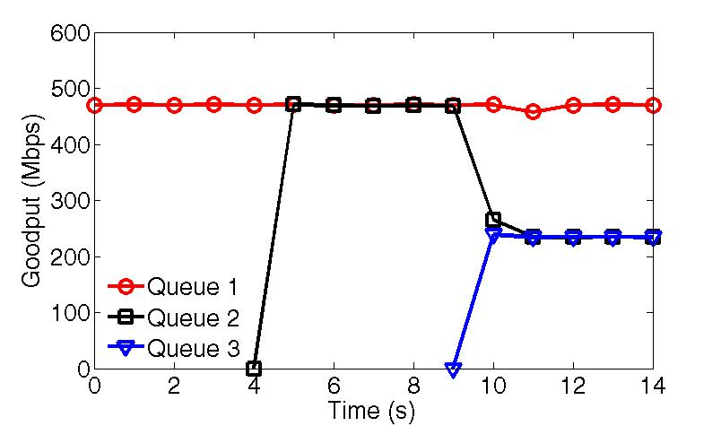
Static Flow Experiment
TCN preserves the scheduling policy
Notes:
This figure gives aggregate goodputs of three queues. Queue 1 maintains around 500Mbps goodput due to its strict high priority. When queue 2 and queue 3 are both active, both queues fairly share the remaining 500Mbps bandwidth regardless of their different numbers of flows. [click] This indicates that TCN strictly preserves the scheduling policy.

Slide 43
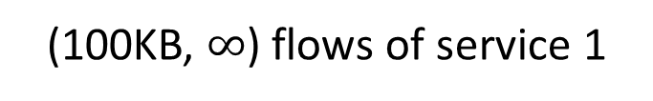
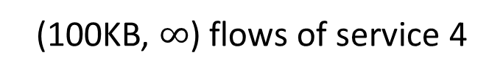

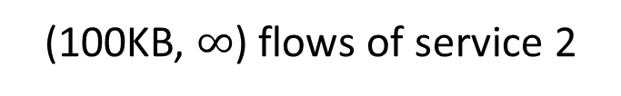
Dynamic Flow Experiment
8 senders to 1 receiver (web search workload)
SP/WFQ scheduling policy at the switch
Traffic
SP/WFQ
(0, 100KB] flows of all services
high prio
(100KB, $∞$) flows of service 1
w=1 (low)
(100KB, $∞$) flows of service 2
w=1 (low)
(100KB, $∞$) flows of service 3
w=1 (low)
(100KB, $∞$) flows of service 4
w=1 (low)
Notes:
We also generate realistic traffic based on a web search workload to evaluate the performance of TCN. [click] Again, we configure SP/WFQ at the switch. There are 5 queues in total. Queue 1 has a strict high priority while the rest 4 queues have the equal weight in the low priority. [click] We classify small flows that are smaller than 100KB into queue 1. For the rest of flows, we classify them into 4 queues in the low priority based on their services.

Slide 44
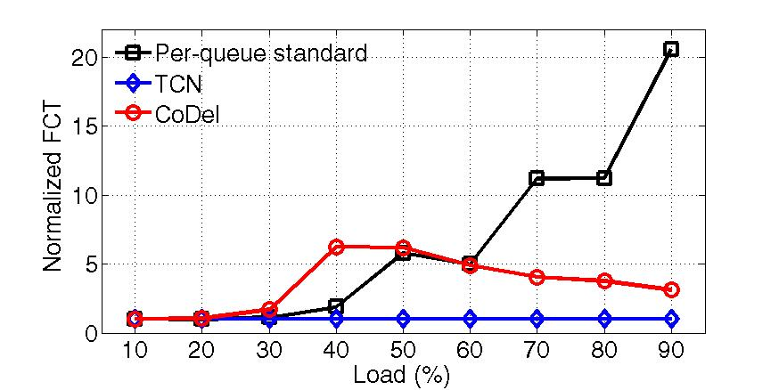
99th FCT of Small Flows (<100KB)
TCN maintains the low buffer occupancy
Notes:
This figure gives the 99th percentile FCT of small flows achieve by three schemes. Even though all small flows finish in the high priority queue, they can still experience packet drops as the buffer is shared by all the queues. As we can see, TCN outperforms the other two schemes. [click] This indicates that, with instantaneous sojourn time based ECN marking, TCN can efficiently maintain the low buffer occupancy, even at high loads.

Slide 45
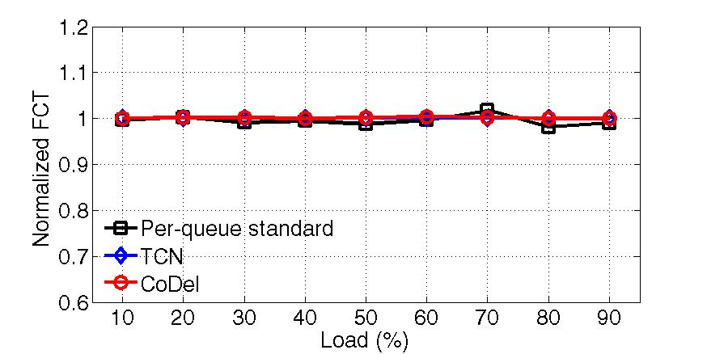
Realistic Traffic: Large Flows (>10MB)
TCN achieves high throughput
Notes:
This figure gives the FCT of large flows. All three schemes achieve very similar performance. [click] This indicates that TCN achieves high throughput in practice.

Slide 46
Conclusion
TCN: a simple ECN solution for data centers
Use sojourn time as the congestion signal (CoDel)
Perform instantaneous ECN marking (DCTCP)
Code: http://sing.cse.ust.hk/projects/TCN
Next step: TCN in programmable hardware

Slide 47
Thanks!

Slide 48
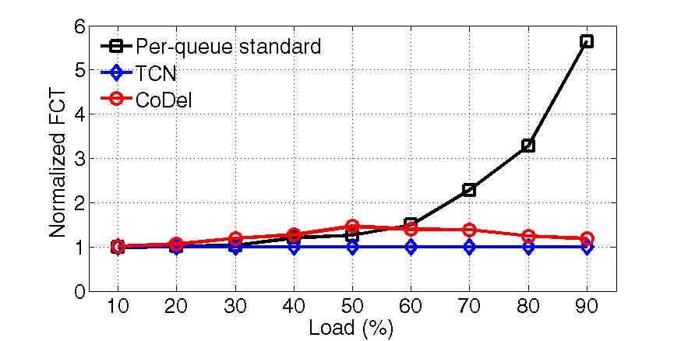
Average FCT of Small Flows (<100KB)

