Slide 1
Zhen Jiang
May 13, 2020

Slide 2
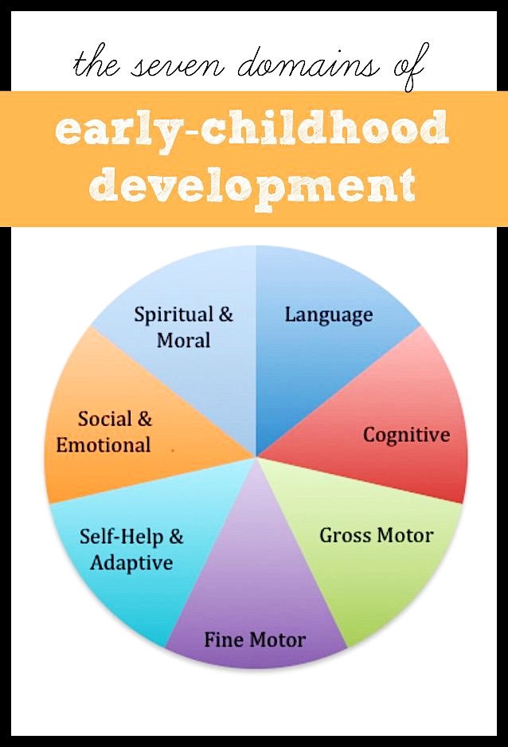
Introduction
Poetry
Effective: simplicity and brevity of thought.
Helps children pay attention to the sounds, patterns of language & encourages vocabulary.
Easy: incorporate into daily activities.
Aim
Provide potential evidences for early child language educator regarding when to provide an efficient teaching.
Notes:
Early child language development is one of the 7 domains in early childhood development. It is essential through the whole life of each person.
When teach language, educators like to introduce poetry because:
Aim: …..via analyzing a poem writing-related dataset.

Slide 3
Dataset
Poki Dataset (11MB)
https://github.com/whipson/PoKi-Poems-by-Kids/blob/master/README.md
Variable Name | Means
id | unique identifier for each poem
grade | school grade (1-12)
author | first name of author
valence | Means valence
arousal | Means arousal
dominance | Means dominance
anger | Means anger
fear | Means fear
sadness | Means sadness
joy | Means joy
total words | total number of non stop words within poem
gender | probable gender based on author name
A corpus of 61,330 poems.
Written by children from grades 1 to 12.
Especially useful in studying child language.
Emotional words:
Scored by intensity analyzed by the NRC Emotion Intensity lexicon.
Notes:
The datasets I used for this project is named Poki, it is A Large Dataset of Poems by Children
Poki is especially useful in studying child language because it comes with information about the age of the child authors as well as the emotion words scores. (school grades 1-12),
This datsset includes: var. names… the emotional words were scored by its intensity which wer analyzed by...
Words in the poem were analyzed by NRC VAD lexicon and the NRC Emotion Intensity lexicon & scored the intensity for basic emotions that are listed here.

Slide 4
Data Analysis
Aim 1
visualize the change in the number of words in a poem that have been created by children from different ages. Also, we want to visualize the trend of the amount of poems been submitted as children grow up. The gender factor was also considered in these analysis since in addition to the age factor, it is another important factor in child language development.

