Slide 1
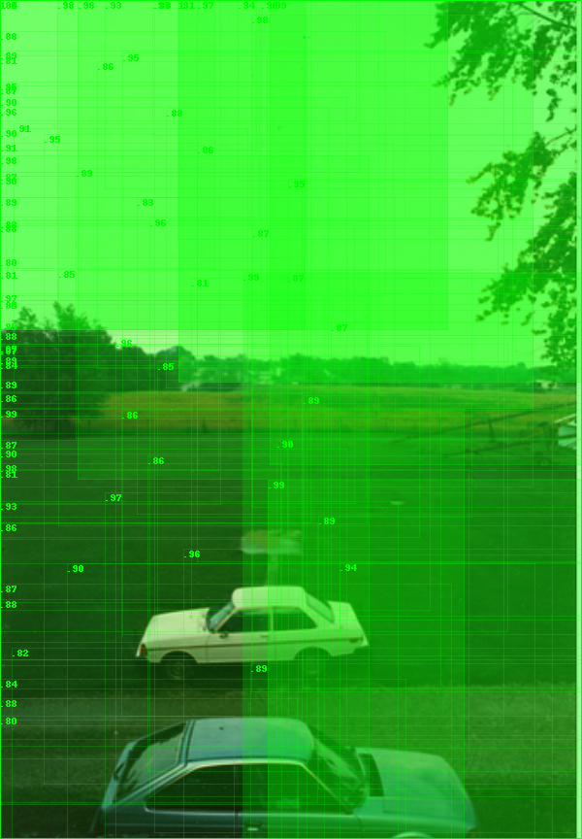
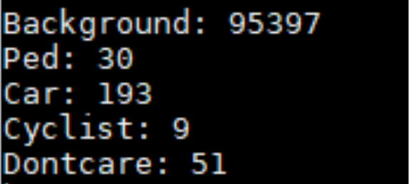
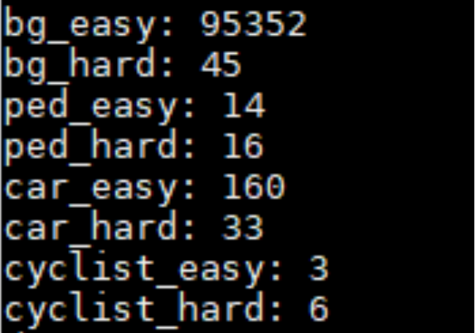
Class imbalance in practice
Batch_size=32
Easy_hard_threshold=0.5
Notes:
Attribute:可以看作来自相同或不同(关系)维度的实例，这些维度以一种确保层次结构存在的方式放置在一个或多个列中

Slide 2
Class imbalance’s questions
Training is inefficient as most locations are easy negatives that contribute no useful learning signal;
一味提高易分类样本的预测值意义不大
The easy negatives can overwhelm training and lead to degenerate models.
Notes:
Attribute:可以看作来自相同或不同(关系)维度的实例，这些维度以一种确保层次结构存在的方式放置在一个或多个列中

Slide 3
Solution—Sampling
Two-Stage Detector
Proposal stage : narrows down the number of candidate object locations(e.g., 1-2k)
Classification stage : foreground/background ratio (1:3); OHEM
One-Stage Detector
bootstrapping
hard example mining
Notes:
Attribute:可以看作来自相同或不同(关系)维度的实例，这些维度以一种确保层次结构存在的方式放置在一个或多个列中

Slide 4
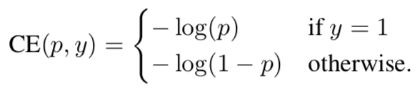

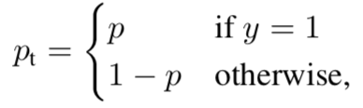

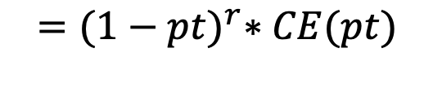
Focal Loss
Binary Cross Entropy
Focal Loss
γ ∈ [0, 5]
$$={(1−pt)}^{r}∗CE(pt)$$
Notes:
没有考虑单元格的聚合关系
电子表格变化多样，许多特征不具有普适性：单元格坐标、字符串长度、开头字母大写

Slide 5



Focal Loss
Binary Cross Entropy
Focal Loss
γ ∈ [0, 5]
${−\left(1−p\right)}^{r}\log{(p)}$ if y=1
$$FL\left(p\right)=$$
$${−(p)}^{r}\log\left(1−p\right) otherwise.$$
Notes:
没有考虑单元格的聚合关系
电子表格变化多样，许多特征不具有普适性：单元格坐标、字符串长度、开头字母大写

Slide 6
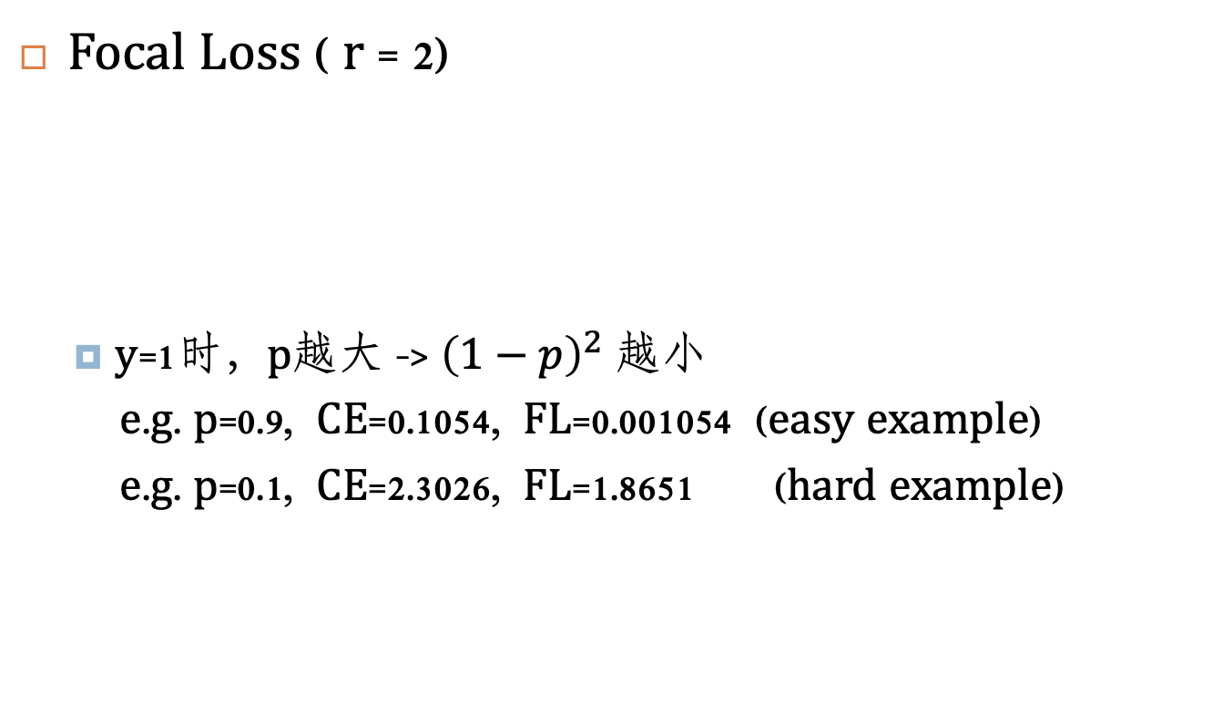



Focal Loss
Focal Loss ( r = 2)
y=1时，p越大 -> ${\left(1−p\right)}^{2}$ 越小
e.g. p=0.9, CE=0.1054, FL=0.001054 (easy example)
e.g. p=0.1, CE=2.3026, FL=1.8651 (hard example)
${−\left(1−p\right)}^{r}\log{(p)}$ if y=1
$$FL\left(p\right)=$$
$${−(p)}^{r}\log\left(1−p\right) otherwise.$$
Notes:
没有考虑单元格的聚合关系
电子表格变化多样，许多特征不具有普适性：单元格坐标、字符串长度、开头字母大写

Slide 7




Focal Loss
${−α\left(1−p\right)}^{r}\log{(p)}$ if y=1
$$FL\left(p\right)=$$
$${−(1−α)(p)}^{r}\log\left(1−p\right) otherwise.$$

Slide 8

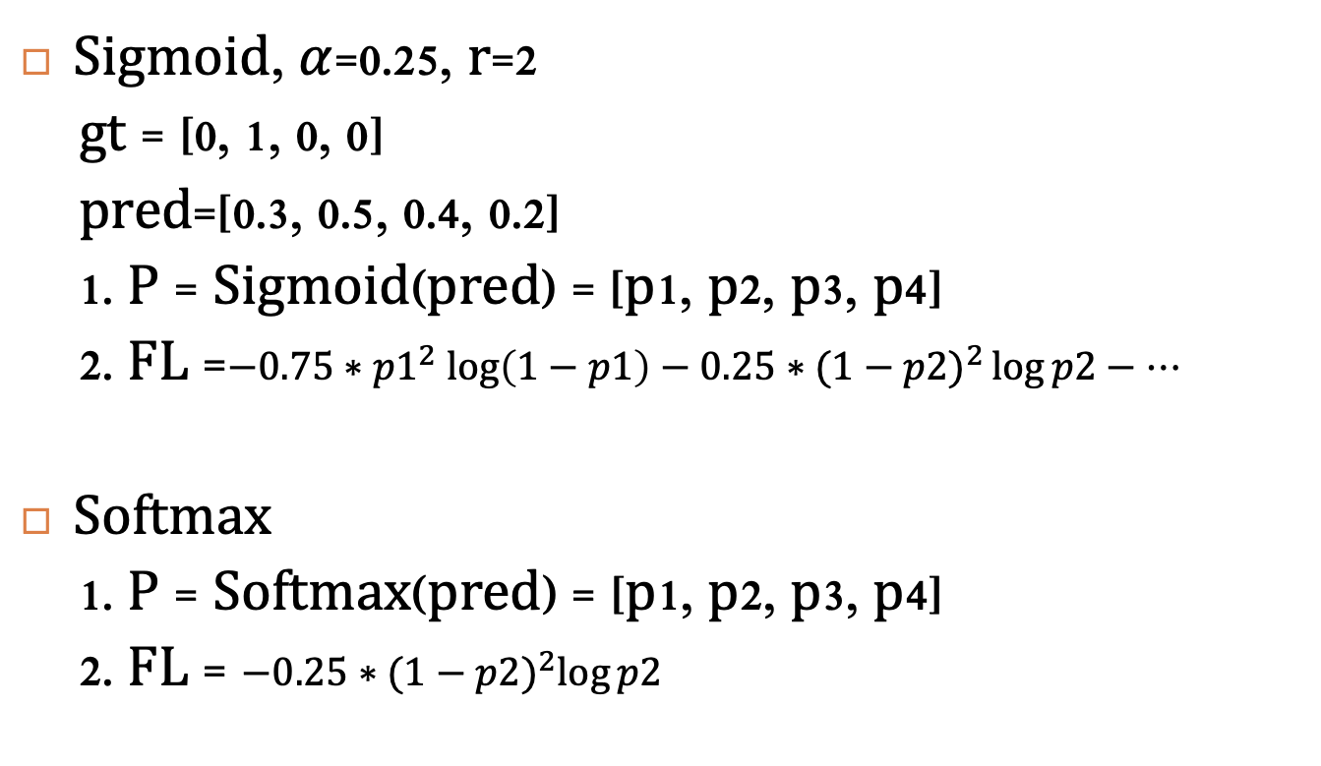


Works Best
${−α\left(1−p\right)}^{r}\log{(p)}$ if y=1
$$FL\left(p\right)=$$
$${−(1−α)(p)}^{r}\log\left(1−p\right) otherwise.$$
Sigmoid, $α$=0.25, r=2
gt = [0, 1, 0, 0]
pred=[0.3, 0.5, 0.4, 0.2]
1. P = Sigmoid(pred) = [p1, p2, p3, p4]
2. FL =$−0.75{∗p1}^{2}\log\left(1−p1\right)−0.25∗{(1−p2)}^{2}\log{p2−…}$
Softmax
1. P = Softmax(pred) = [p1, p2, p3, p4]
2. FL = $−0.25∗{(1−p2)}^{2}\log{p2}$
https://gombru.github.io/2018/05/23/cross_entropy_loss/

Slide 9
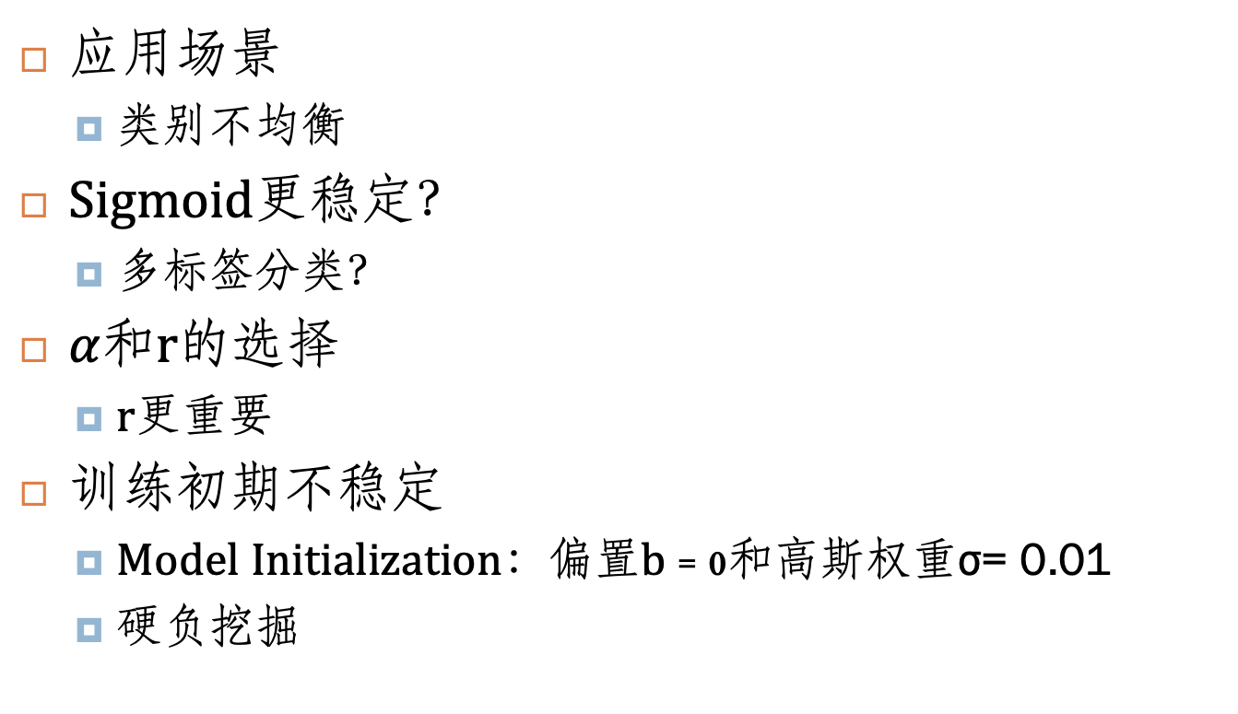
讨论
应用场景
类别不均衡
Sigmoid更稳定？
多标签分类？
$α$和r的选择
r更重要
训练初期不稳定
Model Initialization：偏置b = 0和高斯权重σ= 0.01
硬负挖掘

