Slide 1
MAILBOX DELIVERY NOTIFIER
ME502 - Summer 2013
Project Presentation
Baris Tevfik
Jeff Manzik
Peiwen Hu

Slide 2
What is the Problem?
Checking your mailbox when it is empty.
Rechecking, and keep rechecking.
Forgetting to check the mailbox.
Lower efficiency especially in businesses.
Missing mail carrier when planning to hand-off something for delivery.
Mail tampering and identity theft.

Slide 3
Prior Art
U.S. patent 6,046,675 by Robert L. Hanna
Mail delivery service
A system in which when the door is
opened, a circuit is completed and a
signal is sent to a receiver
The receiver lights up a LED
Some key words searched for: "mailbox", "mail", "indicator", "notifier", "notification", "wireless", "smartphone" etc.
Example search: (TTL/mail OR TTL/mailbox) AND (TTL/notification OR TTL/delivery OR TTL/indicator OR TTL/indication OR TTL/signal)

Slide 4
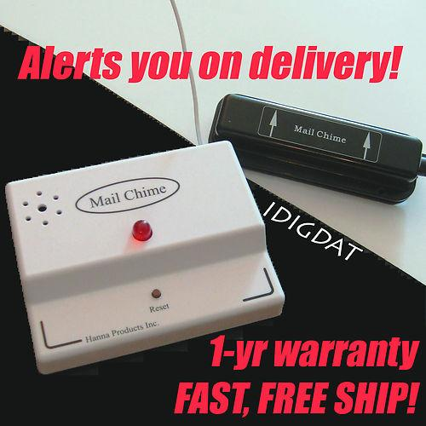
Prior Art
Mail Chime
Possibly the product of the patent on the previous page.
Sold on Ebay.

Slide 5
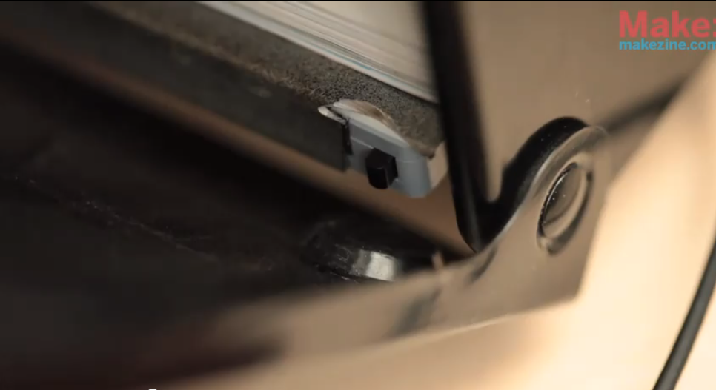
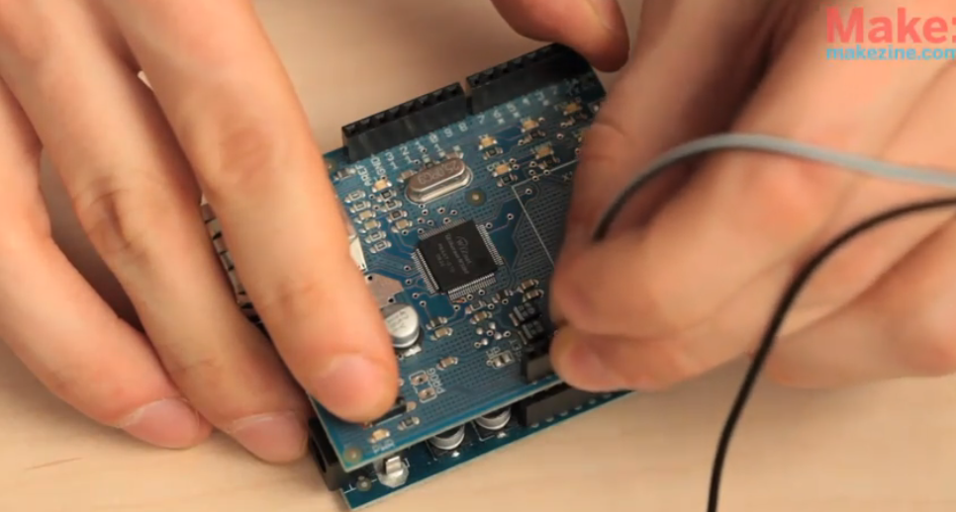
Prior Art
DIY Mail SmartPhone Notifier
Done by LifeHacker.com
A switch An Arduino
Not wireless
Would not work with apartments where the latch is universal.
Another problem is, you receive a notification when you open the door yourself as well.
You would go check only to find out it is spam.

Slide 6
Our Solution

Slide 7
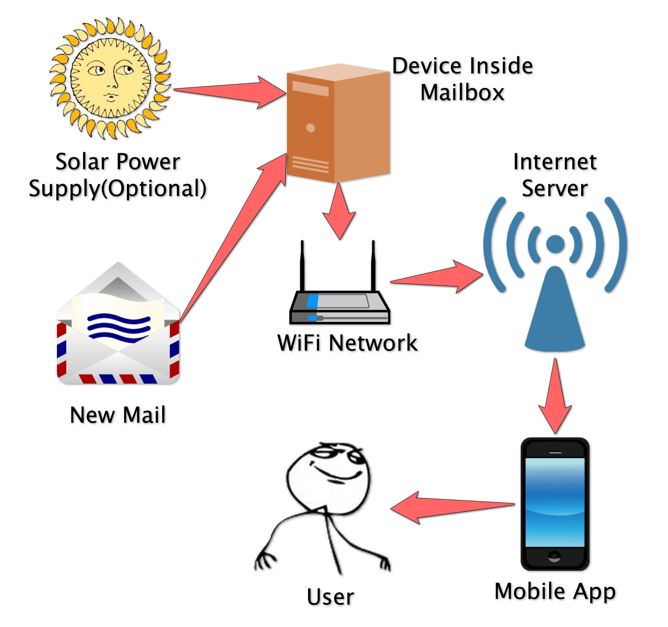
Workflow
Battery/Solar
Wifi Signal
Internet Server
Mobile App

Slide 8
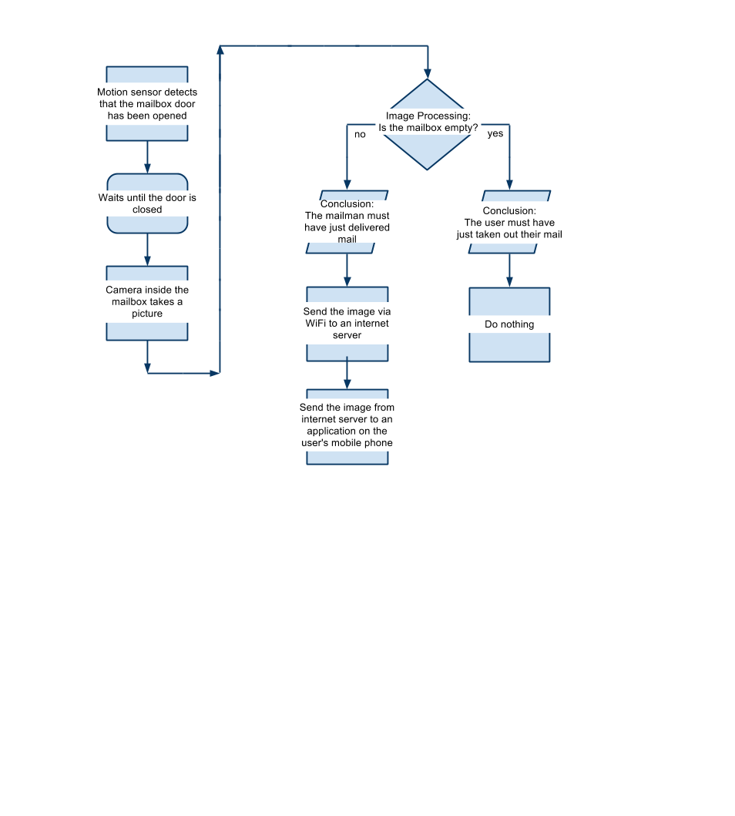
Flowchart

Slide 9
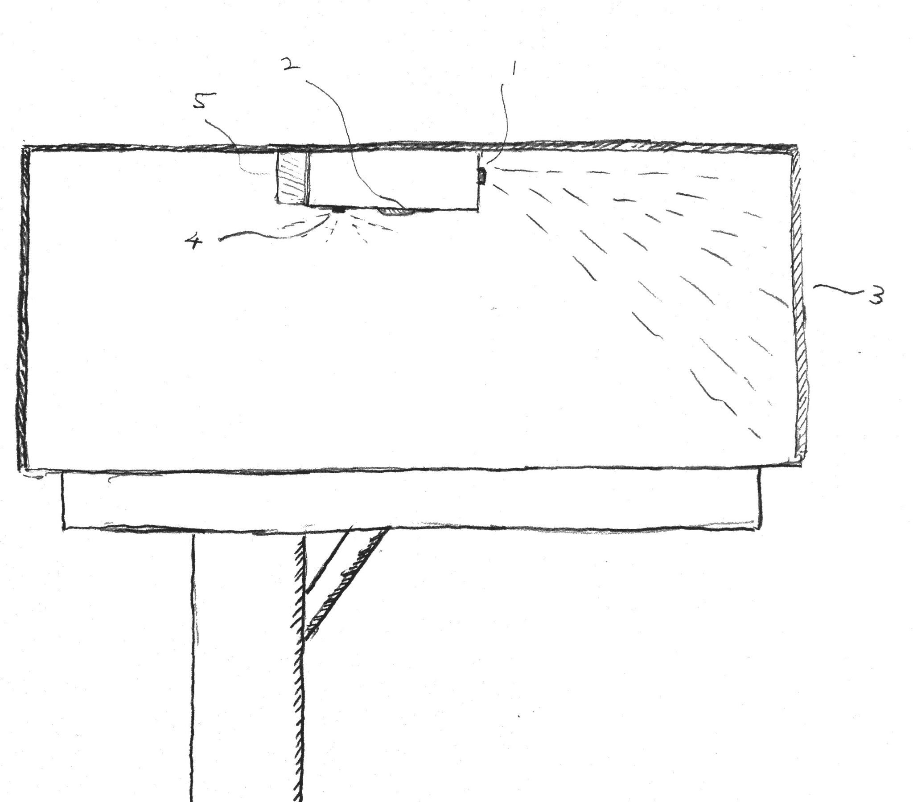
Drawing
1. Sensor
2. Camera
3. Door
4. Flash
5. Battery

Slide 10
Mechanisms
Camera takes a photo after open-and-close of latch
Image Processing Unit compares current photo with "empty state" photo
If not empty, send a notification to user
Hibernate when not triggered
Every device has a unique ID
User registers the app with the ID

Slide 11
Patentability:Why this is novel
With mobile app, get notified remotely.
By camera, check mail information instantly.
Works for apartments with universal latch.
Won't notify when user takes mail out.

Slide 12
Major Patent Claim
1. A mail delivery notification system that alerts a mobile device application of the presence of physical mail in a designated mailbox, comprising of:
a sensor that detects the opening and closing of a mailbox door;
a camera that takes a picture of the mailbox contents;
an image processing unit that determines if mail has been delivered;
a battery and/or solar panel;
internet access through a WiFi network;
an accompanying mobile software application that receives the mail delivery notification and image.

Slide 13
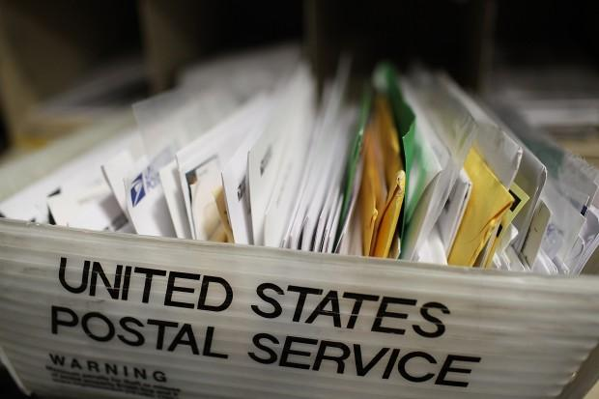
Commercialization:Potential Market
Fact: 300 Mail Chime units are sold according to Ebay page.
Also sold on their website.
(People need better product!)
Fact:In each day, 1 million people visit usps.com
Demand:USPS delivers to more than 152 million homes, businesses and P.O boxes

Slide 14
Commercialization:Cost
Cost of each device
Wifi module: $3
motion sensor: $3-6
Camera CMOS sensor: $9
DSP unit: $6-10
Total: $21-28
Cost of Software
Smartphone app:(one-off development)
1 developer: 20 days * 8 h/day * $30/h = $4800
Server (per year):
Amazon EC2(small): 365 * 24 * $0.06/h = $525
EC2 (extra large): 365 * 24 * $0.48 = $4200

Slide 15
Commercialization:Estimate
Market penetration: 0.2%
Estimate # sold: 152 million * 0.2% = 0.3 million
Estimate unit price:35
Estimate revenue:0.3 million * 35 = 10.5 million
approx. profit: 0.3 million * (35-28) = 2.1 million

Slide 16
Commercialization:Barrier of Entry
Competitor: Mail Chime is sold for $44.95.
Power consumption.
WiFi network range: routers running 802.11n have an approximate range of 300 ft indoors and 600 ft outdoors.
Installation difficulty.
Needs to be sold for a competitive price.

Slide 17

Questions

