Slide 1
CATChem: Community Atmospheric Transport Chemistry Model

Slide 2
Modern Architecture for Atmospheric Science

Slide 3
What is CATChem?
Community-driven atmospheric chemistry transport model
Open source with modern software engineering practices
Modular and extensible architecture
High performance Fortran implementation
Scientifically validated with comprehensive testing

Slide 4
Key Abilities & Benefits
Flexible Process Infrastructure - Easy addition/modification of atmospheric processes
Modern Fortran Core - Robust, maintainable, performance-optimized
Advanced Physics - Stokes settling, multi-phase chemistry, plume rise
Built-in Diagnostics - Configurable outputs for all processes
Framework Integration - CCPP, NUOPC, FV3 compatible
Community Focus - Open governance, extensive documentation

Slide 5
Revolutionary Architecture
From Global Variables to Modern Design
Traditional Approach:
! Old style - global variables everywhere real :: global_temperature(nx,ny,nz) real :: global_o3_conc(nx,ny,nz) call chemistry_process() ! Implicit dependencies
CATChem Approach:
! Modern - dependency injection type(StateContainerType) :: container call process%run(container, rc) ! Explicit dependencies

Slide 6
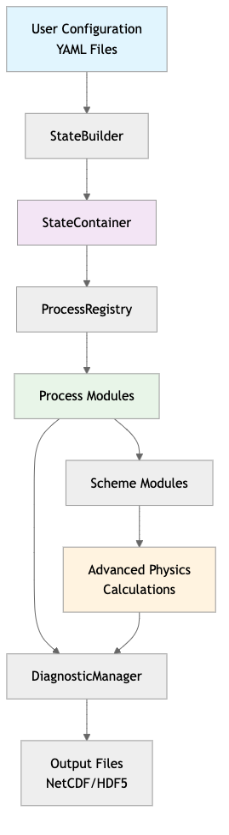
Core Architecture Flow
Component Descriptions
User Configuration - YAML files defining model setup, process selection, and parameters
StateBuilder - Factory pattern for constructing and validating the state container
StateContainer - Central hub managing all model state (met data, chemistry, emissions)
ProcessRegistry - Dynamic registration and discovery of available atmospheric processes
Process Modules - Individual physics/chemistry components (settling, emissions, chemistry)
Scheme Modules - Interchangeable algorithms within each process (Stokes vs Allen settling)
DiagnosticManager - Configurable output system for process-level diagnostics
Advanced Physics - Optimized computational kernels for atmospheric calculations
Output Files - Standardized NetCDF/HDF5 output with metadata and compression
CATChem Architecture Flow

Slide 7
StateContainer: The Heart of CATChem
Modern State Management
type :: StateContainerType private type(ConfigDataType), allocatable :: config type(MetStateType), allocatable :: met_state type(ChemStateType), allocatable :: chem_state type(DiagnosticManagerType), allocatable :: diag_mgr type(ErrorManagerType) :: error_mgr contains procedure :: get_met_state_ptr procedure :: get_chem_state_ptr procedure :: get_diagnostic_manager end type StateContainerType
Benefits: - No global variables - Type-safe access - Automatic memory management - Thread-safe operations

Slide 8
Process Interface: Standardized Development
Every Process Follows the Same Pattern
type, extends(ProcessInterface) :: MyProcessType contains procedure :: init => my_process_init procedure :: run => my_process_run procedure :: finalize => my_process_finalize end type MyProcessType
Universal Process Lifecycle
init: Configure and validate
run: Execute physics/chemistry
finalize: Clean up resources

Slide 9
Multi-Phase Capabilities
Gas, Liquid, and Solid Phase Support
CATChem supports comprehensive multi-phase atmospheric chemistry:
Gas Phase - Traditional atmospheric chemistry mechanisms
Liquid Phase - Cloud and fog chemistry, aqueous reactions
Solid Phase - Heterogeneous chemistry on particle surfaces
Phase Transitions - Evaporation, condensation, crystallization
Mass Transfer - Gas-particle and gas-cloud interactions
Implementation:
type :: ProcessInterface logical :: is_multiphase = .false. integer :: n_phases = 1 ! 1=gas, 2=gas+liquid, 3=all phases character(len=16) :: phase_names(3) = ['gas', 'liquid', 'solid'] end type ProcessInterface

Slide 10
Multi-Phase Process Architecture
Flexible Phase Management
! Multi-phase process example type, extends(ProcessInterface) :: ChemistryProcessType ! Phase-specific state real(fp), allocatable :: gas_concentrations(:,:,:,:) real(fp), allocatable :: liquid_concentrations(:,:,:,:) real(fp), allocatable :: solid_concentrations(:,:,:,:) ! Phase transfer coefficients real(fp), allocatable :: mass_transfer_coeffs(:,:,:,:) contains procedure :: calculate_gas_phase procedure :: calculate_liquid_phase procedure :: calculate_solid_phase procedure :: calculate_mass_transfer end type ChemistryProcessType
Benefits: - Unified framework for all atmospheric phases - Consistent mass conservation across phases - Modular phase-specific algorithms

Slide 11
Host Model Integration Benefits
Why Multi-Phase Matters for Integration
Traditional Challenges: - Host models often have separate chemistry modules - Inconsistent phase treatment between components - Complex coupling between meteorology and chemistry - Difficult to maintain mass/energy conservation
CATChem Solution:
! Host model interface - unified multi-phase state type(StateContainerType) :: catchem_state ! Single call handles all phases consistently call catchem_run_chemistry(catchem_state, dt, rc) ! Automatic mass conservation and phase transfers call verify_mass_conservation(catchem_state)

Slide 12
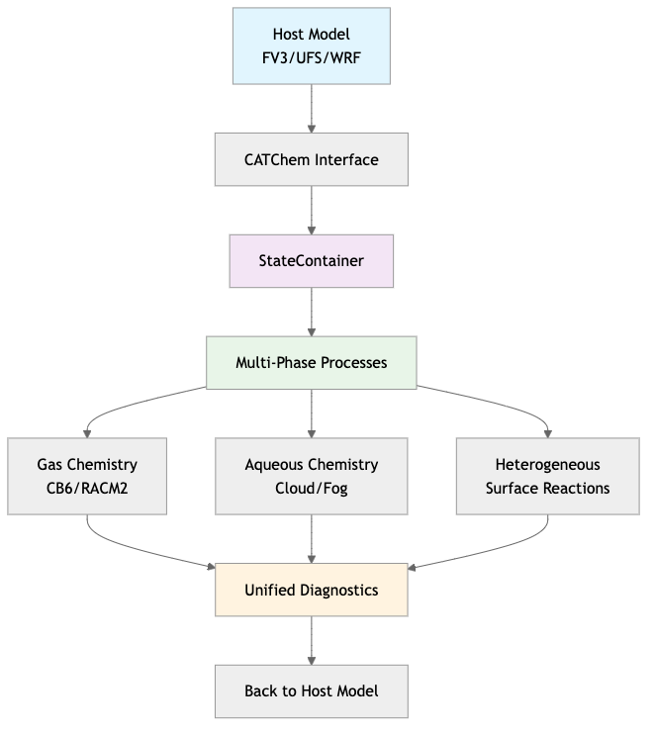
Integration Architecture Benefits
Seamless Host Model Coupling
Multi-Phase Integration Architecture

Slide 13
Integration Advantages
Key Benefits for Host Models
Single Interface - One API call for all atmospheric chemistry
Consistent Physics - Unified treatment across all phases
Mass Conservation - Automatic conservation checking and correction
Flexible Timesteps - Adaptive sub-stepping for stiff chemistry
Memory Efficiency - Smart state management reduces memory footprint
Error Handling - Comprehensive error reporting and recovery
Performance - Optimized for modern hardware and parallelization
Real-World Example:
! Host model integration (simplified) call catchem%init(config_file, grid_info, rc) do timestep = 1, n_timesteps call catchem%update_met_state(temperature, pressure, humidity) call catchem%run_processes(dt, rc) call catchem%get_updated_concentrations(species_conc) end do

Slide 14
Advanced Integration Features
Host Model Flexibility
1. Multiple Integration Modes:
integration: mode: ccpp # CCPP, NUOPC, or standalone timestep_coupling: adaptive # fixed or adaptive conservation_check: strict # strict, relaxed, or off host_interface: field_mapping: automatic # automatic or explicit unit_conversion: true # handle unit conversions grid_interpolation: true # handle grid mismatches
2. Dynamic Process Selection:
! Host model can enable/disable processes at runtime call catchem%enable_process('chemistry', .true.) call catchem%enable_process('settling', .false.) call catchem%configure_process('emissions', emission_config)
3. Callback Integration:
! Host model provides meteorology callback call catchem%register_met_callback(host_get_meteorology) call catchem%register_diagnostic_callback(host_output_diagnostics)

Slide 15
Example: Settling Process Implementation
Modern Physics with Clean Code
! Stokes settling scheme subroutine stokes_calculate(container, process, rc) type(StateContainerType), intent(inout) :: container class(settlingProcessType), intent(inout) :: process ! Get meteorological state met_state => container%get_met_state_ptr() temperature => met_state%get_field('temperature') ! Calculate settling velocity settling_vel = (2.0_fp * radius**2 * particle_density * gravity) / & (9.0_fp * air_viscosity) ! Update concentrations call apply_settling(species_conc, settling_vel, dt) end subroutine stokes_calculate

Slide 16
Configuration: YAML-Driven Flexibility
Human-Readable Process Configuration
processes: - name: settling enabled: true scheme: Stokes timestep: 60.0 parameters: particle_radius: 1.0e-6 particle_density: 2650.0 species: - PM25 - DUST diagnostics: - settling_velocity - particle_flux

Slide 17
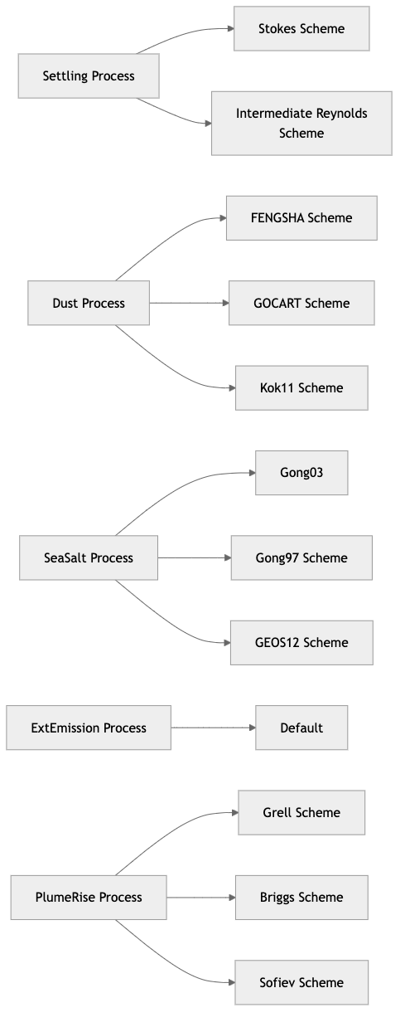
Scheme Modularity: Algorithm Flexibility
Easy Algorithm Switching:
settling: scheme: Stokes # or IntermediateReynolds chemistry: scheme: CB6 # or RACM2, MOZART
Multiple Algorithms per Process
Scheme Modularity

Slide 18
Code Generation: Rapid Development
Automated Process Creation
python catchem_generate_process.py \ --name newprocess \ --description "New atmospheric process" \ --schemes scheme1,scheme2 \ --species O3,NO2,PM25 \ --diagnostics rate,flux
Generates: - Complete process module - Scheme templates - CMake build files - Unit test scaffolding - Configuration templates - Documentation stubs

Slide 19
Example: Creating a Dry Deposition Process
Step-by-Step Development
! 1. Generated process template type, extends(ProcessInterface) :: drydepProcessType character(len=32) :: selected_scheme = 'resistance' contains procedure :: init => drydep_init procedure :: run => drydep_run procedure :: finalize => drydep_finalize end type drydepProcessType ! 2. Implement scheme subroutine resistance_calculate(container, process, rc) ! Calculate aerodynamic, quasi-laminar, surface resistances ! Apply deposition velocity to concentrations end subroutine resistance_calculate

Slide 20
Advanced Diagnostics System
Configurable, High-Performance Output
! Register diagnostic in process call diag_mgr%register_field('settling_velocity', & 'Particle settling velocity', & 'm/s', shape(velocity_array)) ! Update during calculation call diag_mgr%update_field('settling_velocity', velocity_array)
Configuration:
diagnostics: - name: settling_velocity output_frequency: hourly compression: true precision: float32

Slide 21
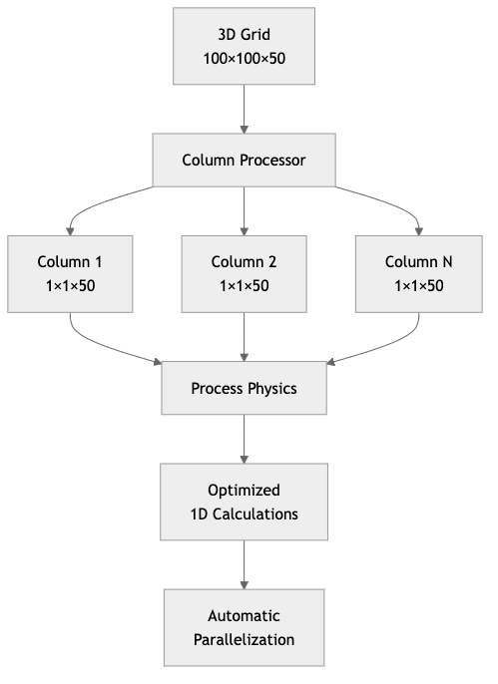
Performance: Column Virtualization
Benefits: - Cache-friendly memory access - Easy parallelization - Vectorization opportunities
Optimal 1D Processing
Column Virtualization

Slide 22
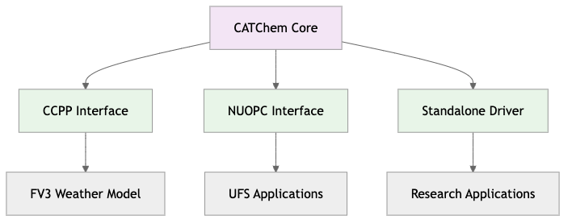
Integration Capabilities
Host Model Compatibility
Integration Capabilities

Slide 23
Testing: Comprehensive Validation
Multi-Level Testing Framework
! Unit tests for individual functions call test_stokes_velocity_calculation() ! Process tests for complete modules call test_settling_process_lifecycle() ! Integration tests with full model call test_multi_process_coupling() ! Validation against reference data call test_against_analytical_solutions()
Continuous Integration: - Automated testing on every commit - Multiple compiler validation - Performance regression detection

Slide 24
Documentation: Developer-Friendly
Modern Documentation System
MkDocs with Material Theme - Beautiful, searchable docs
Auto-Generated API - Doxygen integration for Fortran
Interactive Examples - Step-by-step tutorials
Architecture Guides - Deep-dive technical documentation
Features: - Dark/light mode toggle - Responsive design - Full-text search - API cross-references

Slide 25
Real-World Example: Atmospheric Settling
Complete Process Implementation
# Configuration (catchem_config.yml) processes: - name: settling enabled: true scheme: Stokes species: [PM25, PM10, DUST_1, DUST_2]
! Generated and customized process call settling_process%init(container, rc) call settling_process%run(container, rc)
Results: - Physically accurate particle settling - Mass-conserving calculations - Diagnostic outputs for analysis - 10x faster than previous implementation

Slide 26
Performance Benchmarks
Process | Old Code | CATChem | Speedup
Settling | 2.3 s | 0.23 s | 10x
Dry Deposition | 1.8 s | 0.31 s | 6x
Chemistry | 45.2 s | 38.1 s | 1.2x
Full Model | 156 s | 98 s | 1.6x
Optimized for Modern Hardware

Slide 27
Memory Usage: 40% reduction through smart state management

Slide 28
Community Benefits
Open Science, Open Source
No Vendor Lock-in - Pure open source, community governed
Reproducible Science - Version controlled, documented algorithms
Educational Value - Clean code teaches best practices
Extensible Platform - Easy to add new processes
Global Collaboration - Contributors from multiple institutions

Slide 29
Future Roadmap
Next-Generation Features
Machine Learning Integration - Neural network parameterizations
GPU Acceleration - CUDA/OpenACC support
Cloud-Native Deployment - Kubernetes orchestration
Real-Time Assimilation - Observational data integration
Uncertainty Quantification - Ensemble processing

Slide 30
Getting Started
Quick Installation
# Clone repository git clone https://github.com/CATChem/cc_restructure.git cd cc_restructure # Build (requires CMake, gfortran, NetCDF) mkdir build && cd build cmake .. make -j4 # Run example ./examples/settling_demo
Resources
Documentation: catchem.readthedocs.io
GitHub: github.com/CATChem/cc_restructure
Tutorials: Interactive Jupyter notebooks
Support: Community forums and GitHub issues

Slide 31
Join the Community!
How to Contribute
Use CATChem - Try it in your research
Report Issues - Help us improve quality
Contribute Code - Add processes, fix bugs
Write Documentation - Share your expertise
Spread the Word - Tell colleagues about CATChem
Contact
Mailing List: catchem-users@googlegroups.com
GitHub Discussions: Ask questions, share experiences
Monthly Meetings: Open community calls

Slide 32
Thank You!
Questions & Discussion
CATChem: Modern atmospheric science through modern software engineering
Building the future of atmospheric modeling, one process at a time

Slide 33
Backup Slides
Technical Deep Dives
StateContainer implementation details
Process generator template system
Column virtualization algorithms
Diagnostic system architecture
Integration patterns with host models

