Slide 1
CATChem NUOPC Interface: Earth System Model Integration

Slide 2
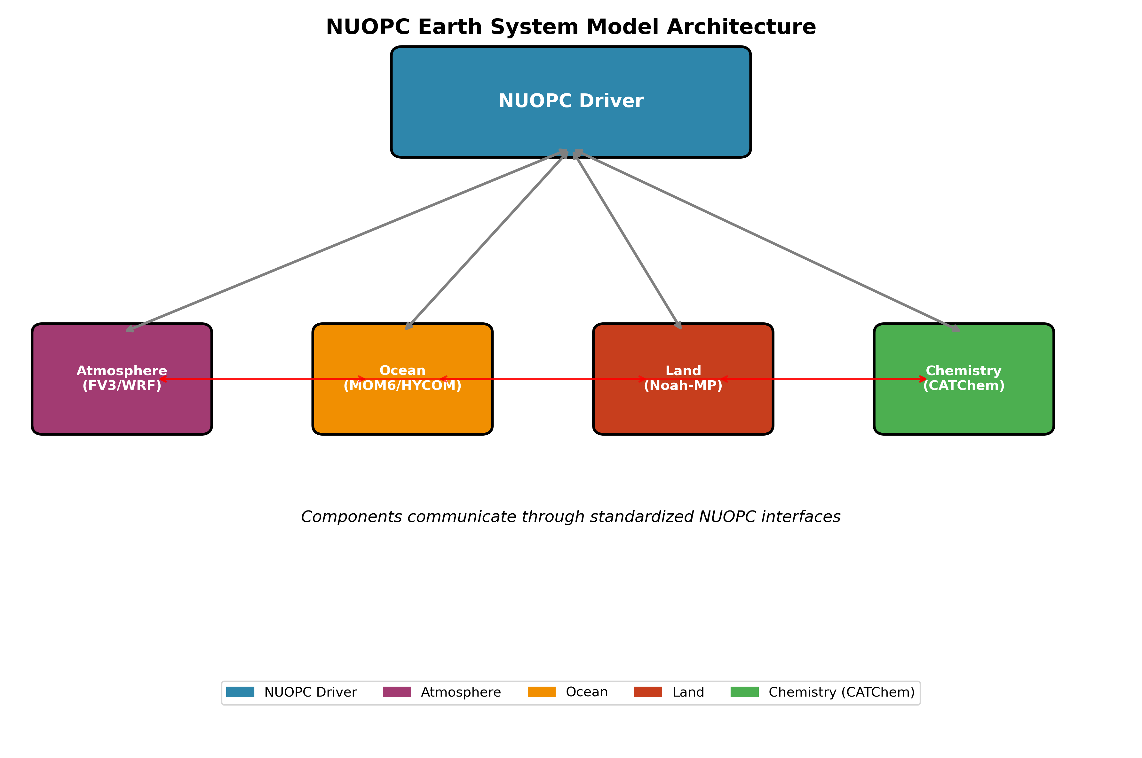
🌍 What is NUOPC?
National Unified Operational Prediction Capability (NUOPC)
Earth System Modeling Framework: Standard for coupling atmospheric, oceanic, land, and sea ice models
ESMF-Based: Built on Earth System Modeling Framework for high-performance computing
Operational Focus: Designed for 24/7 operational weather and climate prediction
Multi-Agency Standard: Used by NOAA, NASA, Navy, Air Force, and international partners
NUOPC Architecture

Slide 3
🎯 CATChem NUOPC Integration Goals
Seamless Earth System Coupling
Plug-and-Play: Drop-in atmospheric chemistry component
Standard Interfaces: NUOPC-compliant field exchange
Scalable Performance: From development to operational scales
Flexible Configuration: Adaptable to diverse modeling needs
Operational Readiness
24/7 Production: Robust error handling and monitoring
Real-time Constraints: Optimized for operational time windows
Restart Capability: Seamless restart and recovery
Quality Control: Built-in field validation and diagnostics

Slide 4
🔄 NUOPC Phases Implementation
Initialize Phase 1: Field Advertisement
subroutine InitializeP1(model, importState, exportState, clock, rc) ! Advertise import fields (from atmosphere/land/ocean) call NUOPC_Advertise(importState, & StandardName="air_temperature", rc=rc) call NUOPC_Advertise(importState, & StandardName="surface_air_pressure", rc=rc) call NUOPC_Advertise(importState, & StandardName="eastward_wind", rc=rc) ! Advertise export fields (to other components) call NUOPC_Advertise(exportState, & StandardName="mass_fraction_of_ozone_in_air", rc=rc) call NUOPC_Advertise(exportState, & StandardName="mass_fraction_of_carbon_monoxide_in_air", rc=rc) end subroutine
Initialize Phase 2: Model Setup
subroutine InitializeP2(model, importState, exportState, clock, rc) ! Realize advertised fields call NUOPC_Realize(importState, rc=rc) call NUOPC_Realize(exportState, rc=rc) ! Initialize CATChem model call catchem_init(config_file, catchem_states, rc) ! Set up field mappings call setup_field_mappings(importState, exportState, rc) end subroutine
Run Phase: Chemistry Execution
subroutine ModelAdvance(model, importState, exportState, clock, rc) ! Get current time and time step call ESMF_ClockGet(clock, currTime=currentTime, timeStep=timeStep, rc=rc) ! Import meteorological fields call import_met_fields(importState, catchem_states, rc) ! Run chemistry processes call catchem_run(catchem_states, timeStep, rc) ! Export chemical fields call export_chem_fields(exportState, catchem_states, rc) end subroutine

Slide 5
📊 Field Exchange Capabilities
Standard Name | Description | Units | Required
air_temperature | Temperature | K | ✅
surface_air_pressure | Surface pressure | Pa | ✅
eastward_wind | U-component wind | m/s | ✅
northward_wind | V-component wind | m/s | ✅
air_pressure | 3D pressure | Pa | ✅
specific_humidity | Water vapor | kg/kg | ✅
cloud_liquid_water_mixing_ratio | Cloud water | kg/kg | ☑️
precipitation_flux | Precipitation | kg/m²/s | ☑️
surface_downwelling_shortwave_flux | Solar radiation | W/m² | ☑️
friction_velocity | Surface friction | m/s | ☑️
Import Fields (Meteorological Inputs)

Slide 6
Standard Name | Description | Units | Process
mass_fraction_of_ozone_in_air | Ozone concentration | kg/kg | Chemistry
mass_fraction_of_carbon_monoxide_in_air | CO concentration | kg/kg | Chemistry
mass_fraction_of_nitrogen_dioxide_in_air | NO₂ concentration | kg/kg | Chemistry
mass_fraction_of_sulfur_dioxide_in_air | SO₂ concentration | kg/kg | Chemistry
mass_fraction_of_dust_dry_aerosol_particles_in_air | Dust aerosol | kg/kg | Dust
mass_fraction_of_sea_salt_dry_aerosol_particles_in_air | Sea salt | kg/kg | SeaSalt
dry_deposition_velocity | Deposition velocity | m/s | DryDep
optical_thickness_of_atmosphere_layer_due_to_aerosol | AOD | 1 | Aerosol
Export Fields (Chemical Outputs)

Slide 7
⚙️ Configuration Management
YAML-Based Configuration
# CATChem_nuopc_config.yml model: name: "CATChem" version: "2.0" time_step: 3600 # seconds processes: dust: enabled: true scheme: "fengsha" seasalt: enabled: true scheme: "gocart" dry_deposition: enabled: true scheme: "wesely" grid: type: "logically_rectangular" decomposition: "block" output: frequency: 3600 # seconds format: "netcdf4" compression: true
Runtime Configuration
! Configure from NUOPC attributes call NUOPC_CompAttributeGet(model, name="config_file", & value=config_file, rc=rc) call NUOPC_CompAttributeGet(model, name="chemistry_scheme", & value=chem_scheme, rc=rc) call NUOPC_CompAttributeGet(model, name="time_step", & value=time_step_str, rc=rc)

Slide 8
🌐 Grid and Regridding Support
Grid Type | Description | Status | Use Case
Logically Rectangular | Regular lat-lon grids | ✅ | Global models
Cubed Sphere | FV3 native grid | ✅ | UFS/GFS
Unstructured | Irregular meshes | 🚧 | MPAS, ICON
Gaussian | Spectral model grids | ✅ | Legacy models
Supported Grid Types

