Slide 1




Random Forest
整合加權樹模型
L1
$$θ_{1}$$
Algorithm
1
$$θ_{2}$$
Algorithm
L2
2
3
$$θ_{3}$$
Algorithm
L3
L
.
.
.
分類:投票法
/迴歸:平均法
訓練樣本
n
Algorithm
$$θ_{n}$$
Algorithm
Ln
n 隨機向量
n 分類器
n 標籤

Slide 2
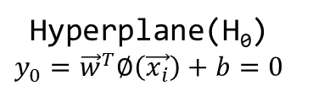

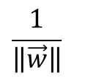
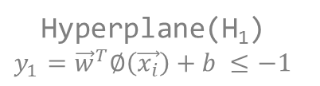
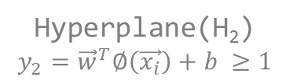
SVM Hyperplane
$$\frac{1}{\left\|\vec{w}\right\|}$$
Hyperplane(H₀)
$$y_{0}={\vec{w}}^{T}∅\left(\vec{x_{i}}\right)+b=0$$
H₂
H₁
Hyperplane(H₂)
$$y_{2}={\vec{w}}^{T}∅\left(\vec{x_{i}}\right)+b ≥1$$
Margin = $\frac{2}{\left\|\vec{w}\right\|}$
Hyperplane(H₁)
$$y_{1}={\vec{w}}^{T}∅\left(\vec{x_{i}}\right)+b ≤−1$$

Slide 3
One-Against-One SVM
3(3,8)
3(1,3)
8(6,8)
1(1,2)
3(1,3)
6(5,6)
8(7,8)
1
2
3
4
5
6
7
8

Slide 4
Bayes
A₅
A₄
A₁
E
A₂
A₃

Slide 5
Bayes Network
 | Factor 2
Factor 1 | T | F
T | 0.3 | 0.7
F | 0.7 | 0.3
 | Factor 1
 | T | F
 | 0.4 | 0.6
Factor 2
Factor 1
Disease
 |  | Disease
Factor 2 | Factor 1 | T | F
F | F | 0 | 1
F | T | 1 | 0
T | F | 1 | 0
T | T | 1 | 0

Slide 6
SOM
O_{n}
O₁
O₂
Output Neuron
...
Input Neuron
X₁
X₂
X₃
X_{m}

Slide 7
Neighbor Joining
Species 1
Species n
(Distance)
Species a
Species b

