Slide 1
Band-wise Multi-scale CNN Architecture for Remote Sensing Image Scene Classification
Jian Kang and Begüm Demir
Remote Sensing Image Analysis (RSiM) Group, TU Berlin
jian.kang@tu-berlin.de, demir@tu-berlin.de
Notes:
Hello, everyone, today I’d like to introduce my work “Band-wise Multi-scale CNN architecture for Remote Sensing Image Scene Classification”.

Slide 2
Outline
Introduction
Motivation
Band-wise multi-scale CNN architecture
Experiments
Conclusion
Notes:
The presentation includes the following parts.

Slide 3
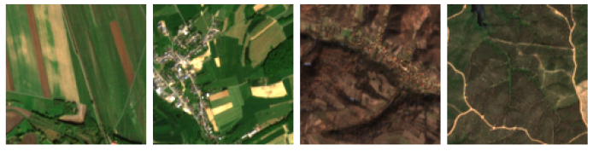
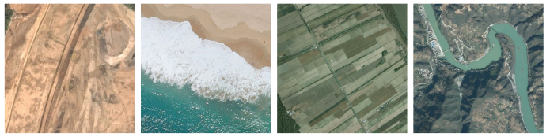
Introduction
Scene classification of Remote Sensing(RS) images
Characterization of remote sensing images based on single-label or multi-label land-use or land-cover classes
Existing large-scale scene classification datasets: e.g., AID¹ and BigEarthNet²
AID: Aerial images
30 scene classes
Single-label
RGB bands
BigEarthNet:
Sentinel-2 images
43 scene classes
Multi-labels
Multi-spectral bands
Discontinuous
urban fabric;
Land principally
occupied by
agriculture;
Non-irrigated
arable land.
Broad-leaved
forest; Complex
cultivation
patterns;
Discontinuous
urban fabric;
Non-irrigated
arable land;
Pastures.
Broad-leaved
forest; Complex
cultivation
patterns; Land
principally
occupied by
agriculture;
Transitional
woodland/shrub.
Agro-forestry
areas;
Broad-leaved
forest;
Transitional
woodland/shrub;
Water bodies.
Bareland
Beach
Farmland
River
[1] Xia, Gui-Song, et al. "AID: A benchmark data set for performance evaluation of aerial scene classification." IEEE Transactions on Geoscience and Remote Sensing 55.7 (2017): 3965-3981.
[2] Sumbul, Gencer, et al. "Bigearthnet: A large-scale benchmark archive for remote sensing image understanding." IGARSS 2019-2019 IEEE International Geoscience and Remote Sensing Symposium. IEEE, 2019.
Notes:
Recently, remote sensing scene classification has drawn significant attention. Based on the semantic information shown in the images, scene classification characterizes them into single-label or multi-label land-use or land-cover classes.

Slide 4
Introduction
Scene classification of RS images
Deep learning has achieved state-of-the-art classification performance
Most of the proposed methods for scene classification are based on the pre-trained convolutional neural network (CNN) architectures on the large-scale computer vision archives (e.g., ImageNet).
However, these pre-trained CNN architectures cannot be directly applied on the scene classification with high-dimensional RS images (e.g., multi-spectral images)
Motivation of this work:
Characterization of semantic contents for high-dimensional RS images based on a novel CNN architecture
Notes:
Supported by large-scale remote sensing archives, deep learning has been widely applied for the scene classification, owing to its excellent feature extraction capability. Most of the proposed methods for scene classification are based on RGB images, where the pre-trained CNN architectures on the large-scale computer vision archives (e.g., ImageNet) are often adopted. However, due to the different numbers of spectral bands, the pre-trained CNN architectures on ImageNet cannot be directly applied on the scene classification with high-dimensional remote sensing images (e.g., multispectral images). In this work, we would like to propose a novel CNN architecture which can sufficiently characterize the spatial-spectral information content of high-dimensional remote sensing images.

Slide 5
Band-wise multi-scale CNN architecture
Standard 2D convolutional layer (bias is omitted)
Image Credit³
[3] https://towardsdatascience.com/intuitively-understanding-convolutions-for-deep-learning-1f6f42faee1
Notes:
First, we review the standard 2D convolutional operation. It can be observed that the feature maps are produced by the summation of all the band-wise convolution results based on the 2D spatial filter and the associated band.

Slide 6
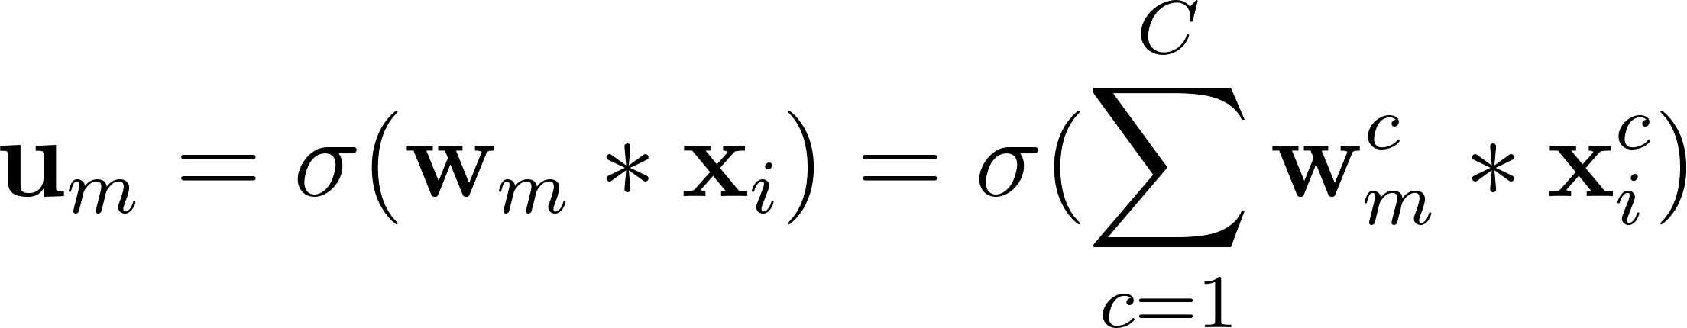

Band-wise multi-scale CNN architecture
Standard 2D convolutional layer (bias is omitted)
Through such operation, the spectral features may not be optimally extracted, since the process for the spectral feature extraction is entangled within the summation of the spatial convolution results.
In addition, the convolution layer with a fixed size filter may not sufficiently extract the spatial features, especially for different land-use or land-cover objects with different spatial sizes.
Notes:
Through this operation, the spectral features may not be optimally extracted, since the process for the spectral feature extraction is entangled within the summation of the spatial convolution results. Moreover, for spatial information encoding, the spatial filter size is usually set to a fixed number of the convolutional layer. However, the convolutional layer with the fixed size of 2D spatial filter may not optimally extract the spatial features in that case.

Slide 7
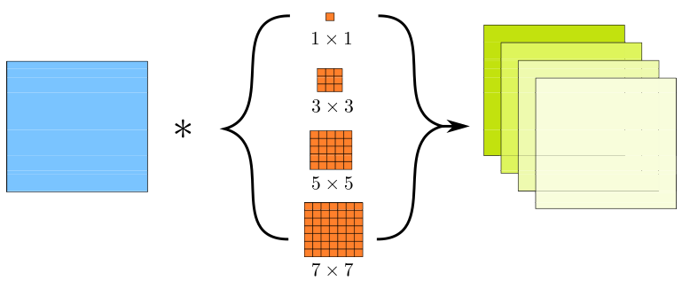
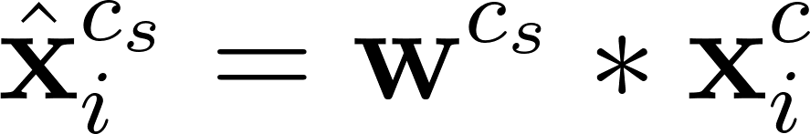
Band-wise multi-scale CNN architecture
Band-wise multi-scale convolution
Sufficiently characterizing the multi-scale spatial features in a band-wise manner
Notes:
To overcome these limitations, we enforce the first convolutional layer to extract the spectral and spatial features, separately. First, the spatial feature extraction is conducted by convolving
multi-scale 2D spatial filters with each band of the input image. As in the illustration, each image band is convolved with four 2D spatial filters with the four different sizes, and results in four feature maps at different scales.

Slide 8
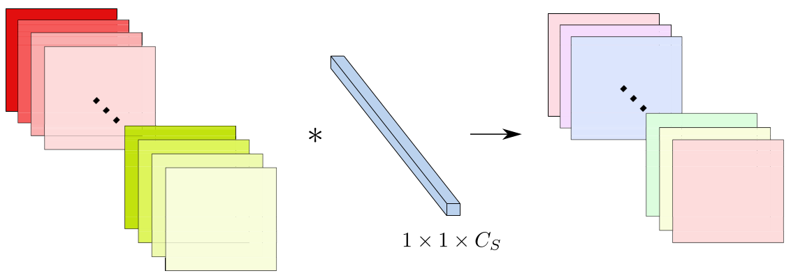
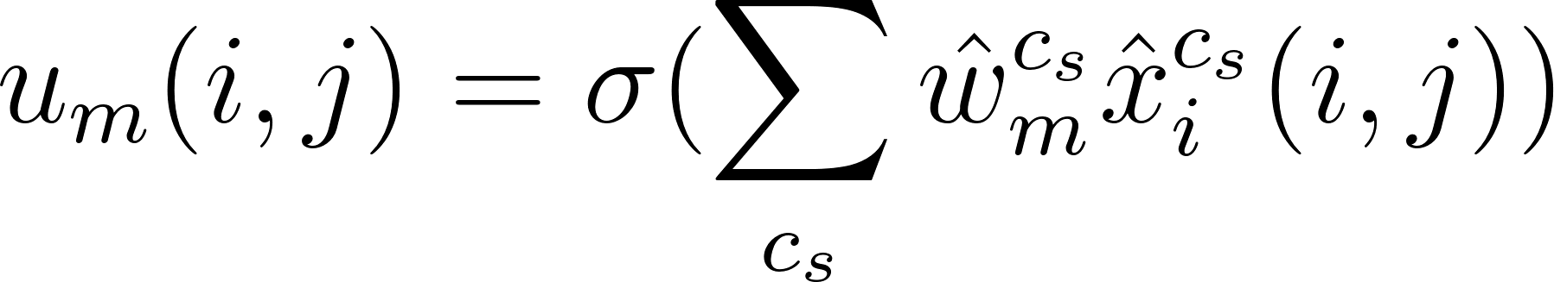
Band-wise multi-scale CNN architecture
Pixel-wise convolution
Learning the spectral information fusion in a pixel-wise manner
Notes:
Then, the spectral feature extraction is carried out on the produced multi-scale feature maps with 1 times 1 2D convolutional filters. Differently from the standard convolutional operation, the features extracted by this operation are obtained through a weighted summation of the multi-scale feature maps in a pixel-wise manner. In this way, the spatial and spectral features can be more accurately extracted compared to the standard 2D convolution.

Slide 9
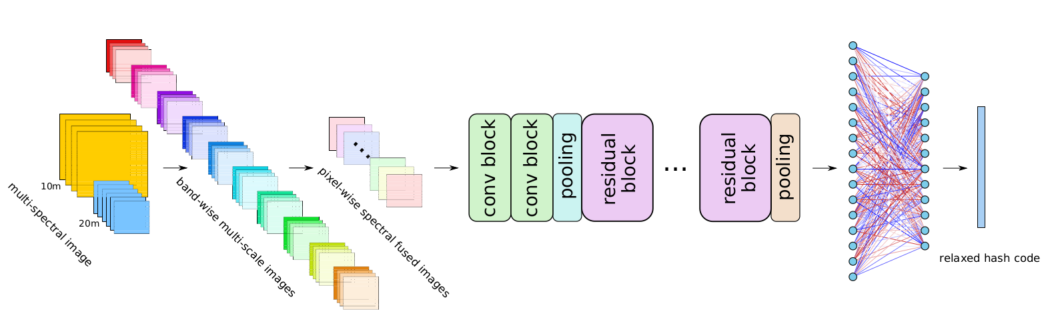
Band-wise multi-scale CNN architecture
Standard 2D residual blocks for learning high-level semantic information
BWMS CNN architecture
Notes:
Then, we adopt standard convolutional and residual blocks for learning the high-level semantic information of the images.

Slide 10
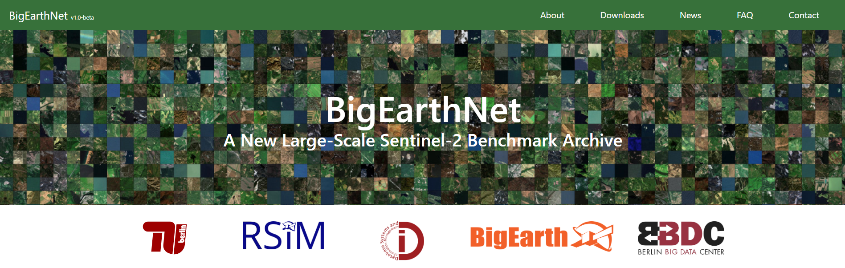
Experiments: Dataset Description
BigEarthNet is utilized for evaluating the performance of the proposed CNN architecture in the task of multi-label classification, where 10m and 20m bands are exploited and the training, validation and test images are following [4].
[4] Sumbul, Gencer, et al. "BigEarthNet Deep Learning Models with A New Class-Nomenclature for Remote Sensing Image Understanding." arXiv preprint arXiv:2001.06372 (2020).
Notes:
To evaluate the proposed CNN architecture, experiments are conducted on BigEarthNet. For details about this dataset, please kindly find it in this article.

Slide 11

Experimental Design
Pytorch implementation
The class probabilities are obtained by applying sigmoid activation function
Binary Cross-Entropy (BCE) loss is utilized
Adam optimizer with learning rate(LR) of 10⁻³
LR is decayed by a factor of 0.5 in every 30 epochs
Leaky ReLU is exploited inside the proposed architecture
ResNet18, ResNet50, and 3D-CNN are regarded as baseline methods
Notes:
The details of the implement of the proposed method and the baseline architectures are listed here.

Slide 12
Experimental Design
Metrics for the evaluation [5]:
F1 score, an integrated metric of sample precision and recall
Accuracy (Acc), the degree of sample-wise correctness
Hamming Loss (HL), evaluates the fraction of misclassified labels
Ranking Loss (RL), evaluates the fraction of reversely ordered label pairs
[5] Zhang, Min-Ling, and Zhi-Hua Zhou. "A review on multi-label learning algorithms." IEEE transactions on knowledge and data engineering 26.8 (2013): 1819-1837.
Notes:
We utilize the following metrics for the evaluation.

Slide 13
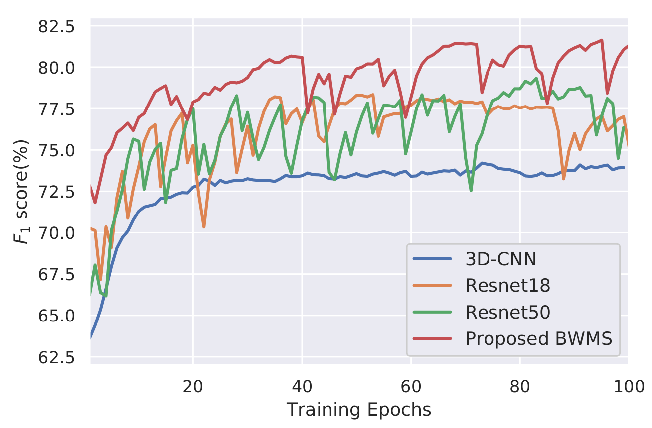
Experimental Results
Learning curves of all the considered CNN architectures:
Notes:
We first display the learning curves of F1 scores calculated on the validation set. As observed in the results, the proposed CNN architecture can preserve the higher classification accuracy compared to the other architectures during the training process.

Slide 14
Experimental Results
Classification performances (%) under all the metrics and the numbers of parameters (#) for all the considered methods:
Architectures | F1 | Acc | HL | RL | #para
3D-CNN | 74.67 | 64.73 | 7.74 | 4.51 | 1.75M
ResNet18 | 78.68 | 69.38 | 6.74 | 3.52 | 11.2M
ResNet50 | 81.05 | 72.13 | 6.18 | 2.87 | 23.6M
Proposed BWMS | 81.84 | 73.07 | 5.97 | 2.70 | 11.3M
Notes:
As shown in the table, compared with ResNet18, the performances of F1 scores and Accuracy based on the proposed architecture can achieve the improvement around 3% and 4%, respectively. However, the numbers of parameters of these two architectures are similar. Furthermore, by increasing the CNN depth, ResNet50 still cannot achieve the same classification performance as the proposed architecture, while the number of parameters of ResNet50 is more than two times of it.

Slide 15
Conclusion
A novel CNN architecture for accurately capturing the spectral-spatial information content present in high-dimensional RS images.
The proposed architecture is composed of:
A convolutional layer for extracting band-wise multi-scale spatial features
A convolutional layer for extracting pixel-wise spectral features
Standard 2D convolutional and residual blocks for learning the high-level semantic features
The proposed convolutional layers can improve the classification performance by sufficiently extracting spectral-spatial features
They can be also integrated into other high-dimensional RS image classification network, such as hyperspectral images.
Notes:
As a conclusion, the proposed spectral-spatial feature extraction modules can sufficiently capture the inherent spectral-spatial information content of the high-dimensional remote sensing images. Moreover, they can also be integrated into other high-dimensional remote sensing image classification networks, such as hyperspectral images. Thank you very much for your attention!

Slide 16
Thank you very much for your attention!

