Slide 1
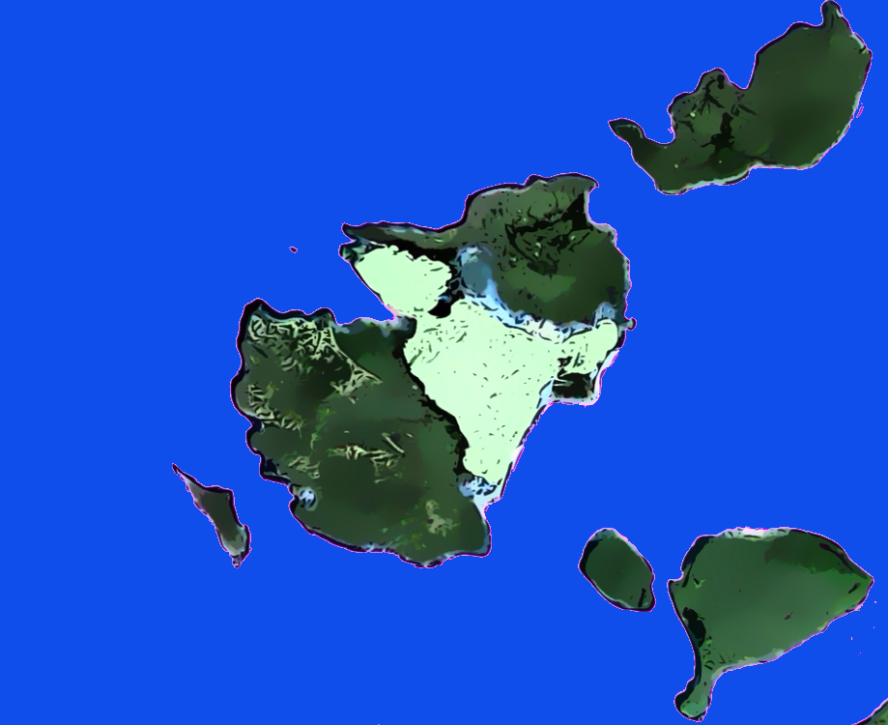





Slide 2
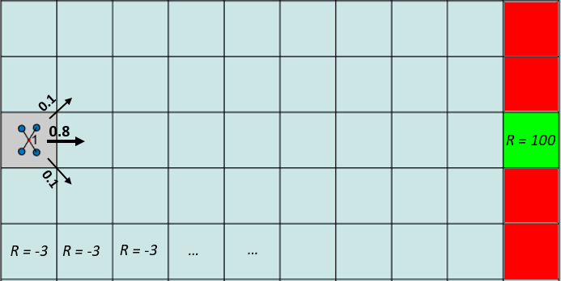
R = -100
0.1
R = -100
0.8
R = 100
0.1
R = -100
R = -3
R = -3
R = -3
…
…
R = -100

