Slide 1
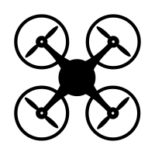
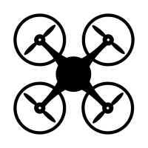



Sensor 1
Sensor 2
$$t_{a}$$
$$t_{d}$$
$$t$$

