Slide 1

Framework for stochastic analysis of mixed-criticality scheduling
Luca Stalder
Advisors: Stefan Drašković, Dr. Rehan Ahmed
Supervising Professor: Prof. Dr. Lothar Thiele, Computer Engineering and Networks Laboratory
Notes:
Talk about the Python framework I’ve been working on

Slide 2
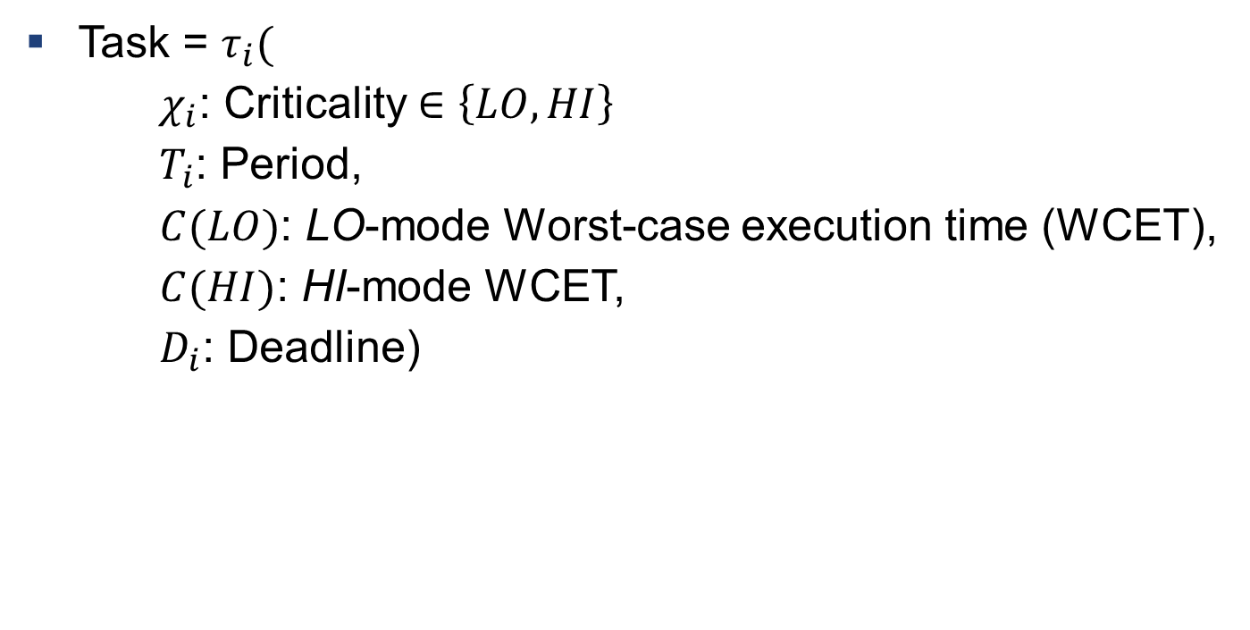
Mixed Criticality
Task = $τ_{i}($
$χ_{i}$: Criticality $∈\left\{LO, HI\right\}$
$T_{i}$: Period,
$C(LO)$: LO-mode Worst-case execution time (WCET),
$C(HI)$: HI-mode WCET,
$D_{i}$: Deadline)
Notes:
Periodic Task Sets
Introduce Criticality
Two criticality levels
For each, a C-value

Slide 3
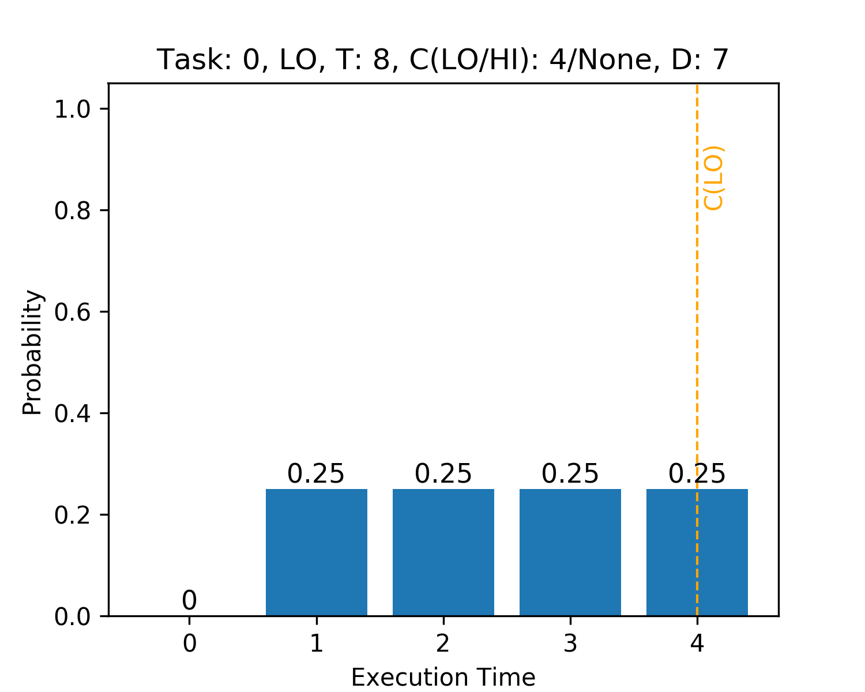
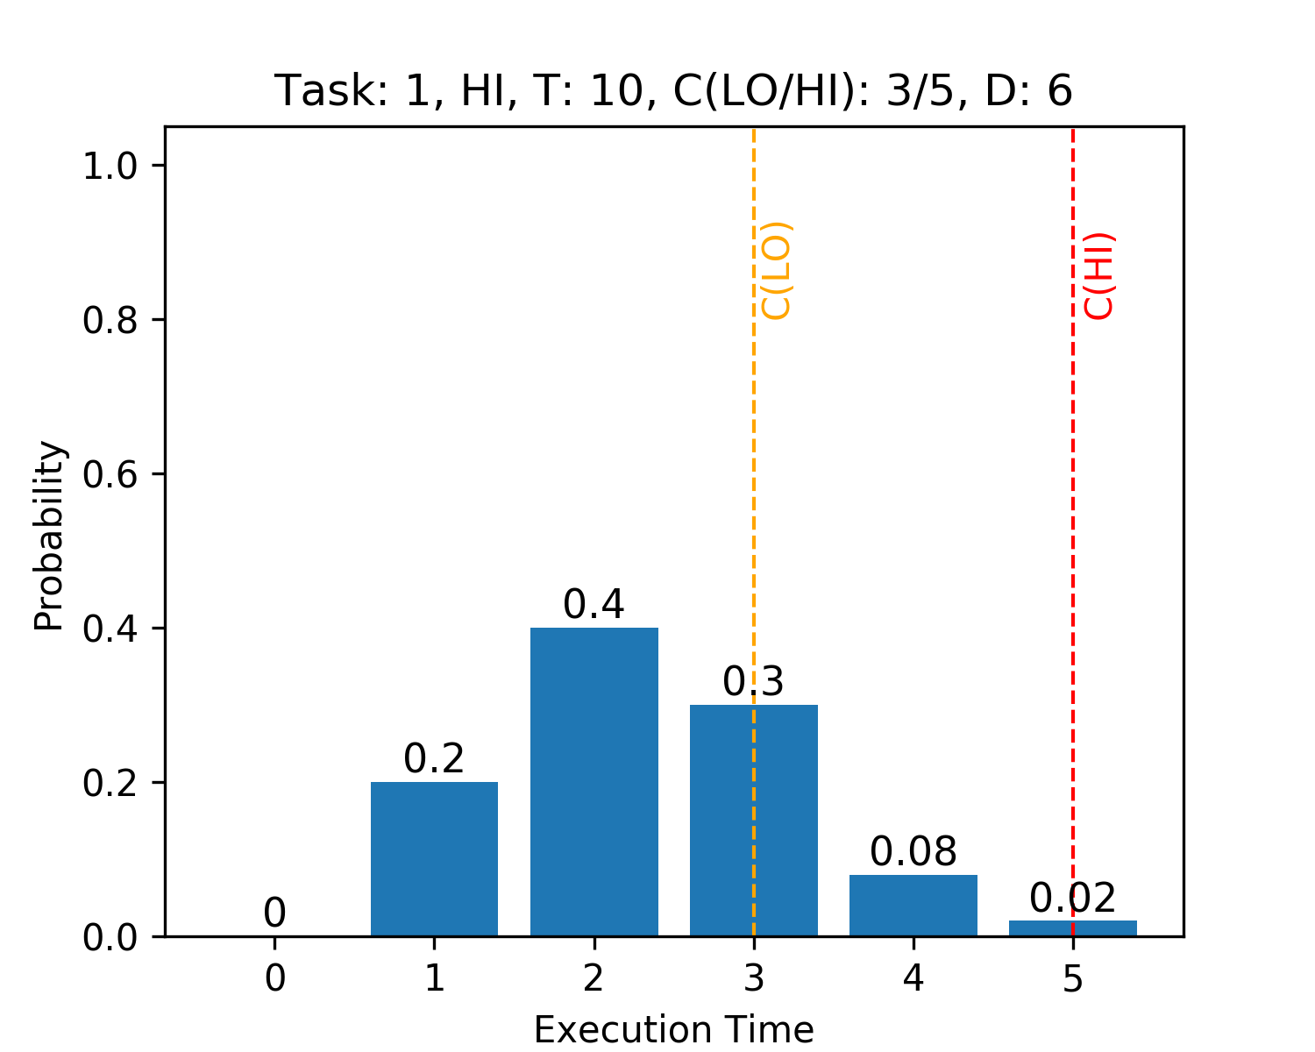
Stochastic Analysis
Notes:
Additional dimension on top of mixed-criticality

Slide 4
Motivation
«Build an extensible framework offering a wide range of analysis tools, covering and comparing different scheduling schemes.»
Notes:
many options, no clear «best» method (yet)
especially stochastic analysis is recent topic, framework brings overview
introduce standard interfaces, flexibility&extensibility for new schemes

Slide 5
The Framework
Synthesis
Task Params
Distributions
Schedulability Tests
Visualization
Plotting
Deterministic
UUnifast
ExpExceedDist
SMC
Performance
AMC
EDF-VD
Animation
Stochastic
Convolve & Shrink
Backlog Analysis
MC-FairGen
Weibull Distribution
Related Topics
pSMC
pAMC-BB
Energy Uncertainty
Monte-Carlo Simulations
Real-world Task Sets
Transient Systems
Notes:
Three parts
Different building blocks, should be interchangeable as much as possible

Slide 6
Task Set Synthesis
Synthesis
Task Params
Distributions
Schedulability Tests
Visualization
Plotting
Deterministic
UUnifast
ExpExceedDist
SMC
Performance
AMC
EDF-VD
Animation
Stochastic
Convolve & Shrink
Backlog Analysis
MC-FairGen
Weibull Distribution
Related Topics
pSMC
pAMC-BB
Energy Uncertainty
Monte-Carlo Simulations
Real-world Task Sets
Transient Systems

Slide 7
Task Set Synthesis
Deterministic Parameters
Probability Distributions
UUnifast
ExpExceedDist
MC-FairGen
Weibull Distribution
...
...
Notes:
Two distinct problems
Literary review yielded two generating algorithms, one specific …..
Any distribution in principle, used these two (heavy-tailed)

Slide 8
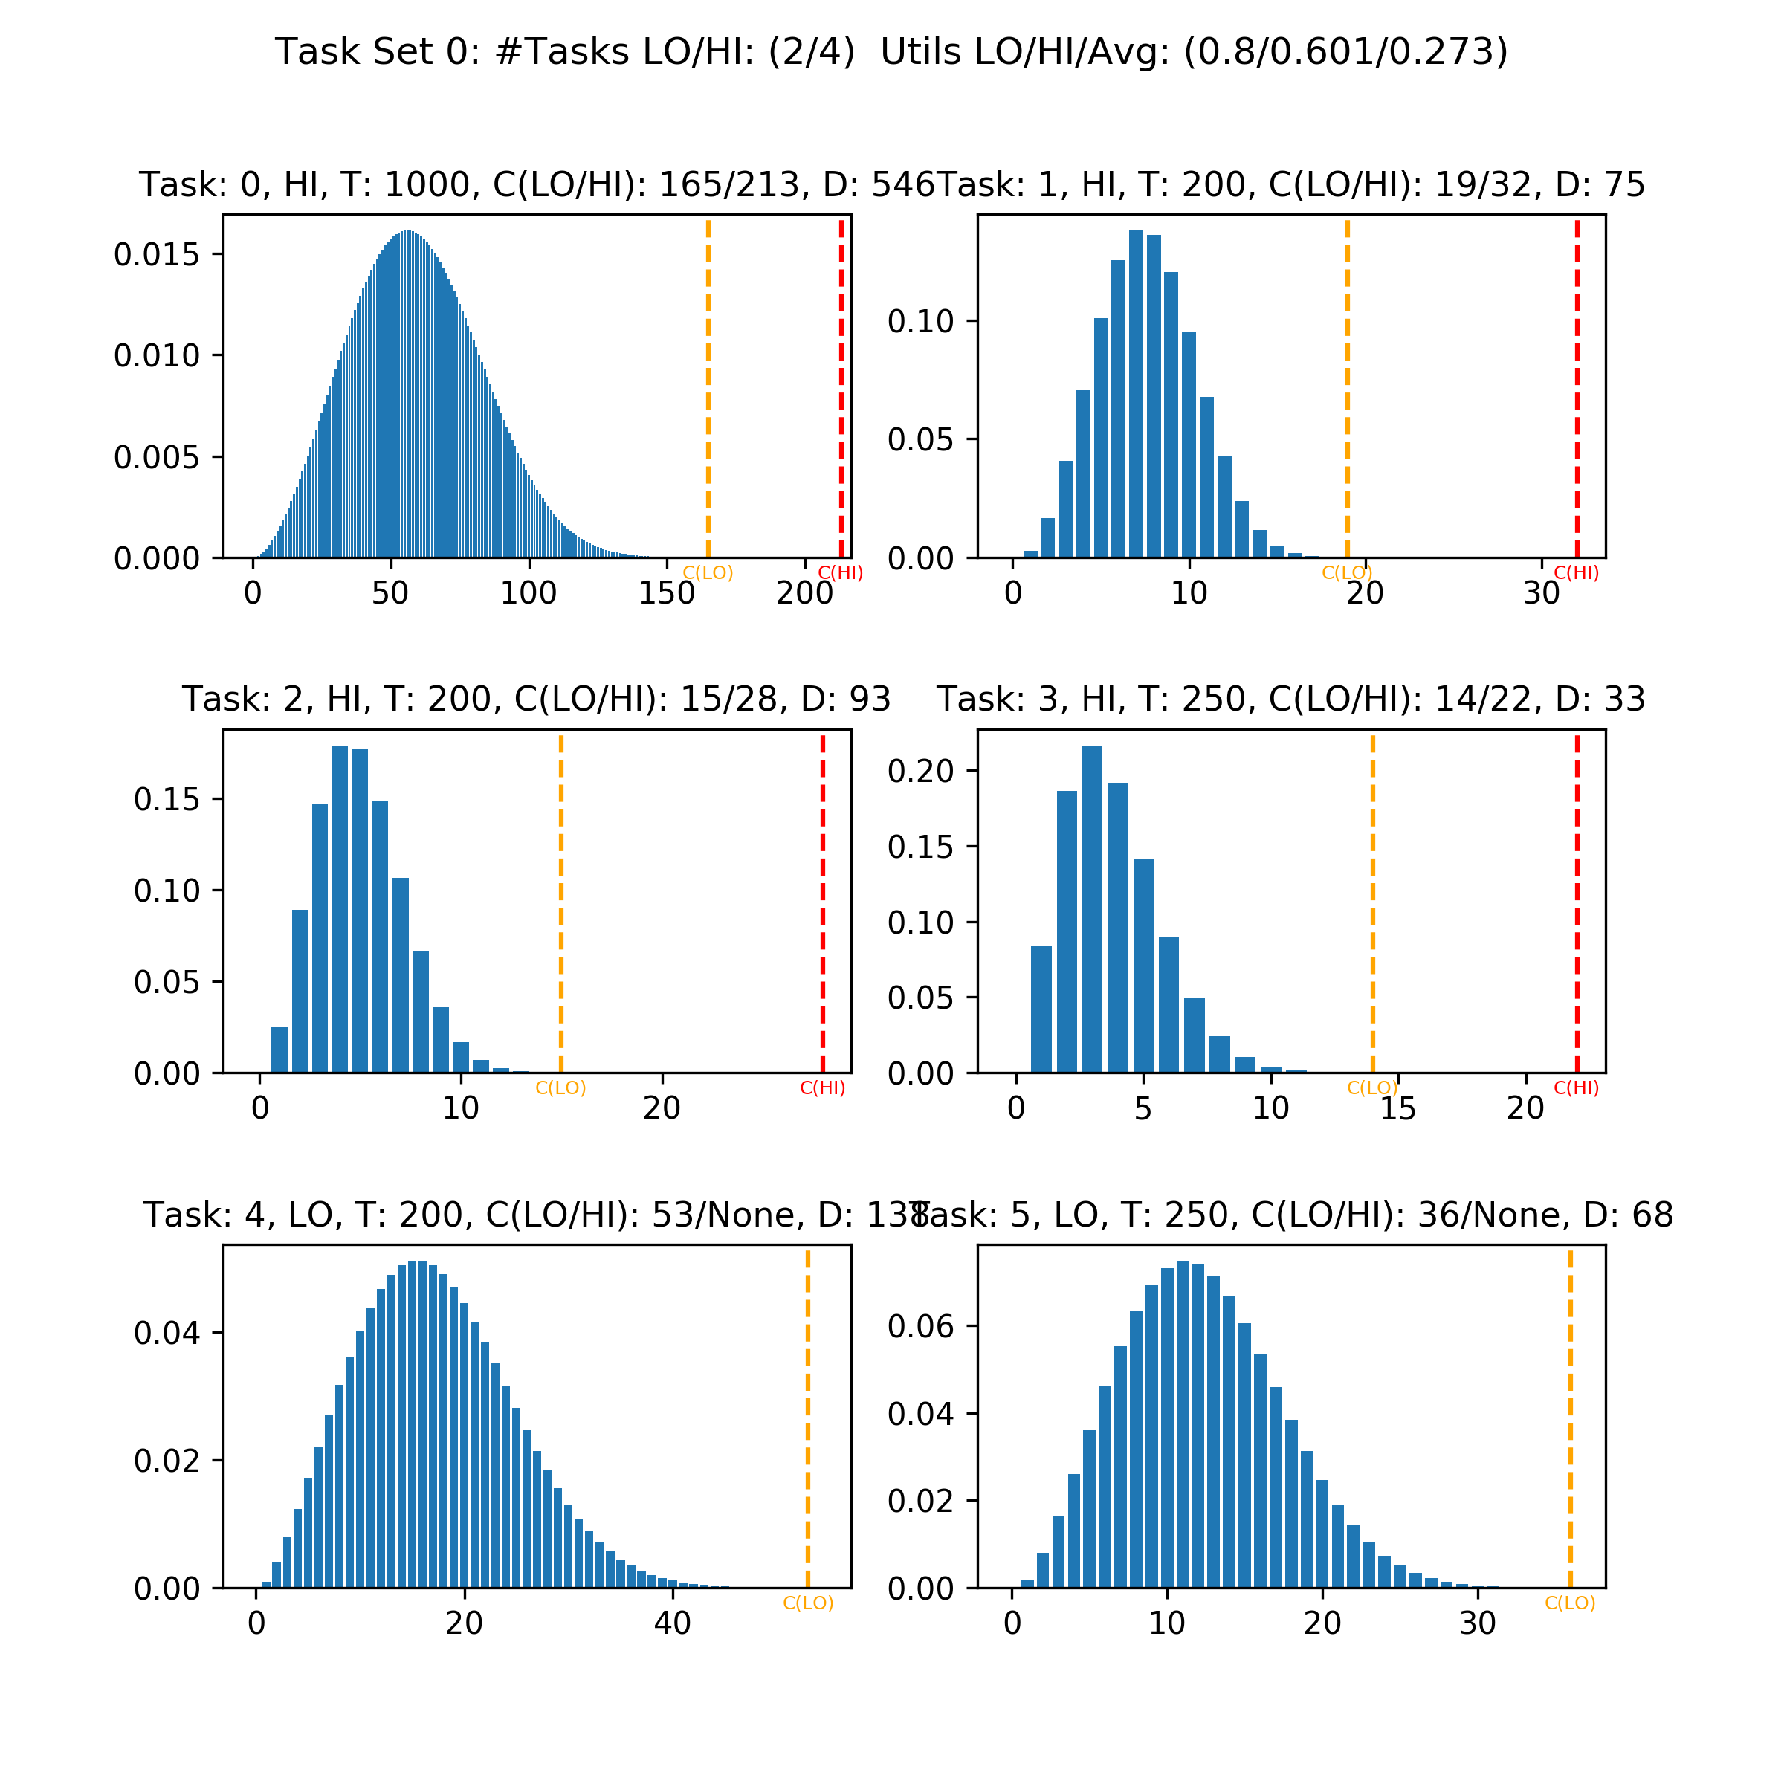
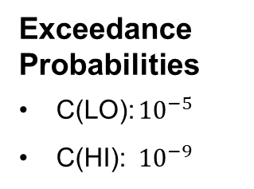
MC-FairGen with Weibull Distributions
Exceedance Probabilities
C(LO): ${10}^{−5}$
C(HI): ${10}^{−9}$
Notes:
Just added for the idea
x- and y- axis
Mention percentiles

Slide 9
Adaptive Mixed Criticality (AMC)
Synthesis
Task Params
Distributions
Schedulability Tests
Visualization
Plotting
Deterministic
UUnifast
ExpExceedDist
SMC
Performance
AMC
EDF-VD
Animation
Stochastic
Convolve & Shrink
Backlog Analysis
MC-FairGen
Weibull Distribution
Related Topics
pSMC
pAMC-BB
Energy Uncertainty
Monte-Carlo Simulations
Real-world Task Sets
Transient Systems

Slide 10
Adaptive Mixed Criticality (AMC)
Mode switch
Triggered on C(LO) budget overrun
LO-mode
Monitor execution times of running tasks
HI-mode
Only release HI-critical jobs
Degradation
On some condition, return to LO-mode
Lines of Python Code: ~50
Notes:
Fixed-priority, normally LO-mode
Additional confidence for HI-tasks with monitoring

Slide 11
Stochastic Analysis
Synthesis
Task Params
Distributions
Schedulability Tests
Visualization
Plotting
Deterministic
UUnifast
ExpExceedDist
SMC
Performance
AMC
EDF-VD
Animation
Stochastic
Convolve & Shrink
Backlog Analysis
MC-FairGen
Weibull Distribution
Related Topics
pSMC
pAMC-BB
Energy Uncertainty
Monte-Carlo Simulations
Real-world Task Sets
Transient Systems

Slide 12
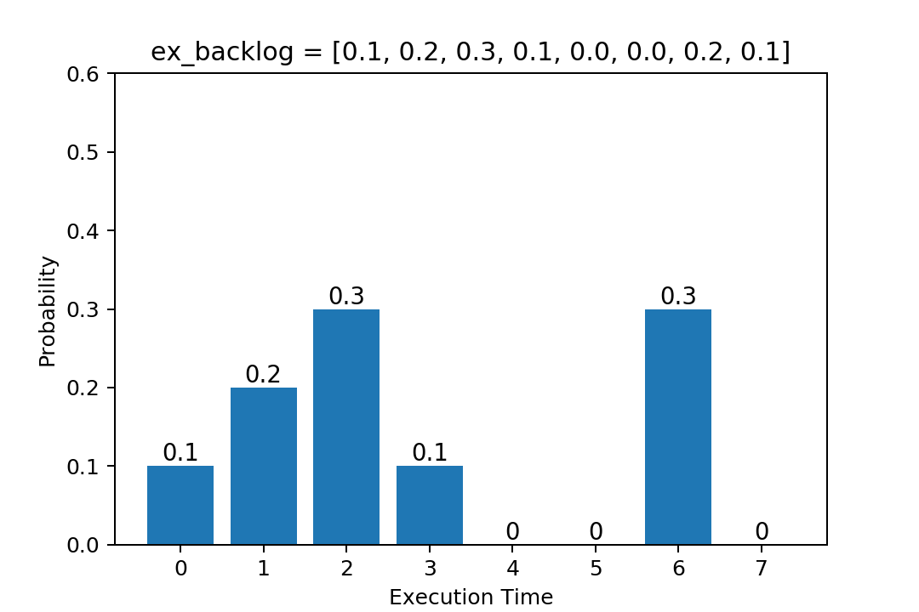
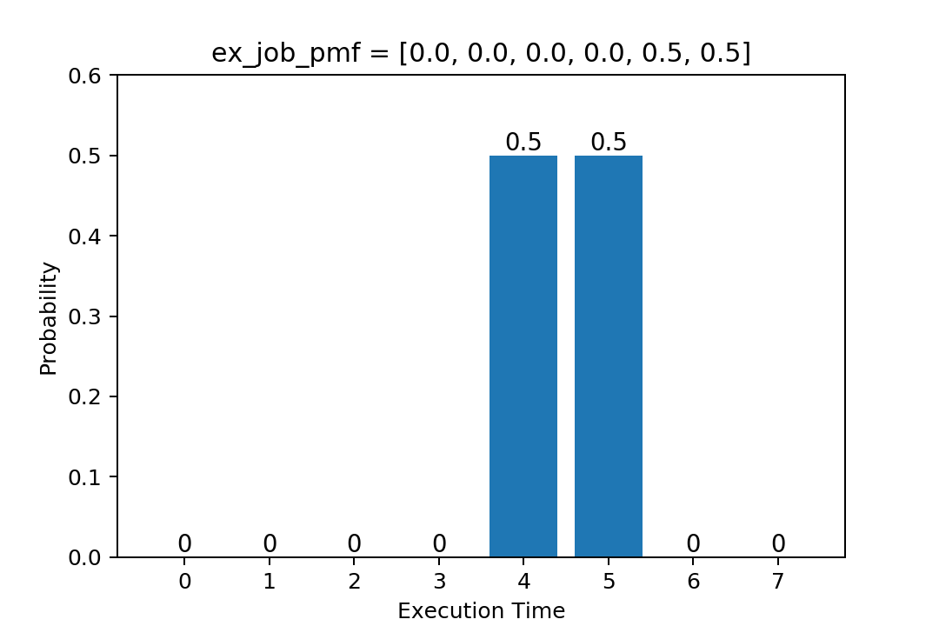
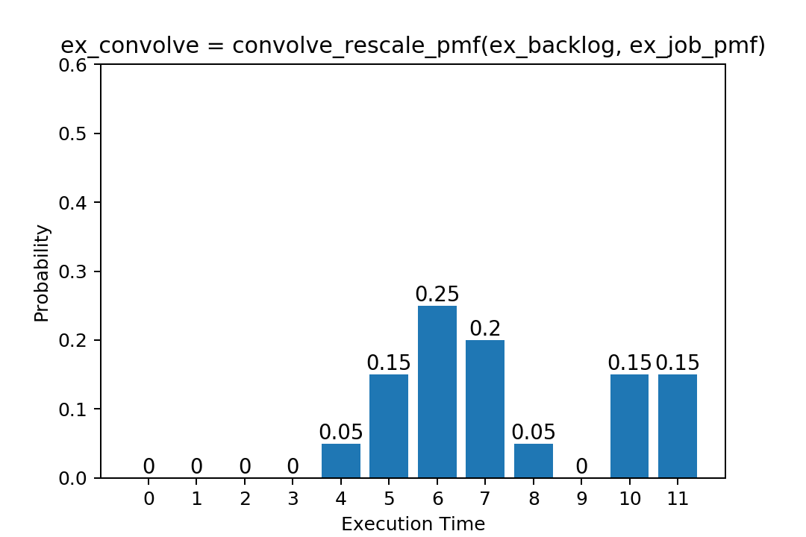

Convolution
$$⊗$$
Notes:
Backlog: Pending work
On the left: backlog distribution

Slide 13

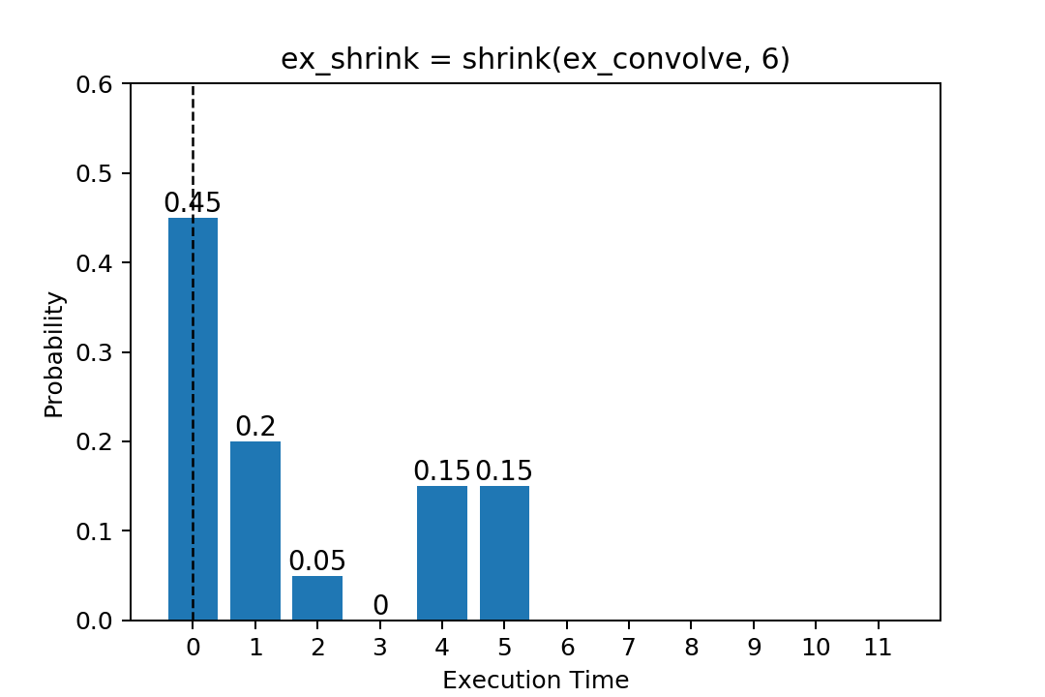
Shrinking

Slide 14
Backlog Analysis
→ Animation: Iterative backlog computation
Notes:
[Animation]

Slide 15
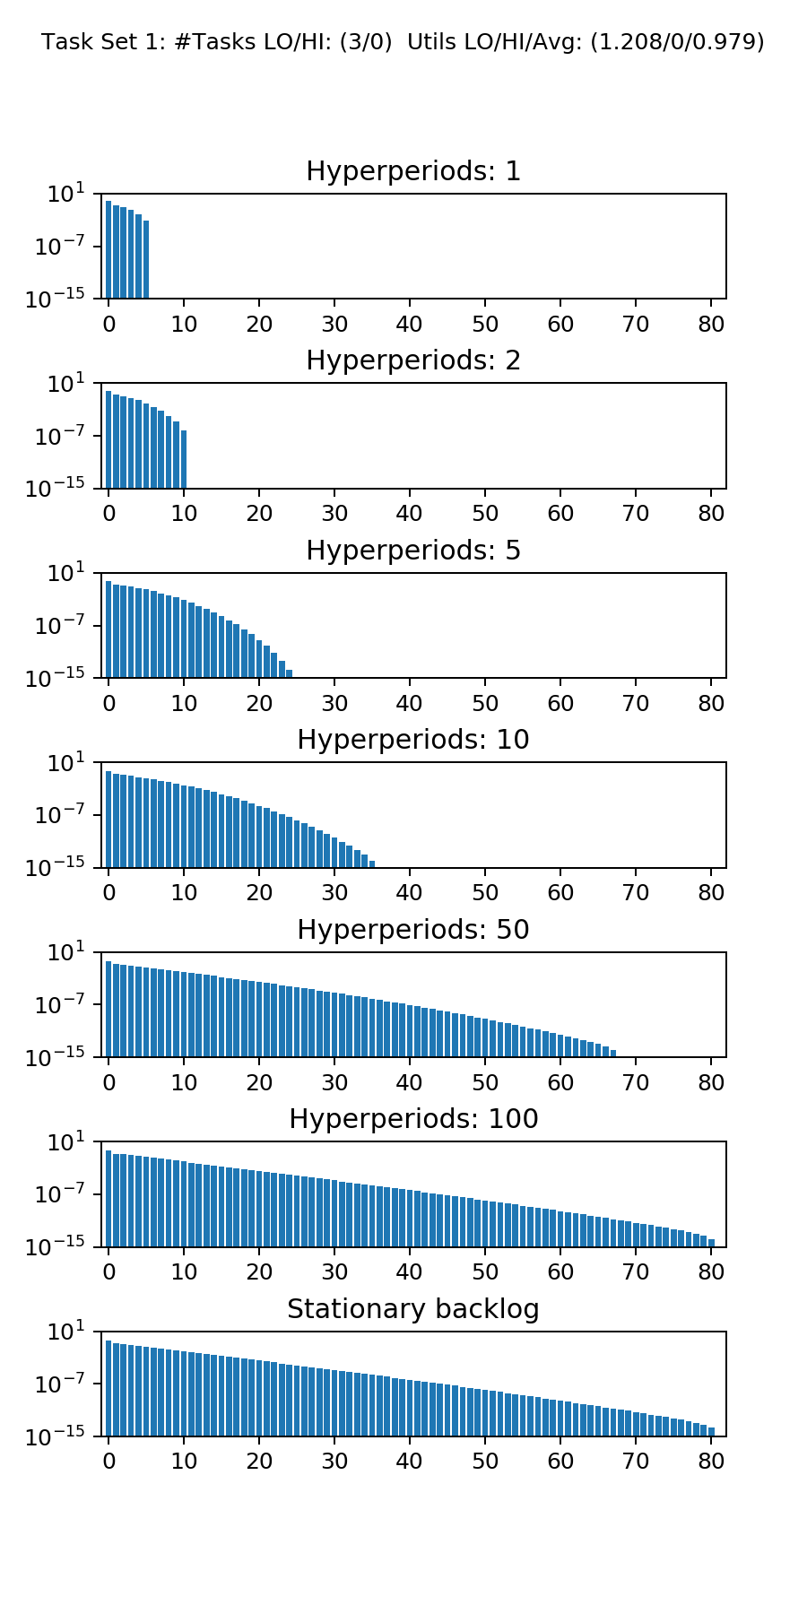
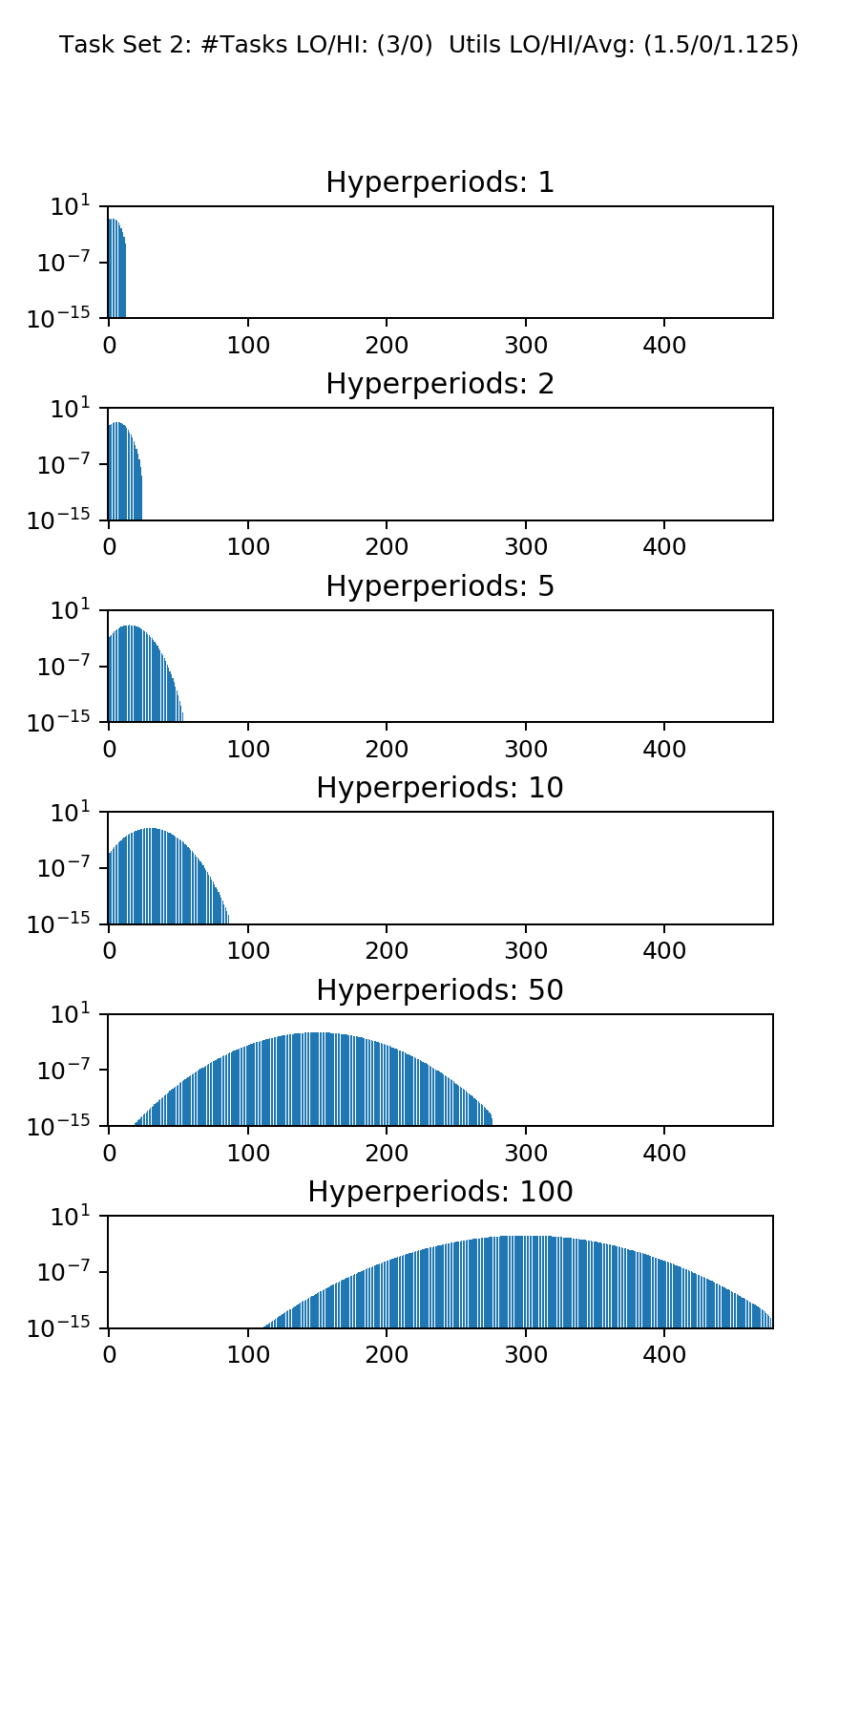
Backlog Analysis
Average Sys Util: <1
Average Sys Util: >1
Notes:
Snapshots at beginning of hyperperiod (initial backlog)
For util < 1, can be shown to converge -> steady-state

Slide 16
pAMC-BB
Synthesis
Task Params
Distributions
Schedulability Tests
Visualization
Plotting
Deterministic
UUnifast
ExpExceedDist
SMC
Performance
AMC
EDF-VD
Animation
Stochastic
Convolve & Shrink
Backlog Analysis
MC-FairGen
Weibull Distribution
Related Topics
pSMC
pAMC-BB
Energy Uncertainty
Monte-Carlo Simulations
Real-world Task Sets
Transient Systems

Slide 17
pAMC-BB
Mode switch
Triggered on C(LO) budget overrun
Kill all LO-critical jobs
LO-mode
Monitor execution times
HI-mode
Black Box
Degradation
After fixed duration, reset system
Notes:
Fixed-priority scheduling
Black box can be used for some penalty in analysis

Slide 18
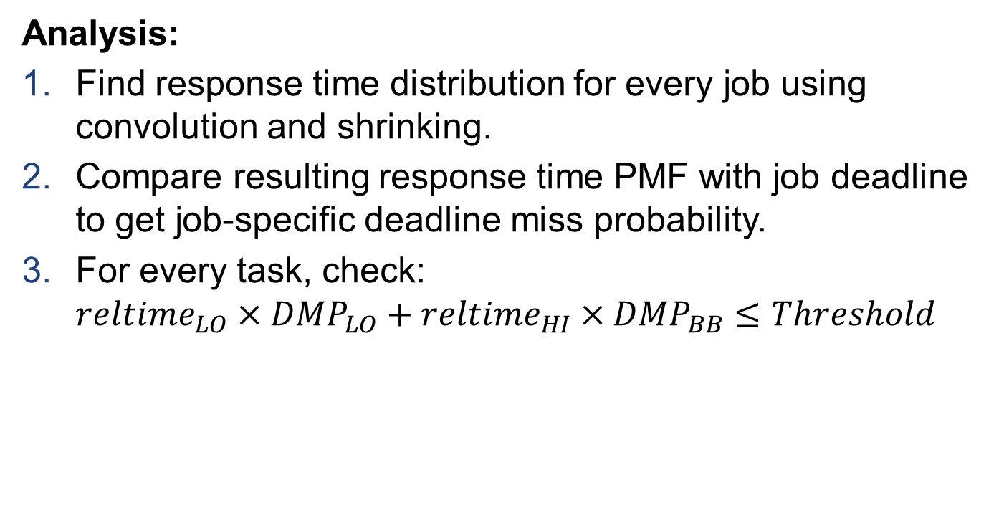
pAMC-BB
Analysis:
Find response time distribution for every job using convolution and shrinking.
Compare resulting response time PMF with job deadline to get job-specific deadline miss probability.
For every task, check: ${reltime}_{LO}×{DMP}_{LO}+{reltime}_{HI}×{DMP}_{BB}≤Threshold$
Lines of Python Code: ~30 + reusable methods
Notes:
«in-house»

Slide 19
Visualization
Synthesis
Task Params
Distributions
Schedulability Tests
Visualization
Plotting
Deterministic
UUnifast
ExpExceedDist
SMC
Performance
AMC
EDF-VD
Animation
Stochastic
Convolve & Shrink
Backlog Analysis
MC-FairGen
Weibull Distribution
Related Topics
pSMC
pAMC-BB
Energy Uncertainty
Monte-Carlo Simulations
Real-world Task Sets
Transient Systems

Slide 20
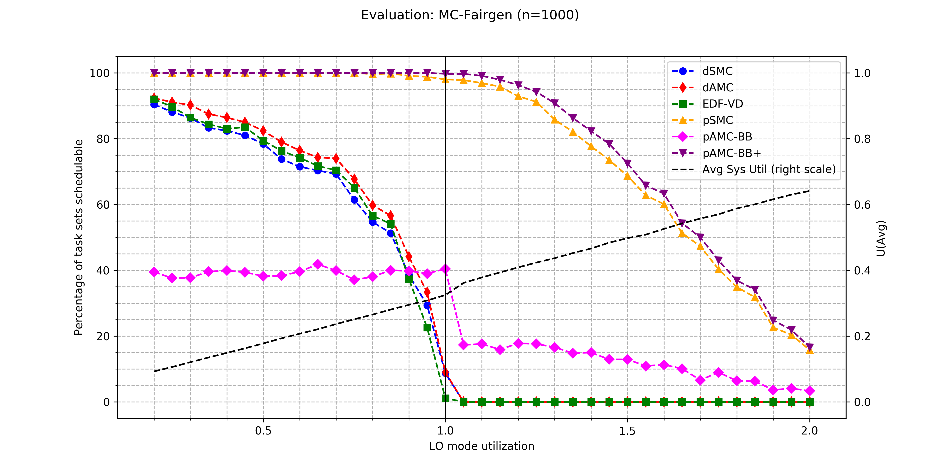
Visualization: Deterministic vs. Probabilistic
Time measured: 1h 21min 28s, Intel i5-7600K, 4 cores @ 3.8 GHz
Notes:
x-y-axes
Deterministic stops at 1
On framework performance: time measured

Slide 21
Monte-Carlo Simulation
Synthesis
Task Params
Distributions
Schedulability Tests
Visualization
Plotting
Deterministic
UUnifast
ExpExceedDist
SMC
Performance
AMC
EDF-VD
Animation
Stochastic
Convolve & Shrink
Backlog Analysis
MC-FairGen
Weibull Distribution
Related Topics
pSMC
pAMC-BB
Energy Uncertainty
Monte-Carlo Simulations
Real-world Task Sets
Transient Systems
Notes:
Monte Carlo alternative schedulability test
Tries a lot instead of analytically solving

Slide 22
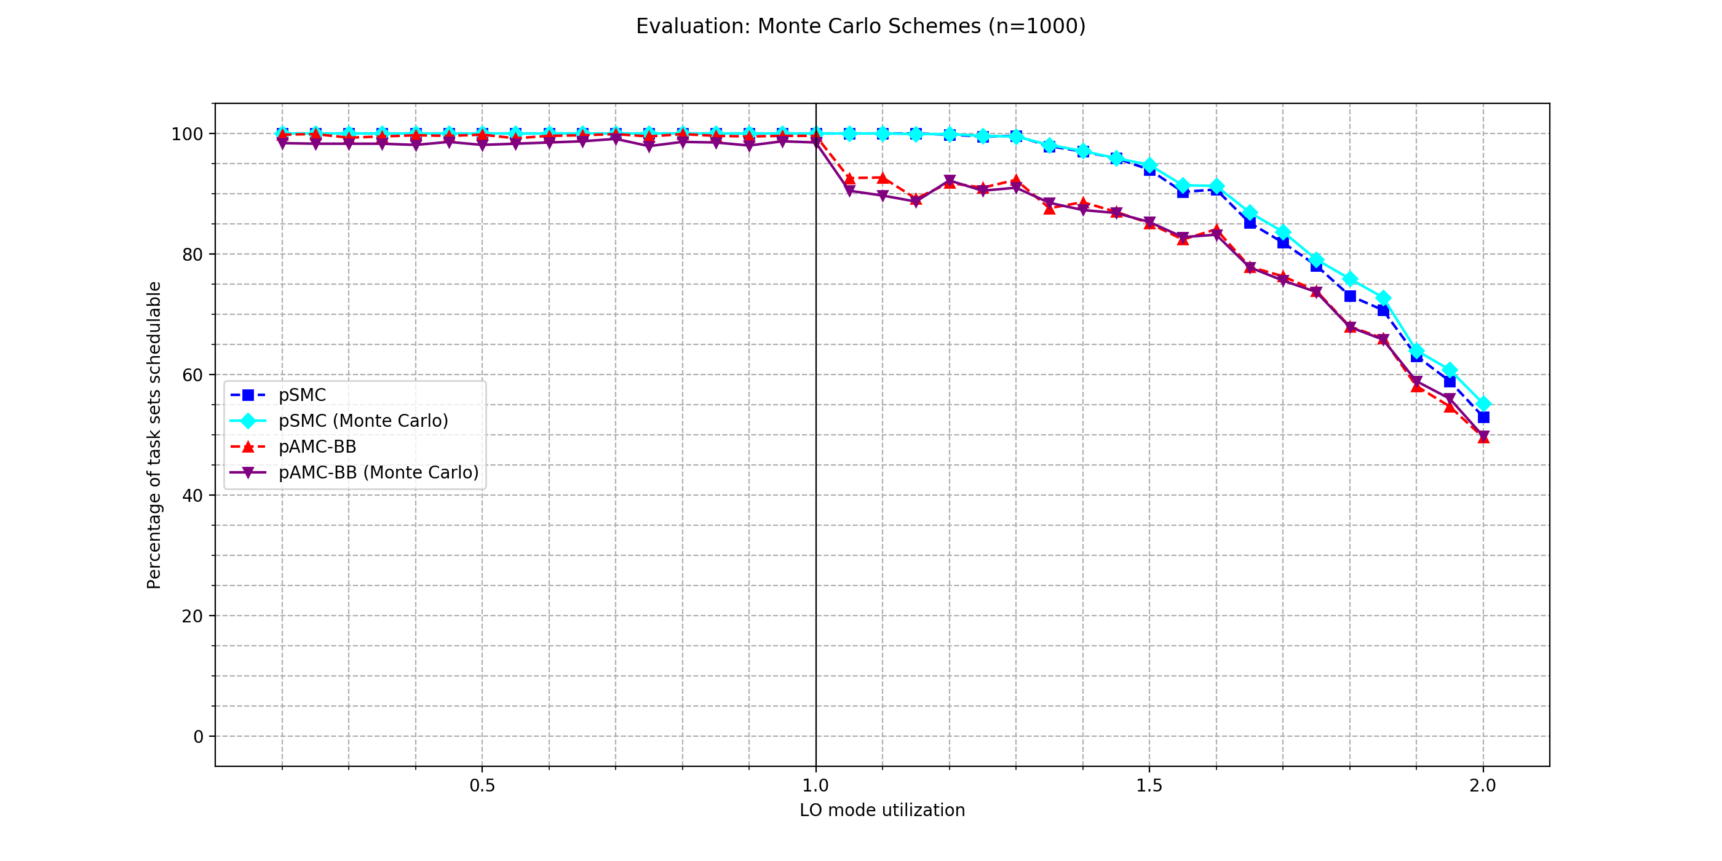
Visualization: Monte-Carlo Simulation
Time measured: 23h 20min 13s, Intel i5-7600K, 4 cores @ 3.8 GHz
Notes:
Very expensive (even with multi-threading)

Slide 23
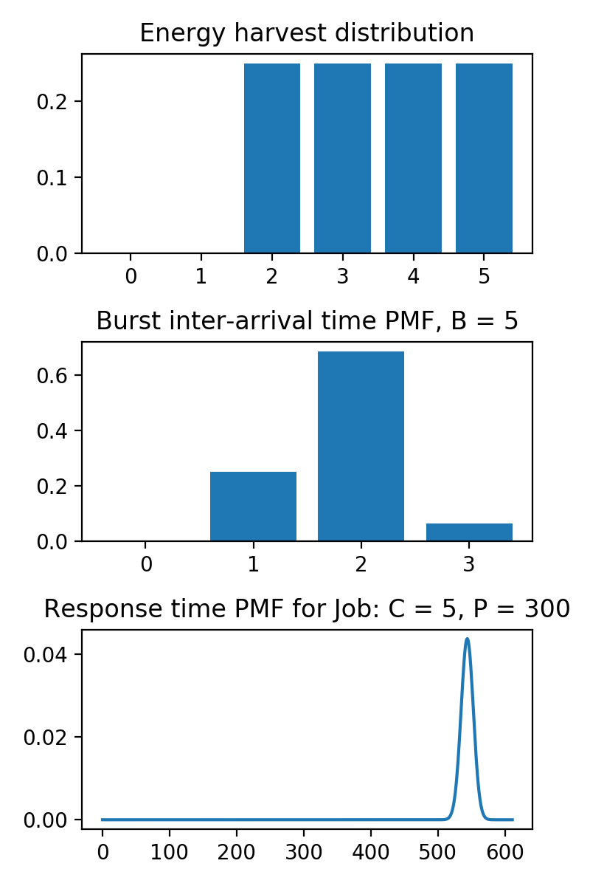
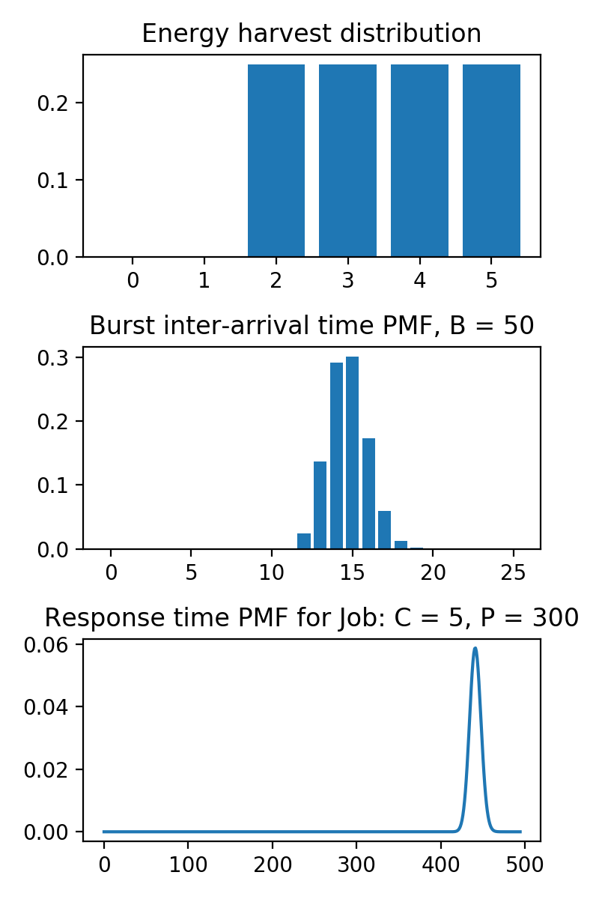
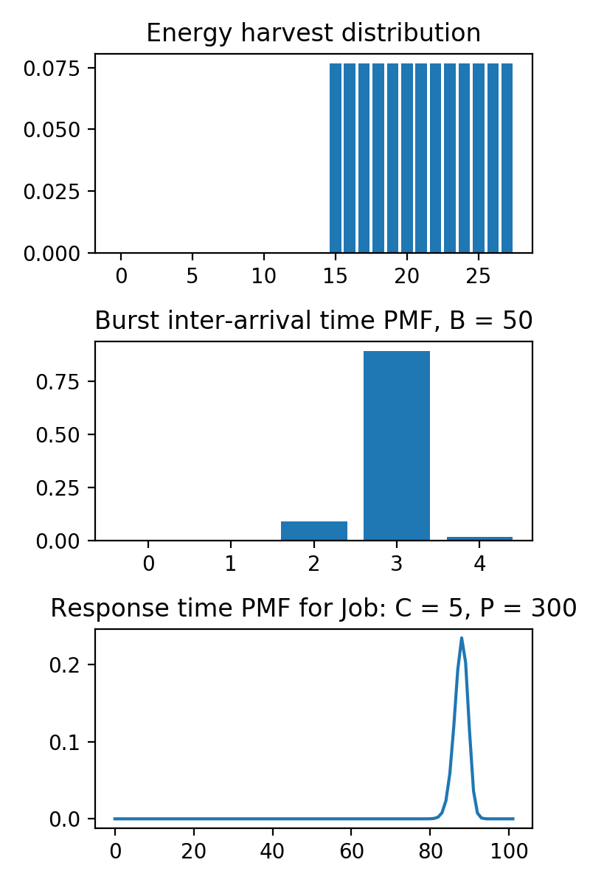
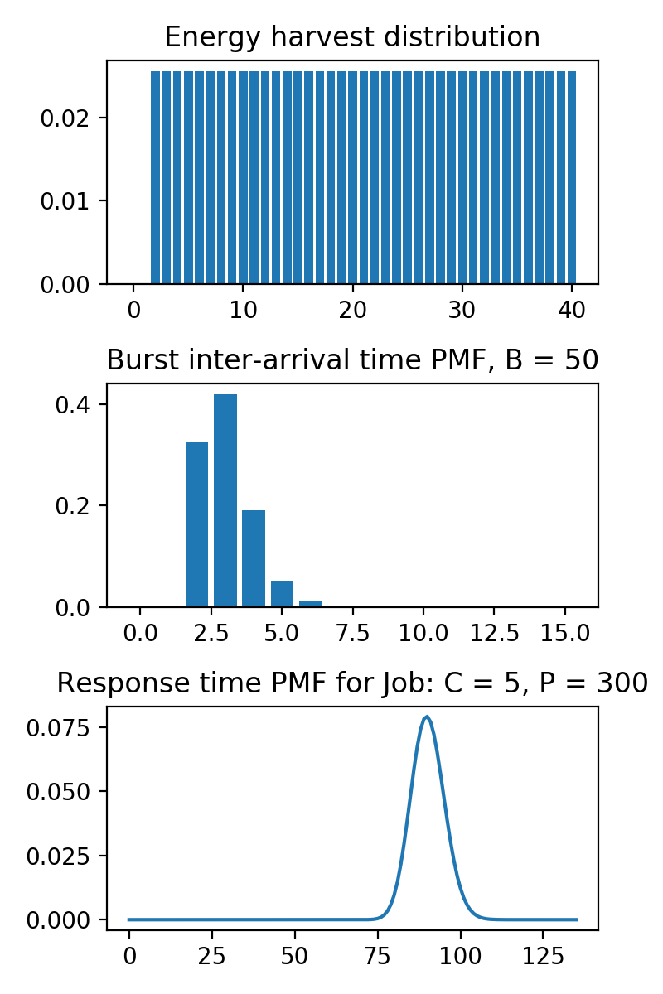
Energy Uncertainty

Slide 24
Conclusion
Still at the beginning!
Future work:
Task Set Synthesis (distributions, influence of different parameters)
Stochastic HI-mode analysis
Expand on related topics (e.g. energy uncertainty)
Notes:
Personally: Great introduction to world of academia
I also could always count on guidance from my advisors, so thank you guys for that!

Slide 25
Discussion
Synthesis
Task Params
Distributions
Schedulability Tests
Visualization
Plotting
Deterministic
UUnifast
ExpExceedDist
SMC
Performance
AMC
EDF-VD
Animation
Stochastic
Convolve & Shrink
Backlog Analysis
MC-FairGen
Weibull Distribution
Related Topics
pSMC
pAMC-BB
Energy Uncertainty
Monte-Carlo Simulations
Real-world Task Sets
Transient Systems

