Slide 1

I bet my plane won’t crash A framework for stochastic analysis of mixed-criticality scheduling
Luca Stalder
Advisors: Stefan Drašković , Dr. Rehan Ahmed
Supervising Professor: Prof. Dr. Lothar Thiele, Computer Engineering and Networks Laboratory
Notes:
Good morning, thanks for having me
I’m in fact a CS student, but always loved being close to the hardware
Big fan of robotics…
Bit of a wacky title (have to go with the times)

Slide 2
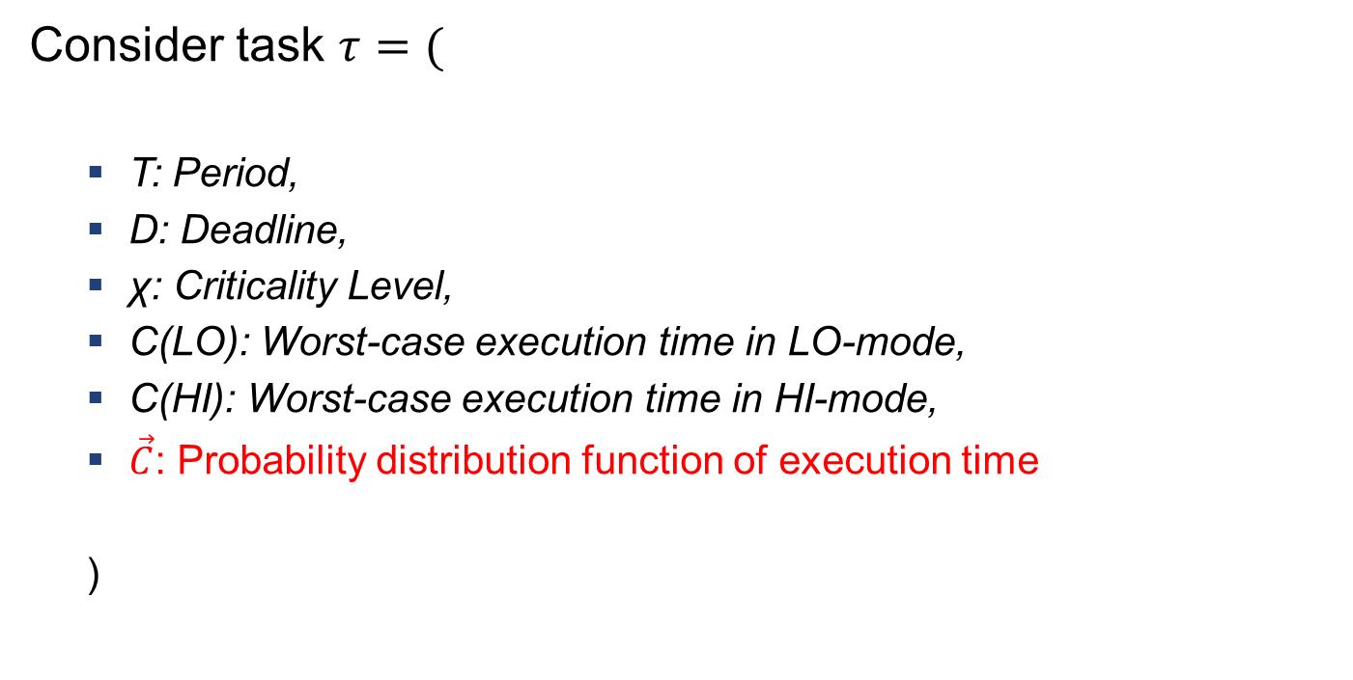
Introduction Stochastic analysis of mixed-criticality systems:
Consider task $τ=($
T: Period,
D: Deadline,
χ: Criticality Level,
C(LO): Worst-case execution time in LO-mode,
C(HI): Worst-case execution time in HI-mode,
$\vec{C}$: Probability distribution function of execution time
)
Notes:
first talk about what’s behind subtitle
mixed criticality system: more and less important tasks
allows safer operation on common infrastructure
pdf adds more info and allows for less pessimistic scheduling

Slide 3
Motivation
Build a framework which can…
… generate unbiased stochastic mixed-criticality task sets.
… perform schedulability analysis – based on various scheduling approaches – and visualize the results.
… also consider the problem of a system’s limited energy.
… be used with ease while still being extensible, so that future methods and usages can be integrated.
Notes:
a lot of research existing: we review material and build framework
want to compare different scheduling policies
energy: sometimes scheduling fails because of not enough energy
last one: non-functional requirement

Slide 4
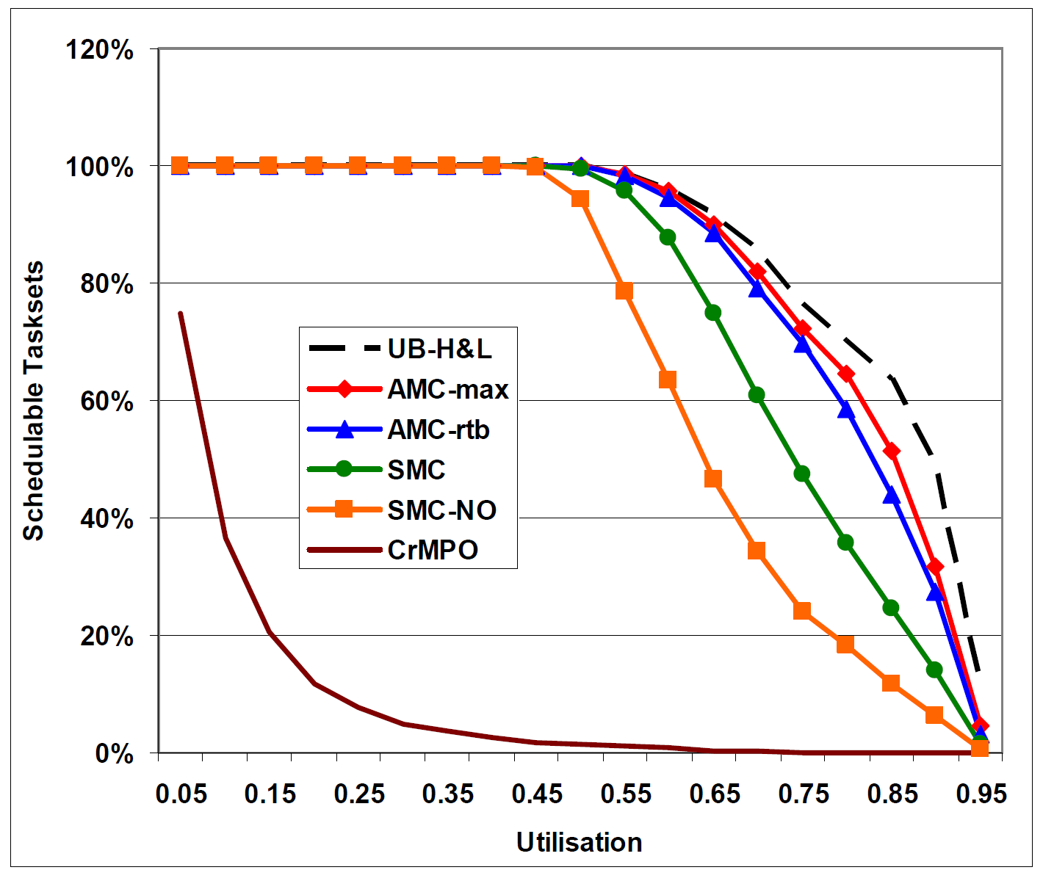
Part 1: Deterministic Analysis & Task Set Generation
Key implementation challenges:
Finding „reasonable“ parameters and execution time distributions
Avoiding bias
Source: Mixed Criticality Systems – A Review, A. Burns & R. Davis, 2017
Notes:
Figure: Different scheduling policies, compared on schedulability
Different design choices: Compare on LO-/HI- or max vs avg util?
Also to familiarize myself with whole topic
Task sets not to favor one scheduling over the other

Slide 5
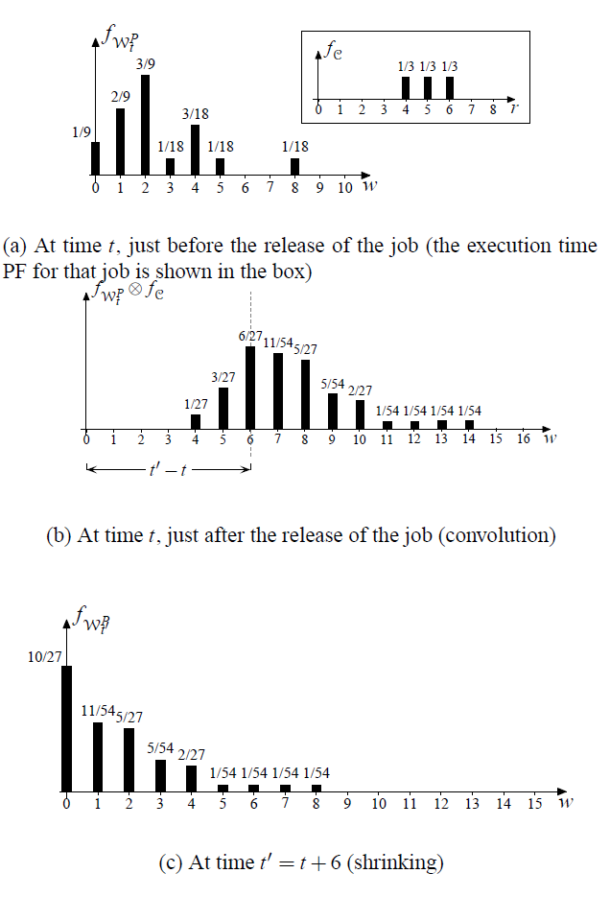
Part 2: Stochastic Analysis
Key implementation challenges:
Finding & comparing performance measures
Extracting meaningful results
Source: Proceedings of the 23rd IEEE REAL-TIME SYSTEMS SYMPOSIUM, 2002
Notes:
Figure: See different PDFs, do operations on them
Performance: No more binary (YES/NO)

Slide 6
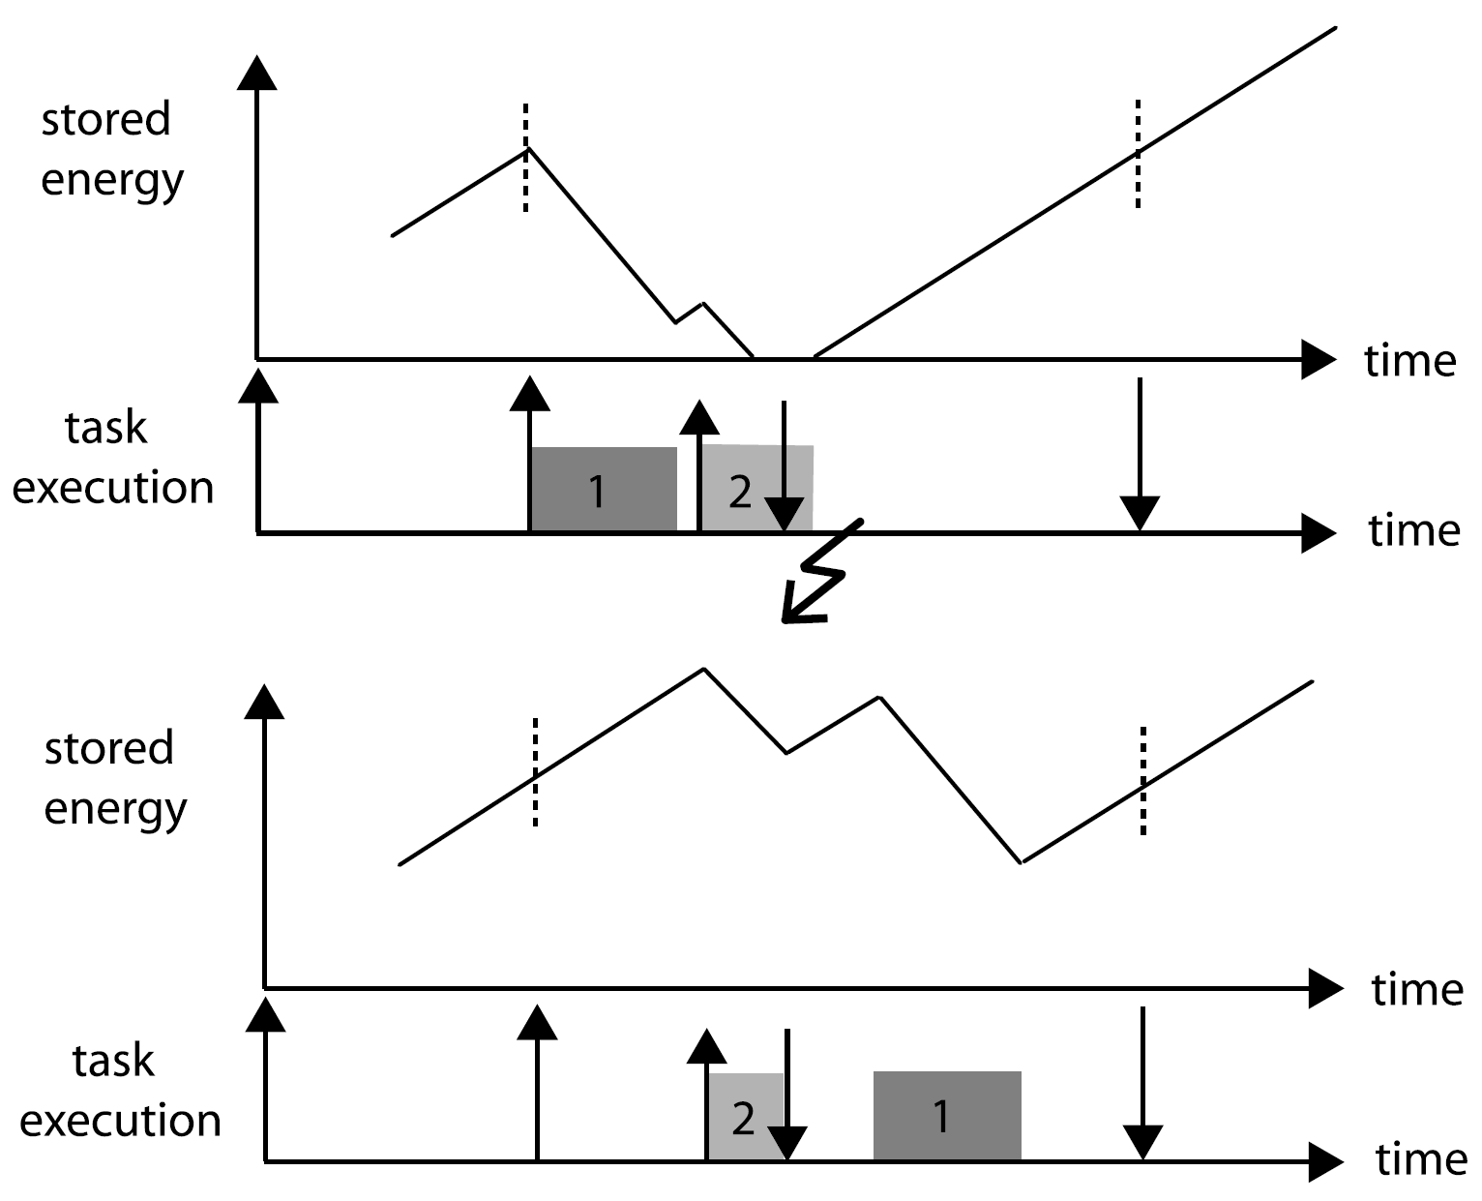
Part 3: Energy Awareness
Key implementation challenges:
Introducing variable power source
Finding relevant metrics in this new system
Source: Real-time scheduling for energy harvesting sensor nodes, C. Moser, D. Brunelli, L. Thiele, L. Benini, 2007
Notes:
- Figure: Lot of research, also here from TIK (?) Different ways of scheduling, one fails because of energy.
might seem a bit off-topic, but maybe can be modeled using principles already in use
Try introducing power source without going too far off tracks

Slide 7
Discussion
Notes:
- That concludes my introduction, happy to hear questions or comments

