Slide 1
Advanced Deep Learning Architectures for Protein Contact Map Prediction
The BDM Lab
Department of EECS
University of Missouri, Columbia
Oct. 22, 2018

Slide 2
Objective
Design and benchmark a number of advanced deep learning architecture for protein contact prediction
Rigorously compare them with existing deep learning methods for contact prediction
Create a state-of-the-art contact predictor
Publish the paper in 2019 and compete in CASP14 in 2020

Slide 3
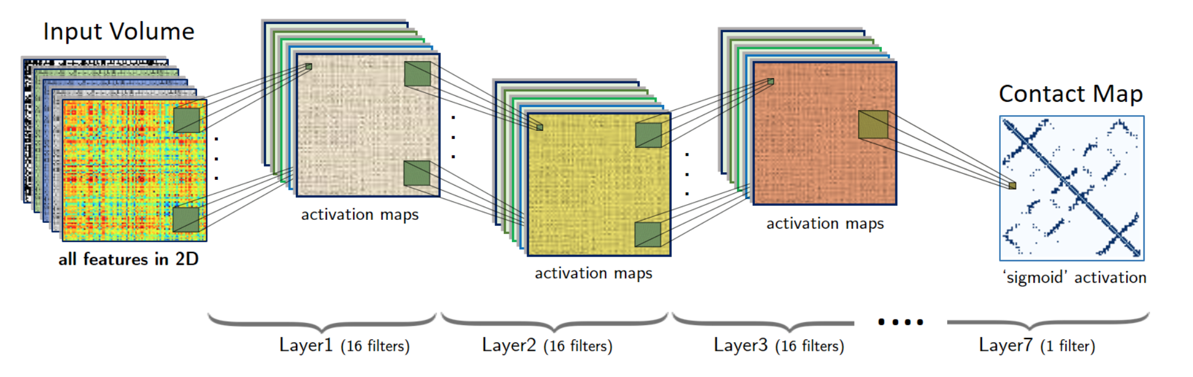
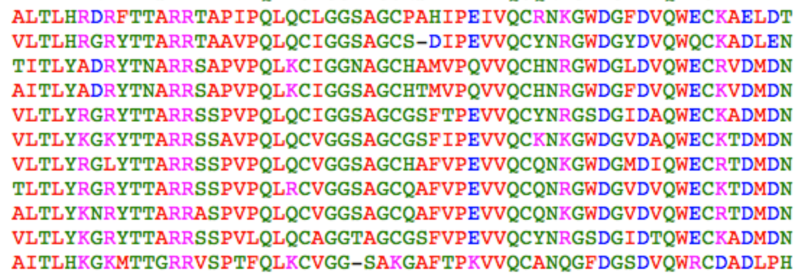
Our Current DNCON2: 2D Convolutional Network for Contact Prediction
i
j
Input Matrix
Co-evolution
Mutation information
Secondary structure
Solvent accessibility
…
Adhikari et al., 2017

Slide 4
Where and How to Improve?
Larger, better training datasets (currently about 1,400 training proteins)
Better sequence alignments and sequence databases for feature generations
Better, more robust input features (currently unreliable feature generation, irrelevant features)
More advanced, state-of-the-art deep learning architectures (currently not very deep, not using advanced technologies and architectures)
Better training, parameter tuning, control overfittting
More rigorous benchmarking (more test datasets, more evaluation metrics)
Other aspects?

Slide 5
Large training dataset
Select proteins from our MULTICOM template library released before a specific date (e.g. before CASP10?)
Reduce pairwise redundancy to less than 25% identity
Only keep the structures with <= 2.5 A resolution determined by X-ray and without chain breaks?
Collect existing datasets using in the field?
Use a randomly selected portions of the training dataset as a validation dataset and a blind test dataset
Compare the new datasets with the DNCON2 training dataset
PDB select
RaptorX dataset

Slide 6
Sequence databases and alignment generation
Test UniRef, hhblits databases (unitprot30 new?), and Non-Redundant (NR) protein sequence databases on all the proteins (TBM and FM) targets of CASP10-13
Metagenome database from Soeding’s group (missing last time)
Hhblits databases → we should create the updated database from NR using hhblits tools
Our own redundancy reduction from NR
Test different alignment methods: PSI-BLAST, Jackhmmer, HHblits

Slide 7
Feature generation and selection
Collect all the co-evolution feature generation tools, test tem, and select accurate, complementary, and reliable ones according to the training and validation datasets
Upgrade secondary structure, solvent accessibility predictors
Perform feature selection to remove irrelevant features
Add some new features (check recent papers or CASP13 abstract)
Build a very robust feature generator that works without crashing or hanging

Slide 8
Input representation (big problem)
Reduce memory requirement
Use both 1D and 2D to make the architecture memory-efficient.
Using inception idea to decompose large convolution/matrix into two smaller operations to make it faster to train and less memory intensive.
Maybe: consider PCA to reduce number of input features. Another feature select can reduce input size.

Slide 9
Advanced Deep Learning Architectures
Convolution
Residual to make it deeper
Recurrent (e.g. LSTM)
Inception, attention, capsule
Combination of the elements above (there are many)
Batch normalization
Drop-out
Different activation functions (ReLU, leaky ReLU, more)
Average the results from multiple architectures
Multiple thresholds: (<6, [6, 8), [8, 10), >=12)

Slide 10
Training and Tuning
Tune hyper parameters according to validation dataset and training dataset
Monitor results on CASP10-13 and the independent test dataset
Improve the efficiency of training (using parallel computing and memory well)
Monitor the performance of different architectures
Adjust the architectures if needed

Slide 11
Rigorous test and evaluation
CASP10-13 datasets
The independent test datasets
External test datasets
Comparison with: co-evolutionary features, DNCON2, RaptorX, and all CASP13 predictors and other publicly available tools based on deep learning or co-evolutionary features
Using multiple metrics (see CASP12/13 contact prediction papers and presentations)
Evaluate how well contacts can be used to build models on CASP12 and CASP13 datasets
Contact cluster prediction?

Slide 12
Assess how features and domains affect prediction performance and analysis of predicted maps?
Quantify the impact of features on prediction accuracy
Can we predict/assess if a prediction is reliable or not?
Contact clusters? prediction patterns?
Domain issues? How to combine predictions for individual domains?
Visualization of predicted contact maps? (ConEVA)

Slide 13
Building a tool
Build a high quality tool for contact prediction
Reliable
Authentic
Robust
Easy to install and use
Have documents
Have samples
Have test datasets

Slide 14
Project management
A private GitHub repository
A clone copy on which server (lewis, sunflower, lotus, violet?)
Unit testing (conducted frequently)
System testing (biweekly)
Programming languages (Python 3, Perl, Keras 2.08, R for data analysis)
Software development environment (TensorFlow 1.9.0)
Project structure (data (Jie, Tianqi, Farhan), feature (Tianqi, Farhan), architecture (Jie, Zhiye), train (Jie, Zhiye), test (Farhan, Tianqi), doc || examples, bin, src, lib, model)
Task assignment (individual responsibility, cooperation, proceed in parallel)

Slide 15
Development model and timeline
Agile software development
Oct., 2018 – initial planning and design
Nov., 2019 – data, feature, architecture design
Dec., 2019 – improve feature, architecture, training, testing
Jan, 2019 - improve feature, architecture, training, testing
Feb. 2019 – rigorous benchmarking, tool development, manuscript writing
March, 2019 – end of 2019: publication, improvement, CAMEO testing

