Slide 1
Train
Training dataset
Cross-Validation dataset
Test
Test dataset
Extra-test dataset

Slide 2
Weight layer
elu
Weight layer
Weight layer(BottleNeck)
elu
elu
Weight layer
Weight layer
Weight layer
elu
Concatenate
elu
elu

Slide 3
0.8895942
1.2304895
1.2039482
2.3049857
BandGap=
Input data
Conv Layer
Conv Layer
Concatenate
Concat Block
Concat Block
Output value
Global maxpooling
FC Layer
FC Layer
Concat Block 1
Concat Block 2
Input layer
Conv Layer
Bottleneck Layer
Conv Layer
Concatenate Layer
Conv Layer
Bottleneck Layer
Conv Layer
Concatenate Layer

Slide 4
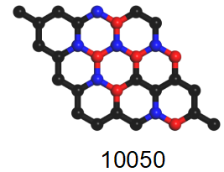
Input Volume
First Conv-Layer
Second Conv-Layer
Graphene Structure
Combine into 2-D data
16th Conv-Layer
First FC-Layer
Second FC-Layer
Third FC-Layer
Global MaxPooling Layer
0.8895942
1.2304895
1.2039482
2.3049857
BandGap=
Out Layer
Extract biggest feature from each 2D feature map

