Slide 1
Expectation–Maximization Approach to Fault Diagnosis With Missing Data

Slide 2
Agenda
1. Introduction
2. EM Algorithm
3. Conclusion

Slide 3
Introduction
This paper introduces a data-driven approach for fault diagnosis in the presence of incomplete monitor data. The expectation–maximization (EM) algorithm is applied to handle missing data in order to obtain a maximum-
likelihood solution for the discrete (or categorical) distribution. Because of the nature of categorical distributions,the maximization step of the EM algorithm is shown in this paper to have an easily calculated analytical solution,making this method computationally simple. An experimental study on a ball-and-tube system is investigated to demonstrate advantages of the proposed approach.

Slide 4
Introduction
FDI methods
· model-based approaches
Principle :calculate the residuals through observers,use the global analytical redundancy relations.
Disadvantage:the applicability of these methods is limited, as building a model for more complex systems is often considered difficult.
· data-driven approaches
Make use of historical data for training
Bayesian solution:deal with complete training data
EM:deal with incomplete data and multiple missing data patterns

Slide 5
Introduction
· Components and Behavioral Modes
·m1=sensors.m2=actuators.m3=pipes
·the number of modes will exponentially grow with respect to the number of components
· Evidence
·e ∈ {e1, e2, . . . , eK}
·The number “1” means there is an abnormal event detected by the corresponding monitor;
“0” indicates no abnormality has been detected.
· Training Data
·D = {d1, d2, . . . , dN}, D:historical training data
·D ={Dm1,Dm2, . . . , DmQ}

Slide 6
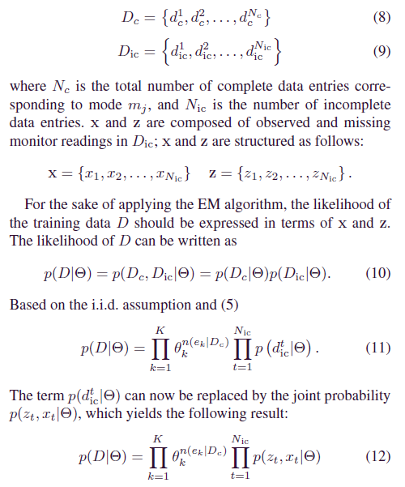
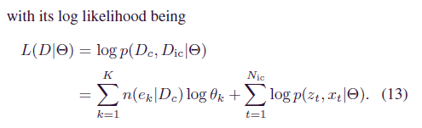
Introduction

Slide 7
EM Algorithm
· An expectation–maximization (EM) algorithm is an iterative method for finding maximum likelihood or maximum a posteriori (MAP) estimates of parameters in statistical models, where the model depends on unobserved latent variables
· The EM iteration alternates between performing an expectation (E) step, which creates a function for the expectation of the log-likelihood evaluated using the current estimate for the parameters
· A maximization (M) step, which computes parameters maximizing the expected log-likelihood found on the E step. These parameter-estimates are then used to determine the distribution of the latent variables in the next E step

Slide 8
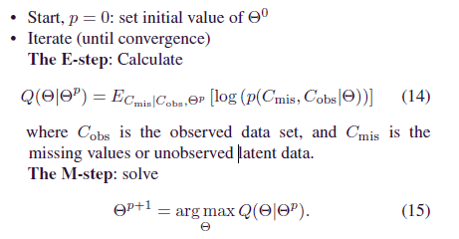
EM Algorithm

Slide 9
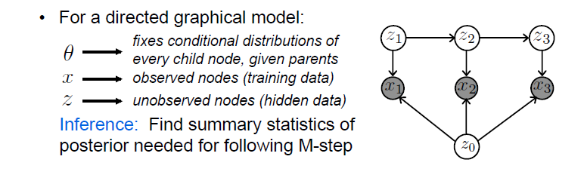
Graphical Models with unobserved variables

Slide 10




EM Algorithm
$\sum_{j=1}^{+∞}{P(X=x_{i},Y=y_{i}})=P(X=x_{i}$)
$$L\left(θ\right)=\sum_{i}{\ln{p\left(x^{\left(i\right)};θ\right)=\sum_{i}{In \sum_{z^{\left(i\right)}}{P(x^{\left(i\right)},z^{\left(i\right)};θ)}}}}$$
$$=\sum_{i}{ln\sum_{z^{\left(i\right)}}{Q_{i}(z^{i})\frac{P(x^{\left(i\right)},z^{\left(i\right)};θ)}{Q_{i}(z^{i})}=\sum_{i}{ln⁡(E\left[\frac{P\left(x^{\left(i\right)},z^{\left(i\right)};θ\right)}{Q_{i}\left(z^{i}\right)}\right])}}}$$
$$≥\sum_{i}{E\left[ln\frac{P\left(x^{\left(i\right)},z^{\left(i\right)};θ\right)}{Q_{i}\left(z^{i}\right)}\right]≥\sum_{i}{\sum_{z^{i}}{Q_{i}\left(z^{i}\right)ln\frac{P\left(x^{\left(i\right)},z^{\left(i\right)};θ\right)}{Q_{i}\left(z^{i}\right)}}}}$$

Slide 11






EM Algorithm
等号成立的条件是当且仅当$\frac{P\left(x^{\left(i\right)},z^{\left(i\right)};θ\right)}{Q_{i}\left(z^{i}\right)}$=C
$Q_{i}表示$隐含变量Z的某种分布，$Q_{i}$满足的条件是：
$\sum_{Z}{Q_{i}\left(z^{i}\right)}$=1 $Q_{i}\left(z^{i}\right)≥0$
$$\frac{P\left(x^{\left(i\right)},z^{\left(i\right)};θ\right)}{Q_{i}\left(z^{i}\right)}=C$$
$$P\left(x^{\left(i\right)},z^{\left(i\right)};θ\right)=C(Q_{i}\left(z^{i}\right))$$
$$\sum_{Z}{P\left(x^{\left(i\right)},z^{\left(i\right)};θ\right)=C(\sum_{Z}{Q_{i}\left(z^{i}\right))}}$$
$$\sum_{Z}{P\left(x^{\left(i\right)},z^{\left(i\right)};θ\right)=C}$$

Slide 12



EM Algorithm
等号成立的条件是当且仅当$\frac{P\left(x^{\left(i\right)},z^{\left(i\right)};θ\right)}{Q_{i}\left(z^{i}\right)}$=C
$$Q_{i}\left(z^{i}\right)=\frac{P\left(x^{\left(i\right)},z^{\left(i\right)};θ\right)}{\sum_{Z}{P\left(x^{\left(i\right)},z^{\left(i\right)};θ\right)}}$$
$$=\frac{P\left(x^{\left(i\right)},z^{\left(i\right)};θ\right)}{P\left(x^{\left(i\right)};θ\right)}$$
$$=P(z^{\left(i\right)}|x^{\left(i\right)};θ)$$

Slide 13


EM Algorithm
$$Q\left(θ | θ^{p}\right)=L\left(θ\right)=\sum_{i}{\sum_{z^{i}}{\begin{aligned}Q_{i}\left(z^{i}\right)ln\frac{P\left(x^{\left(i\right)},z^{\left(i\right)};θ\right)}{Q_{i}\left(z^{i}\right)} \\ \end{aligned}}}$$
$$=E_{C_{mis}|C_{obs}{,θ}^{p}}\left[log⁡(p\left(C_{mis},C_{obs} | θ\right))\right]$$
所以$Q\left(θ | θ^{p}\right)=E_{C_{mis}|C_{obs}{,θ}^{p}}\left[log⁡(p\left(C_{mis},C_{obs} | θ\right))\right]$

Slide 14
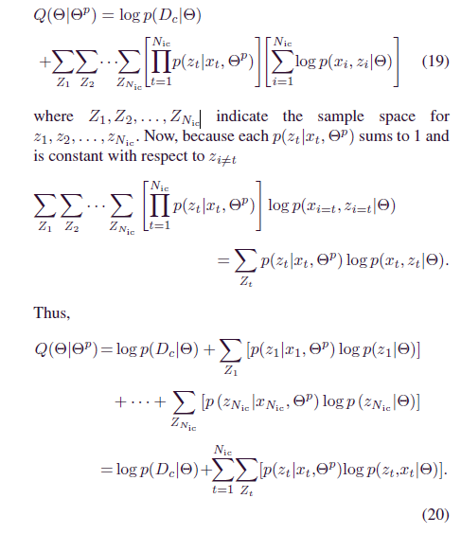
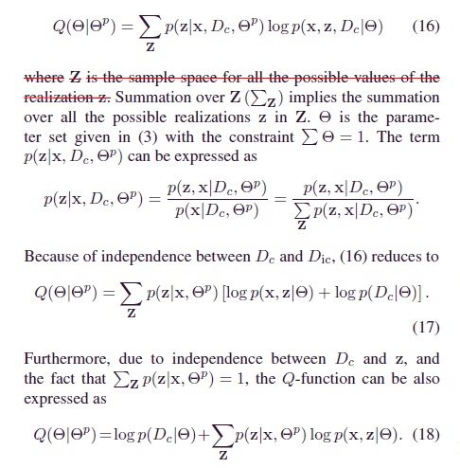
EM Algorithm

Slide 15
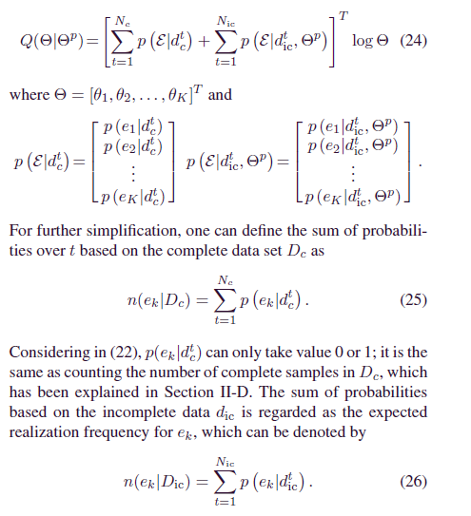
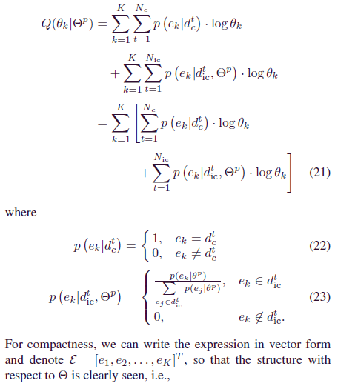

EM Algorithm

Slide 16
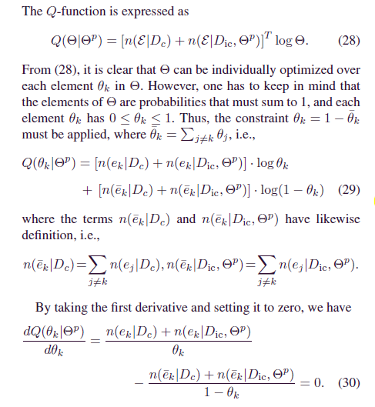
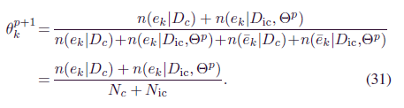
EM Algorithm

Slide 17
EM Algorithm
Advantages:
1) Missing data do not need to be ignored, and including this information increases accuracy of diagnosis.
2) The proposed method is able to handle the multiple missing data patterns.
3) the EM algorithm converges quickly. Particularly in the single missing data pattern problem, it takes one iteration to converge to the result.

Slide 18
EM Algorithm
Limitations:
1) The EMalgorithm only guarantees local convergence, not
necessarily a globally optimal solution.
2) The EM algorithm for missing data will suffer from an overfitting problem in higher dimensions.
3) This solution assumes that the cause of missing data is independent of the mode. If certain modes cause some particular missing pattern or lead more data to be missing,then this method may not work or at least no longer optimal.

Slide 19
Thanks!

