Slide 1
Skip-Thought Vectors
jianlincheng

Slide 2
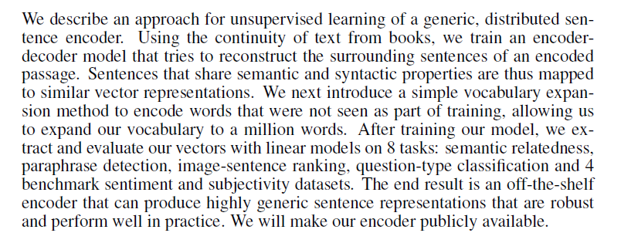
Abstract

Slide 3
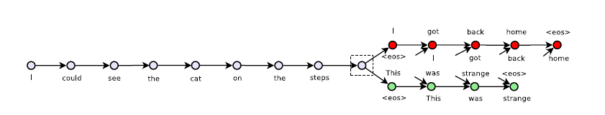

Slide 4
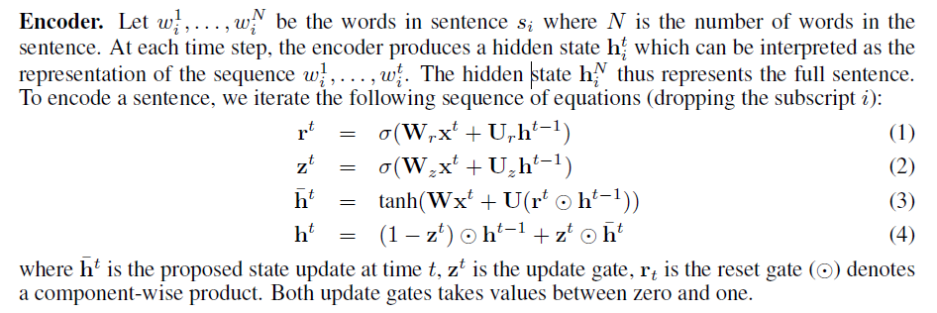
Encoder

Slide 5
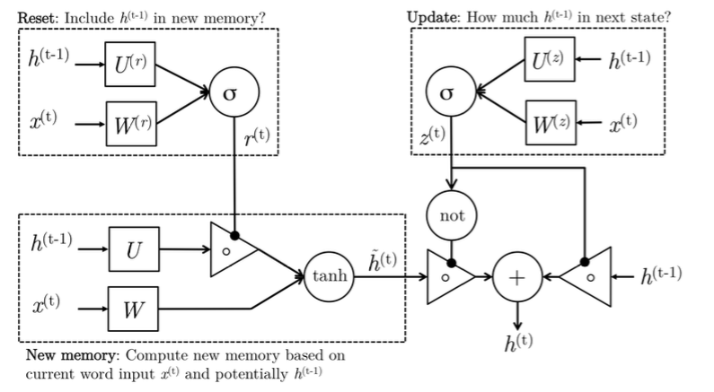
Gated Recurrent Unit

Slide 6
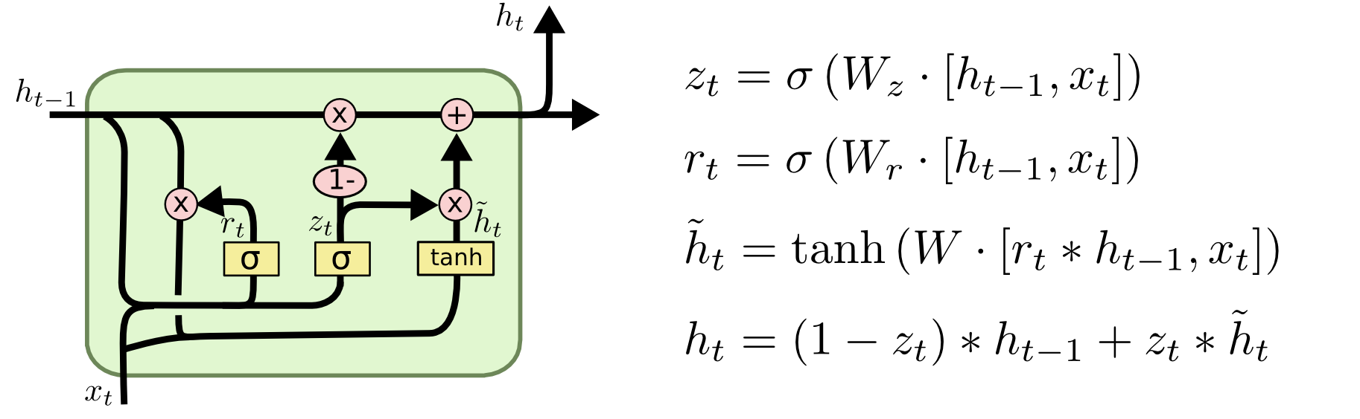
Gated Recurrent Unit

Slide 7
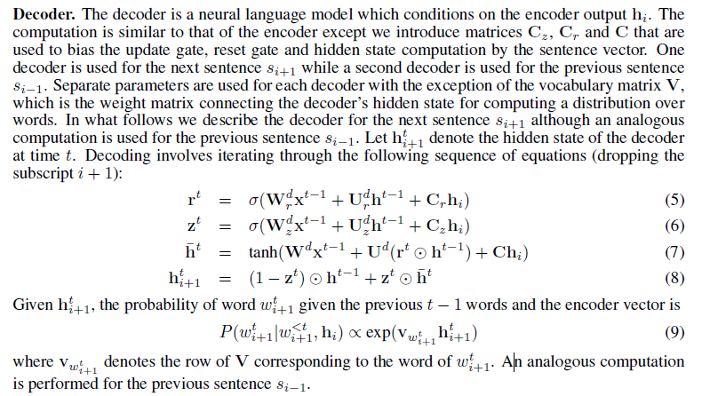
DEcoder

Slide 8
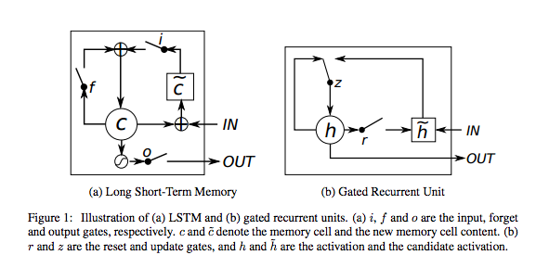
LSTM and GRU

Slide 9
LSTM vs GRU
· A GRU has two gates, an LSTM has three gates
· GRU don’t posses and internal memory(ct)that is different from the exposed hidden state.They don’t have the output gate that is present in LSTMs
·GRUs have fewer parameters (U and W are smaller) and thus may train a bit faster or need less data to generalize. On the other hand, if you have enough data, the greater expressive power of LSTMs may lead to better results.

Slide 10
The Future
Deep encoders and decoders
Larger context windows
encoding and decoding paragraphs
other encoders, such as convnets

Slide 11




