Slide 1
(April26, 2017)
Improved Wasserstein-GAN
Cheng Jianlin

Slide 2

Outline
I. Introduction
II. Optimal WGAN critic
III. Improved Wasserstein GAN
IV. Results
V. Conclusion

Slide 3
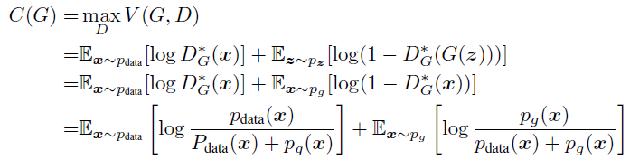
I. Introduction
GAN
Min:

Slide 4




I. Introduction
Wasserstein GAN

Slide 5
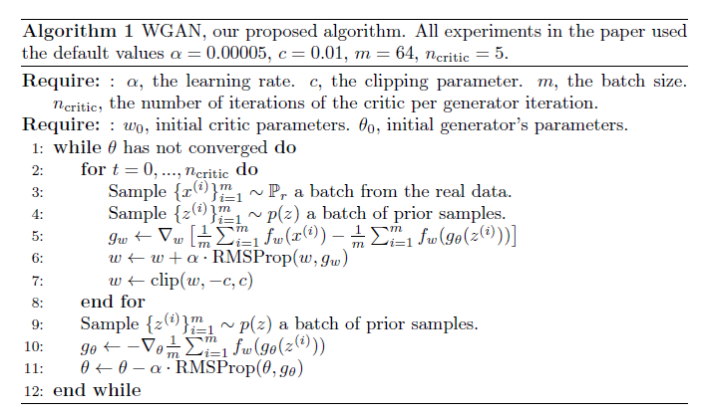
I. Introduction
Wasserstein GAN

Slide 6
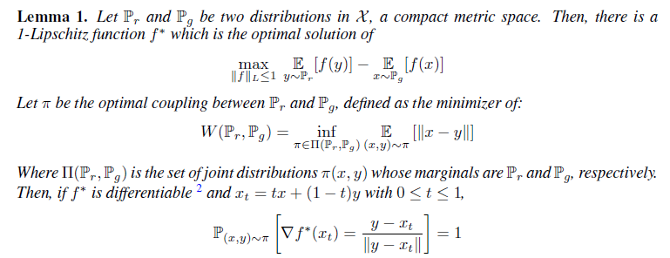
II. Optimal WGAN critic

Slide 7
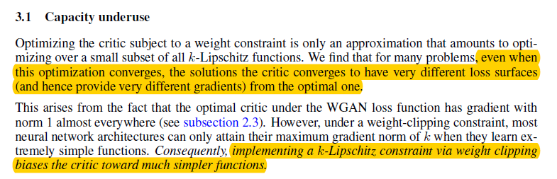
II. Optimal WGAN critic
Difficulties with weight constraints

Slide 8
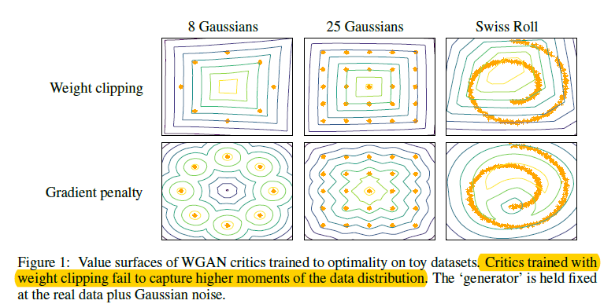
II. Optimal WGAN critic
Difficulties with weight constraints

Slide 9
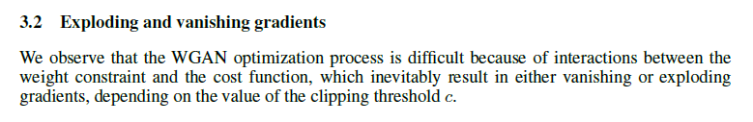
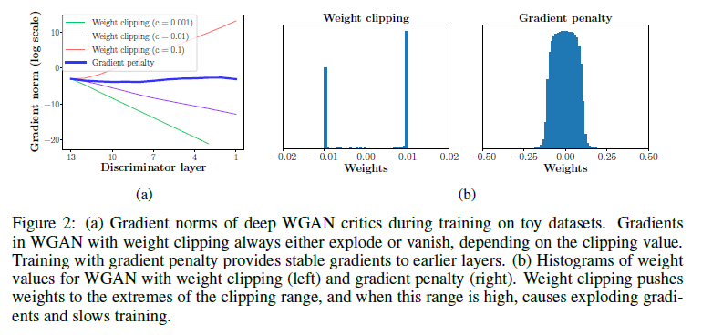
II. Optimal WGAN critic
Difficulties with weight constraints
Notes:
For many problems,even when this optimization converges, the solutions the critic converges to have very different loss surfaces (and hence provide very different gradients) from the optimal one
权值截断后，判别器也能收敛，但是它的loss值会有很多不同的表面，也就是说它会提供不同的梯度

Slide 10
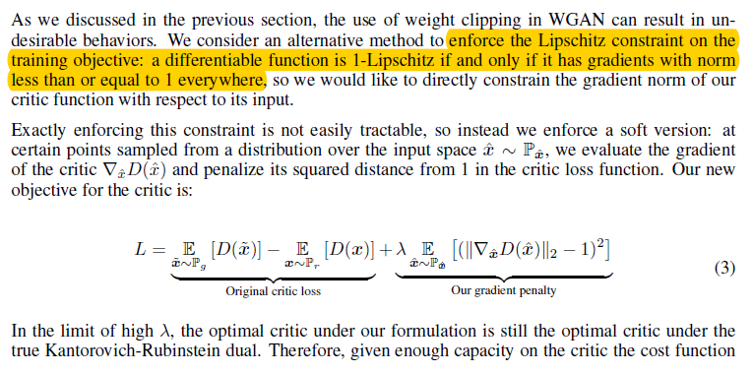
III. Improved Wasserstein GAN
Gradient penalty

Slide 11
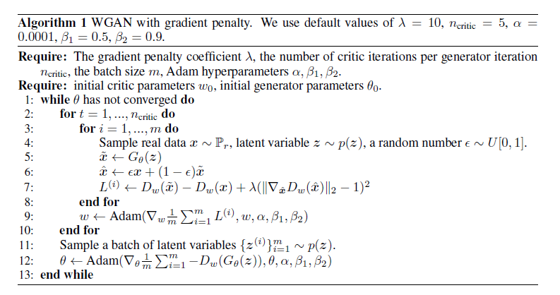
III. Improved Wasserstein GAN

Slide 12
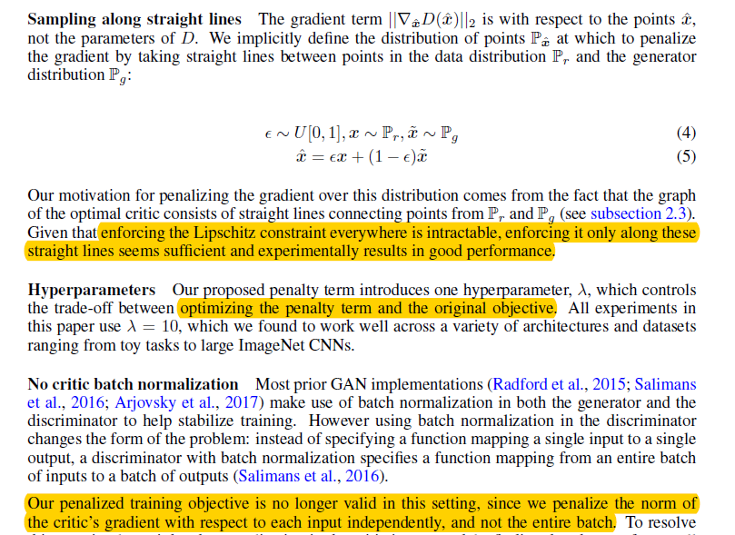
III. Improved Wasserstein GAN

Slide 13
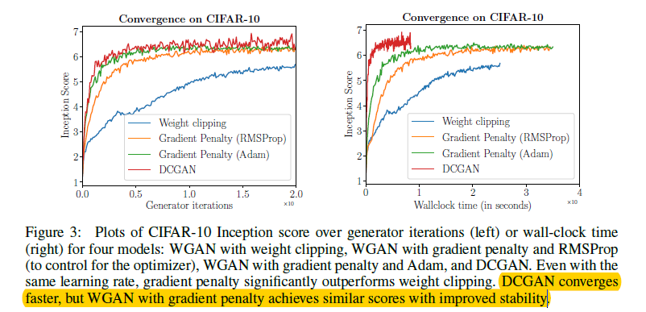
IV. Results
CIFAR-10

Slide 14
IV. Results
LSUN(Large-scale Scene Understanding) bedrooms dataset

Slide 15
V. Conclusion
Improve performance and successfully train difficult GAN architectures
we think our work opens the path for strong modeling performance on large-scale image datasets and language
it might stabilize training by encouraging the discriminator to learn smoother decision boundaries

Slide 16
Bibliography
[1] Wasserstein GAN
[2] Improved Training of Wasserstein GANs

Slide 17

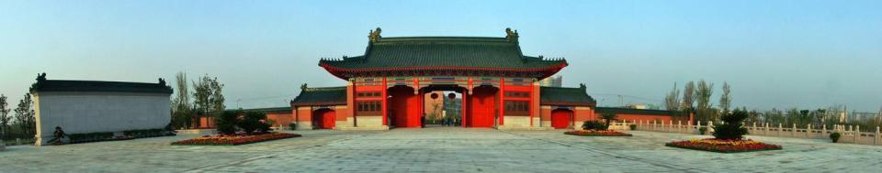
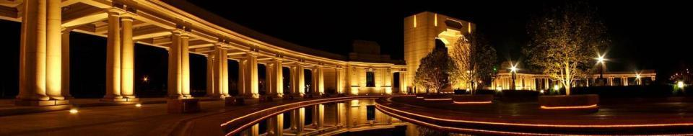
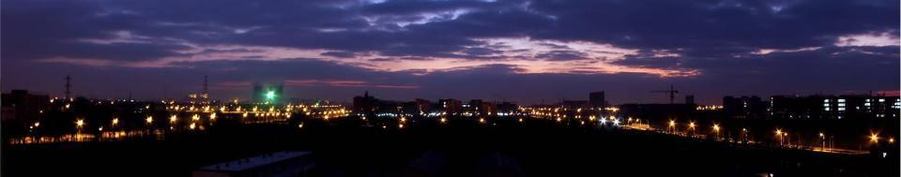
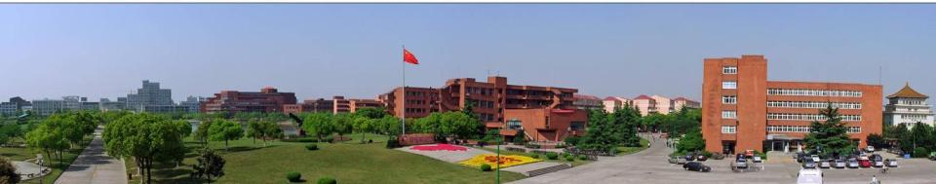
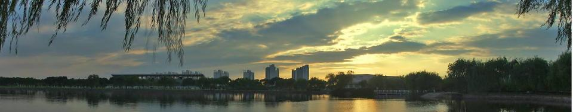
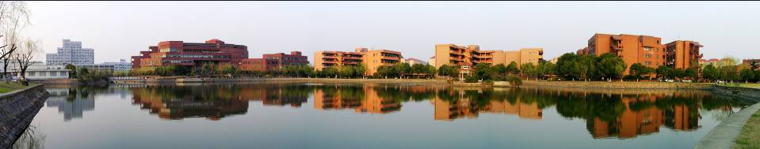
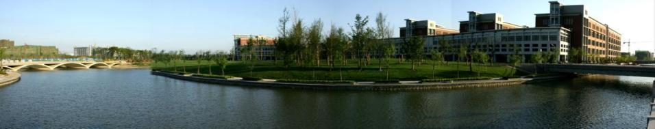
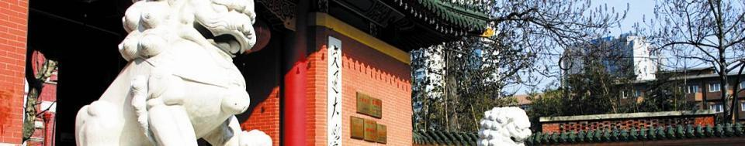
Thanks！

