Slide 1
(Dec 21, 2016)
T-SNE
Cheng Jianlin

Slide 2

Outline
I. Stochastic Neighbor Embedding
II. t-Distributed Stochastic Neighbor Embedding
III. Accelerating t-SNE using Tree-Based Algorithms

Slide 3
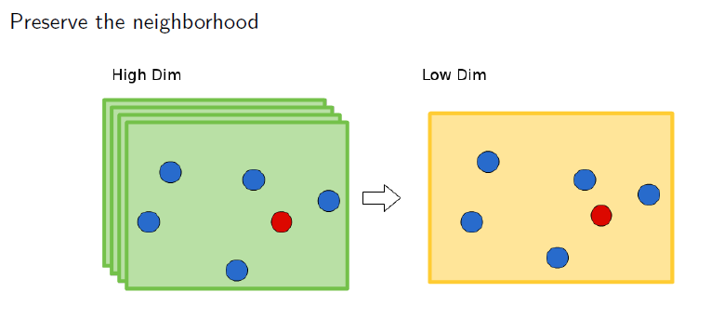
I. Stochastic Neighbor Embedding
Notes:
首先看一个问题，如何很好的或者说比较完美的把一个高维空间的数据映射到低维空间，我们可以理解为映射能够很好地保留每个点的领域点。

Slide 4


I. Stochastic Neighbor Embedding
· First convert the high-dimensional Euclidean distances between datapoints into probabilities that represent similarities.
· Similarity of datapoints in High Dimension
· Similarity of datapoints in Low Dimension
·To evaluate a map:
-- Compute the Kullback-Leibler divergence between the probabilities in the high-dimensional and low-dimensional spaces
Notes:
SNE的目的是找到一个低维的数据表示能够最小化pij和qij之间的差异，通常的方法就是计算p和q之间的kl散度。

Slide 5





I. Stochastic Neighbor Embedding
·Cost function:
·Perplexity:
·Gradient:

Slide 6


II. . t-Distributed SNE
·High-dimensional map:
·Low-dimensional map:
·Why a Student-t distribution:
--dissimilar points have to be modeled as too far apart in the map
Notes:
为什么选t分布呢？t-SNE能够让那些在高维中不相似的点，也就是在高维中隔得比较远的点在低维中能够隔的更远。
所以相同概率下的两个点在t分布下的距离比在高斯分布下的距离大。。

Slide 7

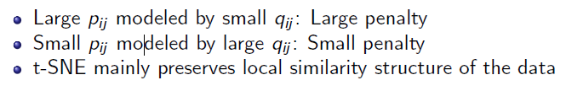

II. . t-Distributed SNE
·Cost function:
·Gradient:

Slide 8
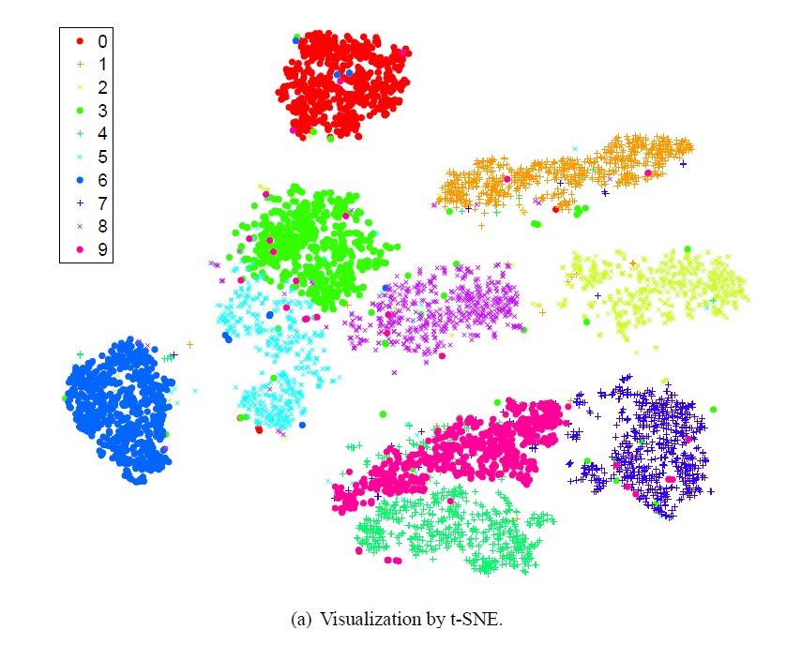
II. . t-Distributed SNE

Slide 9
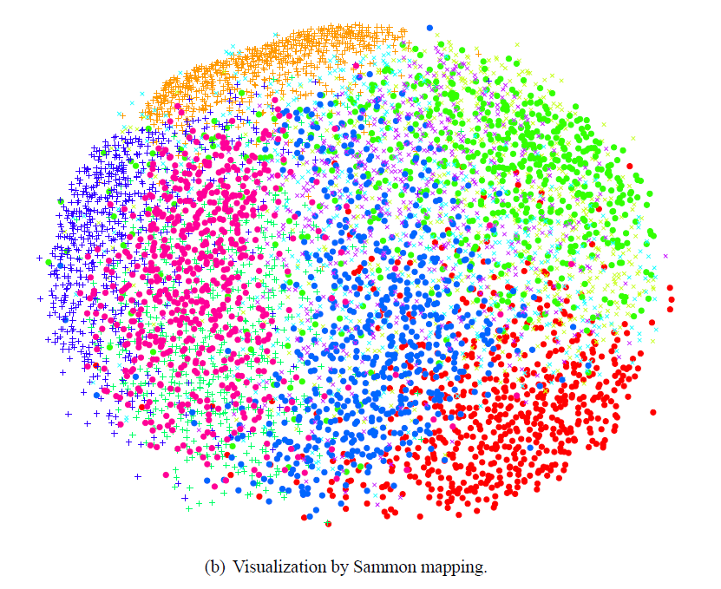
II. . t-Distributed SNE

Slide 10
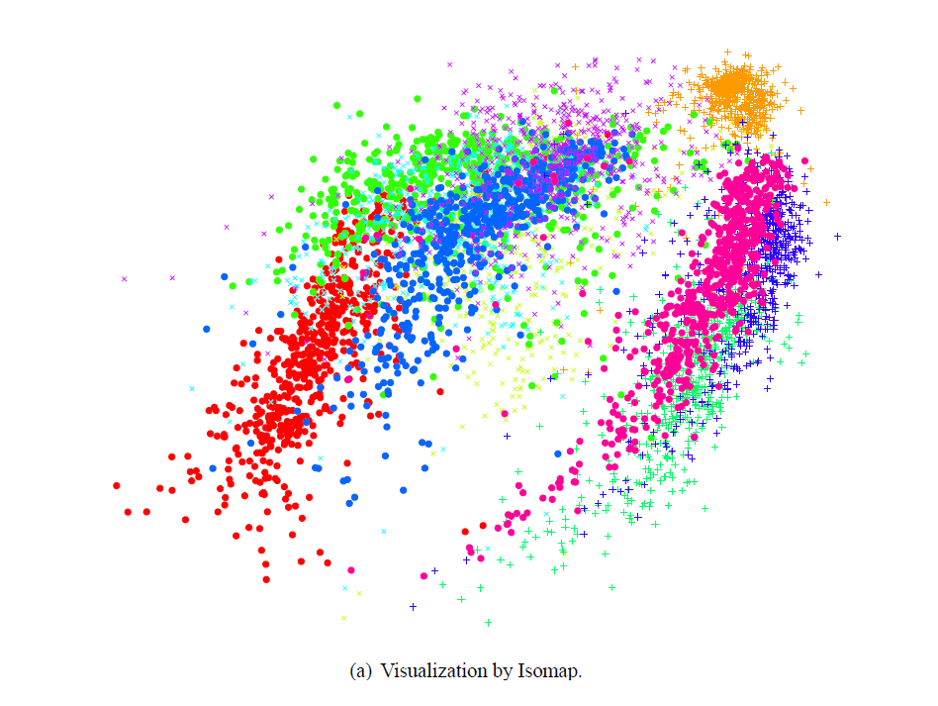
II. . t-Distributed SNE

Slide 11
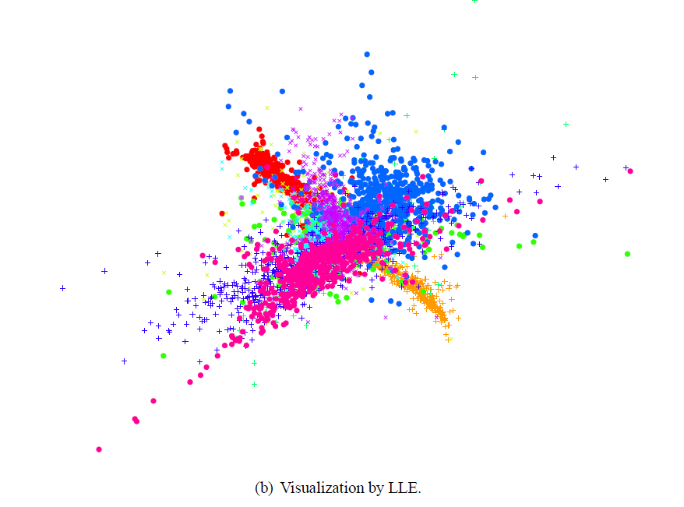
II. . t-Distributed SNE

Slide 12
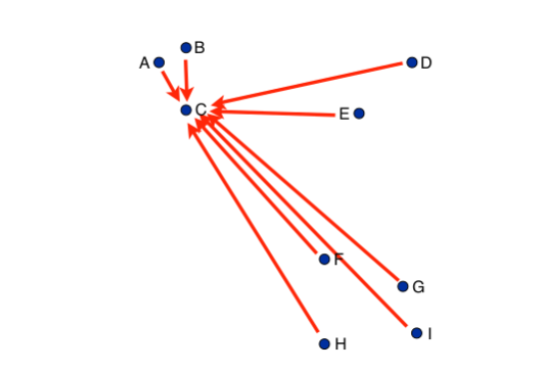
III. Accelerating t-SNE using Tree-Based Algorithms
·Gradient interpretation:
Notes:
n个点的话，就需要考虑n的平方个点之间的关系，梯度计算就会比较复杂。

Slide 13
III. Accelerating t-SNE using Tree-Based Algorithms
·Barnes-Hut Approximation
--Many of the pairwise interactions between points are very similar

Slide 14
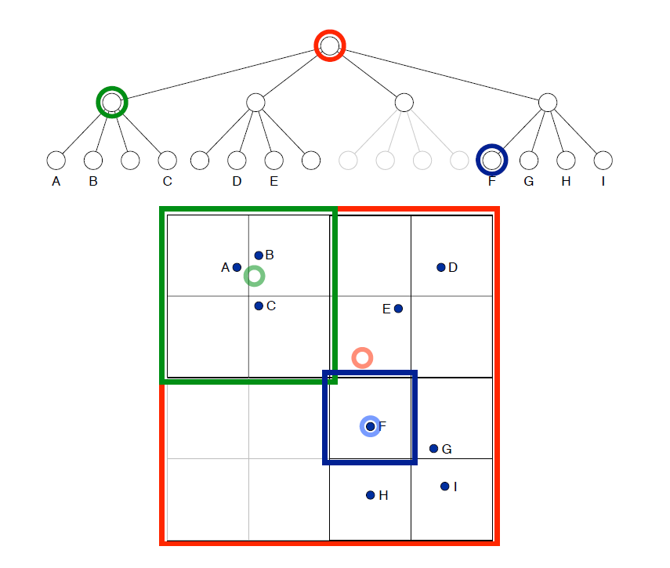

III. Accelerating t-SNE using Tree-Based Algorithms
·Barnes-Hut Approximation
--Summary
is a threshold that trades o speed and accuracy

Slide 15
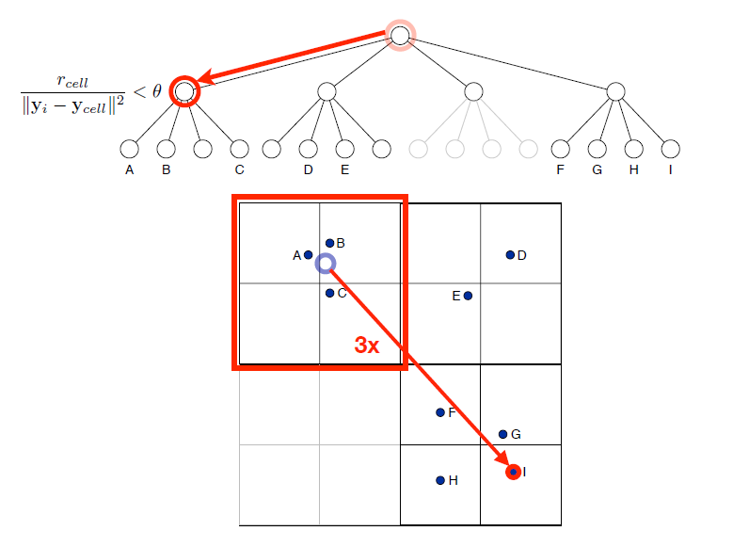

III. Accelerating t-SNE using Tree-Based Algorithms
·Dual-tree Approximation
--Summary

Slide 16
Bibliography
[1] Visualizing Data using t-SNE
[2] Accelerating t-SNE using Tree-Based Algorithms

Slide 17

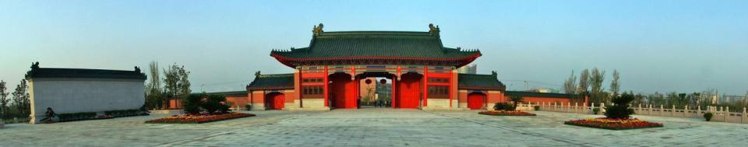

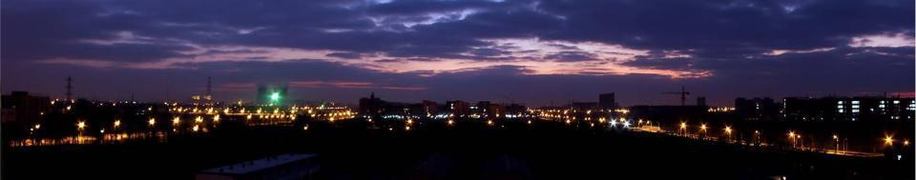





Thanks！

