Slide 1
VGG
On tiny - ImageNet
By:
Lee Twito & Rafael Bouzaglo

Slide 2
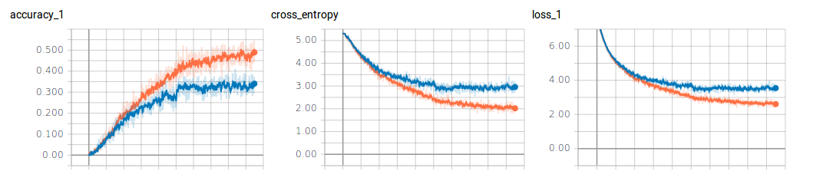
Final results

Slide 3


Final results
Configuration:
Model - VGG C
Learning rate = 0.0001 -> 0.000001 (decay by 10 at 5000 and 50,000)
Batch size = 256
50% dropout on fully-connected layers
Xavier initialization on all weight matrices
Optimizer - ADAM
Regularizer - L2 ( λ = 0.0005)
Loss function:

Slide 4
Experiments
1

Slide 5
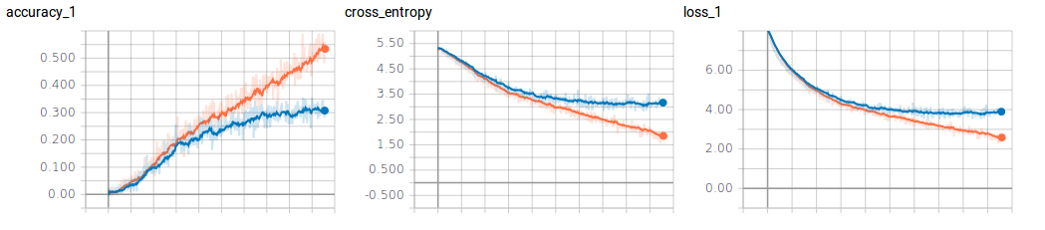
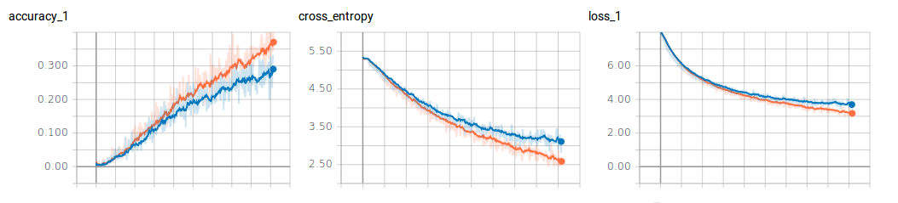
Dropout - keep probability
Kp =0.7
Kp =0.5

Slide 6
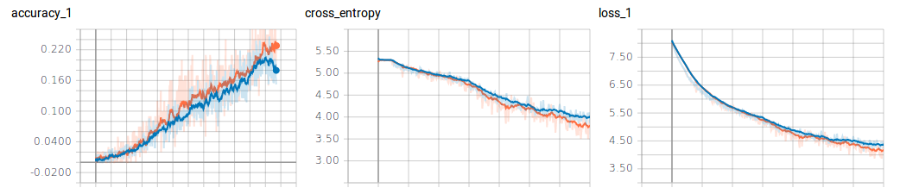
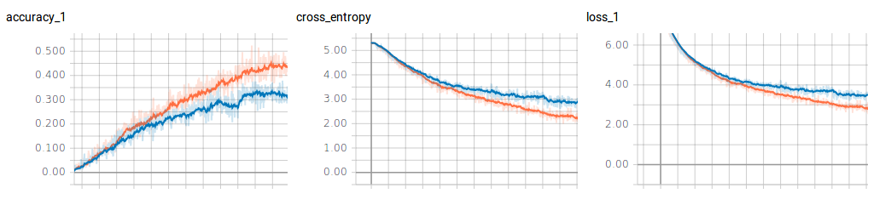
Batch size
Bs = 100
Bs = 256

Slide 7
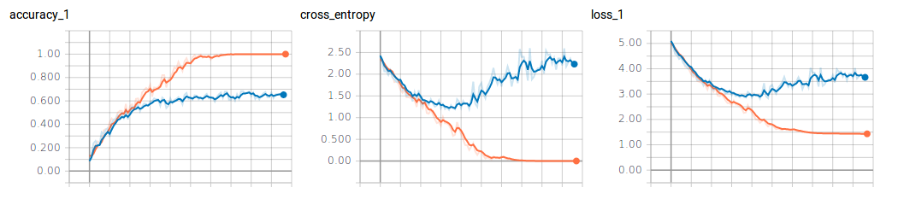
Number of classes
10 classes

Slide 8
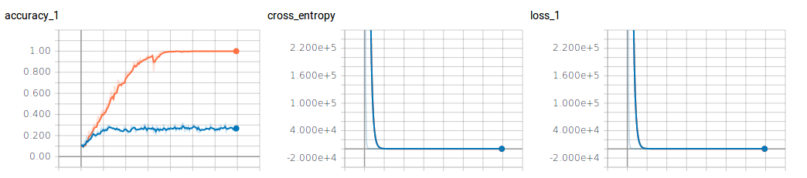
Fully connected dimensions
Fully - connected 512

Slide 9
Evaluation
2

Slide 10
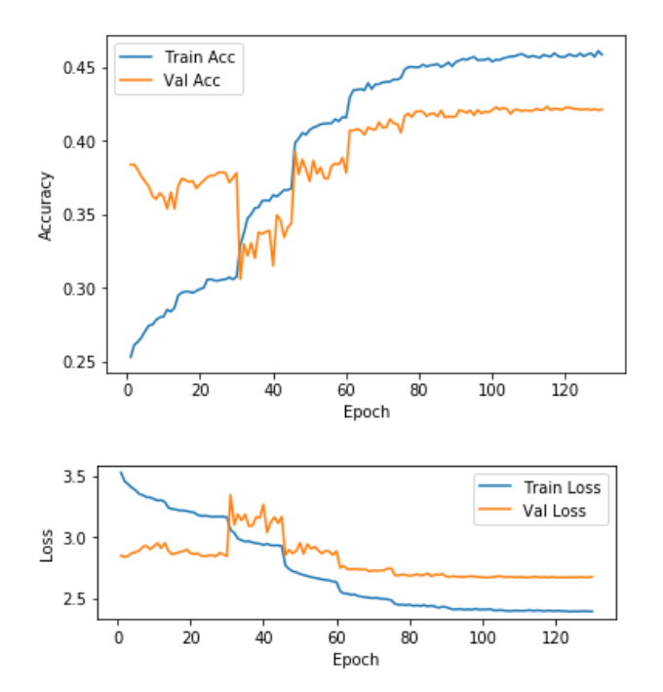
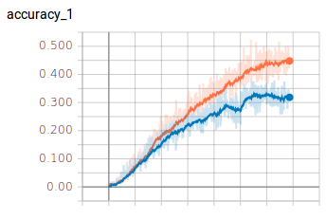
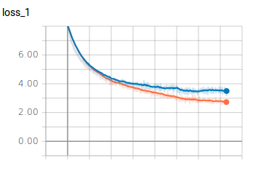
Accuracy & loss
* Tiny ImageNet Image Classification, Alexei Bastidas, Stanford University

Slide 11
Top 5 accuracy
* Tiny ImageNet Image Classification, Alexei Bastidas, Stanford University

Slide 12
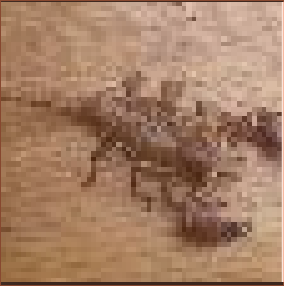
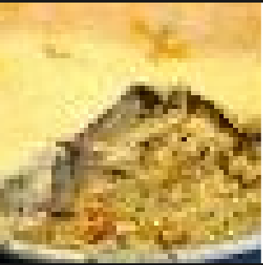
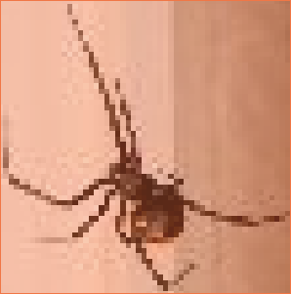
Images examples
* Tiny ImageNet Image Classification, Alexei Bastidas, Stanford University

Slide 13
Thanks!
Any questions?

