Slide 1

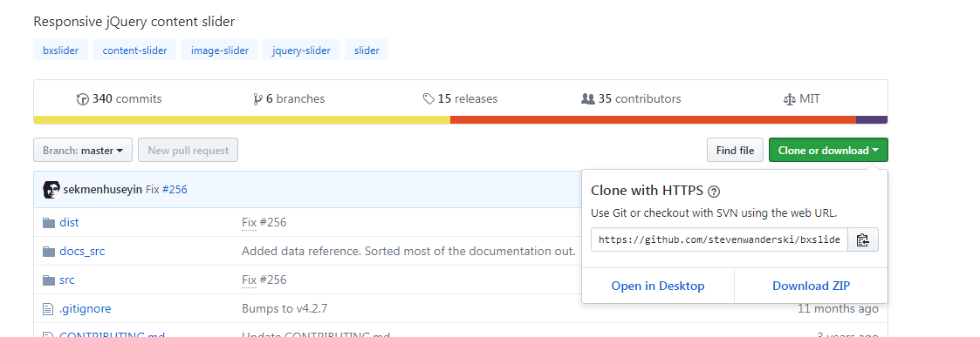
bxslider
Bxslider.com

Slide 2
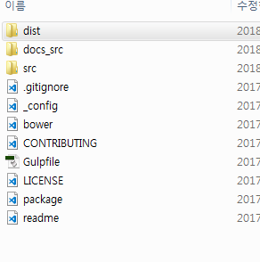
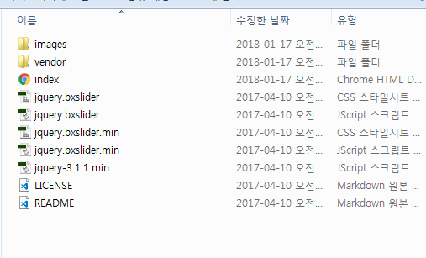


Slide 3
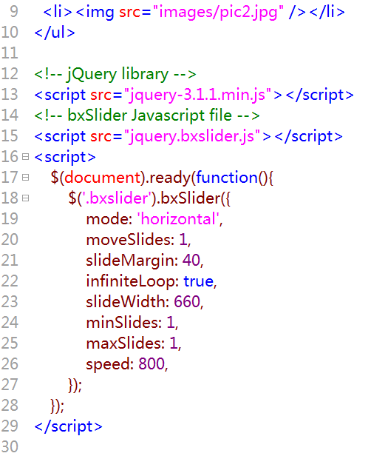


Slide 4
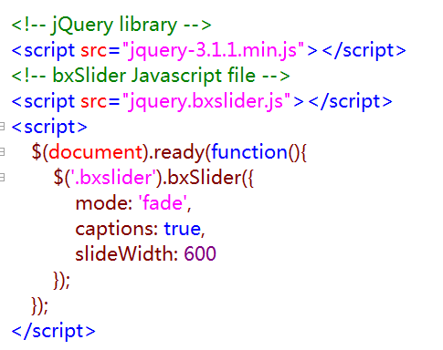

https://bxslider.com/examples/image-slideshow-captions/

Slide 5
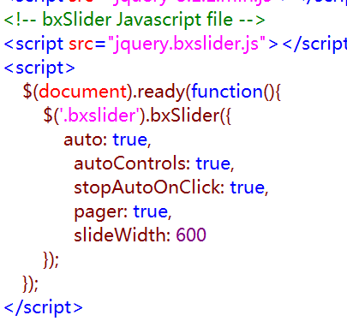

https://bxslider.com/examples/auto-show-start-stop-controls/

Slide 6
