Slide 1





CA2 PDS PRESENTATION
Presented by Soh Jian Min

Slide 2



AGENDA
Q
1
INTRODUCTION
Q
2
DATA SOURCES & DATASETS
Q
3
TRANSPOSE AND TEXT ANALYSIS
4
4
CLEANING, FILTERING & TRANSFORMING DATASETS
Q
5
QUESTION, GRAPH & ANALYSIS
Q
6
CONCLUSION & RECOMMENDATION

Slide 3
Introduction
Title of Analysis:
Market Trends and Insights for Housing Agents in Singapore: Analyzing Popular Flat Types, Sales, and Economic Influences
Story Line:
As a data analyst, I aim to assist a housing agent company named "houseNow" in Singapore in understanding market trends and identifying the most popular types of flats or sales. This is crucial for advising clients and making informed decisions.

Slide 4



data sources
&
DATASETS

Slide 5
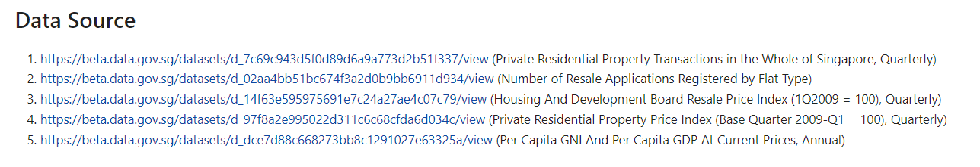
data sources

Slide 6

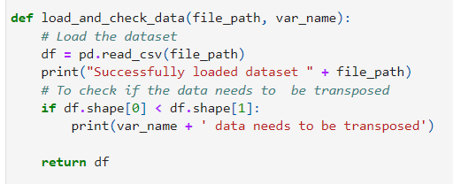

load data
Function to load and check data whether is there a need to transpose
Use function

Slide 7
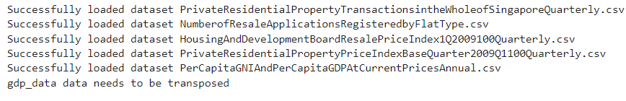
OUTPUT Of lOAD

Slide 8
TRANSPOSE
&
TEXT ANALYSIS

Slide 9

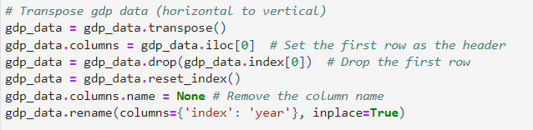
tRANSPOSE DATA

Slide 10
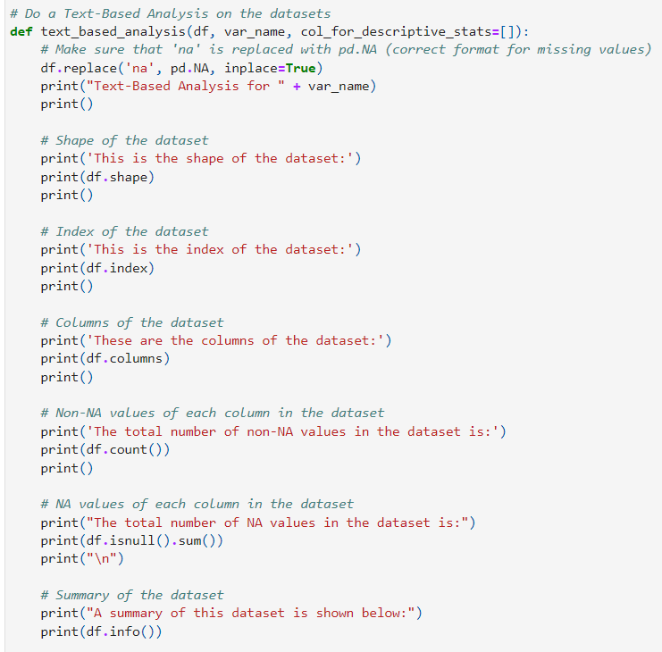
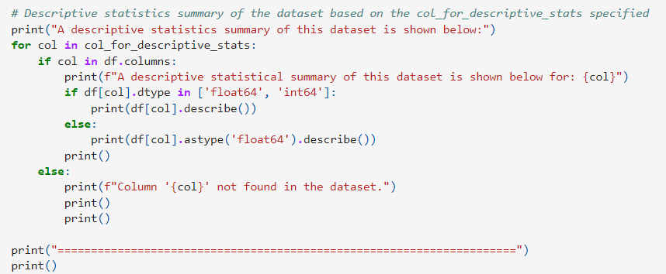
TEXT ANALYSIS
Function for text analysis
Using the function

Slide 11
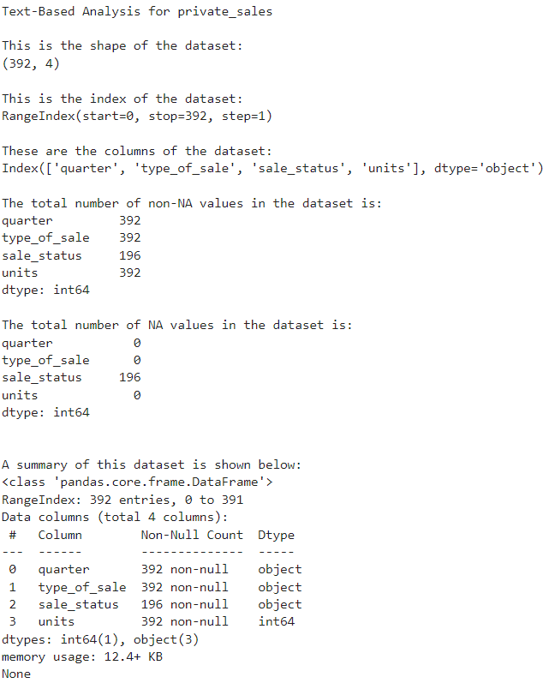
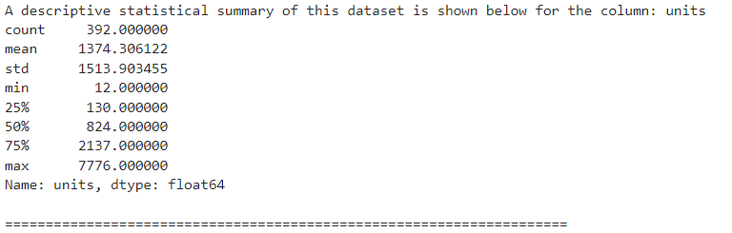
TEXT ANALYSIS

Slide 12
CLEANING, FILTERING & TRANSFORMING DATASETS

Slide 13


Clean Data

Slide 14
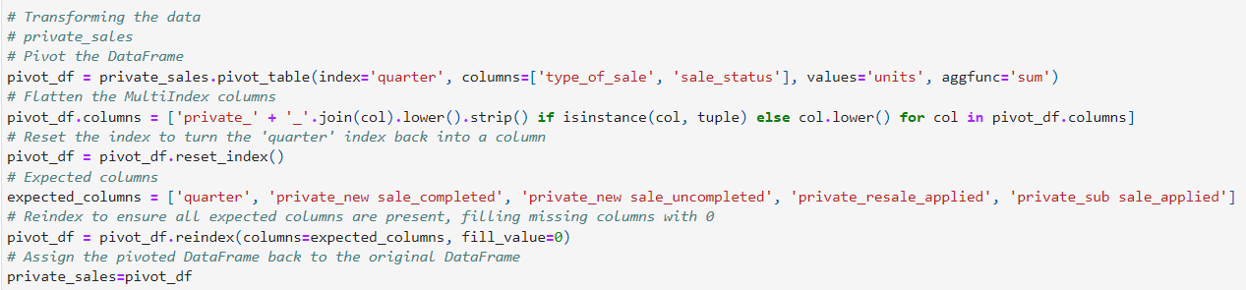
Transform & Filter DATA

Slide 15
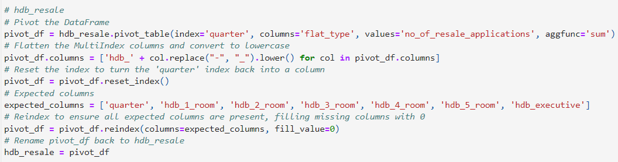
Transform & Filter DATA

Slide 16
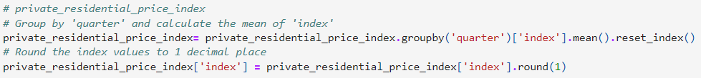
Transform & Filter DATA

Slide 17
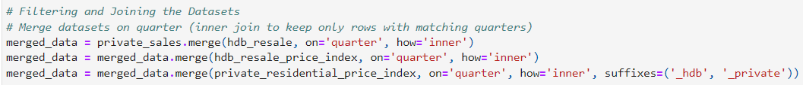
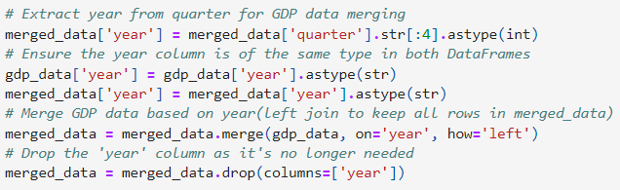
Transform & Filter DATA

Slide 18
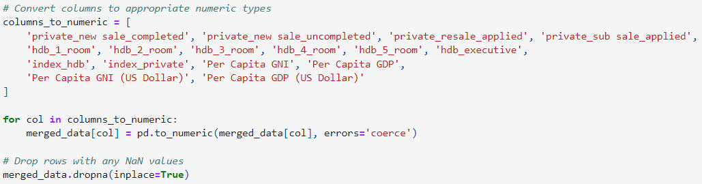
Transform & Filter DATA

Slide 19
QUESTION, GRAPH & ANALYSIS

Slide 20

question 1
What types of sales are most popular in the private residential property market?

Slide 21
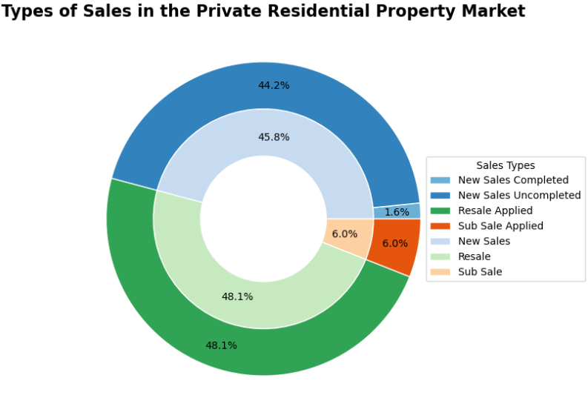
Focus marketing on popular sales types
Tailor recommendations to buyers' needs and budgets
Optimize sales strategies to meet client demands

Slide 22
question 2
Which flat types are most popular in the HDB resale market?

Slide 23
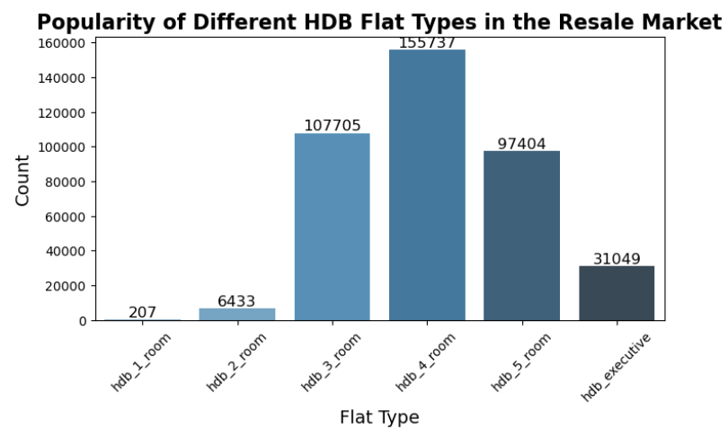
3-room, 4-room, and 5-room HDB flats are the most popular, housing agents should focus their efforts on these flat types
Tailor recommendations based on buyer needs (family size), and budget
Strategic Marketing (Highlight Popularity, Detailed Listings and, Focus on High-Demand Areas)

Slide 24
question 3
Does GDP and GNI affect the price index of HDB and Private housing?

Slide 25
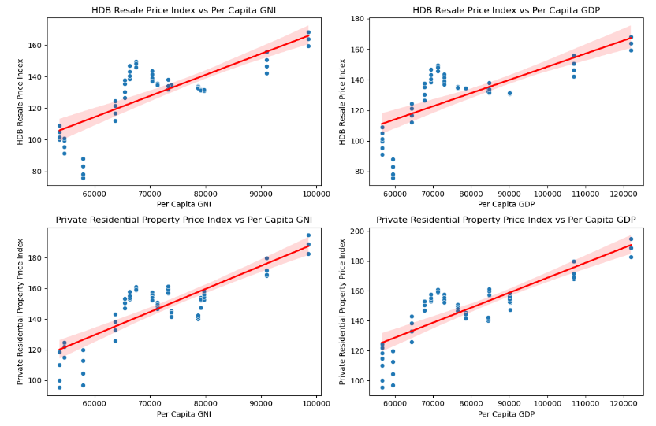
Both HDB and private residential property price indices increase with higher GDP and GNI
Advise Clients on Timing, encourage clients to make purchases when GDP and GNI are lower.
Monitor Economic Trends, to identify the best buying periods and adjust marketing strategies accordingly
Provide Strategic Insights: Use predictive analysis to offer clients timely advice.
Consider Budget and Income Levels, For private properties, ensure that buyers are aware of the higher price indexes and recommend options that fit their budget

Slide 26
question 4
Does GDP and GNI affect the Applications/Transactions of HDB and Private housing?

Slide 27
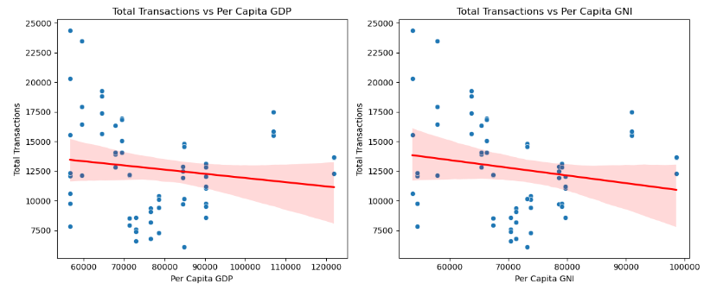
Both Graph shows negative trend.
Higher GDP and GNI are associated with fewer housing transactions
Focus on marketing strategies during periods of lower GDP and GNI, as the number of transaction will be relatively higher.

Slide 28
question 5
Should housing agents focus more on HDB or Private housing flats?

Slide 29
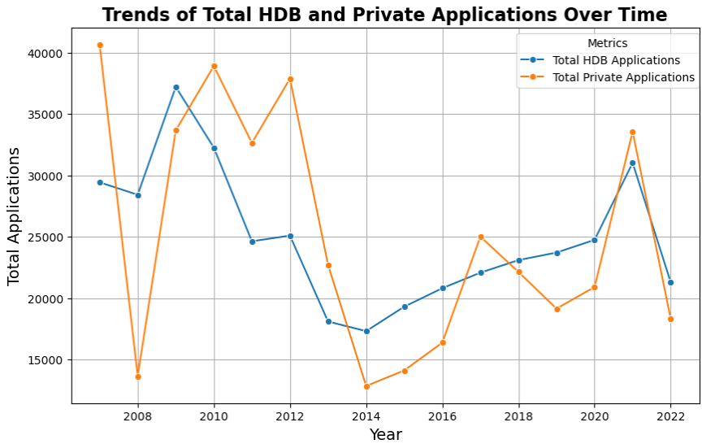
Focus on Both: Both HDB Resale and Private Residential Property applications have shown fluctuations and recoveries. Housing agents should focus on both, adjusting their strategy based on market conditions and economic factors.
HDB Resale Applications: HDB applications tend to be more stable and predictable. Agents preferring stability might focus more on HDB flats.
Private Residential Property Applications: Private applications are more unpredictable but can hit higher peaks, offering the chance for higher returns during good market times.

Slide 30
question 6
How do the prices of private and HDB resale properties compare across different quarters?

Slide 31
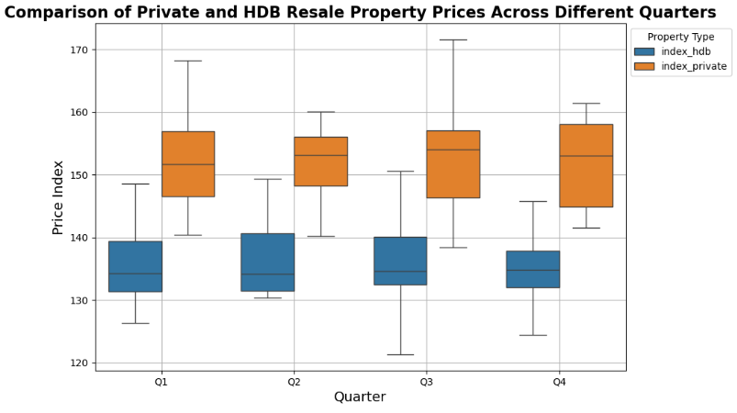
Private Property Price Index is generally higher than HDB Resale Property Price Index (High Income - Private Property, Middle Income - HDB Resale Property)
During Economic Growth, can focus on private properties as premium housing have higher return while during Economic Uncertainty suggest HDB resale properties due to their affordability and stable price.
Q2 and Q4 is more stable for Private Property
Q4 is more stable for HDB Resale Property

Slide 32
CONCLUSION

Slide 33
Dominance of New and Resale Sales
Price Stability
Resales sales type is the most popular in the private residential market
Also shows a strong preference for new sales but large percentage being uncompleted
HDB prices are more stable.
Private property prices are higher and more unpredictable.
Price Variability
Economic Impact
Market Preferences
Higher preference for resale followed by new sales in private market.
Strong preference for 4-room, 3-room, and 5-room flats in HDB Resale market.
GDP/GNI influence prices and transaction volumes.
Higher economic indicators lead to higher prices, fewer transactions.
Private property prices are higher and more variable.
HDB resale prices are stable, especially in Q4.

Slide 34
Recommendations

Slide 35
Timing and Market Conditions:
High-Income Clients
Middle-Income Clients
Recommend private property purchases in Q2 and Q4.
Suggest HDB purchases in Q4 for lower risk.
Monitor GDP and GNI for best buying time for buyers and adjust marketing efforts.
Focus on private properties.
Emphasize Q2 and Q4 for stability.
Resale for immediate occupancy.
New Sales for investment.
Emphasize HDB resale properties.
Promote 4-room, 3-room, and 5-room flats.
Highlight Q4 for stability.
Continuous Market Monitoring
Monitor market trends and GDP/GNI.
Adjust marketing for based on popular flat and sales types.
Focus on Popular Flat Types/Sales Type
Client Education and Advisory
Long-Term Investment Strategy
Prioritize 4-room, 3-room, and 5-room HDB Resale flats.
Prioritize Resale and New Sales in private residential property market.
Educate clients on economic impact on prices.
Use trends to guide purchase timing.
Leverage GDP and GNI predictions for advice.
Encourage HDB resale properties for steady growth.
Suggest selective private properties during stable quarters for higher returns.

Slide 36

Thank
You

