Slide 1
CS2040C S1 AY20/21
Welcome
Zoom etiquette:
Login using NUS account
No waiting room, so please do not share the meeting link publicly to keep the participants mostly from this class only
Mute yourself
Use display name = your name as in matric card,
Use profile picture = your picture as in matric card (or any non-blank profile picture),
You are allowed to turn off your video if you prefer it that way (there is an optional we-fie session at the end)
Raise hand when you want to ask, I will occasionally see the participants window
Do NOT annotate on screen UNLESS the slides are designed for e-annotation and I instructed you to do so
Use private chat if you want to talk to others in this class during this class (very distracting to me otherwise), only use chat to me/public if you are invited to talk and want to give something that is better done via text, e.g., an URL

Slide 2
Agenda for the First Lecture
Introduction
About me
About (119++* of) you
Course (online :O) tools + live demos
VisuAlgo (type https://visualgo.net or… Google search “algo visualization” :O)
Steven’s private “LumiNUS” (doubles as course admin talk, intro of 5+1 TAs)
Kattis (https://nus.kattis.com) online judge (extras at https://open.kattis.com)
(with C++ introduction, review some problems from Week 00 set + more)
Setting Expectations for this 100% e-Learning + Flipped Course
CP4 pre-order (optional --- collection on Thu 13/Fri 14/Mon 17 Aug)

Slide 3
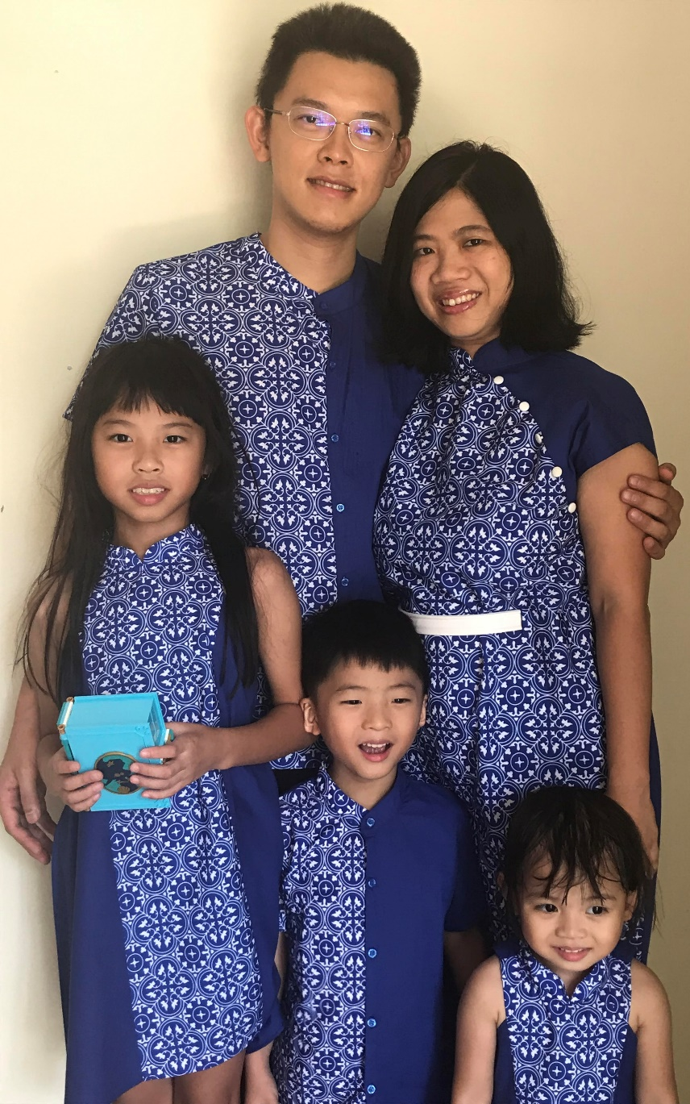
Lecturer: Dr STEVEN Halim
Read IOI stuff (this, this, or this) or ICPC stuff (this or this) or achievements (this, this, or this)
Office: COM2-03-37
(usually in every Mon-Fri, 10am-5pm; unless forced to do WFH)
Office Phone: 6516 7361
(if nobody answers, I am not in office; I redirect it to my phone)
Email: stevenhalim@gmail.com (‘the lecturer’ at Discord)
On Facebook, Instagram, Telegram (steven_halim_7)
Has 1 wife (Grace) and 3 ‘J’ kids (Jane, Joshua, Jemimah)
Wish for CS2040C S1 AY20/21:
To survive my first 100% e-learning + flipped module…
Notes:
Extras this, this, this, this

Slide 4
119* of you… (as of 14 Aug 2020, 11am SGT)
 | CEG Y1/2 (A) | InfoSec (C) | Exchange | Poly PP | Minor/2nd Major
Jul 2020 (Steven’s) Estimation | ~40 | ~20 | 0 | 0 | ~40
Reality (as of 11 Aug 2020) | 42 | 21 | 2 (Local?) | 0 | 49
Re-checks on 14 Aug 2020 | 42, same | 21, same | 2, same | 0 | 54 (+5)
PS:
There are a few known appeal cases as of Tue, 11 August 2020, 5pm, so can probably increase a little bit
Minor/2nd Major breakdown: Eng (A): 34, Sci (B): 11, Biz (C): 4, Arts (C): 3, Yale-NUS (A): 2
Female students: ~20, again a minority (less than 20% of 114)

Slide 5
119* of you (continued)
You should have background in at least one programming language
By passing/exempted from CS1010/its variants
This is true for CEG/InfoSec (the main audience)
Mixed background for Local? Exchange students
But historically, ~40% students (your seniors) S-ed CS1010/its variants :O
So I assume most of you have know at least one of C, Python, or Java before
Most programming languages have “similar structure”
Convert yourself to C++ (17) coder along the way; it is just a “vehicle” to learn DS+Algo
(No longer) surprising (because I have said so in my welcome emails :O)
I prefer not to teach too much basic C++ in my version of CS2040C
You will mostly self-learn, GIYF, see demos today
We will help A LOT along the way
Real life experience: My kids learning (real) language(s)
Notes:
Those coming from CS1010/E know C, (but CS1010E switches to Python from S1 AY2019/20)
Those coming from CS1010S know Python
Very few already know Java before

Slide 6
119* of you (programming language survey) Annotate/give a tick inside a region if you have coded using that programming language before
C | C++ | Java
Python | JavaScript | Others (Elaborate)

Slide 7
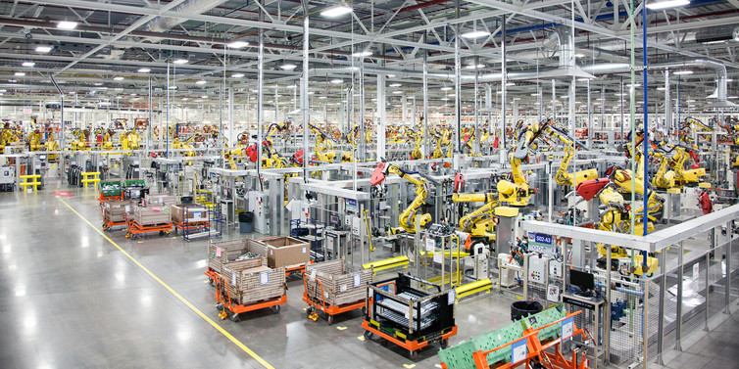
Age of Machines

Slide 8
VisuAlgo (https://visualgo.net --- or ask Google “algo visualization”)
Built (since 2011) and controlled by myself (but currently on development freeze)
My dream is to have a virtual copy of myself available 24/7
Very patient in explaining basic concepts; Never complains; Always available
Your lecture notes (the e-Lecture mode, demo)
zh/id languages will/have been made ready for 8 CS2040C modules so far ☺
Print-friendly (trial mode): Open console, type “openPrinterFriendly()” :O
Your personal instructor/tutor (the exploration mode, demo)
Your examiner (the 15% Online Quiz, demo; actual setup this sem TBC)
Register an account (DO NOT USE)
The current user account system is BROKEN (some registration email never arrives, etc)
Notes:
login for tracking (no need for 2019++ until I fix that sytem)

Slide 9
Flipped Classroom Strategies (for medium to large class)
The style will continue to be enforced, i.e., no basic discussion of ‘trivial stuffs’ if VisuAlgo e-Lecture slides are already clear enough for majority of students
Consequently, those who do not read the prescribed e-Lecture slides before lecture will be really lost during the real lecture…
For today, those who didn’t do Week 00 CS1010 revision set @ Kattis will struggle :O…
For this semester, Steven will just use his experience to discuss the usually top-X hardest slides/topics to be re-explained live (but online), in e-class
119 is a medium-sized class, so there are moments where I will use Poll Everywhere tool (http://www.cit.nus.edu.sg/poll-everywhere/), maybe not today
We will then able to use remaining lecture time to solve some (easier) Kattis problems that require understanding of the ongoing topic that week

Slide 10
Online Classroom Strategies (Special for S1 AY20/21)
Recurring Zoom meetings on Wed 10am-12noon and Thu 5-6pm (the flipped e-Lecture discussed earlier :O) – links given (don’t share the links publicly to minimize “weird appearances of unknown people”)
Lecture recordings will be uploaded sometime on Friday noon
Recurring Zoom meetings on Thu/Fri for Lab+Tut combined 2h sessions
Each Lab+Tut will be handled by one TA, except that Ivan+Nigel will combine forces
Recurring Zoom meetings on Mon/Tue/Wed/Sat for floating 2h consultation slots
Manned by designated TAs (paid :O!!), they will be there at said timeslot
Can be joined by ANY student that needs help at those time
So basically, help is just one Zoom meeting away every single day EXCEPT Sunday
Important: Steven purposely will NOT reply emails after 8pm every day and between Saturday 12noon - Sunday 8pm (“Sabbath”)
Ask at Discord/FB group, there should be others who are “free-er”

Slide 11
About Week 06
It is NOT possible for me to run any live class this week
https://ioi2020.sg/schedule/
Wed+Thu lectures that week will be pre-recorded
Lab+Tut and floating consultation slots are still running as usual

Slide 12
C++ IDE (or lack thereof)
Our C++ default standard is C++17 now (until C++20 becomes ‘common’)
My setup is simply a text editor and a compiler
Editor: Sublime Text 3 (I bought a License ☺), Compiler: g++
For e-lectures → I use this instant stuff: https://repl.it/languages/cpp
But be careful that everything here is public and only good for quick testing
If you do your PSes online like this, your code can become the source of plagiarism by others who Googled :O…
For PE preparation (Week 11)
Normal semester: I suggest that you learn to use DevC++ though
This COVID-19 affected semester: ANYTHING THAT WORKS FOR YOU (C++17)
Notes:
For Sublime setup, if you want, myself, tutorial, or lab TA can help you on this setup thing
But you can stick to your own setup if you don’t prefer this way
CS2040C:
Cygwin64 or MinGW, install g++
CS2040C:
Yet another alternative: CodeBlocks (but this software is notoriously buggy)

Slide 13
For Practical Exam (PE) on Week 11 (TBC)
For PE on Week 11 (Details TBC, lots of admin to sort out), you actually can use any C++ (17) compliant compiler that works on your own computer/laptop
You have 11 weeks from now to familiarize yourself with C++ related tools in your own computer/laptop
The e-Proctoring details will be confirmed later
It will be “Open Internet” :O…
See “Open Internet programming exam” presentation that I shared with NUS colleagues last year (BEFORE THE PANDEMIC) : https://www.comp.nus.edu.sg/~stevenha/myteaching.html
Notes:
You will have to use a PC (laptop) in our PLs for actual PE (controlled environment), PL2+PL4 labs have used new Acer Nitro laptops from last year’s ICPC Asia Singapore 2018

Slide 14
Steven’s CS2040C Private LumiNUS (https://www.comp.nus.edu.sg/~stevenha/cs2040c.html)
Let’s do a tour:
Overview of the module, LOs, TAs, syllabus, and course registration info
Latest news will be prominent upon loading that page
Very detailed lesson plan, detailing each week, with integrated ‘Files’ and clear weightage indicator for each weekly milestones
Bookmark important dates on your calendar!
Class roster with mini gamification component
But since there are many of you, only student with at least one achievement will appear in that partial class roster list
PS: Discussion forum are at Discord (primary) or Facebook Group
Join if you haven’t, you may miss interesting updates otherwise
Primary mode now: Discord (can be anonymous)
For FB: Create a dummy FB account that contains nothing if you actually don’t like FB

Slide 15
Kattis Online Judge (OJ), NUS version :O (https://nus.kattis.com)
Online judges for (much) more programming exercises
Steven will mention relevant, CS2040C level problems from these OJs
Our PSes and PE will use nus.kattis too
Let’s do a live demo of solving a few simple problems with C++
CS1010 review: compass
CP4 – Book 1, Chapter 1 “preview”
Live SPEED coding, wish me luck!!, then I will re-explain
Another CS1010 review (now involving String): wertyu
CP4 – Book 1, page 31-32
Then, a quick review of Week 00 tasks
Notes:
This sem:
Kattis compass
Remarks about indentation, preference of as local variable as possible vs global variables :O, variable naming, etc
Last few AYs
Kattis hello, really just to test the O part of I/O
Kattis judgingmoose, simple if else
Kattis timeloop, simple I and N times O, curly braces styles, indentation styles
Kattis mia, can be used to demonstrate the usage of function to simplify/modularise code, if-else
Kattis treasurehunt, chosen to showcase recursive function (can be written iteratively), also about 2d array and recursive function :O, and first time showing the usage of … global variable :O
Kattis statistics, highlighting either a simple array or on-the-fly computation with built in library

Slide 16
We are nearing the end for today
Let’s take a class we-fie for the first fully online + flipped class of Steven’s CS2040C
Hopefully things get better in the future
By turning on your camera (and being randomly chosen in the gallery view), you consent for the we-fie photo to be shared publicly (actually only in CS2040C FB group cover picture)
(I just need about 30-40 to do so)

Slide 17
End of Wed, 12 August 2020 e-Lecture
These admin slides and all relevant C++/Java/Py demo code will be uploaded to (real) LumiNUS “Files” after Lecture 01b
PS: CP4 Book 1 sales customized for CS2040/C/S of S1 AY 20/21
Pre-order CP4 Book 1 at 20 SGD/copy (first 100 Zone C students ONLY)
https://docs.google.com/forms/d/e/1FAIpQLSdcoNGICukhpxHOyR0TyKIz361RP2_8h0W7gwl0jYgpFnU0Sw/viewform
Collection this Thu/Fri/Mon 13/14/17 Aug 2020
First wave is expected to be out of stock soon
It will be 27.99 SGD (before GST) at Popular bookstores starting soon
It is 19.99 USD (excluding expensive shipping cost) if bought from lulu.com
The older editions: CP3/variants (from seniors/friends) are still useful though
You can also buy Book 2 if you know what this book is all about

Slide 18
Week 00 Tasks for S1 AY20/21 – in one slide CP4 – Book 1, page 23-30
/thelastproblem is about "I/O + Sequences Only", and hint: "S can have space(s)“
Just a basic cin/cout (or scanf/printf - you can use C style I/O in C++, just be consistent)
/qaly is about "Repetition Only", "trivial loop", review of for/while/do-while loop
/onechicken, "Selection Only", "if-else if-else; 4 cases (piece vs pieces)"
/nastyhacks, "Multiple Test Cases + Selection", "3 cases"
/thanos, "Control Flow", "simple simulation; R is at least 2“
Got a trap involving something LONG
/abc, "Function", "sort 3 numbers into ABC; then print output as needed“
It is easier if you use (user-defined) function as similar thing is repeated 3x here
/hothike, "1D Array Manipulation, Easier", "one pass; using array helps a bit"
/ptice, "Easy", "just a simple simulation"
/missingnumbers, "Still Easy", "two linear loops; use a small array of Booleans"
/climbingworm, "Medium", the best problem in this warm-up set ---
Nowadays lecturer can't access students' past grade (of relevant module) anymore due to PDPA, so this is an early indicator whether your CS1010/variant grade is good or not

Slide 19
Demos, continued The actual Py/Java/C++ lesson topics are written as comments in Py/Java/C++ code; All source code will be zipped together and sent to you later
Now we discuss a bit of Object Oriented Programming in C++
For exposure only, will be revisited in future lectures/tutorials/labs
freefood (chosen to illustrate C++ ‘class’, a bit overkill)
Similar problem from last AYs: bookingaroom, princesspeach, quickbrownfox
Notes:
For CS2040C only -> Remarks about #include <bits/stdc++.h>, https://www.quora.com/Is-it-good-practice-to-use-include-bits-stdc++-h-in-programming-contests-instead-of-listing-a-lot-of-includes
Kattis quickbrownfox / princesspeach / bookingaroom, a practice using a C++/Java class, we actually can solve this problem without even using a class, but I have to teach you C++/Java class :O, so…

Slide 20
Setting Expectations
You canNOT S/U this level 2 module (it has pre-requisites :O)
Aim for the best possible grade that you can get
CS1231 is NOT set as pre-req; relevant material will be pre-discussed
With 119* students, NUS standard Bell Curve system is used
Read this public writeup of the 2012 version of NUS Bell Curve system written by the previous NUS provost, now current NUS president
Work hard to self learn as many programming language components
As I said, we will help along the way, throughout this module
CS2040/C/S will NOT use very deep Java/C++ concepts
For CS students, you will learn deeper Java stuffs in CS2030/S
CS2040/C/S assignments will be short (< 50 SLOC), unlike CS2030/CS2103++

Slide 21

Help with Flipped Classroom
This learning technique is likely very new for many of you
It takes lots of self-discipline to make it work
Pre-read the e-Lecture slides @ VisuAlgo before coming to live lecture
You will be very lost otherwise…, I will be very strict on this :O
I will record all Zoom sessions and upload the recording at LumiNUS multimedia (TBC) soon – I will try by tomorrow, the recording from yesterday looks good ☺
Ask lecturer or TAs for help, especially during early days
At Discord, you can mention @staff to alert any of the staffs
Our consultation hours are shown in Steven’s private LumiNUS
Only contact @the lecturer for last resort (or policy issues), there are general discussion forum (Discord/FB group) and TA consultation hours

Slide 22
Prelude to the First Real Flipped Classroom
Skim through CS1020/E Analysis of Algorithms lecture note that will be zipped and sent to you after this together with some demo code so far (in C++ and perhaps also in Java/Python :O)
By next Wednesday, 19 Aug 2020, you must have read https://visualgo.net/en/sorting?slide=1 until slide 8-3 at least
Super duper lost otherwise…
See you again soon…
Online :O

