Slide 1
Team2
- Ya!NaDu
1615039 NaGyeong Yeo
1615047 DoKyung Lee
1615051 YoungEun Lee
1615058 HyoJin Lee

Slide 2
Our Team Project Topic
- Restaurant Information Management
“Program for traveler who come to Korea”
Administrator
Manage the information of restaurants
Customer
Retrieve and Grade

Slide 3
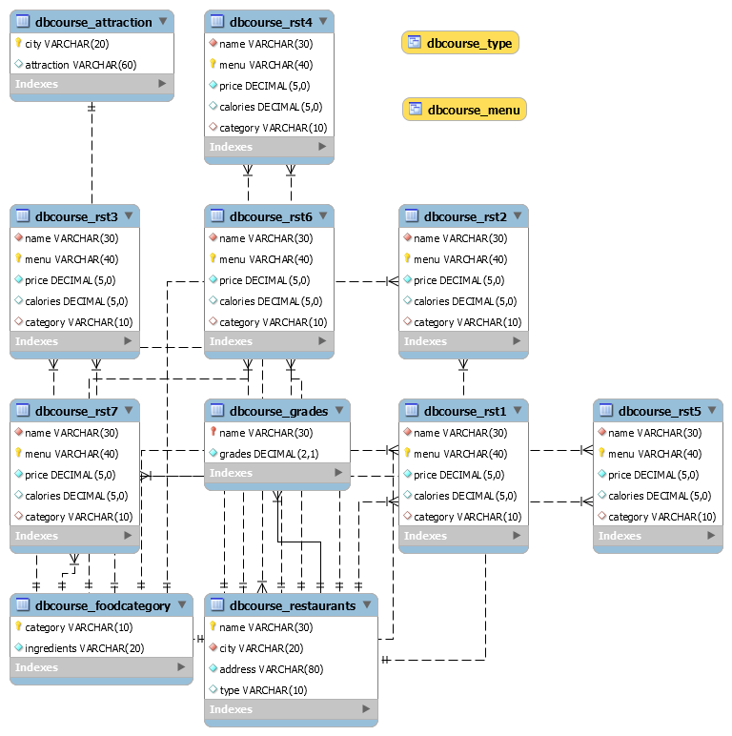
Our Team Project
- Database Schema
DBCOURSE_RESTAURANTS
DBCOURSE_ATTRACTION
DBCOURSE_FOODCATEGORY
DBCOURSE_GRADES
DBCOURSE_RST1 – RST7
Table
View
DBCOURSE_MENU
DBCOURSE_TYPE

Slide 4
Our Team Project
- The structure of our program
Open
Administrator
Disconnect
Customer

Slide 5
Program Demo

