Slide 1
BIGLY LABS × DIS-CHEM
Future-State Scripting
A North Star for Dis-Chem
Defining the prescription experience we want to build — an experience definition, not yet a blueprint.
⚠ Concept for review — not an official Dis-Chem artefact. Generated 2026-06-14 from the Bigly ground-truth vault.
Executive deck for Dis-Chem & Bigly leadership · June 2026
Notes:
Welcome. This deck takes you through how we built a defensible North Star for prescription ('scripting') at Dis-Chem — from the problem, through a rigorous evidence-backed method, to the future-state experience itself. Frame it up front: this is an experience definition we want leadership to agree on, NOT yet a service blueprint — that is the next step. Everything here is cited to our ground-truth research vault.

Slide 2
EXECUTIVE SUMMARY
The North Star in one slide
So what: Price is regulated and fixed — so the durable advantage is the experience around the medicine: a calm, trusted, self-running scripting service for both South Africas.
WHERE WE'RE TAKING SCRIPTING
WHY IT MATTERS
▸ The household medicine manager — one account, every family member, repeats that simply run.
▸ 65% negative pharmacy sentiment — Dis-Chem wins on retail price but is losing on pharmacy trust.
▸ From a transactional, paper-and-queue errand to a managed care relationship.
▸ Customers defect to local pharmacies, willing to pay more for relationship care.
▸ One service spine, two first-class funded paths — insured and cash.
▸ Chronic repeats are the recurring relationship that compounds loyalty — the engine to own.
▸ Automation does the toil; a named pharmacist stays visible and in control.
▸ Buy-in first — agree the experience here, then blueprint and build it.
Source: deliverables/05-tobe-future-state-journey.html · pillars.md
Concept for review — not an official Dis-Chem artefact · Bigly Labs × Dis-Chem
2
Notes:
The whole argument on one page. Where we are taking scripting: a self-running, household-level medicine service that turns a transactional errand into a managed care relationship — built for both the insured 16% and the cash 84% on one spine. Why it matters: pharmacy sentiment runs 65% negative even as the retail brand wins on price, and customers are defecting to local pharmacies. Price is regulated, so experience is the only durable differentiator. Ask of this deck: agree the experience, then we blueprint and build.

Slide 3
WHY NOW — THE PROBLEM
Pharmacy pain is a trust problem, not an availability problem
So what: The medicine is usually there; what fails is the experience around it — and in healthcare, trust failures don't get a second chance.
THE PATIENT TRUST JOURNEY (social listening, 1,270 coded comments)
65% negative pharmacy sentiment
Calm
Trigger
Acceleration
Agitation
Defection
vs 65% POSITIVE on retail price/promo — the trust gap is specific to pharmacy
Assumes it will work
Re-keying, missed windows
Errors feel life-threatening
Can't reach anyone
Moves scripts away
5 complaint clusters
chronic re-order (dominant) · delivery fails · accuracy · service/ownership · billing
“I have been pulling at my hair trying to order my medication via the App or even using the WhatsApp service.”
“Processed on my medical aid and out for delivery. I did not receive it.” — real Dis-Chem customers, Jan-2025 complaints (n=360)
Defection to local pharmacies
customers “willing to pay R460 more” for relationship-based care
Source: wiki/dischem/dischem-social-sentiment-trust-journey · wiki/dischem/pharmacy-complaints-pain-points
Concept for review — not an official Dis-Chem artefact · Bigly Labs × Dis-Chem
3
Notes:
Start with the problem, in the customers' own words. Social listening on 1,270 coded comments shows pharmacy sentiment at 65% negative — the mirror image of the retail brand, which is 65% positive on price and promotions. So this is not a price or availability problem; it is a trust and fulfilment problem. The Patient Trust Journey shows how trust degrades: Calm -> Trigger -> Acceleration -> Agitation -> Defection. The Jan-2025 complaints (n=360) cluster into five themes, with chronic re-order dominant. The endgame is defection: customers move scripts to local pharmacies and pay more for relationship care. Note the honest caveat: these are directional signals, not satisfaction rates.

Slide 4
01
The method
How we built a defensible North Star — and the evidence it stands on.
4

Slide 5
OUR APPROACH
How we built a defensible North Star
So what: A ground-truth research vault feeds a disciplined pipeline — research → best practice → principles → people → journey — so every design choice is traceable to evidence.
Research
Best
practice
Strategic
principles
UX
principles
Segments
Personas
Journey
8 domains,
150+ sources
Global
benchmarks
S1–S5
business bets
U1–U7
experience rules
Two-economy
dual journey
8 research-
backed people
The North
Star
The ground-truth vault method. Every claim traces to a cited source; synthesis lives in a structured wiki; design outputs are defensible, not opinion.
This is the consulting discipline behind the North Star: we earn the outcome by trusting the method.
Source: CLAUDE.md (the vault schema) · meta/research-log.md
Concept for review — not an official Dis-Chem artefact · Bigly Labs × Dis-Chem
5
Notes:
This is the 'trust the method' slide — the spine of a consulting narrative. We did not start with a concept; we built a ground-truth knowledge vault and ran a disciplined pipeline: research across 8 domains, distil global best practice, derive strategic principles (S1-S5) and UX principles (U1-U7), ground in the two-economy segmentation and 8 personas, and only THEN design the journey. Every downstream choice is traceable to evidence. Walk left to right — each of the next sections is one chevron in this row.

Slide 6
THE EVIDENCE BASE
Scale and credibility behind the work
So what: ~150+ cited sources across 8 domains and A–D reliability tiers, anchored by Dis-Chem's own first-party primary research — this is grounded, not borrowed opinion.
8
150+
PLUS DIS-CHEM'S OWN
PRIMARY RESEARCH
research domains
cited sources
▸ Complaints analysis n=360 resolved (Jan 2025)
regulatory, schemes, dispensing, digital, global, UX, consumer, Dis-Chem
one note per source: citation, claims, verbatim excerpts
▸ Social listening 1,270 coded comments (Dec 2025)
A–D
50+
▸ Script-journey interviews n=10 IDIs (Oct 2025)
▸ Store-of-the-Future interviews n=12 (Jan 2026)
reliability tiers
synthesis pages
regulatory & clinical claims rest on A/B; signals labelled
cross-linked wiki — claims link back to their evidence
▸ Omnichannel tech roadmap 24 capabilities (internal board)
Source: sources/_sources-index.md · meta/research-log.md · meta/source-reliability-guide.md
Concept for review — not an official Dis-Chem artefact · Bigly Labs × Dis-Chem
6
Notes:
Credibility. The North Star sits on roughly 150+ cited sources spanning 8 research domains, each rated on an A-D reliability scale so the weight of every claim is explicit — regulatory and clinical claims rest on A/B sources, and consumer sentiment is labelled as a signal. Crucially, this is not just desk research: it is anchored by Dis-Chem's own first-party primary research — the complaints data, social listening, two interview studies, and the internal omnichannel tech roadmap. That mix of external rigour and internal voice is what makes the North Star defensible to this room.

Slide 7
BEST PRACTICE
What the world's leading pharmacies prove — and what transfers to SA
So what: Borrow mechanisms, not funding architectures: Australia, India and China transfer to South Africa far better than the US, UK or EU models.
PATTERNS TO BORROW
TRANSFER STRENGTH TO SA
✓ QR e-script token — scanned at any pharmacy; printed/USSD/WhatsApp fallback (AU)
Australia
Highest
✓ Nominated pharmacy / script list — patient-consented, revocable (UK EPS, AU ASL)
India
High
✓ Auto-refill / med-sync — the refill is automatic; cancelling is the exception
China
High (loop + guardrails)
✓ Teleconsult → Rx → deliver — one integrated loop, scoped to follow-up/chronic (IN, CN)
UK
Medium
✓ Adherence packaging + app wallet — dose-by-time packs; carer mode (PillPack, MedAdvisor)
EU / Germany
Medium (as a warning)
✓ Price legible at point of commit — SEP + capped fee already make this natural in SA
USA
Lowest (features only)
Reject: the US PBM layer, a single online-only rail, PIN/smart-card redemption, density-dependent speed promises.
Source: wiki/global-benchmarks/patterns-to-borrow-and-cautions
Concept for review — not an official Dis-Chem artefact · Bigly Labs × Dis-Chem
7
Notes:
We did not invent from scratch — we studied the world's leading pharmacy models and asked what actually transfers to South Africa. The headline: emerging-market and Australian models fit SA far better than US/UK/EU, because they assume mixed funding, cash-paying patients and dense store estates as fulfilment nodes — exactly SA's reality. Borrow the mechanisms on the left (token e-scripts, nominated pharmacy, auto-refill, teleconsult loops, adherence packaging, price transparency); reject the funding architectures on the right (especially the US PBM layer and Germany's single online-only rail, which drove 99% of patients to the paper fallback).

Slide 8
02
Principles & people
The strategic bets, the experience constitution, the segments and the personas the journey is grounded in.
8

Slide 9
STRATEGIC PRINCIPLES
S1–S5 — the business bets
So what: Five strategic bets define what business this is: compete on service (not regulated price), own the chronic flywheel, and serve both economies on one spine.
S1
Serve both economies on one spine
S2
Pharmacy as the health front door
S3
Compete on service, not price
Insured (~16%) and cash (~84%) are different journeys sharing one spine; the cash majority is never a degraded afterthought.
Scripting is the entry to an ongoing care relationship, not a one-off transaction; the store + clinic estate is a strategic asset.
SEP + capped dispensing fee fix the price; the durable differentiator is the experience around the drug.
S4
Chronic-medicine flywheel = retention engine
S5
Pharmacist at top-of-licence; automate the toil
Proactive, managed chronic repeats are the recurring relationship that compounds loyalty and adherence.
Automation, central-fill and telepharmacy absorb the mechanics so pharmacists do the clinical, trust-building work.
Source: deliverables/_shared/pillars.md
Concept for review — not an official Dis-Chem artefact · Bigly Labs × Dis-Chem
9
Notes:
The strategic layer answers: why build this, and what business is it? Five bets. S1: design for the two South Africas at once. S2: treat the pharmacy as a health front door, not a counter. S3 is the keystone — because SEP and the capped dispensing fee fix the medicine price, you literally cannot compete on price; the only durable differentiator is the experience. S4: the chronic flywheel is the retention engine the courier pharmacies currently win. S5: automate the toil so pharmacists work at the top of their licence. Every step of the journey is defensible from at least one of these.

Slide 10
UX PRINCIPLES
U1–U7 — the experience constitution
So what: Seven UX rules govern how the experience must behave at every touchpoint — WhatsApp-first, never leave them guessing, money legible, graceful failure, dignity, fewer steps, adherence by design.
U1
Channel ladder: WhatsApp-first & data-frugal
U2
Never leave them guessing
U3
Make money legible, early, always
U4
Design for graceful failure
WhatsApp/USSD/SMS first, app as enhancement; low-data, async, resumable.
Honest real-time status at every step; the silent wait is the primary pain.
Price + cover + co-pay shown before the till; cash/EFT/wallet; no cost shock.
Plain-language recovery, never a dead end, always a route to a pharmacist.
U5
Dignity, privacy & language by default
U6
Reduce the journey, don't just digitise it
U7
Adherence-as-design
Stigma-aware, discreet, multilingual; caregivers/proxies are first-class users.
Eliminate steps and re-keying; one profile across channels; measure friction removed.
Design the schedule, label and refill loop as a behaviour-change surface.
Source: deliverables/_shared/pillars.md
Concept for review — not an official Dis-Chem artefact · Bigly Labs × Dis-Chem
10
Notes:
If the strategic bets are the 'what business', the UX principles are the 'how it must behave' — the experience constitution, checkable at every touchpoint. U1 meets people on WhatsApp, the channel they already have. U2 — never leave them guessing — directly answers the silent backstage wait that drives the trust journey. U3 makes money legible before commitment. U4 designs for graceful failure with a human fallback. U5 protects dignity and treats caregivers as first-class. U6 removes steps rather than prettifying them. U7 designs for adherence, not just dispensing. A good design step satisfies at least one S and one U.

Slide 11
SEGMENTS — THE TWO-ECONOMY REALITY
One spine, two first-class funded paths
So what: Funding — not age, device or geography — is the single most load-bearing design variable; the cash-paying majority must never feel like a degraded afterthought.
16%
84%
Insured (medical scheme)
Cash / uninsured majority
INSURED JOURNEY — Nomvula
CASH / UNINSURED JOURNEY — Sipho
▸ Fund: real-time claim pre-adjudication; co-pay shown before commit
▸ Fund: transparent cash price (SEP + dispensing fee) before commit
▸ Fulfilment: home delivery or collection by default
▸ Fulfilment: nearest collection / locker (delivery = premium)
▸ Pay: scheme + saved method
▸ Pay: cash-on-collection + instant EFT / wallet, no saved card
▸ Steering: DSP / formulary / co-pay logic
▸ Steering: generic-first for affordability; CCMDD precedent
Source: wiki/concepts/dual-journey · wiki/consumer-context/two-economy-affordability
Concept for review — not an official Dis-Chem artefact · Bigly Labs × Dis-Chem
11
Notes:
The most load-bearing design variable is not age or device — it is funding. South Africa is a two-economy market: roughly 16% on a medical scheme, 84% paying cash or relying on the public sector. The design answer is one service spine with two first-class funded paths, diverging only where money works differently — pre-adjudicated co-pay on the insured side, transparent cash price on the cash side. The non-negotiable: the cash majority is never a degraded afterthought. We anchor the two paths on real personas — Nomvula (insured chronic) and Sipho (cash, low-data). Removing a trip or a surprise charge is a real financial benefit to the cash customer, not just convenience.

Slide 12
PERSONAS
Eight research-backed people — three become the protagonists
So what: The journey is designed for real, evidenced people spanning the two-economy split — spotlighting an insured chronic patient, a cash WhatsApp-first customer, and a caregiver.
NK
Nomvula Khumalo
SN
Sipho Ndlovu
LD
Lerato Dlamini
Insured chronic, multimorbid
Cash, low-data, WhatsApp-first
Caregiver / proxy collector
★ PROTAGONIST
★ PROTAGONIST
★ PROTAGONIST
54, Discovery, HTN + type-2 diabetes on the CDL. Wants several repeats to flow automatically, fully funded, no co-pay surprise.
45, peri-urban, cheap Android, no street address. WhatsApp + SMS PIN + a collection point near home are the only things that reliably work.
38, sandwich-generation. Runs medicine admin for her diabetic mother, two children and herself — multiple profiles, cycles and wallets.
THE FULL SET ALSO SPANS:
Thabo — cash-pay acute
Trudie — elderly poly-pharmacy
Aisha — time-poor professional
Mandla — public→retail bridge
Naledi — frontline pharmacist (staff)
Source: design-kit/personas/_personas-index
Concept for review — not an official Dis-Chem artefact · Bigly Labs × Dis-Chem
12
Notes:
The journey is grounded in eight research-backed personas — not invented archetypes; every SA-context claim cites a wiki page. They deliberately span the two-economy split, the digital-literacy and connectivity spread, and the customer-vs-staff tension. Three become the protagonists of the North Star: Nomvula, the insured chronic multimorbid patient; Sipho, the cash, low-data, WhatsApp-first customer who has no street address; and Lerato, the caregiver managing meds for three generations. The remaining five — including Naledi, the frontline pharmacist whose oversight we must protect — keep the design honest across the rest of the market.

Slide 13
THE PAINS, MAPPED
Today's complaint clusters map cleanly onto the journey spine
So what: Most root causes sit in the digital and fulfilment seams — yet surface as 'pharmacy' complaints; fixing the counter alone won't fix them. This sets up the journey as the answer.
SUBMIT
VALIDATE
FUND / PAY
DISPENSE
DELIVER
REFILL
A · Chronic re-order
B · Delivery fails
C · Dispensing accuracy
D · Service & ownership
E · Billing transparency
Dominant cluster
Priority 2
Higher-risk
Priority 4
Priority 5
→ REFILL / SUBMIT
→ DELIVER
→ DISPENSE
→ Cross-cutting
→ FUND / PAY
“Dis-Chem App is dysfunctional.”
“Out for delivery. I did not receive it.”
“My blood-pressure tablets were missing.”
“The nurse doesn't know what to do.”
“Pricing differs dramatically between stores.”
Source: wiki/dischem/pharmacy-complaints-pain-points · src-dc-complaints-jan2025
Concept for review — not an official Dis-Chem artefact · Bigly Labs × Dis-Chem
13
Notes:
Here is the bridge from problem to solution. The five complaint clusters map cleanly onto the journey spine: chronic re-order (dominant) at REFILL/SUBMIT; delivery failure at DELIVER; dispensing accuracy at DISPENSE; service and ownership cross-cutting; and billing transparency at FUND/PAY. The load-bearing insight: most root causes actually live in the digital and fulfilment seams, but they surface as pharmacy complaints because the pharmacy is the visible face. So designing only the counter won't fix them — we have to fix the seams. That is exactly what the North Star journey does, which is where we go next.

Slide 14
03
The North Star
The future-state experience — the household medicine manager, revealed.
14

Slide 15
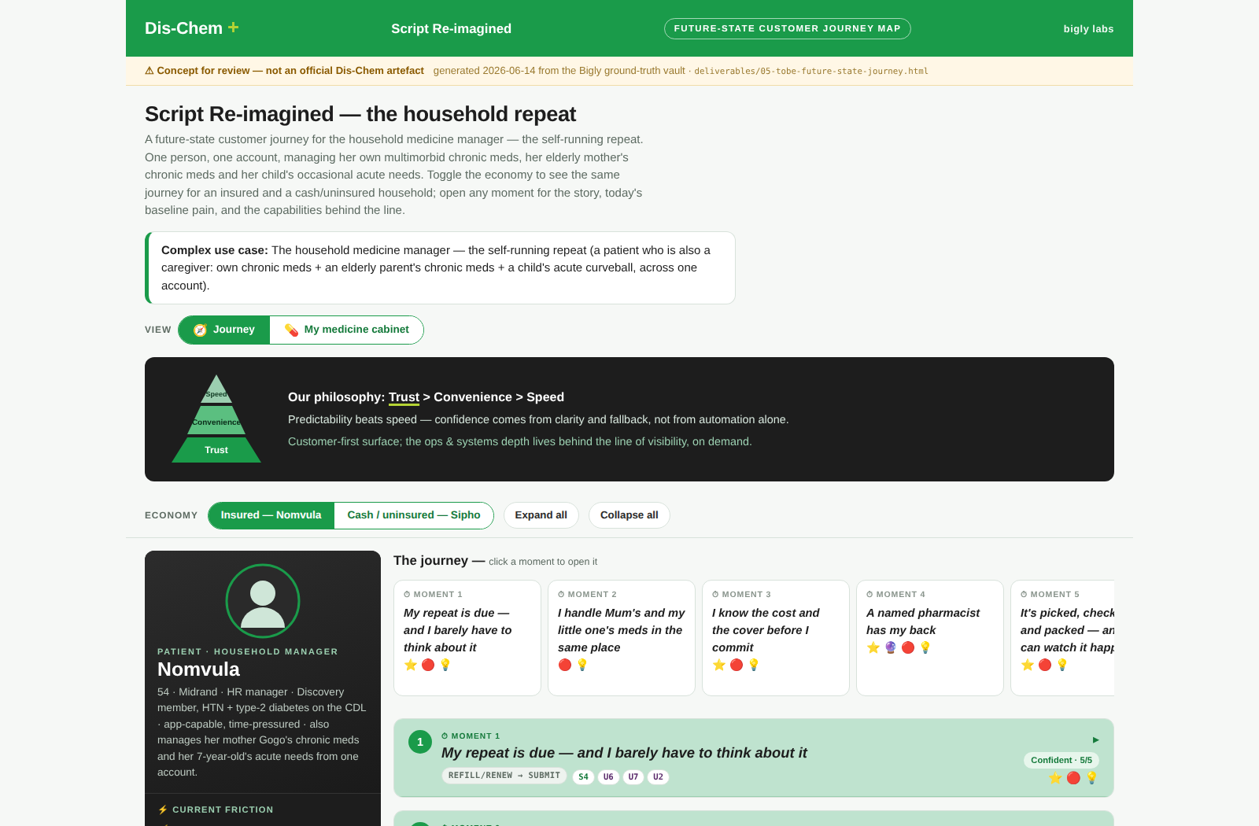
THE NORTH STAR — REVEAL
The household medicine manager — a self-running repeat
So what: One person manages her own, her mother's and her child's medication in one place; the system predicts, dispenses and delivers — she barely has to think about it.
THE MOMENT ARC
→ “My repeat is due — and I barely have to think about it”
→ “I handle Mum's and my little one's meds in one place”
→ “I know the cost and cover before I commit”
→ “A named pharmacist has my back”
→ “It's picked, checked and packed — and I watch it happen”
→ “It arrives when they said — never left guessing”
→ “When life throws a curveball, the system bends”
Source: deliverables/05-tobe-future-state-journey.html · src-vn-cape-point-11
Concept for review — not an official Dis-Chem artefact · Bigly Labs × Dis-Chem
15
The built artefact — interactive future-state journey board (insured view)
Notes:
This is the climax — the North Star itself, and the actual built artefact, not a sketch. The complex use case is the household medicine manager: one person, simultaneously patient and caregiver, managing her own multimorbid chronic meds, her elderly mother's chronic meds, and her child's occasional acute needs — across one account. It exercises the whole spine. The moment arc on the left is written in the customer's first-person voice; each moment answers a real, quoted pain. This is an aspirational ~5-year, tech-led vision, deliberately unconstrained by today's technology landscape.

Slide 16
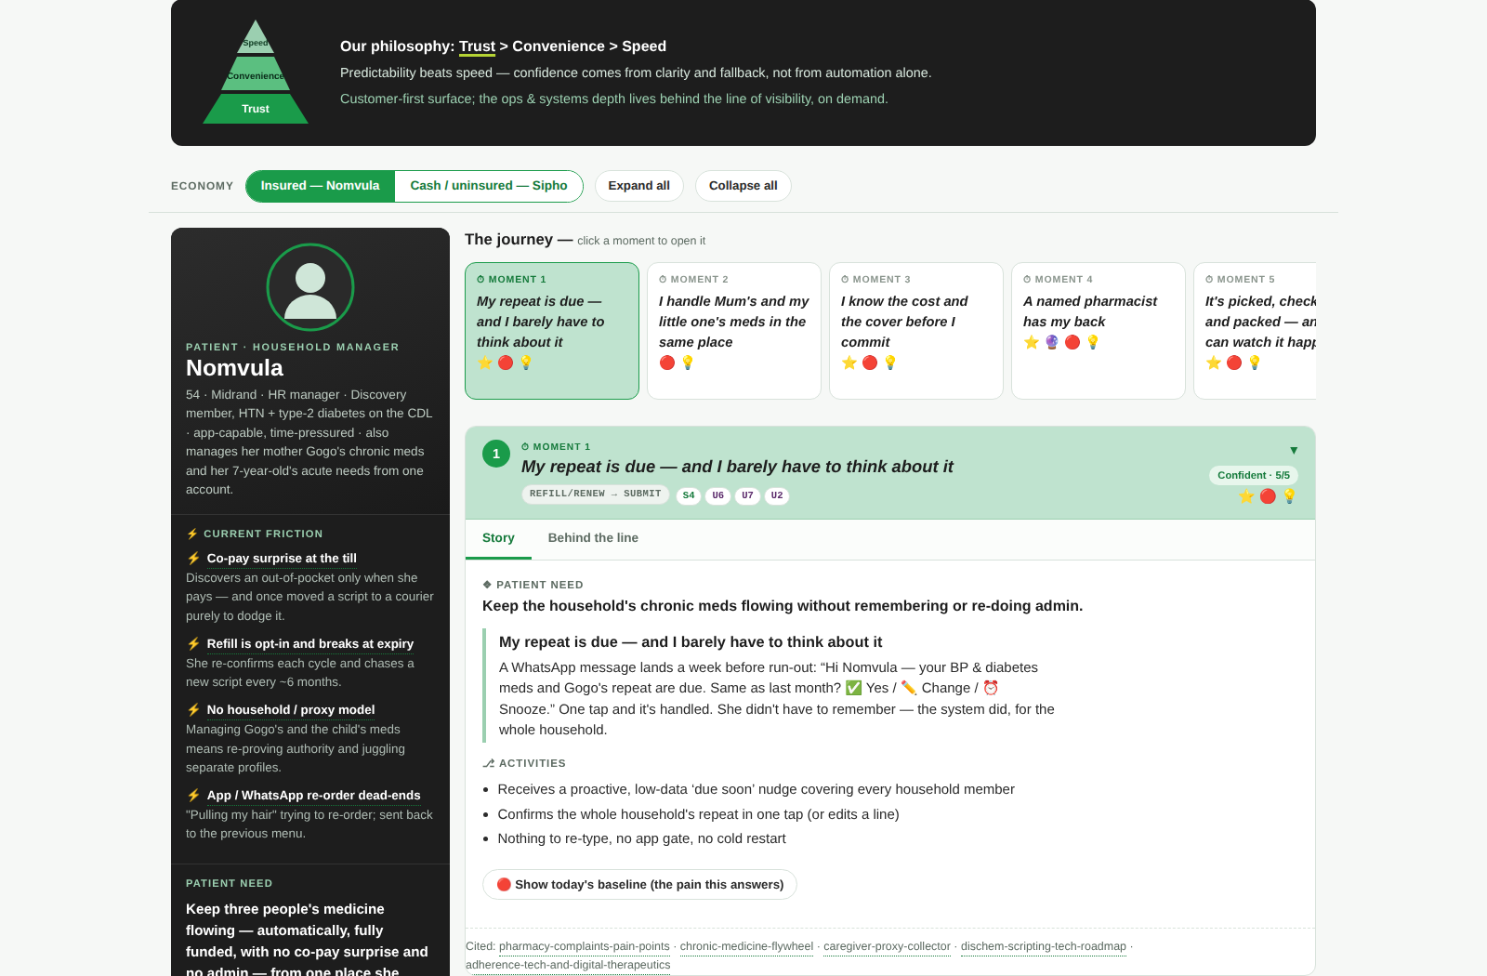
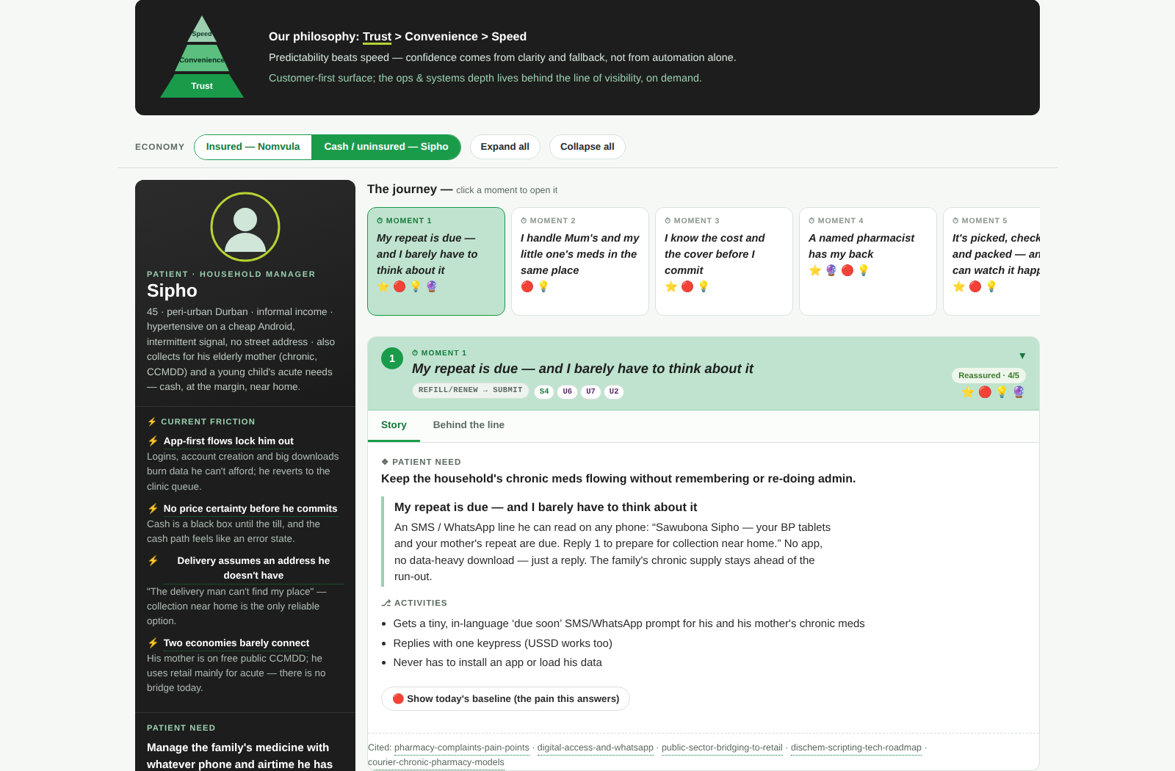
THE NORTH STAR — REVEAL
Calm on the surface, depth on demand — and equal on both paths
So what: Each moment opens to reveal the experience behind the line of visibility; the dual-economy toggle proves the cash path is first-class, not a downgrade.
A moment expanded — story + behind-the-line (insured)
The same journey, cash / uninsured path (Sipho)
Low-friction & human: predictability beats speed (SOTF), the customer surface stays calm, and the ops/tech depth lives behind a line of visibility the reader can open. The cash majority gets the same dignity, transparency and fulfilment quality.
Source: deliverables/05-tobe-future-state-journey.html · wiki/concepts/dual-journey
Concept for review — not an official Dis-Chem artefact · Bigly Labs × Dis-Chem
16
Notes:
Two things to land here. First, the experience is calm on the surface but deep on demand: a customer sees a confident, human, first-person story; a reviewer can open each moment to see the frontstage, line of visibility, backstage, tech callouts, pains and opportunities behind it. Predictability beats speed — that is the Store-of-the-Future finding. Second, the dual-economy toggle: the left is the insured path, the right is the same journey for the cash, low-data customer. The cash path is genuinely first-class — cash price legible up front, locker/collection options, no scheme to lean on — not a degraded afterthought.

Slide 17
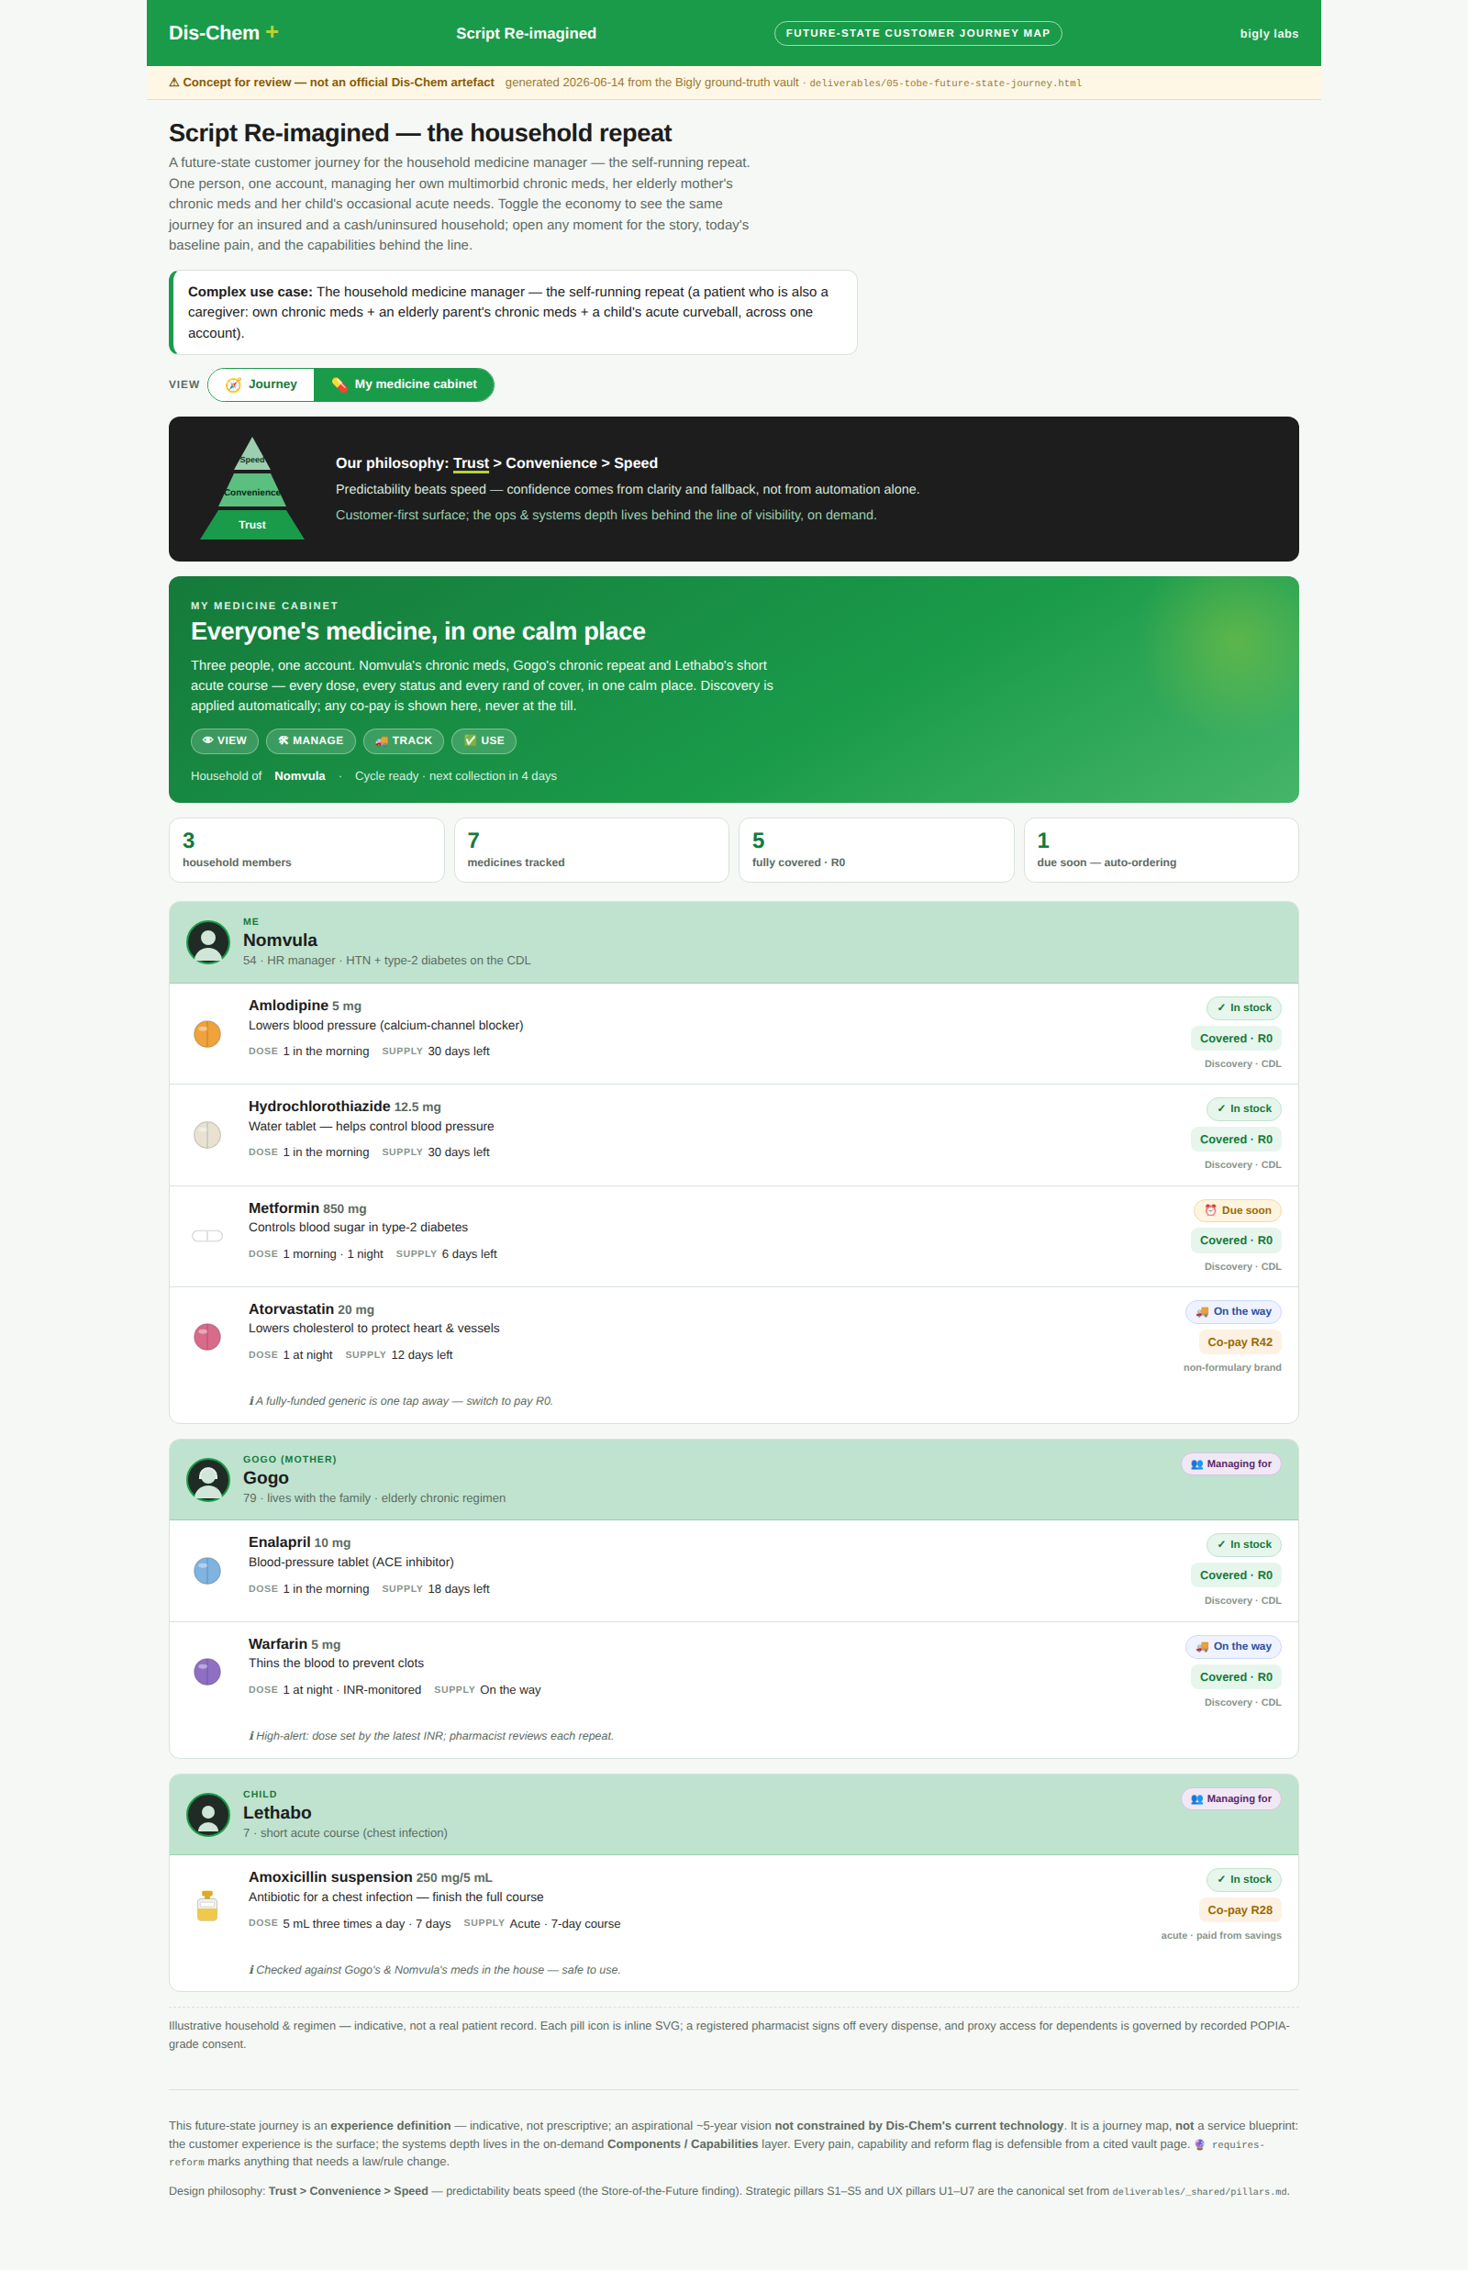
THE NORTH STAR — REVEAL
“My medicine cabinet” — the hero moment
So what: Every household member's medication in one beautiful view — what to take, when, what's left and what's coming — turns admin into confidence.
WHY IT MATTERS
▸ Every member, one view — her own multimorbid regimen, her mother's chronic meds, her child's acute scripts — with a clear pill visual.
▸ Predict, don't prompt — the cabinet shows what's running low and pre-stages the repeat — the best refill is the one she didn't have to think about (U7, S4).
▸ Adherence by design — what to take and when, with hybrid digital + printed instructions and consented, opt-out-able reminders tied to routine.
▸ Dignity & proxy by default — caregivers are first-class users; POPIA-grade consent for managing a dependant's medication (U5).
★ The “manage my medications” showpiece moment
Source: deliverables/05-tobe-future-state-journey.html · src-vn-cape-point-11
Concept for review — not an official Dis-Chem artefact · Bigly Labs × Dis-Chem
17
Notes:
The hero moment Jian and Tamsin called out specifically: a 'really beautiful end-to-end' view of every household member's medication, with a pill visual, tracking, and 'using my medication'. This is where the experience stops being a transaction and becomes a relationship. It directly delivers the chronic flywheel (S4) and adherence-as-design (U7): the cabinet predicts and pre-stages the repeat rather than waiting for the customer to remember. And it treats the caregiver as a first-class user with proper proxy consent — which is the lived reality for millions of South African households.

Slide 18
WHAT MAKES IT REAL
The capability roadmap already exists — and we flag what needs reform
So what: ROWA, OCR, AI capture, BRIX, the E2E Dashboard and PICCUP are Dis-Chem's own roadmapped capabilities; the vision is buildable, with reform-dependencies named honestly.
ROADMAPPED CAPABILITIES (planned, not yet live)
🔮 REQUIRES REFORM — flagged honestly
ROWA
automated picker / dispensing robot — the proof-point for 'automate the toil' (S5)
▸ Auto-dispense without human intervention vs pharmacist-oversight & valid-prescription rules
OCR + AI capture
reads, standardises & routes the script; human fallback (PBQ)
▸ Fully-paperless AES e-script acceptance (ECTA / Reg 33)
BRIX
auto-dispense of eligible repeats + point-of-sale
▸ Locker / unattended dispensing of scheduled medicines
E2E Dashboard
one workflow manager across dispensary, store, collection & delivery
▸ After-hours live scheme authorisation & 24/7 pharmacist oversight
PICCUP + VC
consolidation → driver → last-mile with proof-of-delivery
▸ Remote pharmacist supervision / central-fill
Virtual Manager
human SLA oversight of the virtual order queue
Source: wiki/digital-transformation/dischem-scripting-tech-roadmap · src-dc-omnichannel-scripting-roadmap
Concept for review — not an official Dis-Chem artefact · Bigly Labs × Dis-Chem
18
Notes:
Now we ground the vision so it does not read as science fiction. Every capability on the left is Dis-Chem's OWN roadmapped technology, captured from the internal omnichannel board — ROWA the picker robot, OCR and AI capture, BRIX auto-dispense, the end-to-end Dashboard, and PICCUP delivery. ROWA and OCR are already signed off. Important honesty: these are planned, not confirmed live. And on the right we name the reform-dependencies up front — fully automated dispensing, paperless AES e-scripts, locker dispensing of scheduled meds, after-hours authorisation, and remote supervision. Naming them protects credibility and sets the regulatory agenda.

Slide 19
FROM PAIN TO NORTH STAR
Every future moment answers a real, quoted pain of today
So what: The gap is undeniable when you put today's customer words next to the future experience — the North Star is a direct response to the evidence.
TODAY (the quoted pain)
NORTH STAR (the moment that answers it)
“Pulling my hair trying to order via the App or WhatsApp.”
My repeat is predicted and one-tap — I barely have to think about it.
“Out for delivery. I did not receive it.”
Realistic windows, closed-loop tracking & proof-of-delivery — I'm never left guessing.
“My blood-pressure tablets were missing.”
ROWA picks, the pharmacist signs off, an itemised handover I can check.
“The nurse doesn't know what to do.”
A named pharmacist has my back; renewing is a tap, not a trek.
“Pricing differs dramatically between stores.”
Cost and cover are legible before I commit — no surprise at the till.
Source: wiki/dischem/pharmacy-complaints-pain-points · dischem-social-sentiment-trust-journey
Concept for review — not an official Dis-Chem artefact · Bigly Labs × Dis-Chem
19
Notes:
This is the slide that closes the loop on the whole narrative. On the left, in red, are real customer words from the complaints and social-listening data. On the right, in green, is the specific future moment that answers each one. Pulling-my-hair re-orders become a predicted one-tap repeat. 'I did not receive it' becomes closed-loop tracking with proof-of-delivery. Missing tablets become ROWA-picked, pharmacist-checked, itemised handover. The gap is undeniable — and it shows the North Star is evidence-driven, not aspirational decoration.

Slide 20
04
From here
What this deck is, what comes next, and the evidence behind it.
20

Slide 21
WHAT'S NEXT
This deck is the groundwork — here is the road to build
So what: We've defined the experience and earned buy-in; the next steps turn it into a service blueprint, per-channel adaptations, and a build.
1
THIS DECK
2
NEXT
3
THEN
4
BUILD
Experience defined
Service blueprint
Per-channel adaptation
Build & pilot
Agree the North Star — the experience we want to create.
Frontstage/backstage lanes, ownership, SLAs, exception handling.
Tune the base journey for WhatsApp, app, in-store and USSD.
Sequence against the roadmap; pilot, measure, scale.
Source: deliverables/05-tobe-future-state-journey.html (experience definition)
Concept for review — not an official Dis-Chem artefact · Bigly Labs × Dis-Chem
21
Notes:
To close: be explicit about what this deck is and is not. This is the experience definition — the groundwork that earns buy-in. It is deliberately NOT yet a service blueprint. The road from here: (1) agree the North Star today; (2) develop the full service blueprint with frontstage/backstage lanes, ownership and SLAs; (3) adapt the base journey per channel — WhatsApp, app, in-store, USSD; (4) sequence the build against the roadmap, pilot, measure and scale. The ask of this room is step one: agree the experience, so we can blueprint and build it.

Slide 22
APPENDIX
Methodology & source-reliability tiers
So what: How the vault works and how we weight evidence — the discipline behind every cited claim in this deck.
SOURCE RELIABILITY TIERS
THE GROUND-TRUTH VAULT (3 layers)
Raw sources. one note per source: citation, key claims, verbatim excerpts — append-only evidence.
A
Primary / authoritative
legislation, regulators (SAHPRA, SAPC, CMS, HPCSA), peer-reviewed, standards, company disclosures
B
Strong secondary
The wiki. synthesised, cross-linked entity/concept pages — claims link back to their sources.
reputable analysts & consultancies, established trade press, gov-adjacent bodies
C
Useful but weaker
The schema. conventions & workflows (ingest, query, lint) that keep it consistent and current.
general news, vendor marketing, single-author blogs — verify load-bearing claims
D
Anecdotal / signal-only
Golden rule: a wiki claim links to the source that backs it — synthesis, not narrative, in evidence.
forums, app-store reviews, social posts — never a factual basis; sentiment signal only
Source: CLAUDE.md · meta/source-reliability-guide.md
Concept for review — not an official Dis-Chem artefact · Bigly Labs × Dis-Chem
22
Notes:
Appendix for the curious. The vault follows the Karpathy 'LLM wiki' pattern in three layers: raw sources (append-only evidence), the synthesised wiki (where claims link back to their sources), and the schema (the rules). The golden rule is that synthesis lives in the wiki and every claim cites its evidence. We weight that evidence on an A-D scale: regulatory, clinical and pricing claims rest on A/B; consumer sentiment from social and app-store data is C/D and always labelled as a signal, never asserted as a rate.

Slide 23
APPENDIX
Full persona set & open questions / reform register
So what: The complete cast the design must satisfy, and the honest list of what we still need to verify or change in regulation.
THE 8 PERSONAS
OPEN QUESTIONS & REFORM REGISTER (selected)
1. Nomvula Khumalo — Insured chronic, multimorbid ★
▸ Real-time scheme pre-adjudication API (“can I claim?” dry-run) — exposed by any switch? Key enabler for U3.
2. Thabo Mokoena — Cash-pay acute customer
▸ Legal boundary of auto-dispense for eligible repeats vs pharmacist oversight. 🔮
3. Lerato Dlamini — Caregiver / proxy collector ★
4. Trudie van Wyk — Elderly poly-pharmacy patient
▸ SAPC acceptance of AES-signed e-scripts for S5/S6. 🔮
5. Sipho Ndlovu — Low-data, peri-urban, WhatsApp-first ★
▸ Chain-of-custody for third-party last-mile couriers holding scheduled meds. 🔮
6. Aisha Patel — Time-poor urban professional
7. Mandla Zwane — Public-sector bridging to retail
▸ 24/7 pharmacist oversight & live after-hours scheme authorisation. 🔮
8. Naledi Mahlangu — Frontline dispensary pharmacist (staff)
▸ Exact dispensing-fee bands & CMS coverage split — re-verify vs primary gazette/PDF.
★ = protagonist of the North Star journey
🔮 = requires regulatory reform. 48 reform flags & 63 unverified items tracked across the vault.
Source: design-kit/personas/_personas-index · meta/open-questions.md
Concept for review — not an official Dis-Chem artefact · Bigly Labs × Dis-Chem
23
Notes:
Closing appendix. On the left, the full cast of eight personas the design must satisfy — including Naledi, the frontline pharmacist, whose oversight and time the future-state must protect, not erode. On the right, the honesty register: the open questions and reform-dependencies we are tracking, from real-time scheme pre-adjudication to the legal boundary of automated dispensing and after-hours authorisation. The vault tracks 48 reform flags and 63 unverified items in total. Naming these openly is what makes the work trustworthy.

