Slide 1


GSIR: Generalizable 3D Shape Interpretation and Reconstruction
Jianren Wang¹, Zhaoyuan Fang¹
¹CMU RI

Slide 2
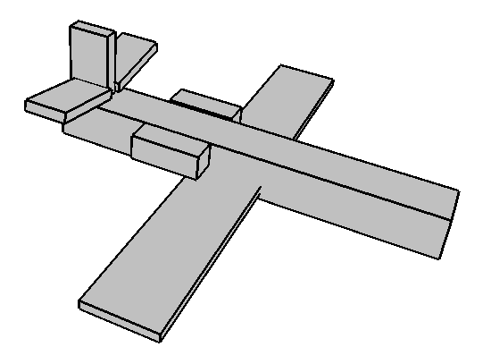
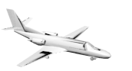
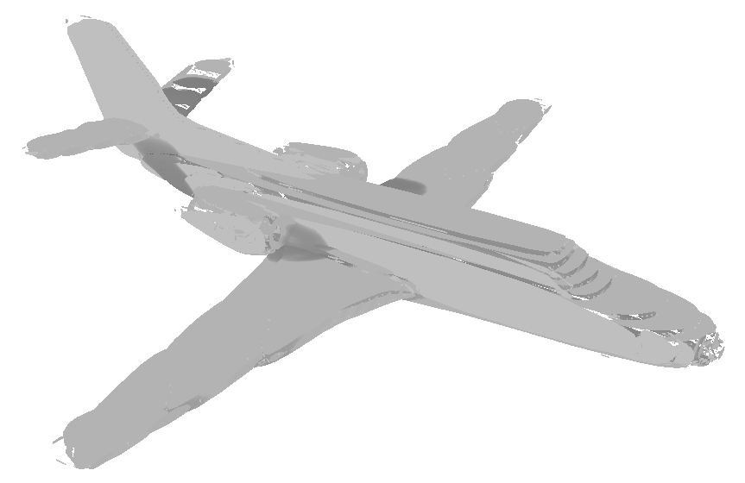
Motivation
Shape Interpretation
Structure-guided Shape Reconstruction
Interpretation Consistency
Image
Shape Reconstruction

Slide 3
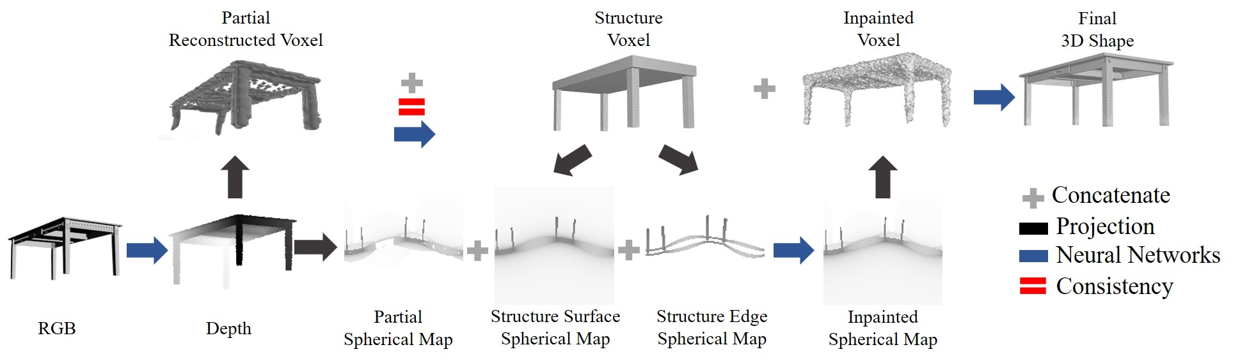
Approach: Pipeline

Slide 4
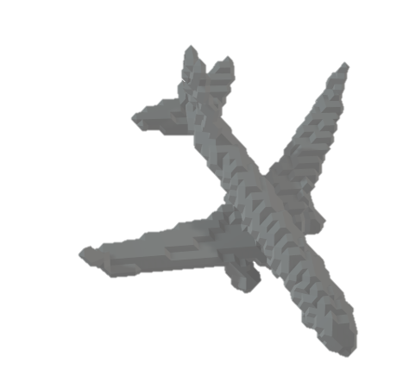
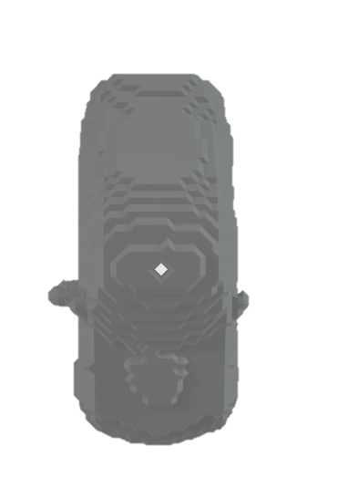
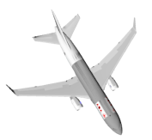
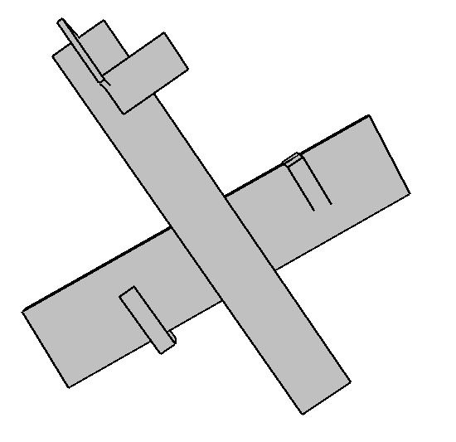
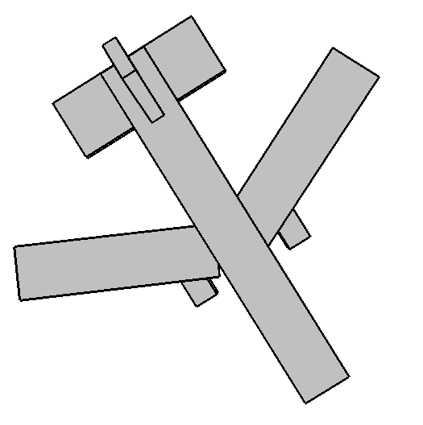
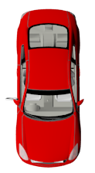
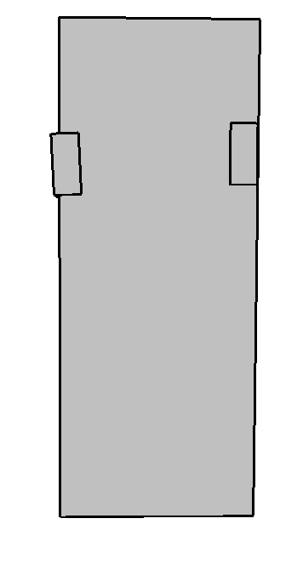
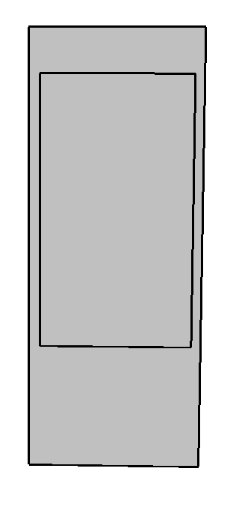
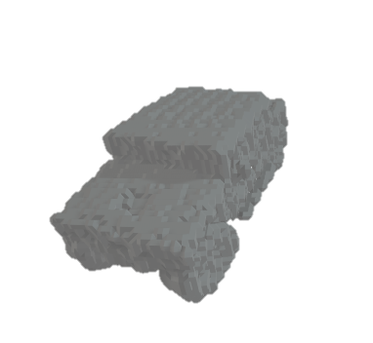
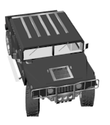
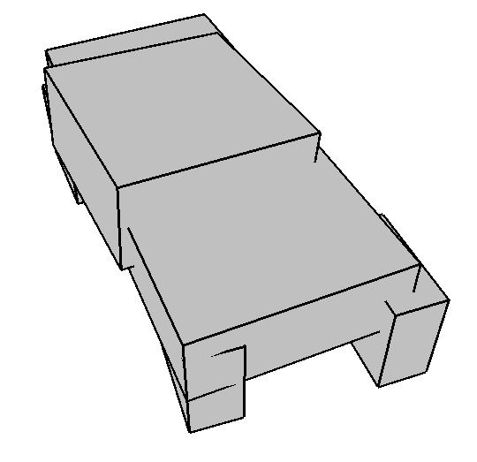
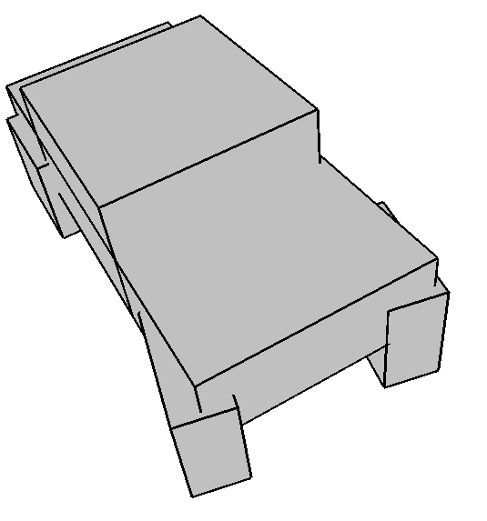
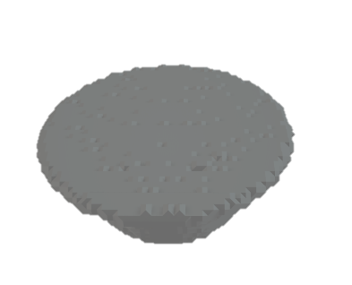
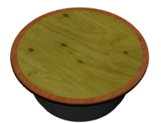
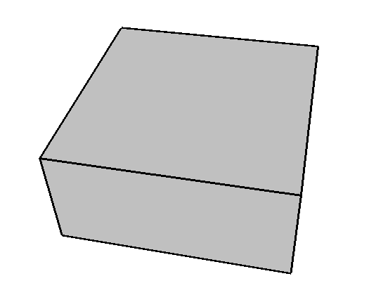
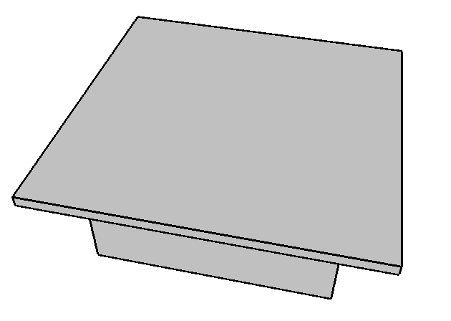
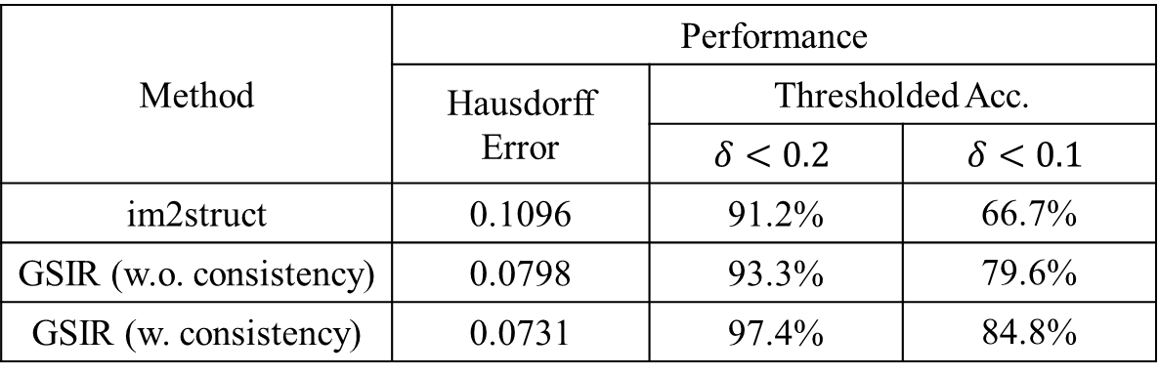
Results
3D Shape Interpretation
Method | Performance
 | Hausdorff Error | Thresholded Acc.
 |  | $$δ<0.2$$ | $$δ<0.1$$
im2struct | 0.1096 | 91.2% | 66.7%
GSIR (w.o. consistency) | 0.0798 | 93.3% | 79.6%
GSIR (w. consistency) | 0.0731 | 97.4% | 84.8%
RGB
Partial
im2struct
GSIR
RGB
Partial
im2struct
GSIR

Slide 5
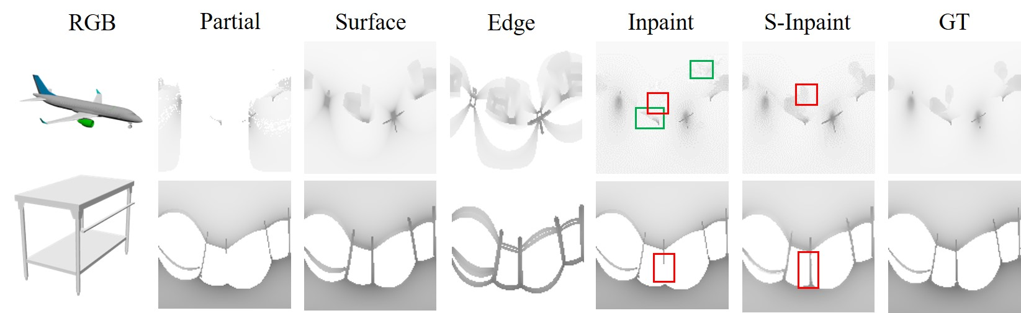
Results
Structure-Guided Shape Completion

Slide 6
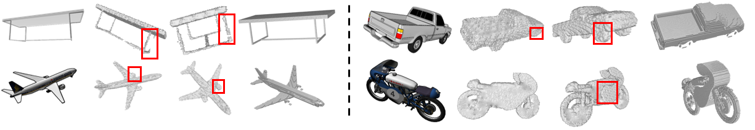
Results
Method |  | Chamfer Distance
 |  | Seen Categories | Unseen Categories
Object-Centered | IM-Net | 0.055 | 0.119
 | ONet | 0.060 | 0.128
 | DeepSDF | 0.053 | 0.115
 | AtlasNet | 0.063 | 0.126
Viewer-Centered | DRC | 0.097 | 0.127
 | MarrNet | 0.081 | 0.116
 | GenRe | 0.068 | 0.108
 | GSIR | 0.057 | 0.099
3D Shape Reconstruction
RGB
GenRe
GSIR
Ground Truth
RGB
GenRe
GSIR
Ground Truth

Slide 7
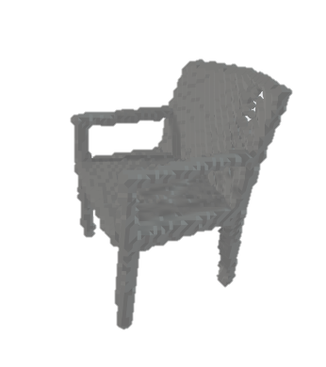
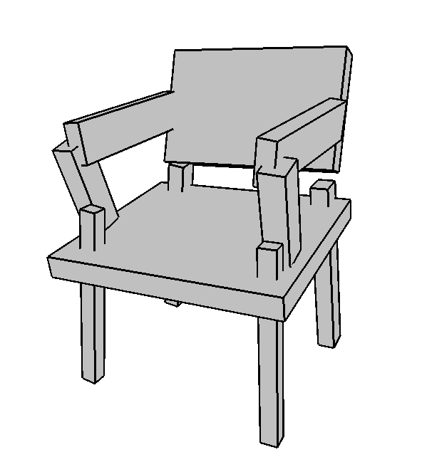
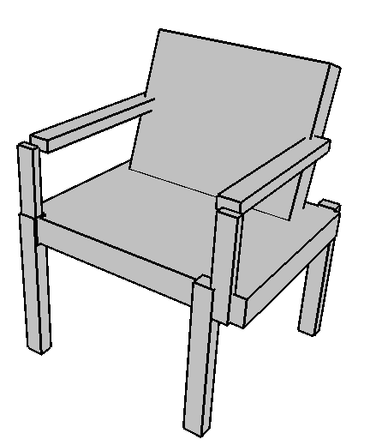
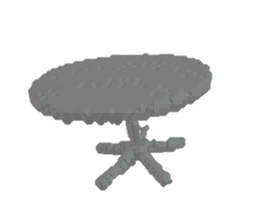
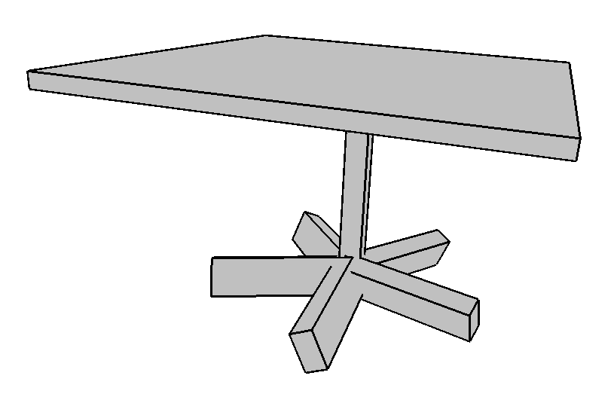
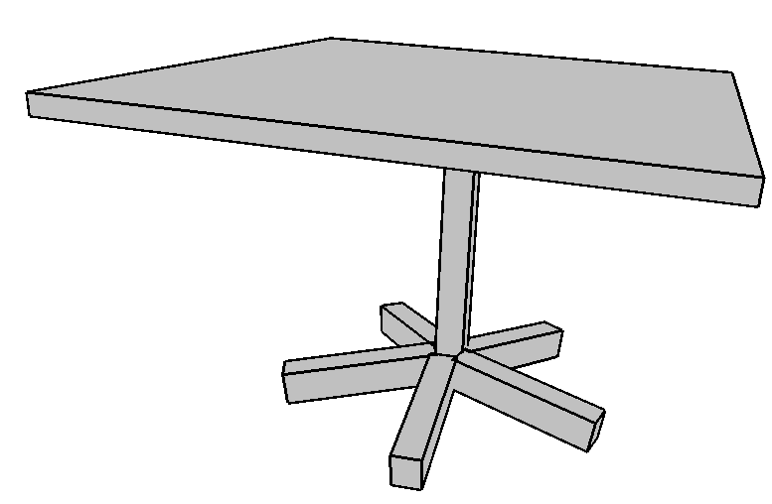
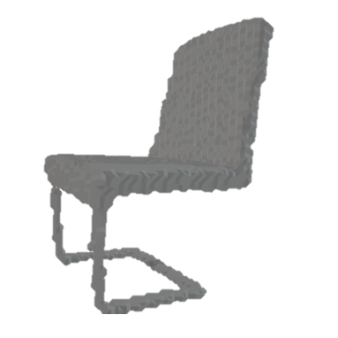
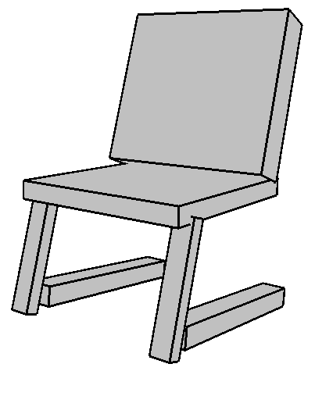
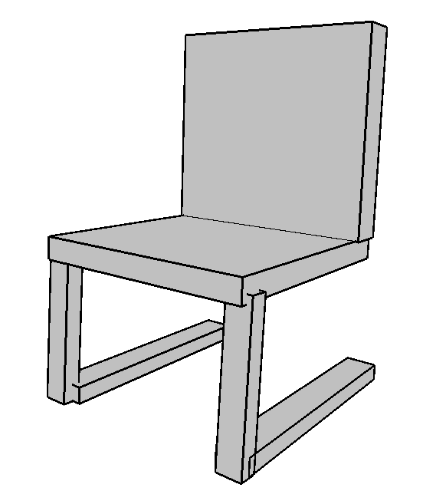
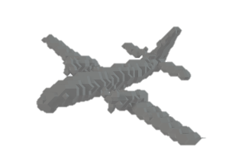
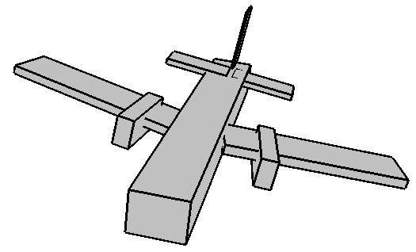
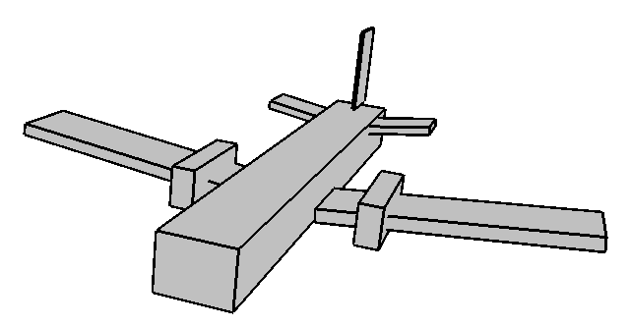


Results
Shape Interpretation with Consistency
$$V_{p}$$
Structure
Fine-tuned
$$V_{p}$$
Structure
Fine-tuned

Slide 8
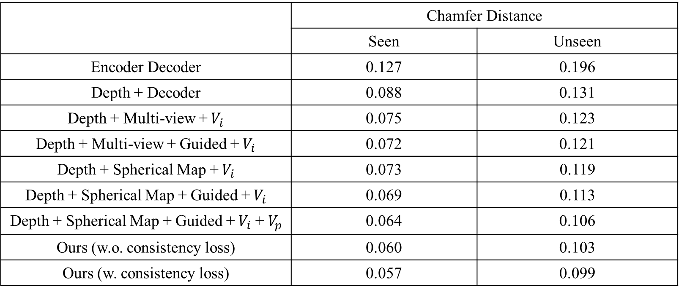
Results: Ablation Study
 | Chamfer Distance
 | Seen | Unseen
Encoder Decoder | 0.127 | 0.196
Depth + Decoder | 0.088 | 0.131
Depth + Multi-view +${ V}_{i}$ | 0.075 | 0.123
Depth + Multi-view + Guided +${ V}_{i}$ | 0.072 | 0.121
Depth + Spherical Map +${ V}_{i}$ | 0.073 | 0.119
Depth + Spherical Map + Guided +${ V}_{i}$ | 0.069 | 0.113
Depth + Spherical Map + Guided +${ V}_{i}$ +${ V}_{p}$ | 0.064 | 0.106
Ours (w.o. consistency loss) | 0.060 | 0.103
Ours (w. consistency loss) | 0.057 | 0.099

Slide 9
Thank you for listening!

