Slide 1
RaffleMe
By Have Tests? Maybe Later
Brandon Arbuthnot
JS Teoh
Notes:
Introduce myself and JS
Ask about HQ or Trivia Crack

Slide 2
What is RaffleMe?
Live Question-based Raffle App
Uses Faye WebSockets
Maintains the Database of questions, answers, accounts, and rooms
Chooses A Winner!
Notes:
Hold a Raffle, where every correct question answered by a user is submitted like a digital ticket
Users join using the join code, where they answer questions set by the host of the raffle

Slide 3

Why make RaffleMe
HQ
Valued at over $100 Million
$10 Million in ad revenue (2018)
Highest user payout? $50,000
Trivia Crack
$200,000 made in March 2019
Earned well over $100 Million
Notes:
At its peak, an app like this has insane value
Making a live game would be an exciting challenge for our group
We wanted to build something users could play rather than just look at

Slide 4
Why make RaffleMe
Malleable
Addicting
Useful in classrooms
Users do the work!
Notes:
At its peak, an app like this has insane value
Making a live game would be an exciting challenge for our group
We wanted to build something users could play rather than just look at

Slide 5
RaffleMe
CREATE
JOIN
PLAY
New Raffles
New Questions
New Accounts
Rooms
Friends
Organizations
To Have Fun
To Study
To Win!

Slide 6
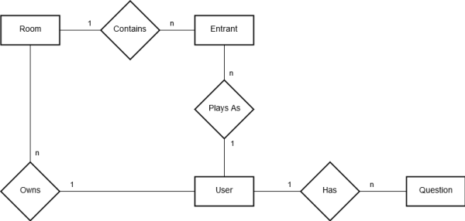
ER Diagram
Notes:
Reusability of questions
Owner relationship of rooms
Tickets represented by entrants in the 1 to many, many to 1 connection of User-Entrant-Room

Slide 7
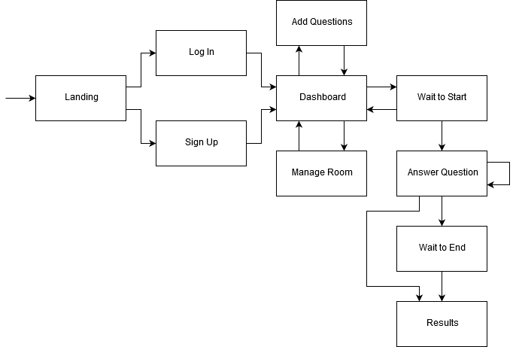
Page Flow

Slide 8

Devise
Account Setup
Helper Methods
Routing
Notes:
Devise

Slide 9

Faye Websockets
Joining Rooms
Disconnecting
Ending Raffle
Redirects
Live pages
Notes:
Faye redirects handle the game ending

Slide 10

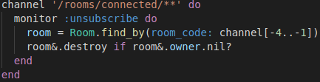
CRUD Operations

Slide 11
Hosting a Raffle
Sign Up/Log in or find the Quick Create Form
Enter a Room name and hit ‘Create’
When everyone has joined using the 4-digit Join Code provided, hit ‘Start Raffle’

Slide 12
Creating Questions
Log in
Hit ‘Your Custom Questions’
Fill out the prompt and hit ‘create’ to add your question
Your questions are what appear to participants during the raffle!

Slide 13
Joining a Raffle
Sign Up/Log in or find the Quick Join Form
Enter a Username, the Room’s 4-digit Join code and hit ‘Join’
Wait for the Raffle to begin and start answering as many questions as you can!

Slide 14
Winning the Raffle
Answer the Questions provided
Wait for the Host to End the Raffle and draw the winning entrant!
???

Slide 15
The Winner
Selected Randomly
Weighted by correct answers
Picked at the end of the raffle

Slide 16
$ rails generate LiveDemo JS
Notes:
JS takes over for demo
Code screenshots?

Slide 17

The Hardest Part
Using Websockets
Accepting user questions
Randomizing selection with odds based on correct answers

Slide 18



Functionality we wanted to add
Payout support
Public Rooms
Search Functions
Public Questions/Tags
Customizable Profiles

