Slide 1
Machine Learning Alternatives to Forecasting the 10-Year Treasury
Statistical Methods vs. Market Expectations

Slide 2
Question and Value-Add
Can Machine Learning (ML) methods forecast 10-year Treasury rates more accurately than the market’s expectation?
Value-Add:
Assist financial market participants in preempting interest rate movements
Determine which macroeconomic factors are most important in forecasting rates

Slide 3
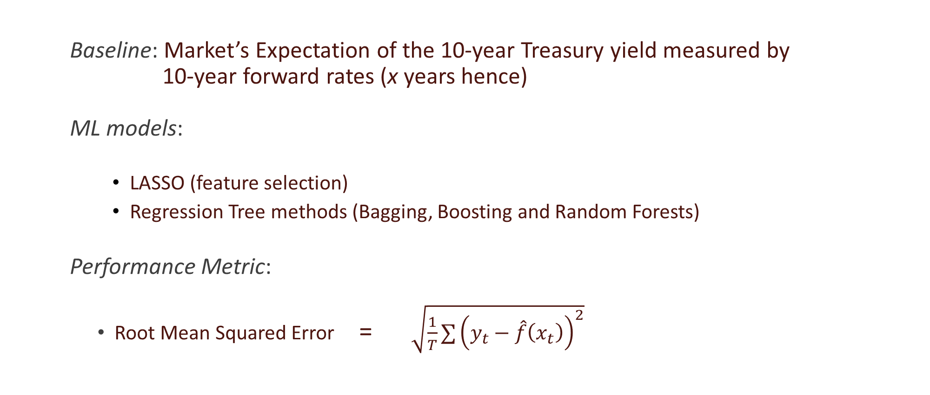
Methodology
Baseline: Market’s Expectation of the 10-year Treasury yield measured by 10-year forward rates (x years hence) ML models:
LASSO (feature selection)
Regression Tree methods (Bagging, Boosting and Random Forests)
Performance Metric:
Root Mean Squared Error = $\sqrt{\frac{1}{T}∑{\left(y_{t}−\hat{f}\left(x_{t}\right)\right)}^{2}}$

Slide 4
Data
Dependent Variable: 10-year Treasury rates
Independent Variables: Selected Leading, Lagging and Coincident Macroeconomic indicator series Examples: CPI, Employment, Personal Income, Prime Loan Rate, Housing Permits
Structure: Time Series (June 1990 – December 2018)
Frequency: Weekly (Macroeconomic data interpolated Monthly → Weekly)
Source: FRED

Slide 5
Baseline
There are several candidates for our baseline forward rate:
10-year forward rate, 1 year hence
10-year forward rate, 3 years hence
10-year forward rate, 5 years hence
The best-performing candidate rate will be used as our baseline Market Expectation moving forward.

Slide 6
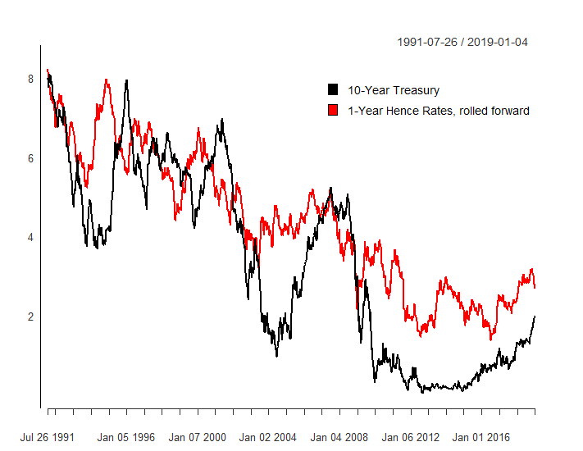
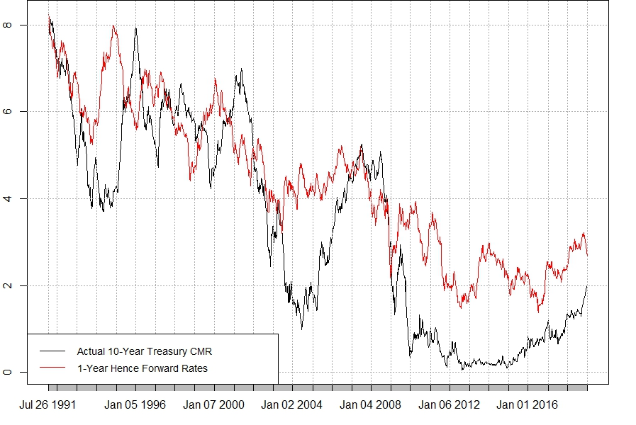
RMSE = 1.616
Performance: 10-Year Forward Rate, 1 Year Hence

Slide 7
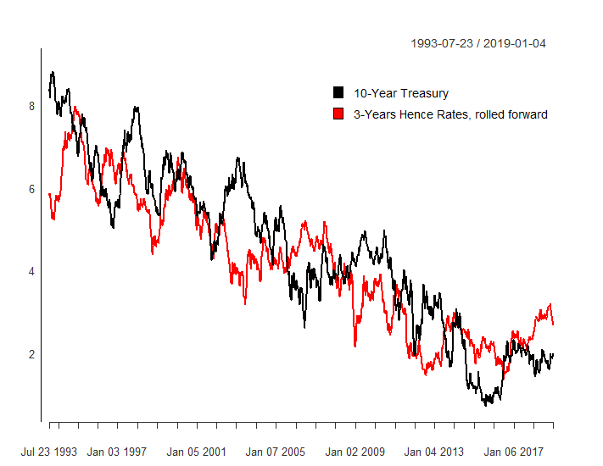
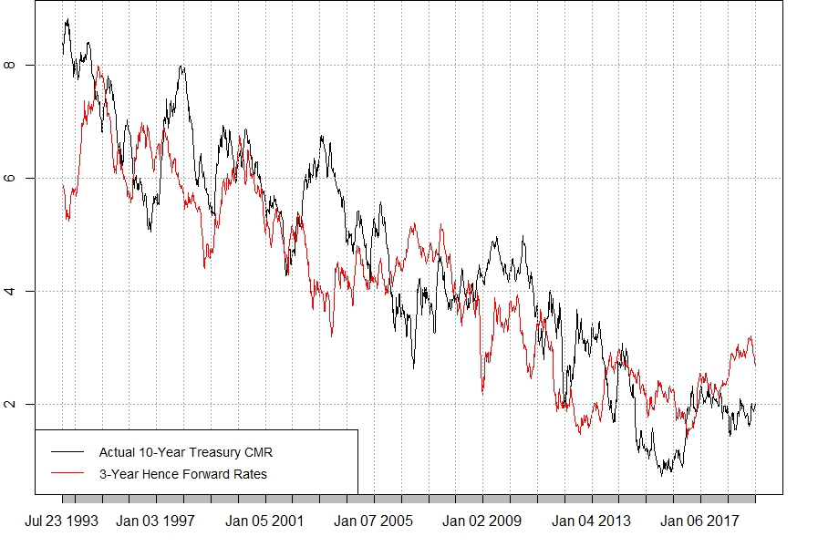
RMSE = 1.116
Performance: 10-Year Forward Rate, 3 Years Hence

Slide 8
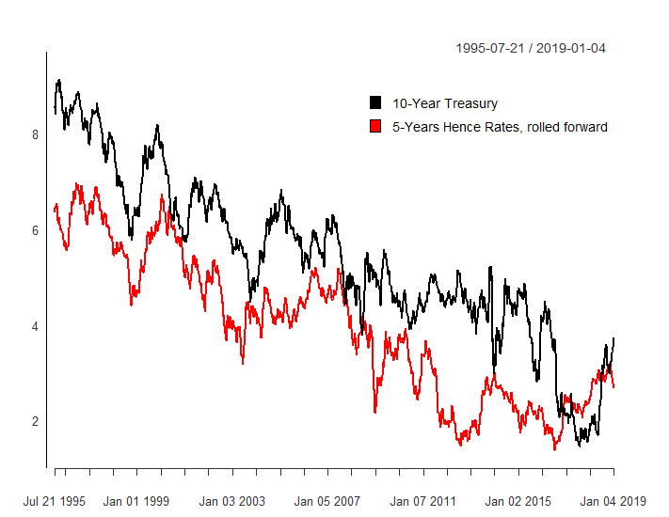
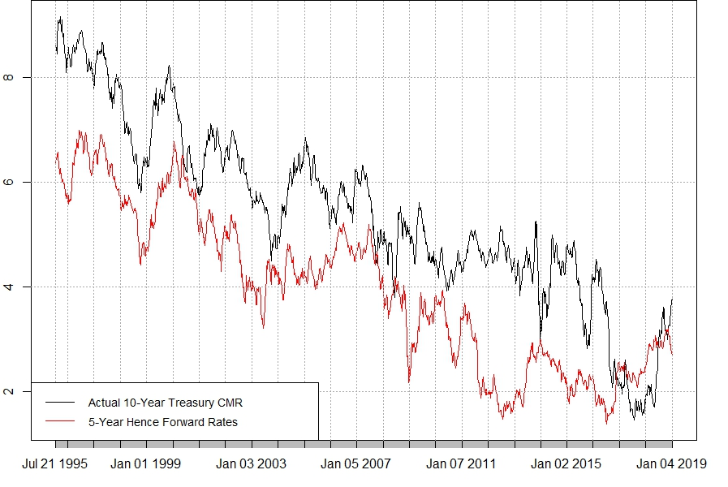
RMSE = 1.680
Performance: 10-Year Forward Rate, 5 Years Hence

Slide 9
The 3 Years Hence Forward Rate is the most accurate in forecasting the 10-Year Treasury
Forward Rates | RMSE
1 Year Hence | 1.616
2 Years Hence | 1.221
3 Years Hence | 1.116
4 Years Hence | 1.295
5 Years Hence | 1.680

Slide 10
Advantages of Our Approach
We expect ML methods to outperform the 3-year hence baseline:
LASSO is regularized regression which provides feature selection
Regression Tree methods do not impose linear structure on the data
Regression Tree methods capture interactions between predictors well

