Slide 1
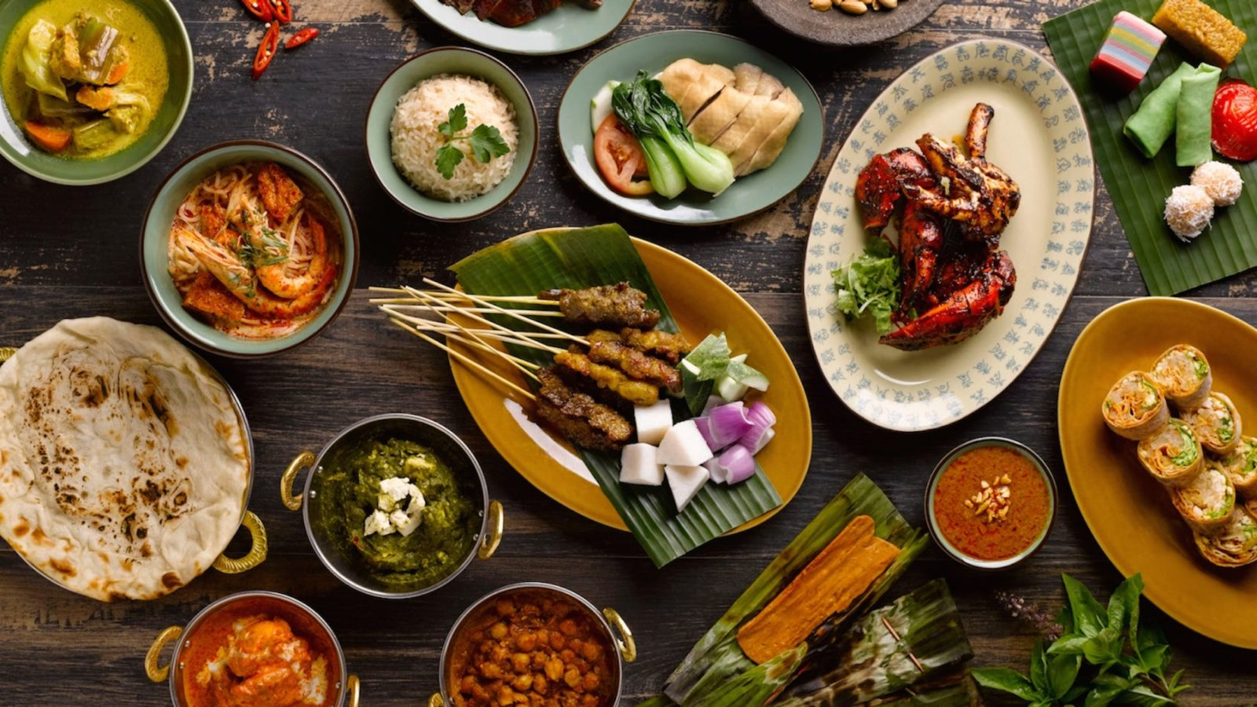
Best Singaporean Neighborhood for the Foodie

Slide 2
Introduction
Food and eating is central to the national identity and is an important cultural and social activity
Singapore well-known for its food, with both delicious local hawker cuisine and world-class international fares
This project uses location data to determine the neighborhood in Singapore with the best food.
This information has several useful applications :
Tourists who are foodies can find places to stay that will give them easy access to the best food, or find neighborhoods that they can visit for a one-stop food trial.
Considering the importance of food nationally, Singaporeans can use the information as an additional metric when they are considering where to move and stay.

Slide 3
Data
List of neighborhoods: https://en.wikipedia.org/wiki/Planning_Areas_of_Singapore
Longitude and latitude collected manually using Google Search
Foursquare API Venue Search
ID
Name
Latitude
Longitude
Category
Foursquare API Venue Details Search
Overall rating
Number of tips
Number of likes

Slide 4
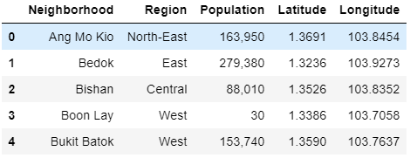
Methodology – Web Scraping and Data Collection
Scraped web for list of neighborhoods, combine with location data

Slide 5
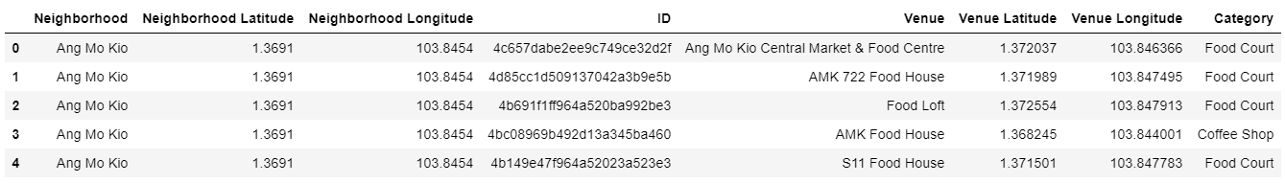
Methodology – Getting Information on Food Venues
Used Foursquare API to get food places near each neighborhood
Cleaned the data to remove non-food related venues

Slide 6
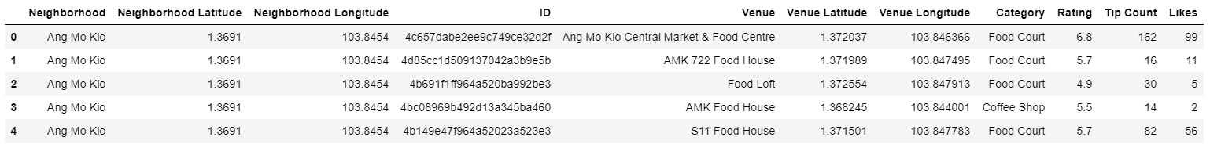
Methodology – Getting Information on Food Venues
Used the Foursquare API to get details on the venue

Slide 7
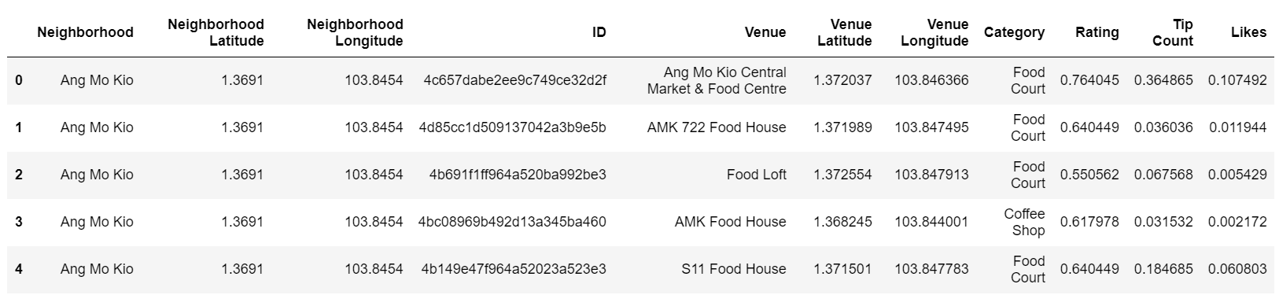
Methodology – Data Wrangling
Replace empty values of rating, tip count and likes with mean of other venues in the same category
Normalized values between 0 and 1

Slide 8
Methodology – Scoring Venues and Neighborhood
Gave each venue a 'Makan’ = rating + (tip count * like) * 1/4.
Given that most of the tip counts and likes are closer to zero, the formula reduces the extent of the penalty for venues that have no tips or likes.
After experimenting with various formulae, the above formula gives a reasonably good outcome with a decent spread in the scores and few outliers.
Venues with a high number of tips and likes (i.e. close to normalized value of 1), will get up to a maximum 50% boost on their overall score.
Normalized the scores to get a 'Makan' score out of 10.
Calculated the aggregate 'Makan' score for each neighborhood, and determined their ranking

Slide 9
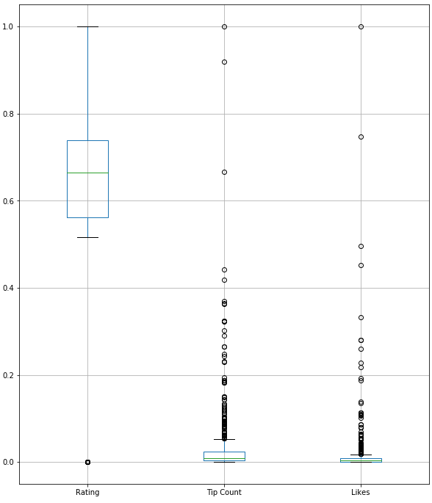
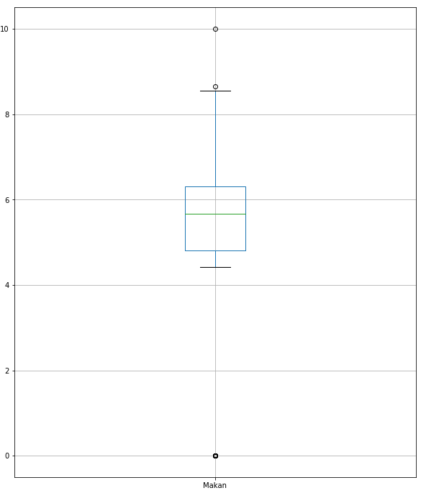
Methodology – Scoring Venues and Neighborhood

Slide 10
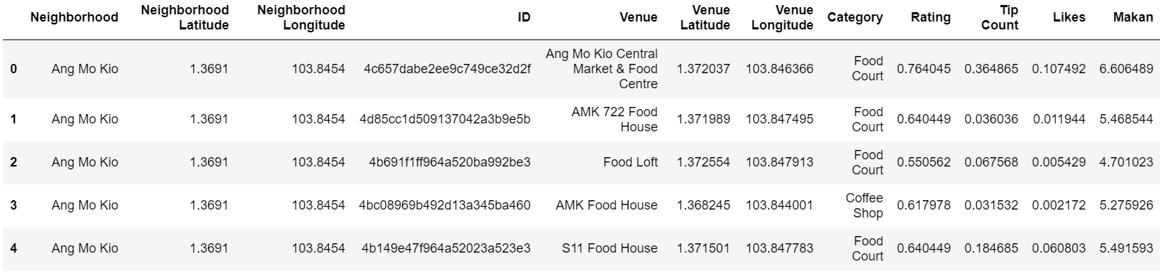
Results
Makan score for individual venues

Slide 11
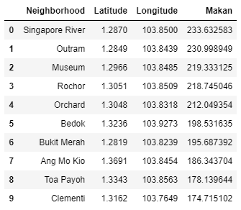
Results
Top 10 neighborhoods

Slide 12
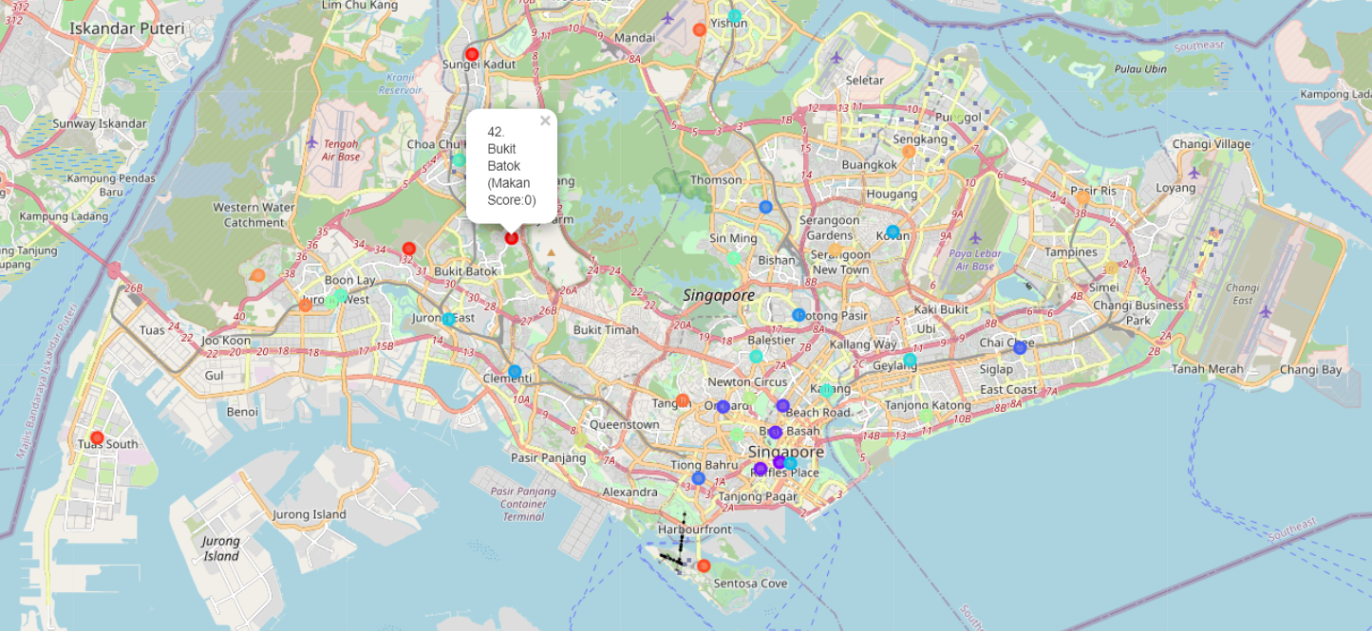
Results
Map available at https://github.com/jiantleman/Coursera_Capstone/blob/master/Capstone%20Project%20-%20The%20Battle%20of%20Neighborhoods.ipynb

